Slide 1
Nutrition Leadership for Climate Change Resilient Food System and Nutrition in Ethiopia
Namukolo Covic, Director General’s Representative to Ethiopia
CGIAR Regional Director, East and Southern Africa
President: African Nutrition Society
Ethiopian Nutrition Leaders Network (ENLN)
Addis Ababa, 23 November 2022

Slide 2
Outline of presentation
Key messages
What does taking a food systems perspective mean for nutrition and health?
What are the global food systems challenges we face and how do they relate to our local context in Ethiopia?
What are the associated climate challenges?
What is the implication of all this for Nutrition Leadership?
Some specific examples where your leadership is needed
Be deliberate about monitoring progress on food systems transformation
Key messages

Slide 3


Key messages
Be deliberate in seeking to have a comprehensive understanding of the challenges we face
Ethiopia’s policy environment is quite rich, but you must be deliberate about creating linkages across different efforts.
Understand that food systems have different entry points for different stakeholders to act. What is your entry point? Use it to lead from where you stand!
Ask: What can you do to “lead from where you stand” within your context to bring about greater resilience?
Overfocus on high agricultural potential areas does not bring resilience to all!

Slide 4
What does taking a food systems perspective
mean for nutrition and health?

Slide 5
Be deliberate and take time to develop a comprehensive understanding
of what taking a food systems perspective really means
CFS, HLPE 2017
Notes:
Indicate what has been done/is being done and how it fits into this big picture of the HLPE framework.

Slide 6
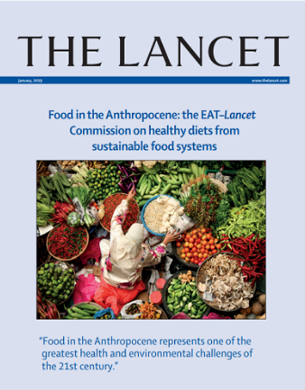
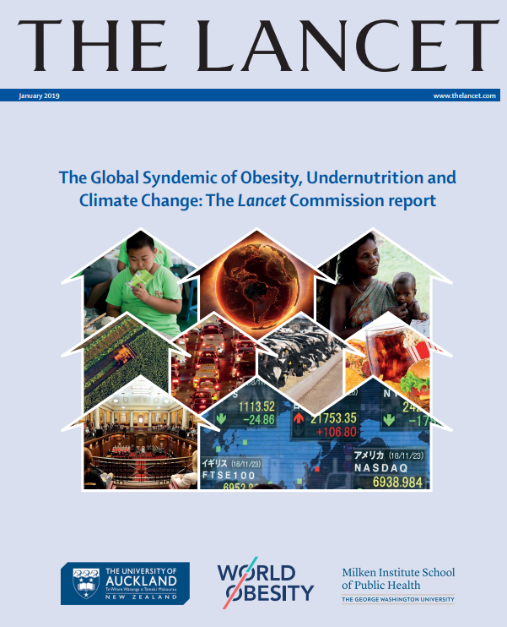


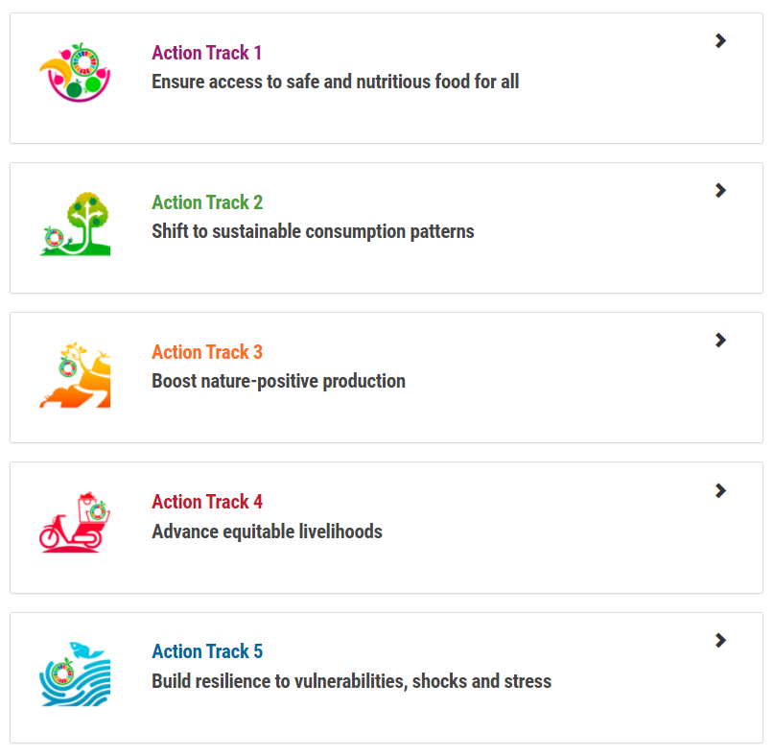
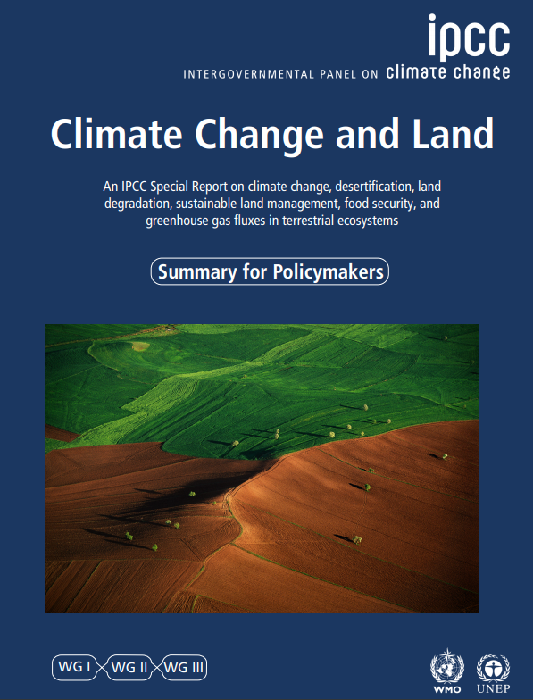


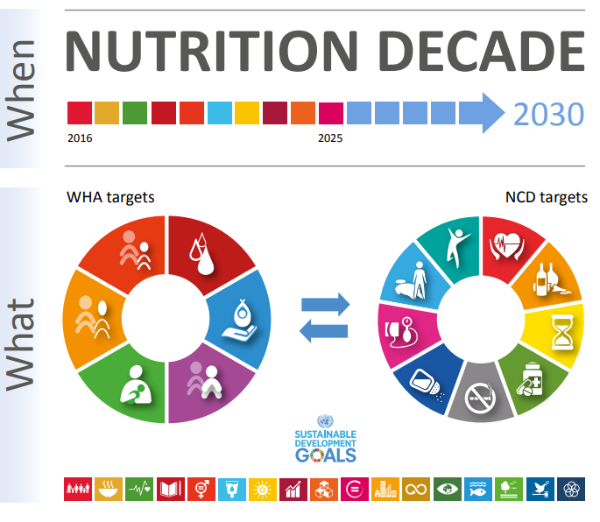
Take time to understand the food systems transformation challenges faced globally and more importantly relate them to local contexts
…and at least 50 such reports published since 2016
Notes:
Food systems are the inputs, actors and activities relating to the production, processing, distribution, preparation, consumption and disposal of food
A sustainable food system “…ensures food security and nutrition for all in such a way that the economic, social and environmental bases to generate food security and nutrition of future generations are not compromised” (FAO, 2018)

Slide 7
What are the global food systems challenges we face?
How do they relate to our local context in Ethiopia?
What are the associated climate challenges?

Slide 8

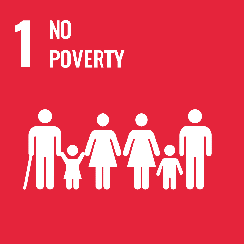
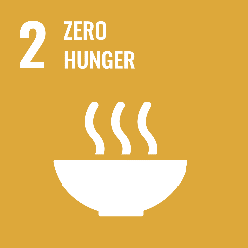






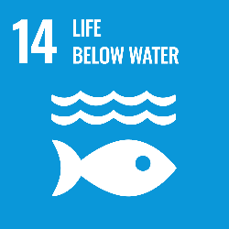








Why a UNFSS 2021 process and implications for Ethiopia
Launch bold new actions to transform the way the world produces and consumes food, delivering progress on all 17 Sustainable Development Goals.
The ambitious aim reflects the urgency needed
Address profound global and local problems linked existing food systems
    Widespread poor diets and different forms of malnutrition
    The climate crisis and environmental degradation
    The significant contributions of food systems to climate and environmental challenges
    Challenges of inequities, safety and sustainability of livelihoods
    Livestock normally called out as a significant challenge on sustainability.

Slide 9
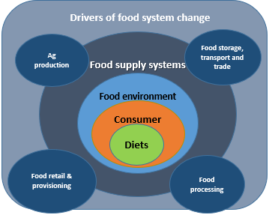
Diets, health, and environment:
What are the challenges Ethiopia faces?
Poor diet and malnutrition:
Very low diet diversity
Inadequate Vit A, Zn & protein intake
Underweight and micronutrient deficiencies
Raising overnutrition and obesity
Food supply system:
Improving cereal productivity, can do better.
Livestock productivity is low
Diversification towards more nutrient-dense foods like fruits vegetables is limited
Regenerative production practices should include livestock
Consumer:
Changing purchasing power
Large heterogeneity of consumers
Food environment:
Fluctuating & increasing price of nutritious food groups including animal source foods
Assuring safety of food products.
Drivers of food system change:
Urbanization and population growth,
Economic & agricultural growth,
Education, infrastructure investments,
Climate change & land degradation,
Institutional innovations,
multi-sectoral polices & programs
Climate change: climate variability; frequent droughts;
unpredictable rains, pests; diseases; land and soil degradation
Adapted from Gebru et al. 2018

Slide 10
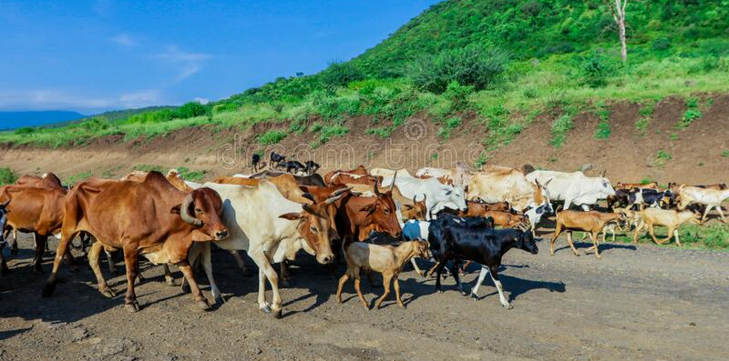
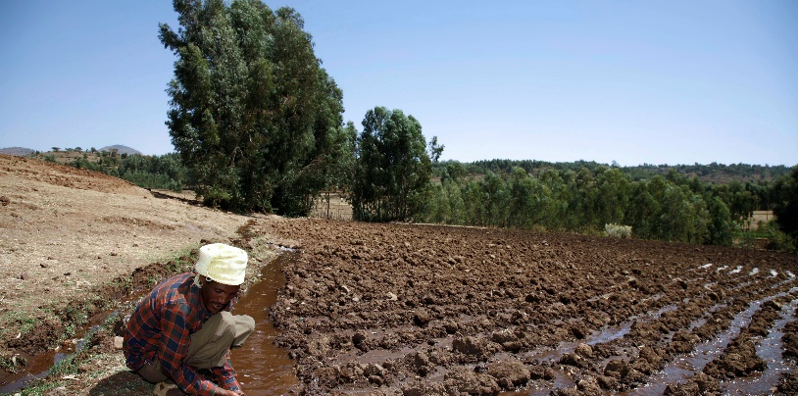
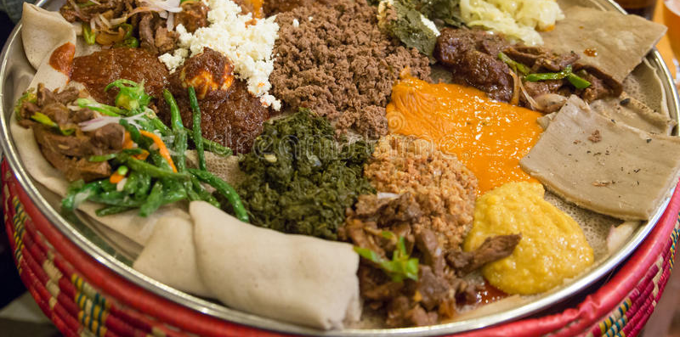
Example: Ethiopia vision
for food systems transformation
could help align efforts
“A holistic transformation of Ethiopia’s food systems
from production to consumption
that promotes enhanced food safety, nutrition and diets,
improved livelihoods,
greater land preservation and restoration
and greater resilience to shocks and stress.”
“We seek to transform our food systems using
sustainable and healthy diet-centered lens that
minimizes tradeoffs through calling for strong collaboration
across all food systems actors,
uniting around a common goal
of heathy and sustainable diets for all.”

Slide 11





Ethiopia food systems transformation pathway clusters: what about resilience?
AT 1 : Ensure access to safe and nutritious food for all
AT 3: Boost nature positive production
AT 2: Shifting to sustainable consumption patterns
Cluster 1:
Ensure availability and accessibility of safe and nutrient dense foods
Cluster 2:
Sustainable and equitable consumption of healthy, safe and nutrient-dense diets throughout the life cycle
Cluster 3:
Integrated policy and system to promote Agricultural transformation
AT 4: Advanced equitable livelihoods
AT 5: Build resilience to vulnerabilities and shocks
Manage trade offs across sectors
Cluster 4:
Enhanced digital technology and innovation throughout the food system
How do we address climate?
Resilience & managing consumption patterns
Nutrition messaging?
Cluster 5
Access to markets, market information, infrastructure and specialization
Cluster 6
Managing and mainstreaming risk and protecting the poor
Leverage markets for resilience
Protect production capacity

Slide 12
What is the implication of all this for Nutrition Leadership?

Slide 13
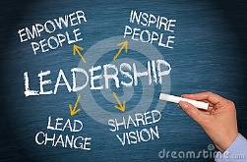
What is leadership in the context of resilient food systems toward better nutrition and health outcomes for all
BE DELIBERATE IN YOUR ACTIONS & LEAD FROM WHERE YOU STAND!

Slide 14
Ethiopia’s shared vision
for food systems transformation
could help align efforts
“A holistic transformation of Ethiopia’s food systems
from production to consumption
that promotes enhanced food safety, nutrition and diets,
improved livelihoods,
greater land preservation and restoration
and greater resilience to shocks and stress.”
“We seek to transform our food systems using
sustainable and healthy diet-centered lens that
minimizes tradeoffs through calling for strong collaboration
across all food systems actors,
uniting around a common goal
of heathy and sustainable diets for all.”

Slide 15
The expectations from you as leaders for nutrition. What you must do….
Vision
Create energy
Empower
Grow & develop
Enjoy
Shared values
Notes:
Leadership is associated with taking an organization into the future, finding opportunities that are coming at it faster and faster and successfully exploiting those opportunities.
Leadership is about vision, about people buying in, about empowerment and, most of all, about producing useful change.
Leadership is not about attributes, it’s about behavior.
In an ever-faster-moving world, leadership is increasingly needed from more and more people, no matter where they are in a hierarchy. The notion that a few extraordinary people at the top can provide all the leadership needed today is ridiculous, and it’s a recipe for failure. (Kotter HBR 2013)

Slide 16
How leaders are is what you should be for Ethiopia….

Slide 17
Some specific examples where your leadership is needed

Slide 18
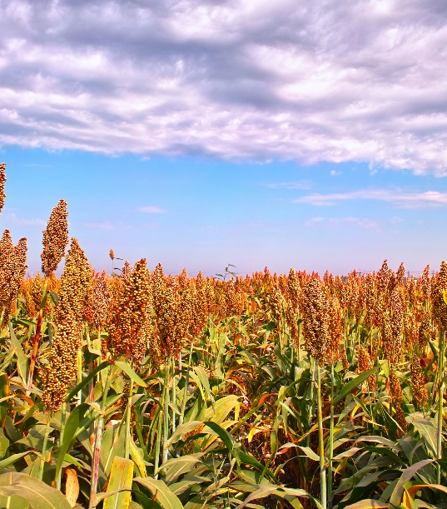
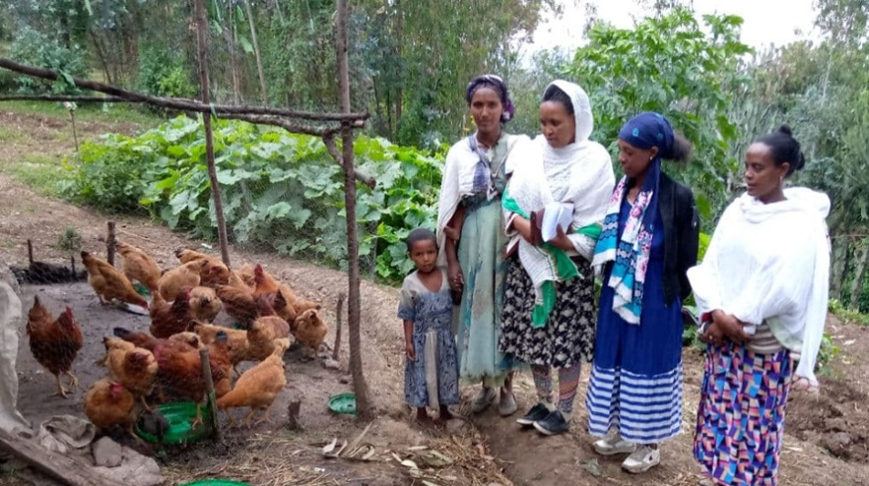
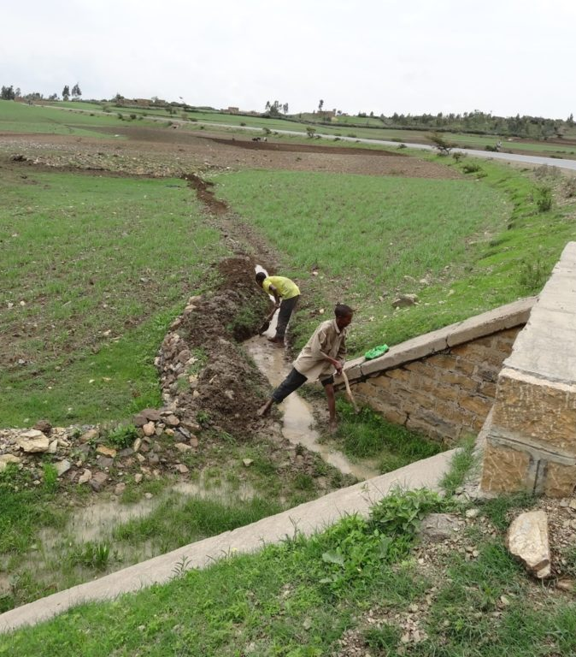
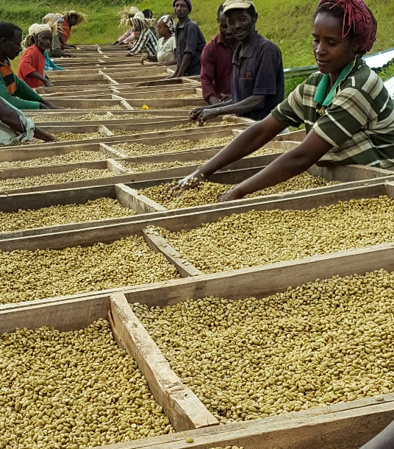
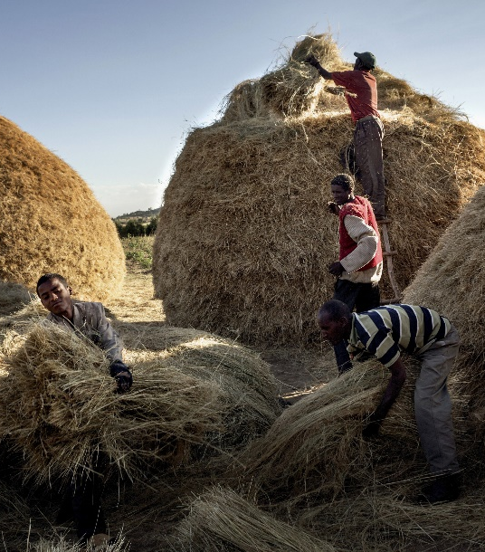
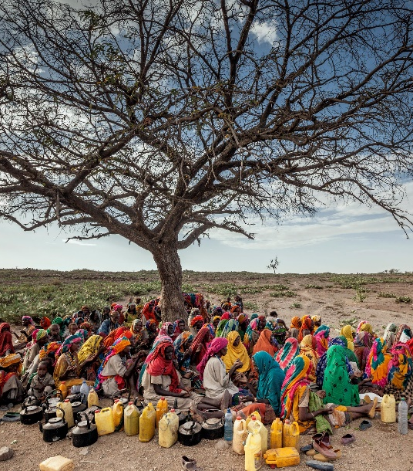
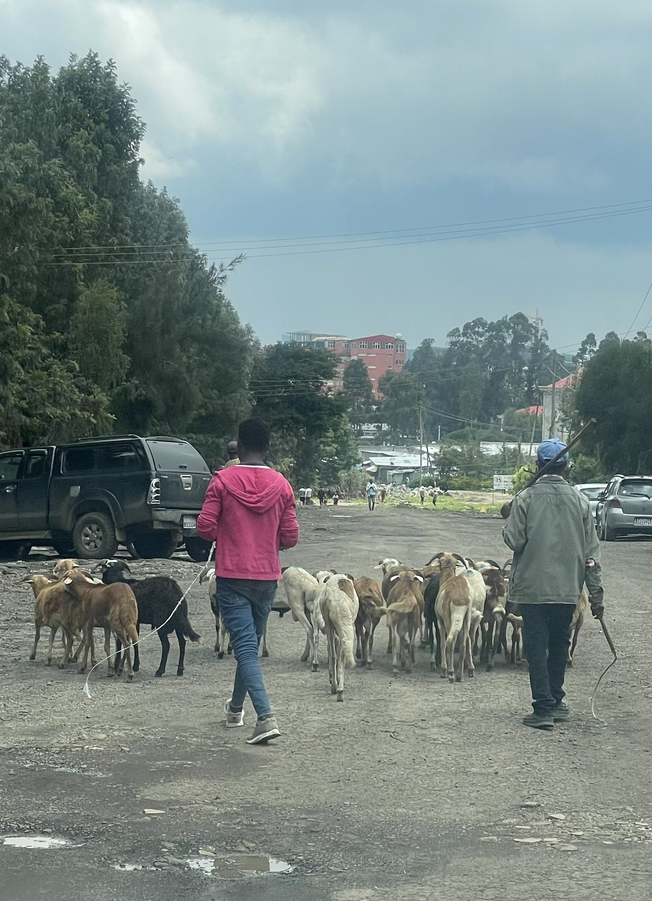
Different contexts, different interventions - - towards the common vision

Slide 19
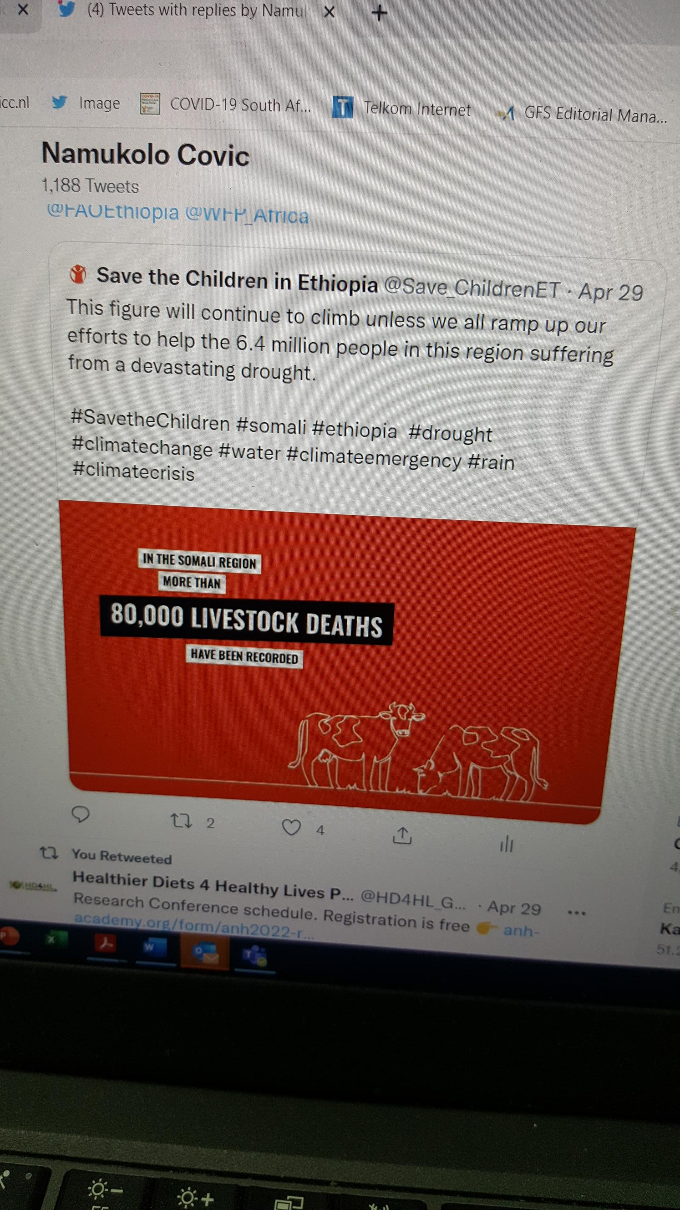
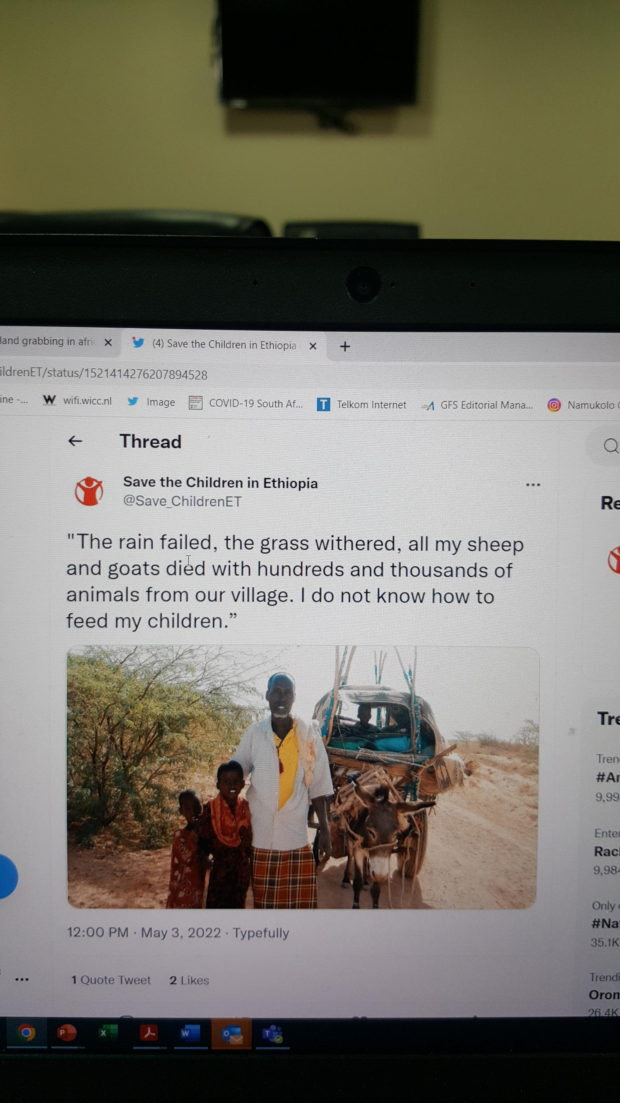
For some pastoralist settings crop agriculture
is not a viable option. What will be the sustainable solutions?
Focus on high potential areas should not forget these settings!

Slide 20
There are clear opportunities to align efforts to foster positive and collective momentum leveraging Ethiopia’s food systems transformation pathway and the given vision
UN Nutrition Strategy Can support and complement these efforts at the regional and country levels
UNFSS 2021
Food & Nutrition Policy
EFS-TP
Seqota Declaration
Food Based Dietary Guidelines can help align these Efforts
One CGIAR transition
must Similarly complement efforts through research
MoH
MoA
MoE
Notes:
In response to the UNFSS many African countries have developed food systems transformation pathways that recognize the need to address the double burden of malnutrition.
At the same time the African Union has taken common elements of these the country transformation pathways to develop an Africa Common Position to foster collective food systems transformation momentum across the continent.
The above two are opportunities to generate synergy across the continent given our common problem of the double burden of malnutrition.
Only 9 countries have food based dietary guidelines. The opportunity in this is that those countries with no food based dietary guidelines will be developing guidelines within the new context of enhanced attention to food systems transformation.
In summary all the above present an opportunity to generate synergy and positive momentum at country and regional levels.
The insect dishes are simply to draw attention to the diverse biodiversity of food still consumed on the continent. An opportunity to leverage

Slide 21

Expected added value of the Healthy Diets Coalition
Coalition for Healthy Diets From Sustainable Food Systems for Children and All
Support
actors in deciding on a course of action
Mobilize
further action
Increase and scale-up of impactful action by stakeholders across food systems
Shared vision
Align
actions already being taken
Notes:
An example of the added value of the Healthy Diets Coalition to the efforts under the Country or regional food system transformation pathways

Slide 22
Be deliberate about monitoring progress
on food systems transformation

Slide 23
The food systems transformation countdown to 2030 initiative has proposed a monitoring and evaluation framework for food systems transformation with attention to better diets and nutrition outcomes
Fanzo, et al., 2021
Crosscutting issues
Outcomes of food systems
Shared vision
Strategic planning
and policies
Effective
implementation
Accountability
Governance
Diets, nutrition, and health
Environment and climate
Livelihoods, poverty, and equity
Diet quality
Food security
Food environments
Policies affecting food environments
Land use
Greenhouse gas emissions
Water use
Pollution
Biosphere integrity
Poverty and income
Employment
Social protection
Rights
Exposure to shocks
Resilience capacities
Agrobiodiversity
Food security stability
Food system
sustainability index
Resilience and sustainability
There has been discussions of a sub-national food systems dashboard for Ethiopia

Slide 24
Key messages
Be deliberate in seeking to have a comprehensive understanding of the challenges we face
Ethiopia’s policy environment is quite rich, but you must be deliberate about creating linkages across different efforts.
Understand that food systems have different entry points for different stakeholders to act. What is your entry point? Use it to lead from where you stand!
Ask: What can you do to “lead from where you stand” within your context to bring about greater resilience?
Overfocus on high agricultural potential areas does not bring resilience to all!

Slide 25
