Slide 1
African cattle genomic reference resource, SNP assays, and signatures of selection
Speaker name: Abdulfatai Tijjani
Speaker organisation/s: ILRI – Addis Ababa
Investigators: Karen Marshall (ILRI), Kellie Watson (CTLGH), James Prendergast (Roslin) and Olivier Hanotte (ILRI)
CTLGH Annual Meeting, Edinburgh, 24-25 September 2019

Slide 2
Outline
Genomic reference resource for African cattle (GRRFAC)
Assessment of the commercial Bovine HD SNP chip
Genome-wide scans for signatures of positive selection in African cattle

Slide 3
GRRFAC – Objectives
to facilitate the generation of a set of sequences and genotype information on African cattle, for use by African and international research communities in cattle genomics for the ultimate benefit of African livestock keepers
We aim to collate between 600 and 700 sequences of African cattle samples covering up to 40 African indigenous breeds. This will comprise about 300 new sequences that we envisaged to generate by the end of 2019, while the remaining sequences will be obtained from other sources including public databases and ILRI collaborators including the 1000 Bull genome project in which ILRI is a consortium member
Facilitate the capacity building of African researchers in the field of genomics

Slide 4
GRRFAC – project update
A summary of the current status of the resource
National partners
Total number of African national partners | 13
Cattle breeds
Total number of breeds | 40
The number currently classified as taurine | 8
The number currently classified as zebu | 28
Number currently classified as zebu x taurine crosses | 4
Cattle Samples
Total number of samples | 1500
Total number of samples with sequence generated under this project | 71
Additional samples planned to have new sequence by the end of 2019 | 225

Slide 5
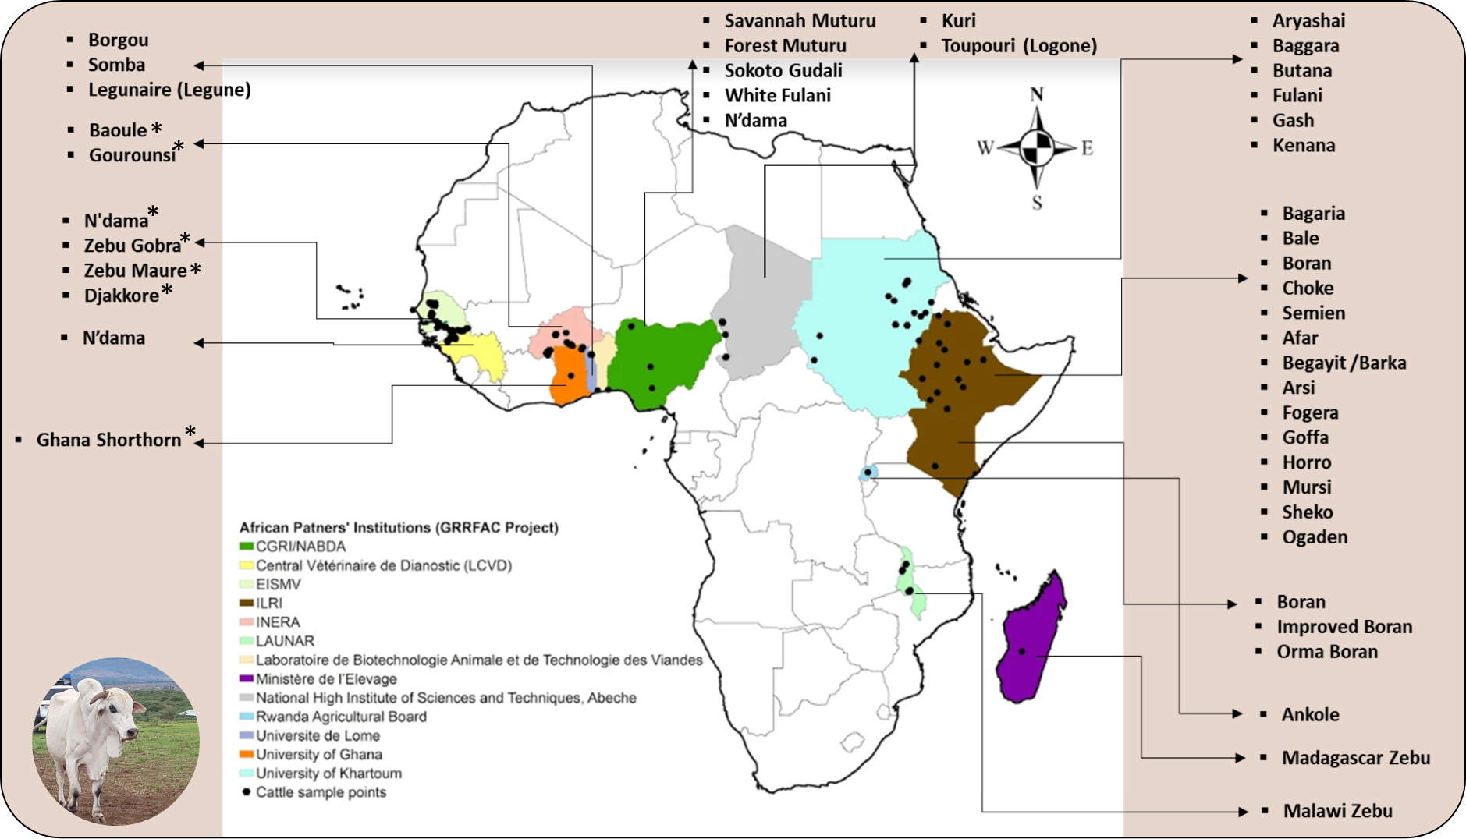
GRRFAC – project update
GRRFAC collaborators
Country | Research partner
Senegal | Ecole Inter Etats des Sciences et MÃ©decine VÃ©tÃ©rinaires de Dakar (EISMV)
Malawi | (LAUNAR)
Burkina Faso | Institut de l’Environnement et de Recherches Agricoles (INERA), Ouagadougougou
Chad | National High Institute of Sciences and Techniques, Abeche
Togo | Universite de Lome
Sudan | University of Khartoum
Ethiopia | Ethiopian Biodervisity Institute (EBI)
Rwanda | Rwanda Agricultural Board
Kenya | National Environment Management Agency (NEMA)
Madagascar | Ministère de l’Elevage
Ghana | University of Ghana
Guinea | Central Vétérinaire de Dianostic (LCVD)
Nigeria | Centre for Genomic Research and Innovation (CGRI), NABDA
Benin | Laboratoire de Biotechnologie Animale et de Technologie des Viandes
Indigenous African cattle Breeds and countries where samples were collected
13 African partners, 40 African cattle breeds and about 1500 samples

Slide 6
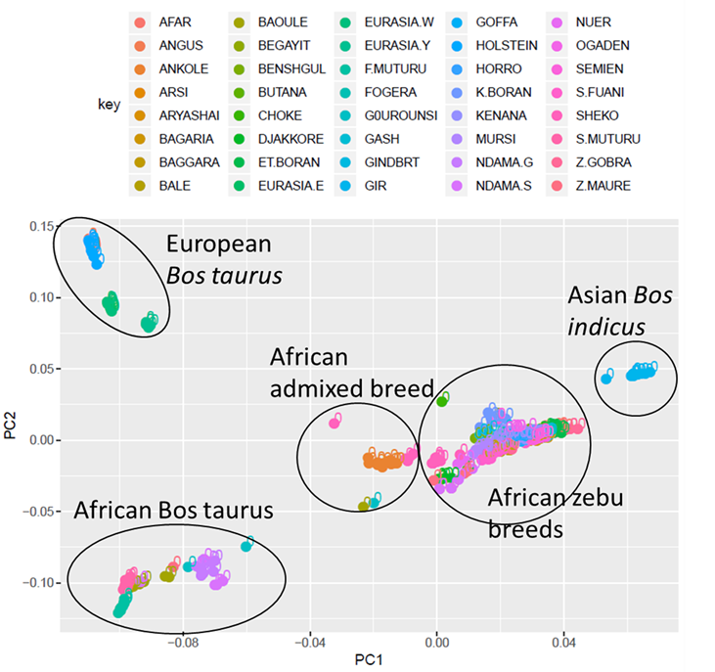
GRRFAC – project update
13 African partners, 40 African cattle breeds and about 1500 samples
Whole genome sequences of up to 380 samples is already in our database and the generation of new sequences is on-going
Sequences are being mapped to the latest Bos taurus reference genome assembly (ARS-UCD1.2) for variants discovery and further analyses
About 38 million SNPs identified in all samples and PCA of these samples shown
principal component analysis of the currently collated African cattle samples/breeds in relation to reference cattle breeds.

Slide 7
Assessment of the commercial Bovine HD SNP chip - Objectives
to test the hypothesis that a meaningful proportion of African cattle SNPs remain unrepresented on the existing BovineHD SNP panel, resulting in ascertainment bias when utilized in the study involving African indigenous cattle
we will investigate the relative genome-wide correlation between BovineHD-SNPs and sequence variants within appropriate genomic windows. A significant and meaningful difference between European and African genotypes in terms of the sequence-based polymorphism which are (and are not) in LD with SNPs contained in the BovineHD would suggest there is a benefit in developing a supplementary SNP assay for African cattle.

Slide 8
Assessment of the commercial Bovine HD SNP chip - Update
Breed | Country | Number samples | Status
N’dama | Senegal | 19 | 30 x sequence data available on 9 animals; 10 additional samples already submitted for sequencing
N’dama | Guinea | 15 | 15 samples already submitted for sequencing
N’dama | Nigeria | 15 | 15 samples already submitted for sequencing / Access and benefit-sharing agreement for ILRI use of data in negotiation/
N’dama | Kenya | 1 (used to generate reference genome) | Access and benefit-sharing agreement in negotiation
Boran (Improved) | Kenya | 15 | Access and benefit-sharing agreement obtained/ sequences of 6 samples have been generated under different ILRI project
Boran (Orma) | Kenya | 15 | Access and benefit-sharing agreement in negotiation/15 samples for sequencing are being identified
Boran | Ethiopia | 20 | Access and benefit-sharing agreement obtained /20 samples for sequencing are being identified
Our plan is to calculate the R-squared values between BovineHD SNP genotypes and the sequence variants of African cattle breeds (mainly N’dama and Boran) and to compare these values to that obtained in European Bos taurus.

Slide 9
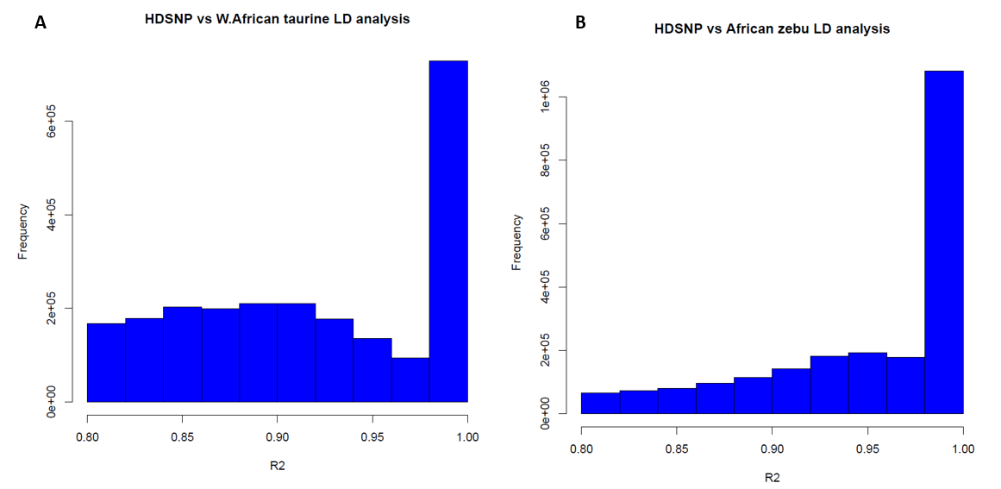
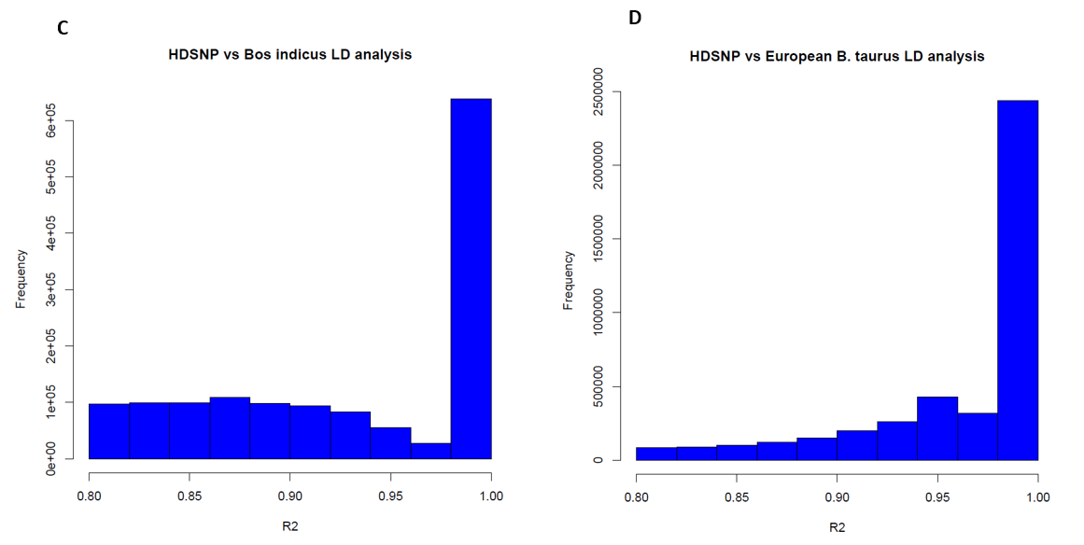
Bovine HD SNP chip - Update
West African taurine
Muturu
N’dama
Baoule
Ghana Shorthorn
African zebu
Ethiopian Boran
Afar
Bale
Semien
Bos indicus
Gir
Nellore
Brahman
European Bos taurus
Holstein
preliminary assessments reveal lower proportions of SNPs captured on the SNP chip are in high linkage disequilibrium with the sequence variants in African cattle population when compared to the European Bos taurus

Slide 10
Signature of Selection analysis : Objectives
Genome-wide investigation of signature of positive selection underpinning adaptability/resilience and productivity traits in African indigenous cattle
Initial focus is on thermotolerance , trypanotolerance and milk production traits
Several widely used selection scan approaches will be adopted for this investigation, including
1. Within-population tests (e.g. Integrated Haplotype Score (iHS), Composite Likelihood Ratio (CLR), pooled heterozygosity (H_{p}), and
2. Between-population tests (eg. Population differentiation (FST), Cross-population Extended Haplotype Homozygosity (XPEHH), Cross-population Composite Likelihood Ratio (XPCLR) and Haplotype differentiation (hapFLK))

Slide 11
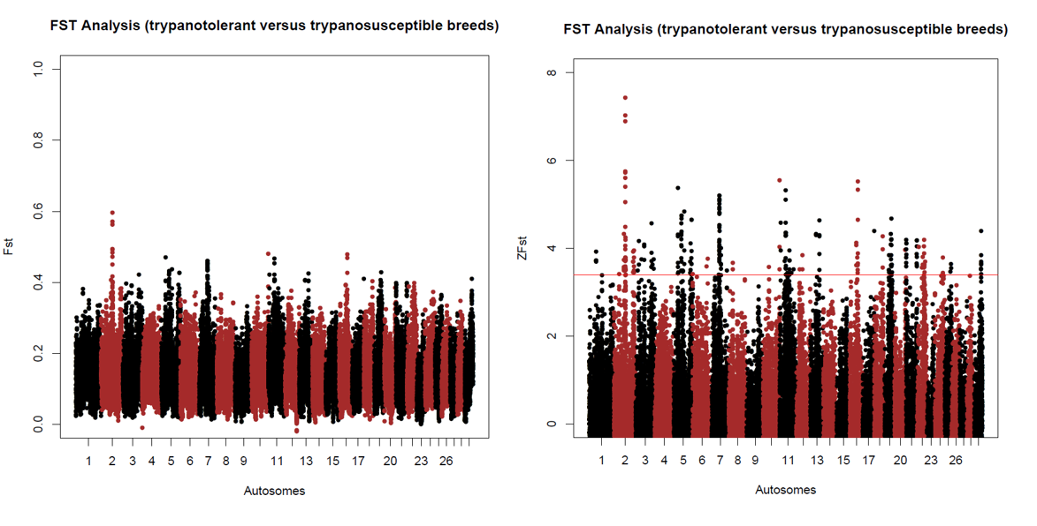
Signature of Selection analysis : Update
comparative genome-wide selection scan of the genome of African indigenous Trypanotolerant cattle population based on population differentiation (FST) test.
West African taurine
Muturu
N’dama
Baoule
Ghana Shorthorn

Slide 12
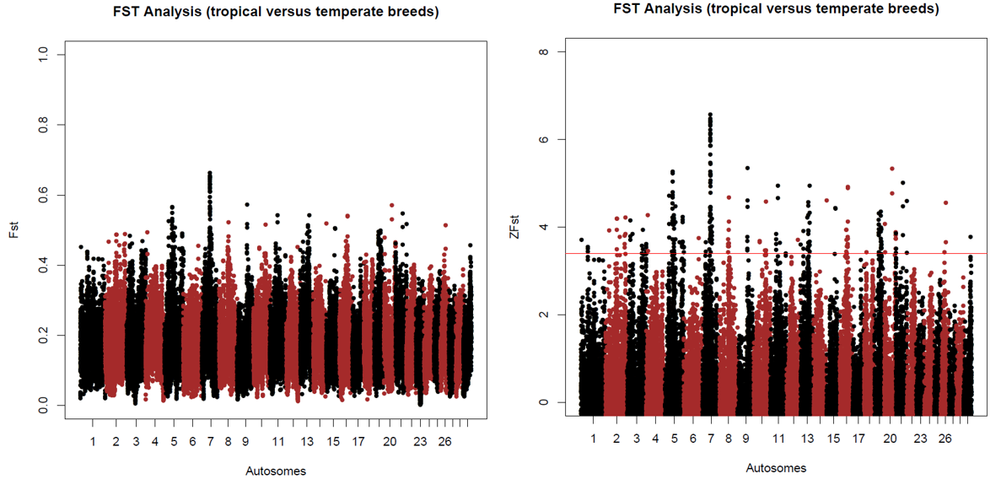
Signature of Selection analysis : Update
comparative genome-wide selection scan of the genome of African indigenous cattle breeds based on population differentiation (FST) test, for investigation of the genomic regions under position selection due to adaption to heat stress.

Slide 13
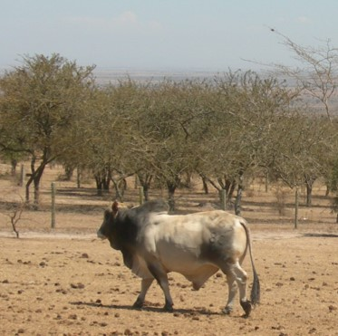
Going forward . . . . . .
Continued efforts are being undertaken to ensure the resource is compliant re-access and benefit-sharing legislation of provider countries (i.e. the African partner countries), as well as user countries (Kenya and the United Kingdom)
Discussions with partners are on-going in relation to establishing a consortium around the obtained samples and data generated.
sequencing of more samples are expected soonest and much more samples are being prepared for sequencing
further downstream analysis will be performed to meet set objectives

Slide 14
Acknowledgements
Olivier Hanotte
Karen Marshall
James Prendergast
Kellie Watson

Slide 15


CTLGH Funders

Slide 16
www.ctlgh.org

