Slide 1
ILRI KM Architecture: use of open access and FAIR principles to make knowledge travel
Abenet Yabowork and Daniel Haile-Michael
ILRI Communications and knowledge management
For the KM4Agdev Challenge 2022
July 15, 2022

Slide 2
KM challenges
Increase uptake of research;
Make research widely available and accessible (as international public goods);
Embed communications and knowledge sharing at all stages within the research process;
Enhance collaboration, reach and impact;
Move towards ‘open’.

Slide 3
Open opportunities
Allows direct use of our work;
Increases its visibility;
Increases likelihood of outcomes and impact;
Fosters collaboration;
Facilitates re-use of products
Safeguards legacy

Slide 4
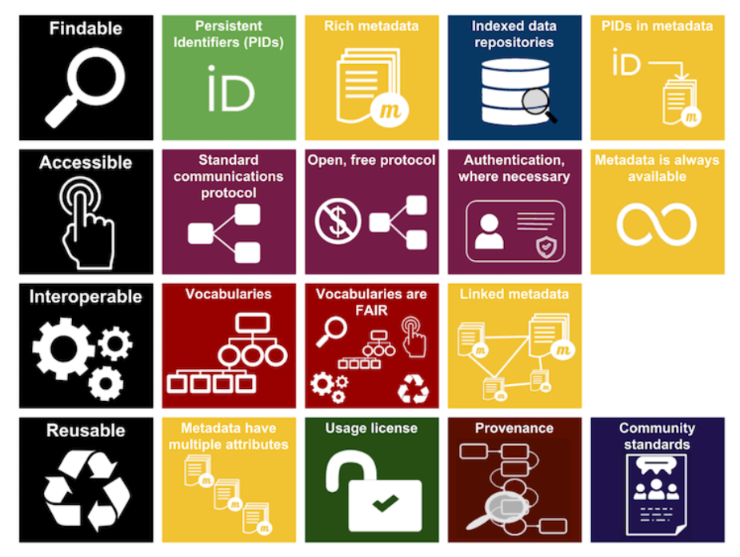
FAIR principles
Source: https://www.linkedin.com/pulse/why-your-data-must-fair-david-crosswell

Slide 5

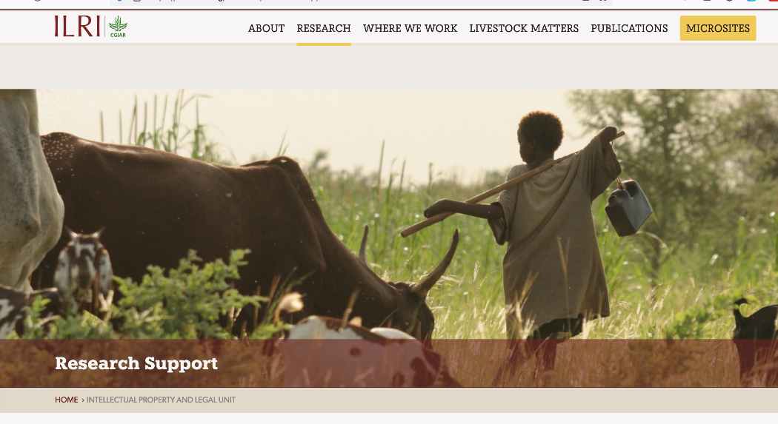

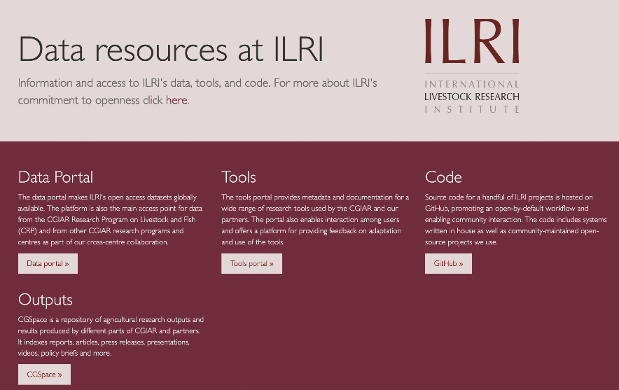
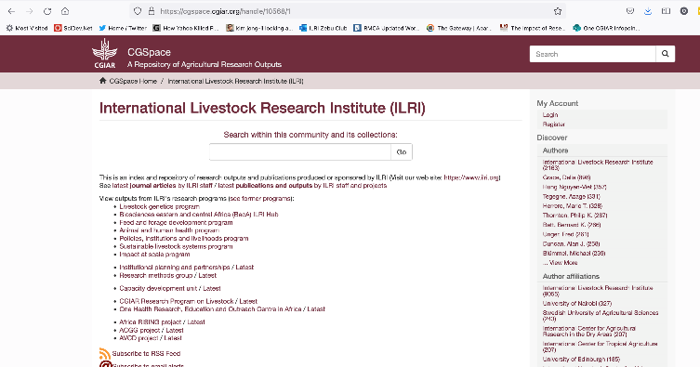
ILRI digital ecosystem
Reuse and sharing
Foundations:
Meta data - repositories
Open source/Open code
CG-CORE
Agrovoc
Standard set of tags use across sytems

Slide 6
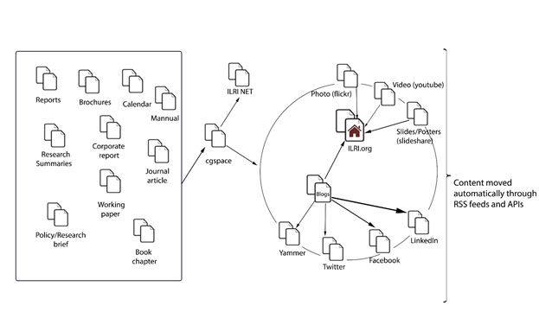
Tagging is the backbone of ILRI's information architecture
Notes:
Controlled vocabulary ensures consistent IA
Allows us to move and curate content across platforms.
Important to reuse and recycle content and for a coherent UX
RSS is the 'glue' that keeps it all together
Tagging is easy once you know the system

Slide 7
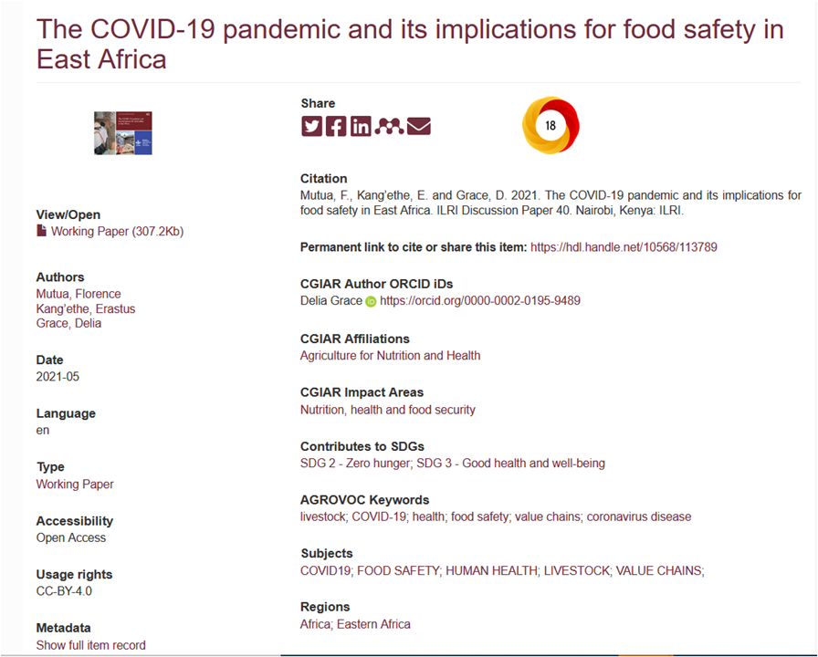
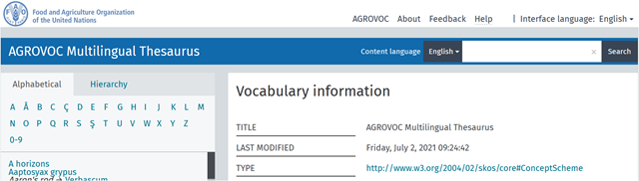


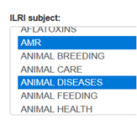
ILRI repository/CGSpace: Controlled vocabularies and lists
Includes
ILRI subjects
AGROVOC keywords
Structured lists (for authors, affiliations, countries, regions, CRPs, sponsors etc)
Metadata (DC, CG core, CGSpace specific)
=> Consistent tags (ILRI subjects) are meant to be used across platforms

Slide 8
Tagging across social media platforms
Event tags
Twitter, Facebook, Linkedin, Flickr , YouTube, etc
Program and subject tags
Stories, news, blogs
Generic tags
Op-Eds, townhall, interviews, etc...
Campaigns tags
Annual report, UNEP reports, OH breifs, etc
ILRI tagging guideline
http://ilri-comms.ilriwikis.org/Ilri_tagging_guidelines
=> Content re-usability and facilitate searchability

Slide 9
Tagging on Website & Wordpress Blogs
Controlled vocabularies
Subject categories. (Livestock or Animal Health or Livestock systems...)
Country that the object is about (Ethiopia or Nigeria).
Region (East Africa or West Africa or Asia...)
Program (PIL, AHH...)
http://ilri-comms.ilriwikis.org/Ilri_tagging_guidelines

Slide 10
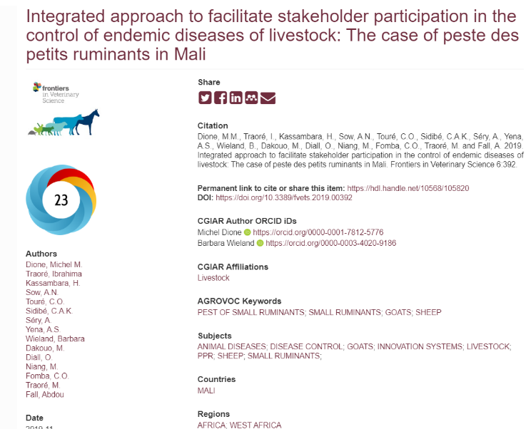

Slide 11
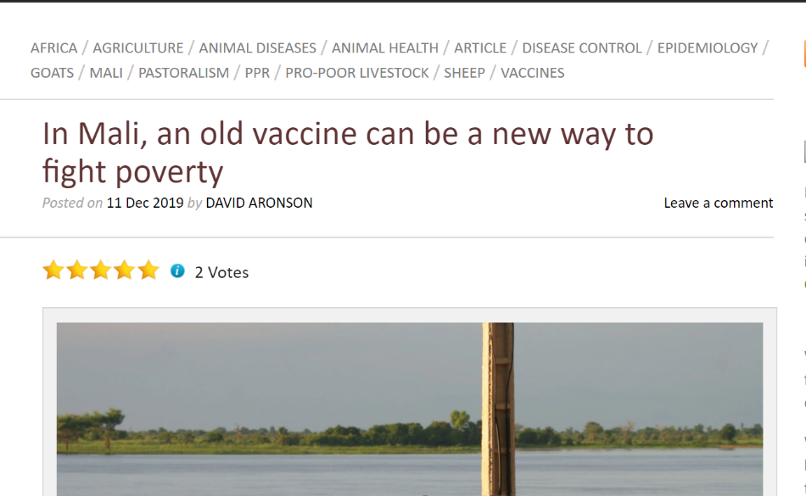

Slide 12
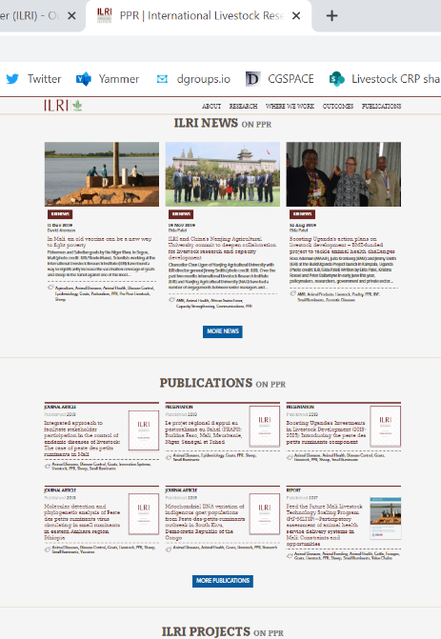

Slide 13
Lessons learned
Publish once and reuse as many times as possible
A consistent taxonomy across platforms allows to dynamical reuse and aggregate content
Tagging is the glue that holds the content together
Standardized tagging with robust small vocabulary allows for finability
Constant training is essential (people become lazy/new staff)
Staff with responsibility on curation is key (issue of quality)
Continually revising and updating the vocabulary

Slide 14

THANK YOU

