Slide 1
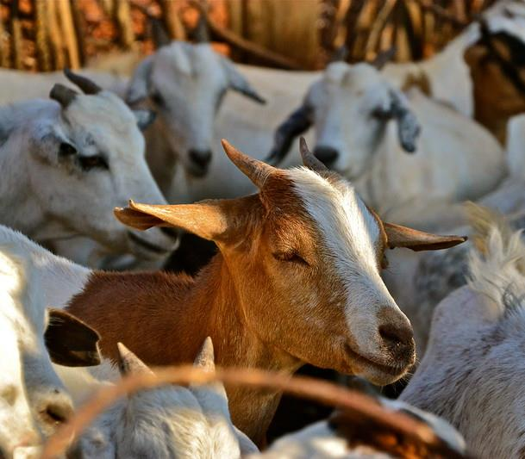
World Food Forum
Transformative Research Challenge, 1-5 October 2021
Call For Action:
Eradicate Peste des petits ruminants and improve the livelihood of smallholder farmers in developing countries
Evidence from Senegal.
Pacem Kotchofa, PhD
Agricultural Economist,
International Livestock Research Institute (ILRI) Senegal.
Mentor: Mr. Andrew Mang’ula
Director, SigSen, Nairobi, Kenya

Slide 2
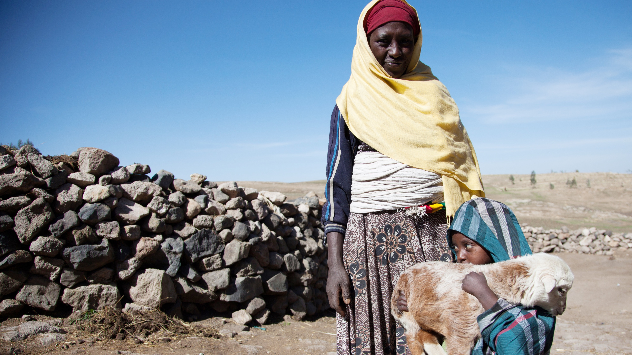
Problem
The goats and sheep I keep are my ATM
Peste des petits ruminants (PPR) infects millions of sheep and goats each year.
The virus robs hundreds of millions of families who depend on small ruminants of their basic right to live good and healthy lives.
Notes:
Tools to generate evidence on disease epidemiology, social networks, and gendered disease impact of PPR
Interdisciplinary
Trilingual
Programmed for digital administration with ODK
Used in 7 countries in East and West Africa
Online YouTube trainings

Slide 3
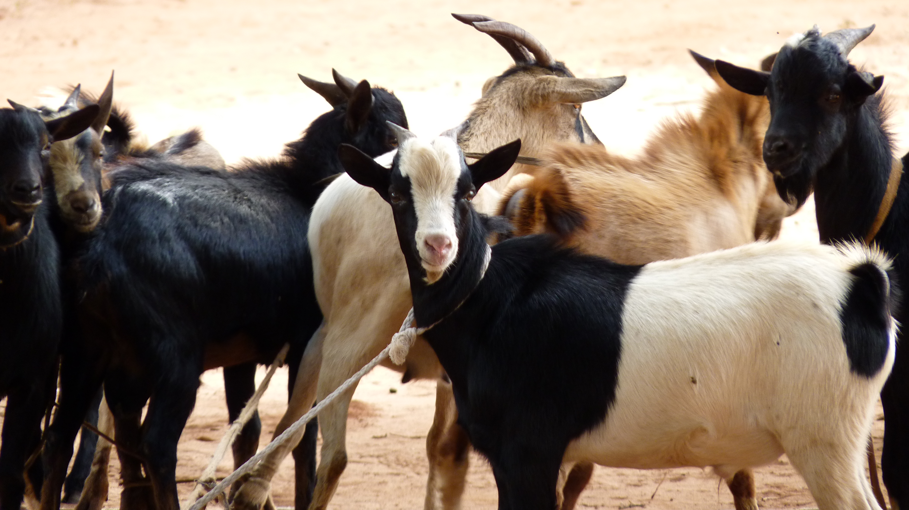
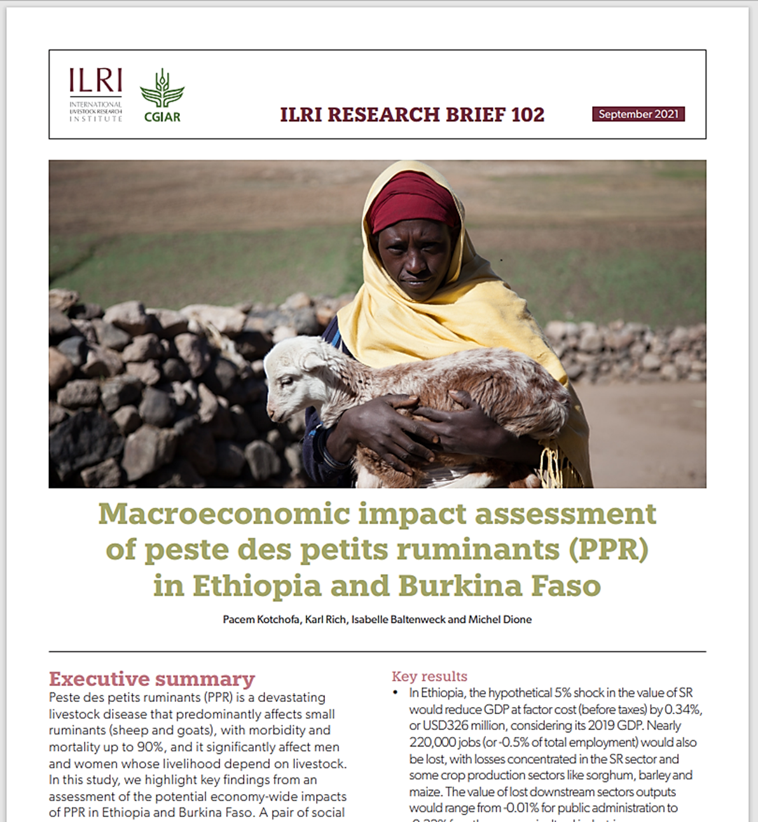
Problem
Global annual losses due to PPR is estimated to be up to $2.1 billion
(OIE, 2019)
PPR compromises national and regional economic progress, turning back the clock on decades of development progress and outcomes.
(OIE, 2019)
Notes:
Tools to generate evidence on disease epidemiology, social networks, and gendered disease impact of PPR
Interdisciplinary
Trilingual
Programmed for digital administration with ODK
Used in 7 countries in East and West Africa
Online YouTube trainings

Slide 4
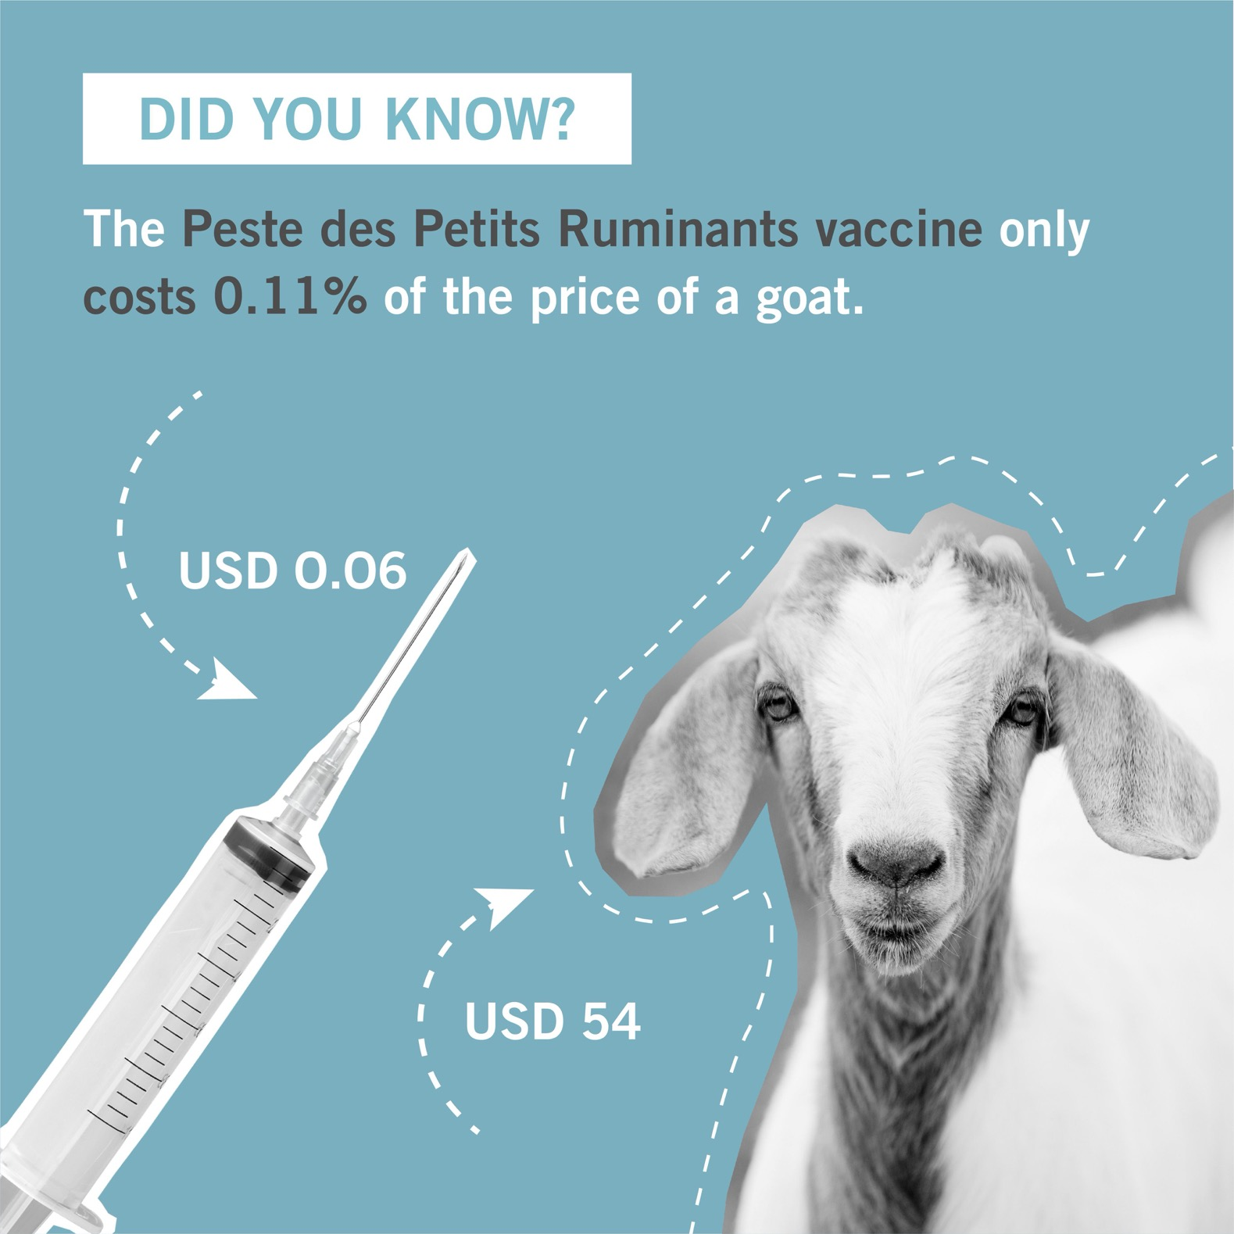
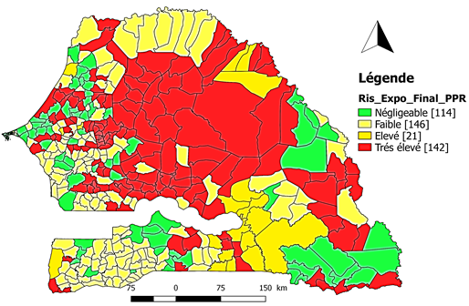
Vaccination is a viable solution
FAO-led Global Control and Eradication Strategy (GCES) by 2030
Senegal has set its goal to 2025.
Source: DSV Senegal, 2021
Prioritization map for PPR vaccination in Senegal.
PPR is preventable with effective and inexpensive vaccines that provide immunity for life. Vaccine availability is limited in the Sahel.

Slide 5
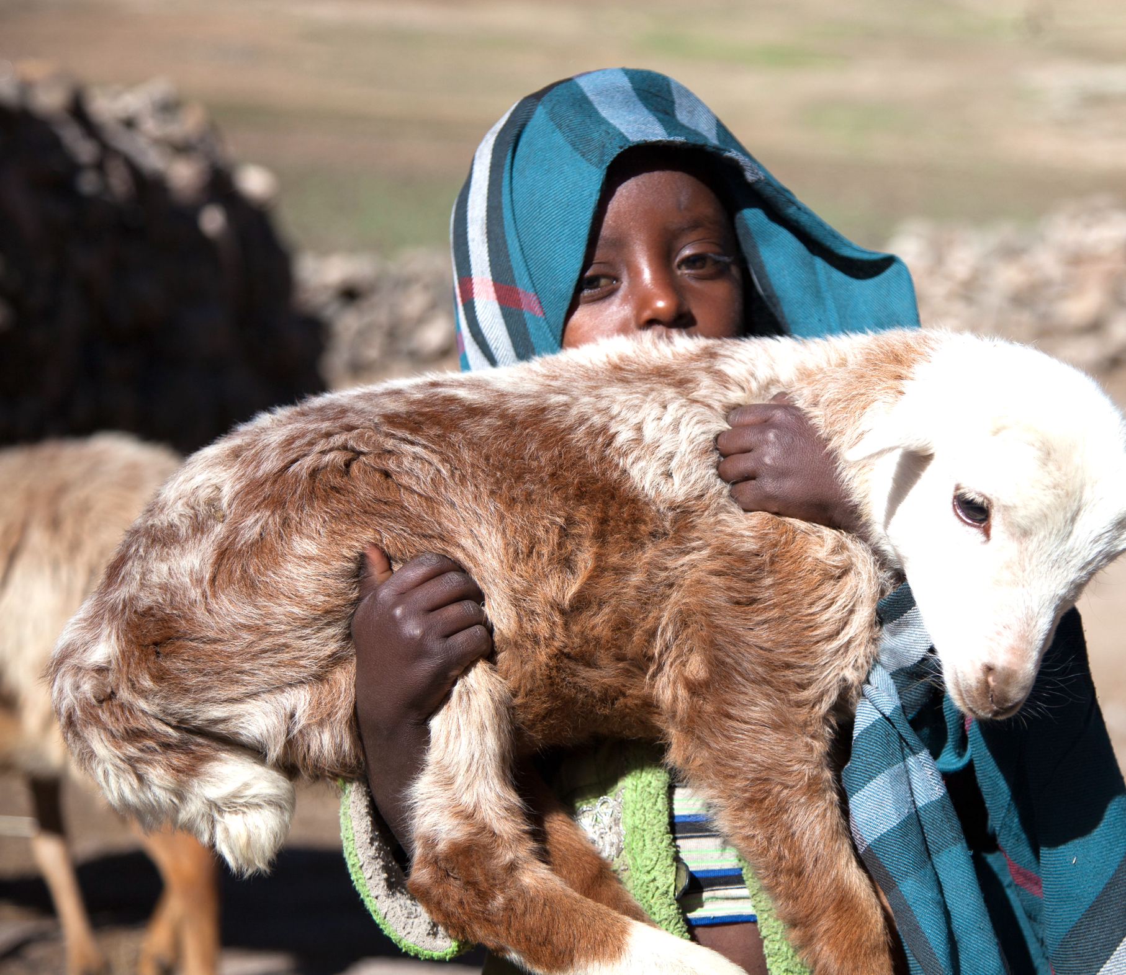
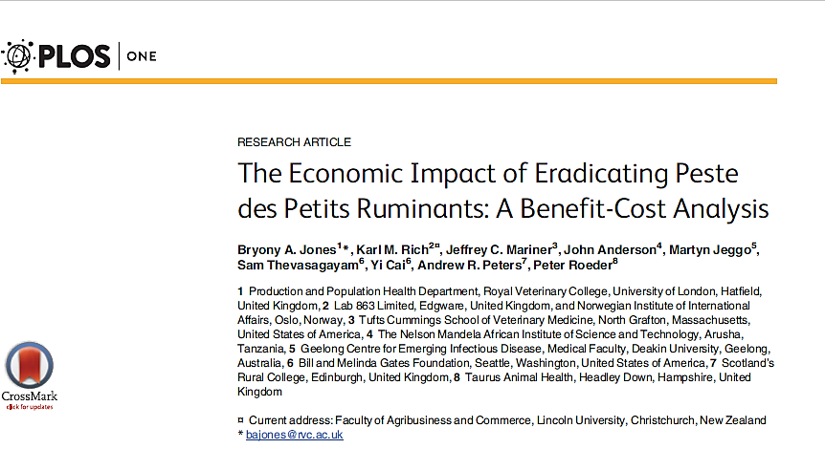




OUTCOMES
Benefit Cost Ratio of 33.8 per dollar
(Jones et al. 2016)
Eradicating PPR will contribute to food & nutrition security, poverty reduction, conflict alleviation, and strengthening resilience of these millions' poor farmers
It will play a role in achieving Sustainable Development Goals.
Notes:
Tools to generate evidence on disease epidemiology, social networks, and gendered disease impact of PPR
Interdisciplinary
Trilingual
Programmed for digital administration with ODK
Used in 7 countries in East and West Africa
Online YouTube trainings

Slide 6
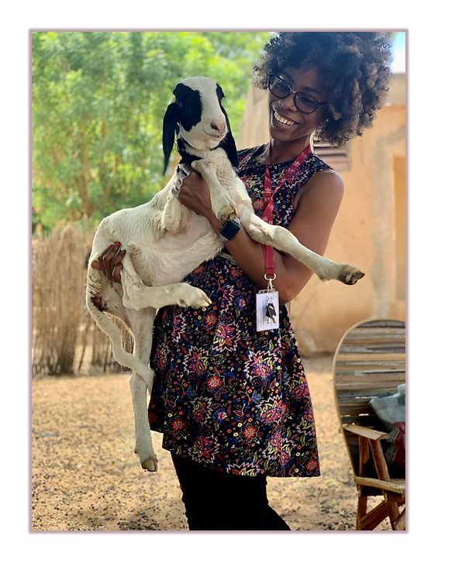



“…Thank You.”
My special thanks go to…
My WFF TRC mentor, Andrew Mang’ula
Toastmasters coaches
Barbara Wieland
Mireille Ferrari
The entire ECoPPR Project Team
My collaborators at (ISRA & DSV) in Senegal
And ILRI for this exciting journey.
p.kotchofa@cgiar.org

