Slide 1


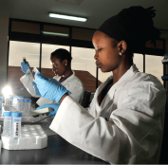
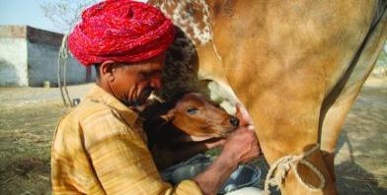
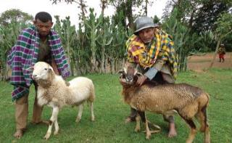

Feeds and forage research and development under SIMLESA project: Achievements and lessons
Endalkachew Wolde-Meskel, Aberra Adie, Melkamu Bezabih and Peter Thorne
Africa RISING Ethiopian Highlands Project Review and Planning Meeting
Addis Ababa, 21–22 May 2019
Notes:
Mention SIMILESA is closing this June, and it is time to report achievements and hand over to projects and partners to further scaling up

Slide 2
Presentation Outline
Background
Approaches and methods
Feed and forage interventions
Main achievements/results
Ways forward
Notes:
This is a presentation of the achievements and lessons of ILRIIS contribution for the SIMLESA feed/forage components 2015 – 2018 and the closing and handing of the activities to sister projects and partners .

Slide 3
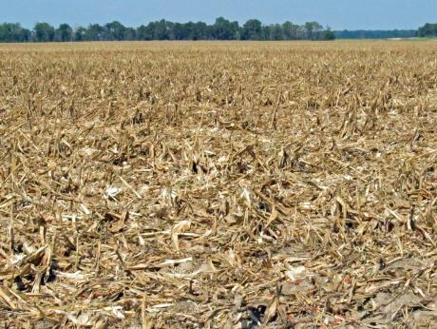
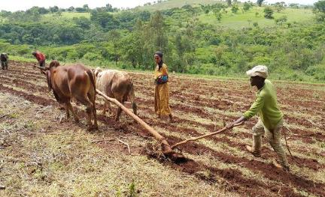
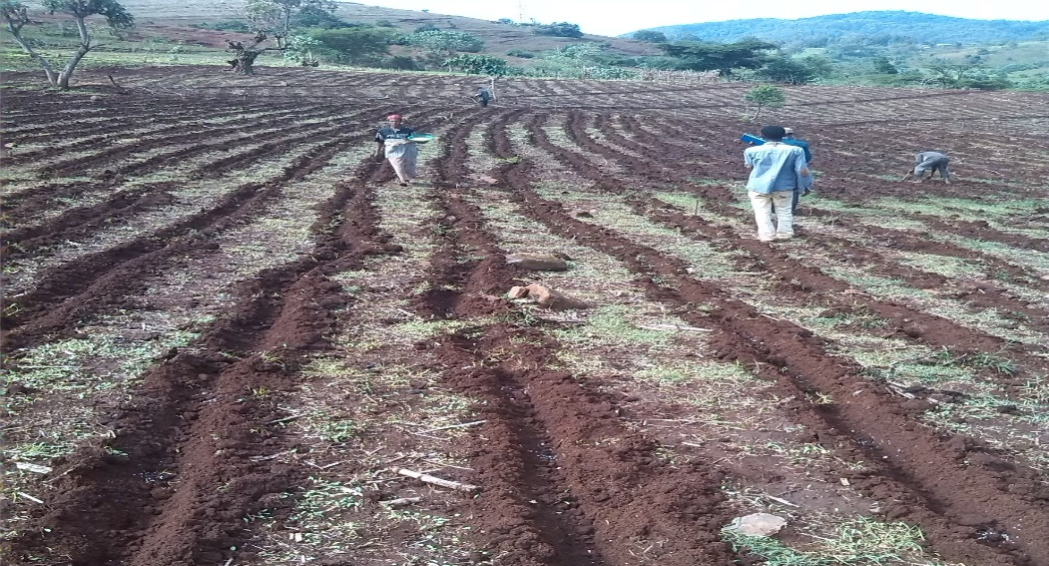
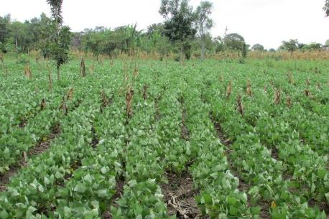
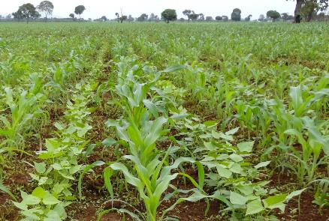
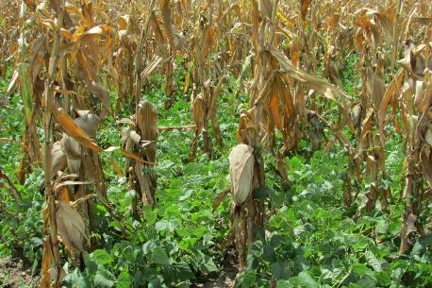
Conservation agriculture (CA) has been a core component of the SIMLESA program

Slide 4

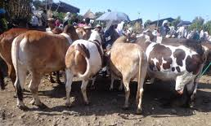
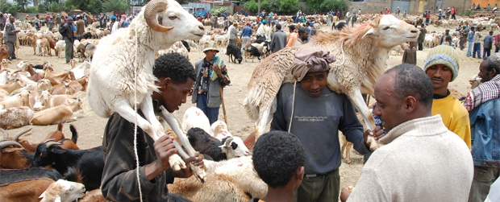
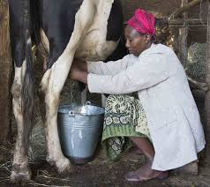
CA to contextualize with mixed crop-livestock system
Livestock are key source of livelihood for smallholders (Ethiopia, East Africa )
Farmers are keen to optimize crop-livestock productivity simultaneously

Slide 5
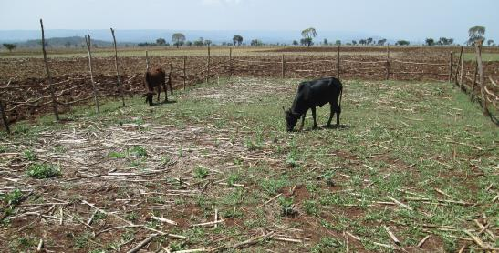
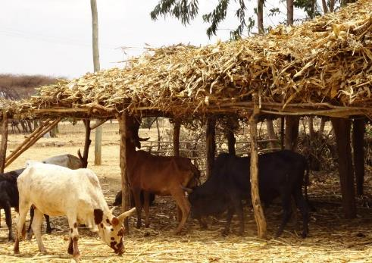
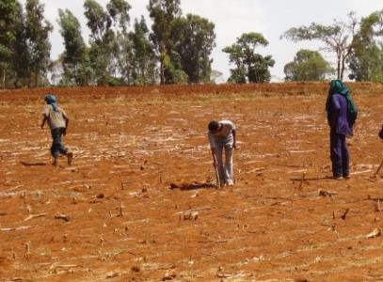
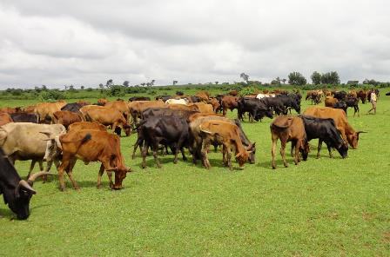
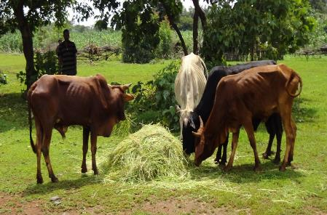
Feed: limiting resource for livestock production in the mixed system
Grass weeds fill the feed shortage gaps during the wet season

Slide 6
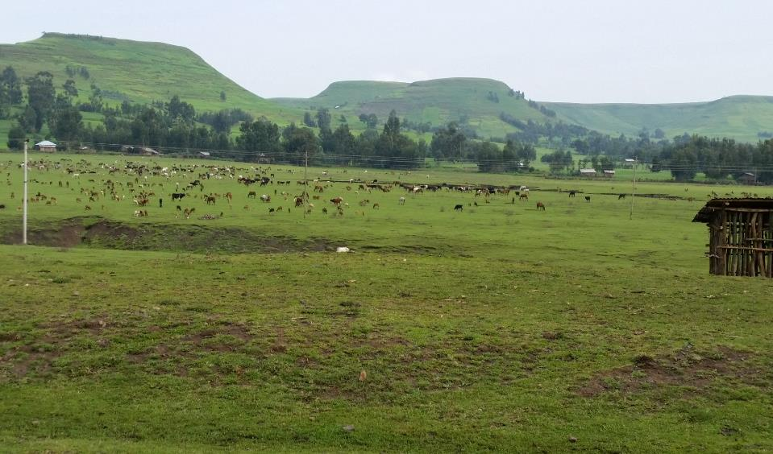
Background
After end of SIMLESA Phase I, it has become clear that implementing CA in mixed crop-livestock smallholder systems is difficult without a strong alternative feed resource development

Slide 7
Background
ILRI came on board during SIMLESA phase two in 2015 to lead the feed and forage research and development
Increase feed biomass production at farm level through better integration of cultivated forages in the system
Improve utilization of available feed resources

Slide 8







Approaches
Site selections by aligning with ongoing SIMLESA agronomic interventions
SNNPRS, Oromia, Amhara, Arusha (7 districts, 5 in Eth & 2 in TZ)
Partnerships

Slide 9
Approaches
FEAST
System diagnosis using FEAST tool to describe the system in relation to livestock production and prioritize feed technology options that best work under the local context

Slide 10
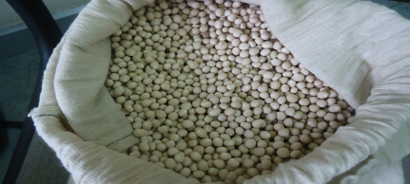
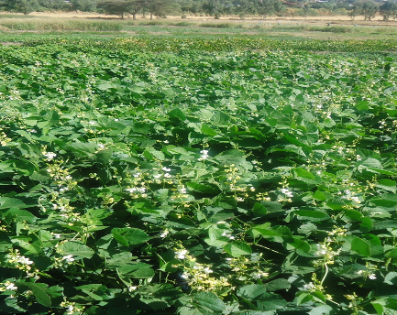
Approaches
Testing and demonstrating promising forage options on-farm
Linking with Africa RISING project and others for farmer validated technologies
Engaging research partners (EIAR, ARARI, and OARI) for demonstrations

Slide 11
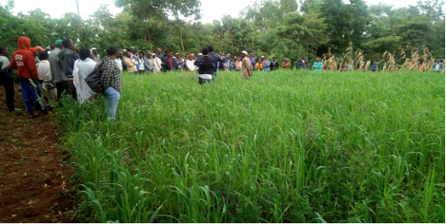
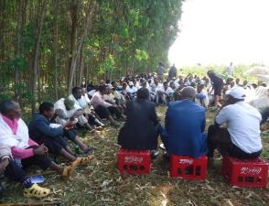
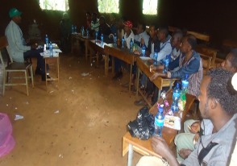
Approaches
Engaged development partners (Send A Cow and Interaide France) for scaling forage technologies
Information sharing platforms:
Trainings
Annual planning meetings,
field days and visits

Slide 12
Feed and forage interventions
Typical feed resource situation in the intervention sites (SNNPR, Wondo-gent)

Slide 13
Feed and forage interventions
Results of FEAST assessment in the intervention sites:
Farmers put feed shortage as a major constraint for livestock production
High seasonality in the availability and quality of feed resources;
Farmers are willing to invest/allocate land and labor for forage

Slide 14
Feed and forage interventions
Based on the results of the initial assessment, technology interventions prioritized and demonstrated
Grass forages
Legume forages
Fodder trees
Improved postharvest feed utilization techniques

Slide 15
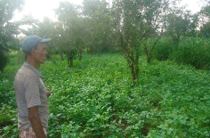
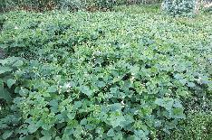
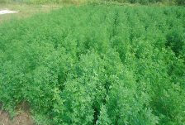
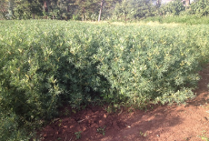
Feed and forage interventions
Menu of feed/forage options introduced and promoted included
Legumes
Lablab
Desmodium (green leaf)
Cowpea
Alfalfa
Stylosanthes Spp
Vetch
Sweet lupin

Slide 16
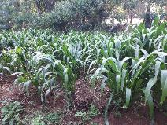
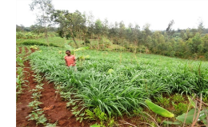
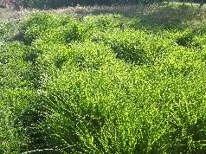
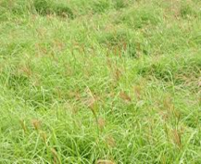
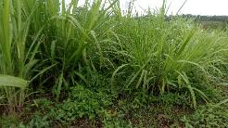
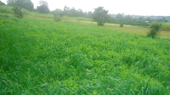
Feed and forage interventions
Grasses
Napier grass
Brachiaria mutica
Rhodes grass
Desho grass
Guatemala grass
Panicum maximum
Phalaris
Oats

Slide 17
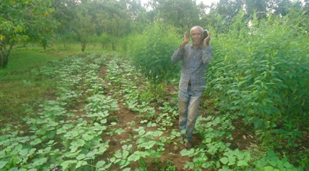
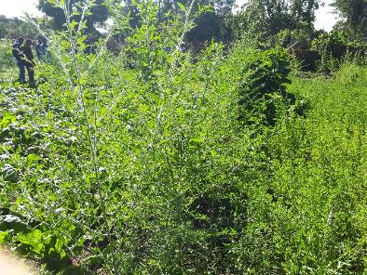
Feed and forage interventions
Fodder trees and shrubs
Sesbania
Leucaena L.
Tree Lucerne
Pigeon pea
Planted on soil bunds, boarder lines and as an alley crop

Slide 18
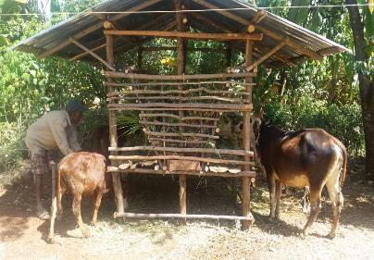
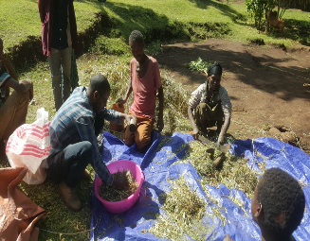
Feed /forage conservation/utilization
Improved feed utilization practices
Demonstration of improved feed troughs and storage sheds
Training and demonstration of optimal mixing proportions for cultivated forages and local feed resources
Short-term fattening of small ruminants using cultivated
forages

Slide 19
Feed and forage interventions
Grassland improvement work
Testing the feasibility of alternative fertilizer sources for grassland improvement
Over-sowing
Evaluating productivity, forage quality and species diversity

Slide 20
Main achievements
Land area (ha) covered with different forage technologies
 | 2016 | 2017 | 2018
Legume forages | 31.5 | 22.3 | 26.4
Grass forages | 11.1 | 18.0 | 20.6
Fodder trees | 0.15 | - | 3.2
Total | 42.8 | 40.3 | 50.2
On average 50 % of the participants are woman households

Slide 21
Main achievements
Households reached through different feed/forage production technologies

Slide 22
Main achievements
Benefits realized
Forages as cash crop
Feed available on-farm to feed own livestock
Reduced runoffs in arable lands, increasing crop yields
Increased biomass production at farm level (better contribution to CA practices)

Slide 23
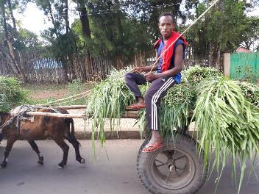
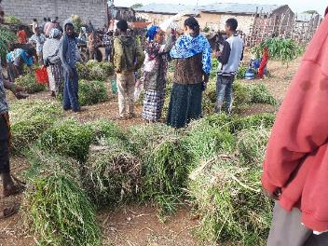
Main achievements
Forages as cash crop
Market for fresh fodder and planting material is growing
Farmers earn income from direct sale of forage
Price of fresh forage: 1.75-2.50 ETB/kg

Slide 24
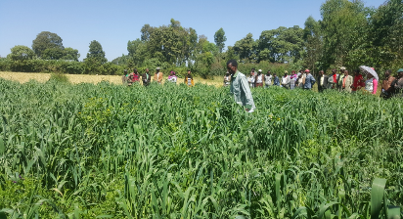
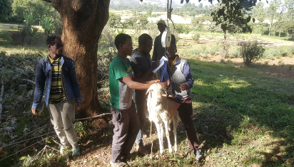
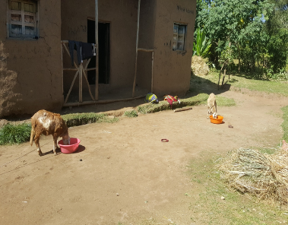
Achievements/results
More biomass available on-farm to feed own livestock
Small ruminant fattening, cultivated forages used as replacement for concentrates

Slide 25
Achievements/results
Weight gain of fattening sheep supplemented with different levels of cowpea
On-farm grown supplements
Better accessed
Reduce cost of feeding
Increase profitability

Slide 26
Achievements/results
Daily weight gain of fattening sheep supplemented different levels of oat-vetch forage

Slide 27
Achievements/results
Yield response of degraded grasslands to different sources of soil fertility treatments
Calculated net income from pasture with different fertilizer treatments

Slide 28
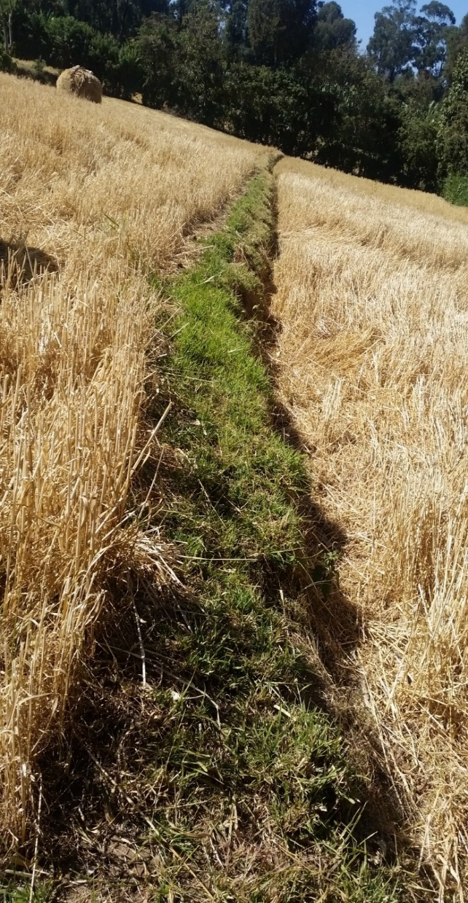
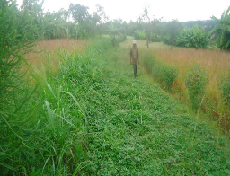
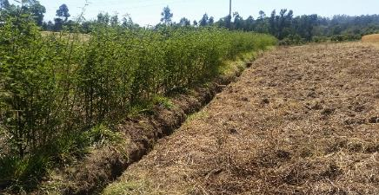
Achievements/results
Desho grass on soil bund
Grass forages as NRM practices in arable lands increase crop/livestock productivity

Slide 29

Technical capacity building trainings to farmers and experts
Achievements/results
Year | Partner | Male | Female | Total | Category
2016 | ARARI | 72 | 12 | 84 | Farmers training
 | ARARI | 24 | 4 | 28 | TOT
 | ARARI | 104 | 10 | 114 | Farmers training
 | BARC/OARI | 62 | 43 | 105 | Farmers training
 | WGARC/EIAR | 171 | 93 | 264 | Farmers training
2017 | ARARI | 75 | 15 | 90 | Farmers training
 | SACE | 12 | 6 | 18 | TOT
 | SACE | 280 | 159 | 439 | Farmers training
 | Interaide | 27 | 16 | 43 | TOT
 | Interaide | 263 | 150 | 413 | Farmers training
2018 | ARARI | 40 | 9 | 49 | Farmers training
 | SACE | 36 | 9 | 45 | TOT
 | SACE | 247 | 157 | 404 | Farmers training
 | Interaide | 150 | 150 | 300 | Farmers training
 | Interaide | 65 | 45 | 110 | TOT
Total |  | 1628 | 878 | 2,506
Fact sheets and brochures distributed |  |  |  | 24,000
(1 PhD, 3 MScs)

Slide 30
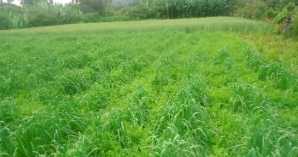
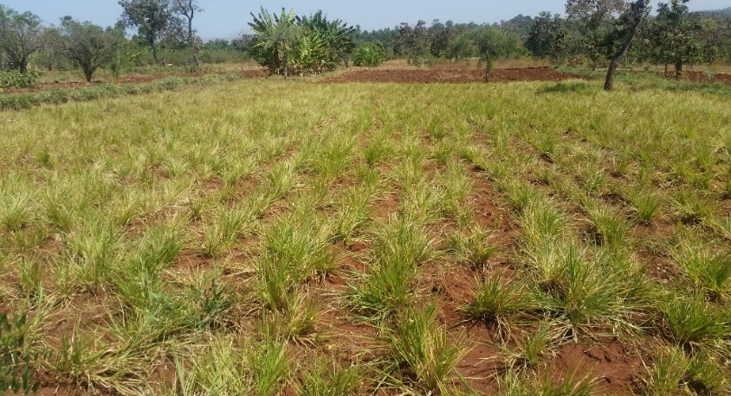
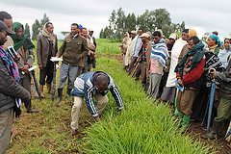
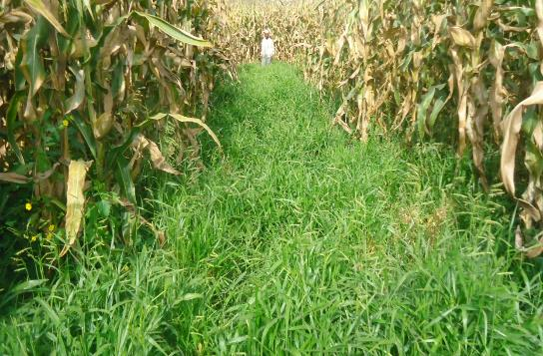
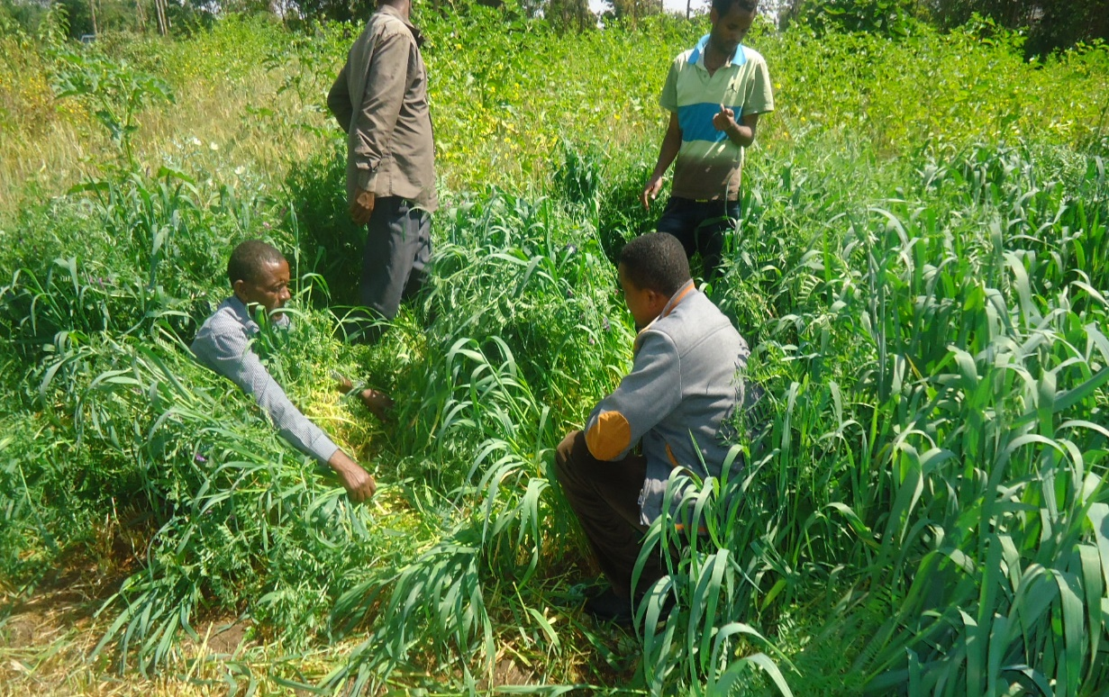

Conclusion
Oats/vetch on farm, Damote, Ethiopia
Strong interest created and farmers are willing more than ever to engage in forage development
Desho on bunds
Forage at the backyard
Integration of cultivated forage in the cropping system helped to realize improved biomass yield, increased livestock productivity and income
Cultivated forages enhances environmental sustainability in the mixed crop livestock system

Slide 31



Conclusion
Engaging in improved forage production appears economically competitive and attractive
Continuous support to create strong market linkage is important
Access to quality forage seed supply remains a bottleneck. Additional work on the seed supply system is required

Slide 32


Conclusion
Employment opportunities along the fodder value chain appear to benefit youth and rural households
Increased on-farm feed availability and improved feed utilization practices have a potential to reduce burden on women and children
Comment from a woman, SNNPR
Now am free to go to market, no need for someone to look after the animals.
No need to go far to look for forages, it is available on-farm

Slide 33







Acknowledgement

