Slide 1
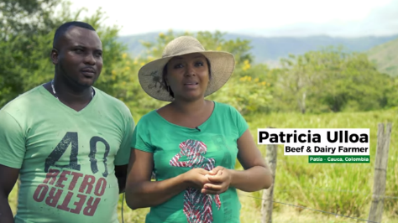
From genebanks to farmer’s fields Forage breeding and selection to improve livelihoods
Valheria Castiblanco
(Alliance of Bioversity International and CIAT)
CGIAR Livestock review and planning meeting, 11 June 2020

Slide 2





Why are Livestock feeds and forages important: The facts
Peters et al., 2013
17
About two-thirds of the world’s total agricultural area
The value of livestock as a global asset reaches
4.9 Bha
USD3.1
BILLION
TRILLION
The estimated total number of livestock worldwide
(including cattle, sheep, goats, pigs, chickens, and about a dozen lesser known species, like guinea fowl, yaks, and camels).
is used to feed livestock, including
that accounts for some
3.3 Bha
25%
1.3 Billion
jobs
Of grazing land
Total crop area
~200 MHa
The annual contribution of livestock to climate change, which is about
50%
Of total agricultural emissions
In America Latina alone, have been degraded by overgrazing and other unsustainable production practices.
This negative impact is similar in most areas used for feed 70% of sweet water to agriculture, 22% to livestock
8.1 billion
15%
of all human-induced greenhouse gas emission
tCO₂eq
These includes emissions from deforestation to make way to pastures.
Notes:
Take home message:
*There is a huge and diverse demand for forages worldwide.
*Demand is distributed across several agro-climatic conditions, diversity in terms of cultural practices of farmers and diversity in terms of type of animals.
*therefore a huge and diverse portfolio of forage alternatives is requested!!!

Slide 3
Why are Livestock feeds and forages important: The facts
Peters et al., 2013
17
About two-thirds of the world’s total agricultural area
The value of livestock as a global asset reaches
4.9 Bha
USD3.1
BILLION
TRILLION
The estimated total number of livestock worldwide
(including cattle, sheep, goats, pigs, chickens, and about a dozen lesser known species, like guinea fowl, yaks, and camels).
is used to feed livestock, including
that accounts for some
A diverse portfolio of highly productive forage alternatives is requested
3.3 Bha
25%
1.3 Billion
jobs
Of grazing land
Total crop area
~200 MHa
The annual contribution of livestock to climate change, which is about
50%
Of total agricultural emissions
In America Latina alone, have been degraded by overgrazing and other unsustainable production practices.
This negative impact is similar in most areas used for feed 70% of sweet water to agriculture, 22% to livestock
8.1 billion
15%
of all human-induced greenhouse gas emission
tCO₂eq
These includes emissions from deforestation to make way to pastures.
Notes:
Take home message:
*There is a huge and diverse demand for forages worldwide.
*Demand is distributed across several agro-climatic conditions, diversity in terms of cultural practices of farmers and diversity in terms of type of animals.
*therefore a huge and diverse portfolio of forage alternatives is requested!!!

Slide 4
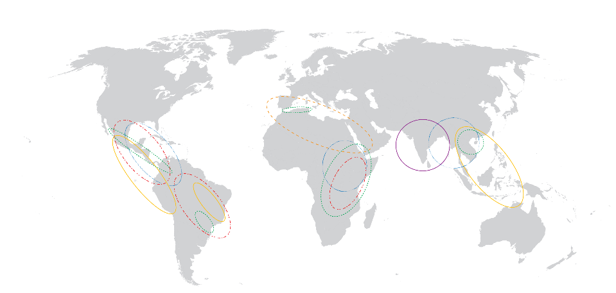
Huge and diverse portfolio of forage alternatives
Barley
Region: Sub-tropics
Basic traits: Grain & straw yield, drought tolerant, disease resistance
Added value traits: Feed, fodder, food and/or malt quality
Germplasm: e.g. Napier Grass
Region: Tropics
Basic traits: Yield and forage quality
Added value traits: disease resistance and drought tolerance
Hybrids of Urochloa humidicola
Region: Tropics
Basic traits: Highly resilient, tolerant to poor soils and water flooding
Added value traits: Quality
Dual purpose maize
Region: Sub-tropics
Basic traits: Grain and stover yield and stover fodder quality
Added value traits: Drought and temperature tolerance
Hybrids of Megathyrsus maximus
Region: Tropics
Basic traits: Cut and carry, high biomass and quality for fertile soils
Added value traits: Resilience
Interspecific hybrids of Urochloa
Region: Tropics
Basic traits: Tolerant to acid and poor soils with spittlebug resistance
Added value traits: Pest resistance
Notes:
Products directed to each agro-ecological niche

Slide 5

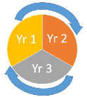
















60’s and 70’s
Started at 70’s
Started at 80’s
From 2001 onward
Product Design
TOOLS and strategy
Product Development and testing #1
Product testing #2
Product multiplication
Product Introduction
Adaptation to acid soils
U. decumbens (apomictic)
Basic information about the cytology and reproduction of grasses
Recurrent selection
1988
2001
Differences in ploidy
(intra- and inter-specific differences)
1990
2004
2001
2010
MET x 3Loc
3000 hybrids
Resistance to spittlebugs
U. Brizantha
(apomictic)
2001
2014
2003
2018
Br19 on the field 3000 hybrids
Br15
Br09
Br12
Br04

Slide 6
Stage 1
Stage 2
Stage 3
Stage 4
Stage 5
Stage 6
Product Design
TOOLS and strategy
Product Development and testing #1
Product testing #2
Product multiplication
Product Introduction
ToolBox:
Genomic tools
Marker Assissted Selection
High-troughput Phenotyping
Drone image analysis
NIRS
Diversity in germplasm resources
e.g. Napier grass
Kakamega-I
Kakamega-II
Crosses and selections according to each crop breeding strategy
Barley
HB-1964
HB-1963
Interspecific hybrids
of Urochloa
Mulato II Cayman
Cobra
Hybrids of Urochloa
humidicola
Bh 16 population of 26 hybrids
Hybrids of Megathyrsus maximus
Pm16 population of 5 promising hybrids
Double purpose
maize
Define Strategy
CAH153
hybrid maize

Slide 7

Innovations that benefit smallholder farmers
“Working with the rotation system and improved pastures, the animals have more to eat as they take better advantage of the feed.”
“We have seen improvements with the animals, in the quality of the meat or even the performance of the animals has improved. In the production of milk, the density was low but now it is much better.”
Patricia Ulloa, Beef & Dairy Farmer Patía, Cauca, Colombia
Video: bit.ly/PatriciaUlloa

Slide 8
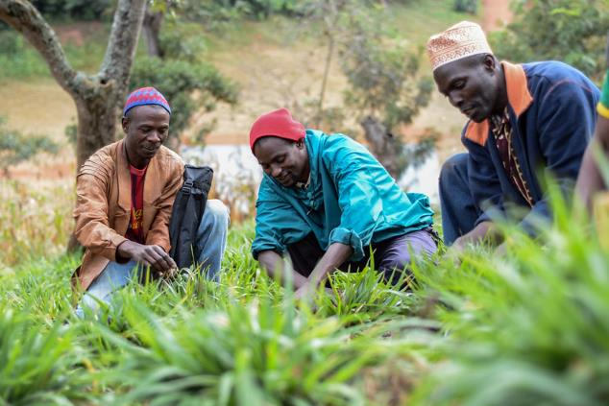
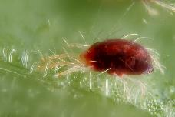
What is next…..
Value-chain and seed systems in East Africa to promote dissemination
Spidermite resistance

Slide 9
Main achievements, outcomes and Impacts
Barley
21 new varieties released by NARS partners in 7 countries in the last 4 years
Napier Grass support
1.5 million
Smallholder dairy farmers
In Kenya and Ethiopia*
26 hybrids
of Urochloa humidicola released to partners for further testing and dissemination
Dual purpose maize
Experimental dual purpose maize hybrids commercialized by private sector.
> 20 000 ha
3 years after commercialization in India
Over 20,000
smallholder farmers
in Kenya, Uganda, Tanzania, Nigeria and Ethiopia have already planted CIAT-breded Urochloa. ^{(Maas et al 2015)}
Hybrids have been a success in the market, reaching a total area of 1MM ha*
based in seed sales

Slide 10



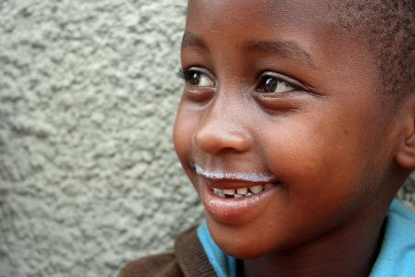


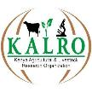




Acknowledgments

