Slide 1
Contribution of Africa RISING Validated Technologies, Nutrition-Education Interventions to Household Nutrition and Participatory Nutrition-education need assessment with seasonal food availability In Amhara, Oromia and SNNP Regions of Ethiopia
By Mestawet Gebru, Research Officer
Alliance of Bioversity-CIAT
14th May 2021

Slide 2
Outline
1. Introduction
2. Methodology
3. Results:
i. Contribution of AR technologies to household nutrition in SNNPR
ii. Contribution of AR nutrition-education intervention to household nutrition in Amhara and Oromia
iii. Participatory nutrition-education need assessment in SNNPR
iv. Seasonal food availability assessment in, Amhara, Oromia and SNNP regions
4. Summary: Strength, Weakness/Gaps, Opportunities, Recommendations

Slide 3
Introduction
Africa RISING (AR) identified, validated and distributed different agricultural technologies
  Livestock feed and forage management and utilization practices
  Improved crop varieties and management practices cereals, food legumes and oil crops
  High value horticultural crops (HVFTs)-fruits and vegetables
  Small-scale mechanizations –2-WD tractor with water pump, trailer, thresher and other accessories
  Fertilizer blends
  Water lifting, delivery and application
  Landscape restoration

Slide 4
Introduction
Implemented nutrition-education interventions in Sinana and Basona Worena districts to address the knowledge gap of experts
Interventions include:
  Development of nutrition training manual in local languages
  Training of Trainers (ToT)
  Cooking demonstrations
The effect of AR intervention has not been assessed by the program

Slide 5
Objectives of the Study
General Objective
  Identify how the different AR interventions contributed to household nutrition and help the project to realize the interventions that worked well and the shortcomings to determine the best way to improve the existing service to their beneficiaries.

Slide 6
Objectives of the Study
Specific Objectives
  To get better understanding of AR activities
  To assess how AR technologies and nutrition-education interventions contributed to improved nutrition
  To conduct the nutrition education need assessment at local government and household level
  To assess the seasonal food availability

Slide 7
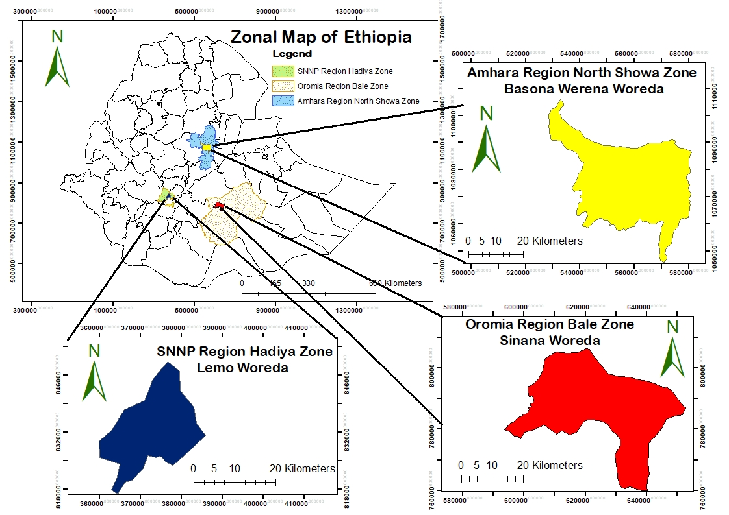
Methodology
Study Areas:
Basona Worena, Sinana and Lemo
Located in Amhara, Oromia and SNNPR

Slide 8
Methodology
Study design
  A formative research
Research Approach
  A qualitative research approach
Sampling
  Participant – AR project beneficiaries
  64 key informant interviews (KIIs)
  12 focus group discussion (FGD) of 80 participants

Slide 9
Methodology
Methods | Level | Participants | Total Number
Project document review | International; National
Key Informant Interviews (KII) | Regional | Research center | 2
 | Regional | University | 1
 | District | Woreda Office of Agriculture | 7
 | District | Woreda Office of Health | 2
 | District | AR field staff | 2
 | Community | AR beneficiaries | 34
 | Community | Health Extension Workers | 9
 | Community | Development Agents | 7
 | Total |  | 64

Slide 10
Methodology
Methods | Level | Participants | Total Number
Focus Group Discussion (FGD) | Community at Basona Worena | Female Merchants | 7
 |  | Male Merchants | 9
 |  | Female Farmer | 9
 |  | Male Farmer | 7
 | Community at Sinana | Female Merchants | 7
 |  | Male Merchants | 6
 |  | Female Farmer | 7
 |  | Male Farmer | 8
 | Community at Lemo | Female Merchants | 3
 |  | Male Merchants | 5
 |  | Female Farmer | 6
 |  | Male Farmer | 6
 | Total |  | 80

Slide 11
Methodology: Challenges
Delays in obtaining ethical clearance
Travel restriction due to COVID
Timing of data collection
  Beneficiaries
  AR site coordinators
  HEWs

Slide 12
Result
i. Contribution of AR technologies to household nutrition in SNNPR
ii. Contribution of AR nutrition-education intervention to household nutrition in Amhara and Oromia
iii. Participatory nutrition-education need assessment in SNNPR
iv. Seasonal food availability assessment in, Amhara, Oromia and SNNP regions

Slide 13
I. Contribution of Africa RISING Technologies to Household Nutrition in SNNPR

Slide 14
Key agricultural technologies identified and discussed
  Livestock feeds and forage technologies and management practices
  Improved crop varieties and management
  High value horticultural crops
  Water lifting technology

Slide 15
Best performing technologies include
  New improved varieties of
    Pulses -wheat, faba bean, malt barley
    Vegetables - cabbage, carrot, beet root and potato
    Fruits - avocado
  Pilot works on livestock feed improvements
    Enhance milk production

Slide 16
Role of AR
Supporting in technology scaling up efforts through
Capacity building activities includes:
  training, field day, exposure visits and experience sharing forums to
    Farmers
    Government staffs - agricultural experts and Development Agents.

Slide 17
How does these technologies contribute to household nutrition
Helped the targeted households to
  Produce diversified nutritious foods
  Generate income from the sales of vegetables, avocado fruits, potato, milk and milk products
  Purchase other food items - cooking oils, vegetables, salt, sugar and other consumables.

Slide 18
Perception about the AR Intervention
“I implemented feed technologies, high value horticulture technologies (Avocado, cabbage and carrot), and water harvesting. Particularly avocado has brought change to our household consumption and income. Initially, I planted five avocado seedlings that I got from AR project; however, only three of them survived to give fruit twice a year. My family, especially my children has been consuming avocado fruit”.
(KII Farmer, Upper Gana Kebele, Lemo Woreda, SNNPR)

Slide 19
Strengths Agricultural production, productivity and crop diversity improved The project assisted the households to increase their income from the sales of agricultural produce. Income generation from the sales of horticultural crops (cabbage and avocado fruits) increased | Weaknesses The project failed to create sustainable seed supply of vegetables, faba bean and forage crops as well as grafted avocado planting materials Limited work to expand water lifting and water harvesting technologies Lack of crop disease/pest resistant varieties (potato, cabbage, alfalfa, brachiara) Failed to sustain farmers association for seed multiplication specifically faba bean that resulted in shortages of seeds
Opportunities Favourable agro-ecologies for horticultural crops production Availability of water resources for irrigable crop production in some areas Availability of agricultural research center and university that could be source of improved technologies and also assist in technology validation and scaling up activities | Threats Shortages of seeds of forage crops, vegetables and faba bean Occurrence of crop diseases and pest Productivity of varieties decrease from year to year due to breakage of resistance to diseases and pests Shallow underground water sources are limited to only certain areas Poor market linkage for avocado
SWOT Analysis on Agricultural Interventions

Slide 20
II: Contribution of Africa RISING Nutrition-Education Intervention to Household Nutrition in Amhara and Oromia

Slide 21
Interventions
Nutrition-education interventions - Sinana and Basona Worena districts
  To address the knowledge gap of experts and farmers
Include
  Development of nutrition training manual in local languages
  Training of Trainers (ToT) - 40 trainees, 20 from each region
      Health Extension Workers (HEWs)
      Development Agents (DAs)
      Project’s woreda focal persons
      Researchers and
      model women and male farmers
      experts from Debre Berhan and Mada Walabu Universities
  Cooking demonstrations

Slide 22
Perception about the Intervention
“I together with other 5 farmers from my kebele have participated on nutrition training organized by AR project in Robe, zonal capita 4 year ago. Cooking demonstration was part of the training where we learned how to prepare child food and feeding. My knowledge and skill of nutrition has been improved and started diversifying our diets as a result of it. We were informed to train other households in our kebele”.
(KII Female farmer - Ilu-Sambitu kebele, Sinana woreda, Oromia region)
  Improved beneficiary households’ knowledge and skill of food preparation and feeding practices.

Slide 23
Perception about the Intervention
  Changed farmers’ attitude towards production and consumption of high value farm produces - avocado, potato and animal source foods.
“involvement in potato production helped us to produce more on small plot of land. Thus, our food security has been improved and we are able to generate income from sales of potato.
(KII Male Farmer - Selka Kebele of Sinana woreda in Oromia Region)

Slide 24
Strengths The ToT incorporated both theoretical and practical training The training material on nutrition was prepared in local language – Amharic and hard copies were also provided to the trainees The project provided an opportunity to bring HEWs and DAs to work together for nutrition intervention Not only HEWS and DAS, but also model farmers were targeted for ToT on nutrition education | Weaknesses Contrary to the AR project’s second phase protocol, nutrition component is almost ignored while focusing on only improvement of agricultural production and farm income Limited focus on nutrition activities and poor linkage of production and farm income to nutrition. ToT on nutrition education was provided in 2016 at the end of the first phase of the project, but failed to cascade at the farmers level during in the second phase Cascaded only to selected lactating and pregnant women by HEWs in some villages of Selka and Ilu-Sambitu kebeles in Oromia. Inadequate coordination with woreda office of agriculture in planning, implementation and monitoring of nutrition activities No follow up activities to the trainees on nutrition education from the project Majority of men respondents did not have any idea about nutrition education and cooking demonstration provided by AR project.
Opportunities The highland climate is conducive for rain-fed agricultural production; both Sinana and Basona Worena woredas are surplus producers Introduction of various validated agricultural technologies enhance agricultural production and productivity, increased farm income and women participation could in turn contribute to household food security and dietary diversity | Threats Staff turnover mainly trained HEWs; limited attention is given to nutrition activities by HEWs DAs are forced to engage in non-agricultural businesses so that they had insufficient time to work with the project adequately Lack of dry season high value crop production due to shortage of water for irrigation Local government is supposed to do scaling up technologies but their effort is unsatisfactory particularly in Sinana woreda
SWOT analysis of nutrition education intervention

Slide 25
III: Participatory Nutrition-Education Need Assessment in SNNPR

Slide 26
Status of Nutrition Education at Community Level
Limited knowledge on the concepts of nutrition, food preparation and feeding (DAs, HEWs and the AR beneficiaries)
Did not receive any nutrition education either by AR or by government or any development organization (KII Farmer)
Pregnant women were provided with nutrition information at health posts during their anti-natal visit (KII Female )
Majority of the respondents were less aware of the need of nutrition education while few of them felt that it is very important to have nutritional knowledge on food preparation especially for the purposes of feeding the kids

Slide 27
Nutrition Gap Assessment
There is a huge knowledge gap in nutrition knowledge at all level of the community (KII Health experts)
  E.g. Overcooking vegetables - Kale
Diet diversity is very low where the farmers focus on growing limited crop varieties, dominantly enset or cereals

Slide 28
Way forward
Nutrition-education intervention is still needed by the experts and community members to create awareness.
Awareness creation should include husbands, grandmothers, elders and religious leaders
Adequate attention should be given to technical support and training on nutrition to the government staff at woreda level, HEWs and DAs, and then to the farmers with frequent follow up
Adequate supportive resources and materials should be provided to HEWs and DAs - training manuals and posters

Slide 29
IV: Seasonal Food Availability Assessment in, Amhara, Oromia and SNNP Regions

Slide 30
Introduction to Seasonal Food Availability Assessment
Food availability almost all over Ethiopia is highly seasonal
Seasonality is one of the key factors in determining food availability, especially of perishable foods like fruits and vegetables
Focus Group Discussion (FGD) and Key Informant Interviews (KII) were used to gather data
Experienced farmer and merchant, both men and women with mix of ages, ethnicity and economic status were involved

Slide 31
Minimum Dietary Diversity for Women (MDD-W) was implemented to categorize each food item to food group.
  Grains, white roots and tubers – starchy staples that are rich in carbohydrate
  Pulses – foods including beans, lentils
  Nuts and seeds – include mostly tree nuts, groundnuts and seeds
  Dark green leafy vegetables (DGLV) –rich in vitamin A (e.g. cassava leaves, pumpkin leaves)
  Other Vitamin – A rich fruit and vegetables – this are typically orange, red or deep yellow fleshed both vitamin A-rich fruits and vegetables (e.g. ripe mango, papaya, melon, passion fruit);
  Other vegetables – vegetables not counted as dark green leafy or other vitamin-A rich vegetables (e.g. onion, garlic, cucumber, potatoes)
  Other fruits – fruits aside from vitamin-A rich fruits (orange, apple, strawberries)

Slide 32
Section 1: Free Listing of food items
No | Food item |  | Food Group (1, 2, 3, 4, 5, 6, 7) | Food sources (1, 2, 3, 4, 5, 6) | What part is consumed | How it is consumed
 | Local name | English/scientific name
1 | ጎመን | Kale | 4 | 4 | Leaves | Cooked
The participants were asked to list all the food items available for consumption in the community

Slide 33
Section 2: Scoring seasonal availability
No. | Name of Food items as per the community food list | Maskerem | Tiqimt | Hidar | Tahsas | Tir | Yekatit | Megabit | Miyazia | Ginbot | Sene | Hamle | Nehase
1 | Kale | 3 | 3 | 2 | 2 | 1 | 1 | 0 | 0 | 0 | 2 | 3 | 3
Participants also specified the levels of food availability each month that was ranked on four-level scales:
    not available (0)
    low availability (1)
    medium availability (2)
    high availability (3)

Slide 34
Diversity, Culinary use, Source and Perceived seasonal availability of foods
The seasonal availability of food groups across the three AR sites was compared.
Overall the diversity and availability of food groups slightly better in Sinana district when compared with the other two AR sites.

Slide 35
Cereals, grains, roots and tubers
Diversity of the food items generally similar
Barely, wheat, teff, sorghum, maize, rice, potato and sweet potato
sourced from own farm and local market
Both men and women mentioned the same number of species

Slide 36
Pulses (beans, peas, and lentils)
Pulses | Perceived availability
District | Jan | Feb | March | April | May | June | July | Aug | Sept | Oct | Nov | Dec
Basona | 1 | 1.1 | 1.7 | 2.2 | 2.2 | 2.3 | 1.8 | 1.6 | 1.4 | 1.4 | 1.1 | 1.1
Sinana | 2.6 | 2.5 | 2.1 | 2 | 2 | 2.3 | 2.4 | 2.6 | 2.5 | 2.3 | 2 | 2.1
Lemo | 3 | 2.5 | 1.9 | 1.6 | 1.5 | 1.1 | 0.5 | 0.5 | 2 | 0.6 | 0.9 | 2.3
Lentil, field pea, faba bean, chick pea, haricot bean and grass pea
consumed both raw at the green stage and cooked
Majority of the pulses are sourced both from own production and local market

Slide 37
Nuts and seeds
5 species were documented – linseed, Niger seed, sesame, ground nut and safflower.
Notes:
Sinana it is moderate throughout the year

Slide 38
Dark Green Leafy Vegetables (DGLV)
DGLV |  | Perceived Availability
Species | District | Jan | Feb | Mar | Apr | May | June | July | Aug | Sept | Oct | Nov | Dec
Ethiopian Kale | Basona | 3 | 2.5 | 2 | 1.5 | 1.25 | 1.5 | 1.25 | 1.25 | 1.25 | 1.25 | 1.75 | 1.75
 | Sinana | 1.75 | 1 | 1 | 1.25 | 2 | 2.75 | 3 | 3 | 2.75 | 3 | 3 | 2.5
 | Lemo | 1.8 | 1.8 | 2.5 | 2.8 | 3 | 3 | 3 | 2.8 | 2.5 | 2 | 2 | 1.8
Swiss chard | Basona | 2.25 | 2.5 | 2.25 | 1.5 | 1.5 | 1.25 | 1.5 | 1.5 | 1.5 | 1.5 | 1.25 | 1.75
 | Lemo | 1.5 | 1.5 | 2.5 | 3 | 2.5 | 2.5 | 2.5 | 1.5 | 1.5 | 1 | 1.5 | 1.5
Green Pepper | Sinana | 2 | 1.75 | 1.5 | 1.25 | 1 | 1.25 | 1.5 | 2.25 | 2.25 | 2.25 | 2.75 | 2.75
kale and swiss chard discussed in all districts, but it is in different time period

Slide 39
Other Vitamin-A rich fruits and vegetables
Low diversity of fruits and vegetables was documented in all districts.
Pumpkin, Carrot , Papaya and Mango were mentioned by all districts
Carrot was the only vitamin-A rich vegetable discussed by all participants in all group

Slide 40
Other vegetables
Seven verities of vegetable were identified
Of this food items, all were available in Sinana and six of them were found in Basona and Lemo
Almost all the food items listed are sourced primarily from home garden.

Slide 41
Other Fruits
The availability of other fruits greatly varied across all districts
apple, orange and banana were mentioned by participants in all groups.
Banana was indicated to be available in all the study areas year-round from moderate to high level

Slide 42
The seasonal availability of food groups across the three AR sites was compared.
Overall the diversity and availability of food groups slightly better in Sinana district when compared with the other two AR sites.
The food items listed under dark green leafy vegetables, Other V-A rich vegetables and fruits are low in diversity and availability across all districts and this may lead to low intake of fruits and vegetables by the community.
Conclusion and Recommendations
Conducting the seasonal food availability assessment as many as possible

Slide 43










Project partners in Ethiopia
Notes:
Ethiopia

Slide 44
Thank You

