Slide 1
Important!
This module is designed to potentially serve a wide variety of audiences (nutritionists and agronomists, policymakers, extension workers, farmers).
Not all of the material will be relevant to all audiences.
Please refer to the accompanying Facilitator’s Guide for guidance on how to adapt these materials to your audience and facilitation best practices.

Slide 2




Legend
Icon | Description
 | Expected Duration, minutes
 | Quick Review/Survey Questions
 | Brainstorming Session
 | Discussion Session
 | Group Activity
 | Animated Slide
 | End of Animation
Xm

Slide 3
Legal
Unless otherwise noted, all images copyrighted to International Potato Centre.
Attribution-NonCommercial-ShareAlike 2.0 Generic (CC BY-NC-SA 2.0)

Slide 4
Everything You Ever Wanted to Know About Sweetpotato
Topic 4: Nutrition and Orange-fleshed Sweetpotato

Slide 5
Introduction
Nutrition and Orange-fleshed Sweetpotato

Slide 6

Welcome
During this session, we will discuss nutrition and explore what we mean by good nutrition, why it is important and the different ways we can be malnourished. We will also focus on nutritional benefits of sweetpotato.

Slide 7
Nutrition
Unit 1

Slide 8
Objectives
By the end of this unit, you should be able to:
Explain the difference between macro and micronutrients.
Discuss what is meant by a healthy balanced diet, and why it is important.

Slide 9
Types of Food
Foods can be categorised based on their main nutrient type and function:
  Carbohydrates (energy giving)
  Proteins (body building and energy giving)
  Fats (energy storage and giving, insulation)
  Vitamins and minerals (support and protect body development and functioning)
In addition, we also need to:
  Eat fibre (to help move food through the digestive track), and
  Drink water (which is a key component in many bodily functions)

Slide 10
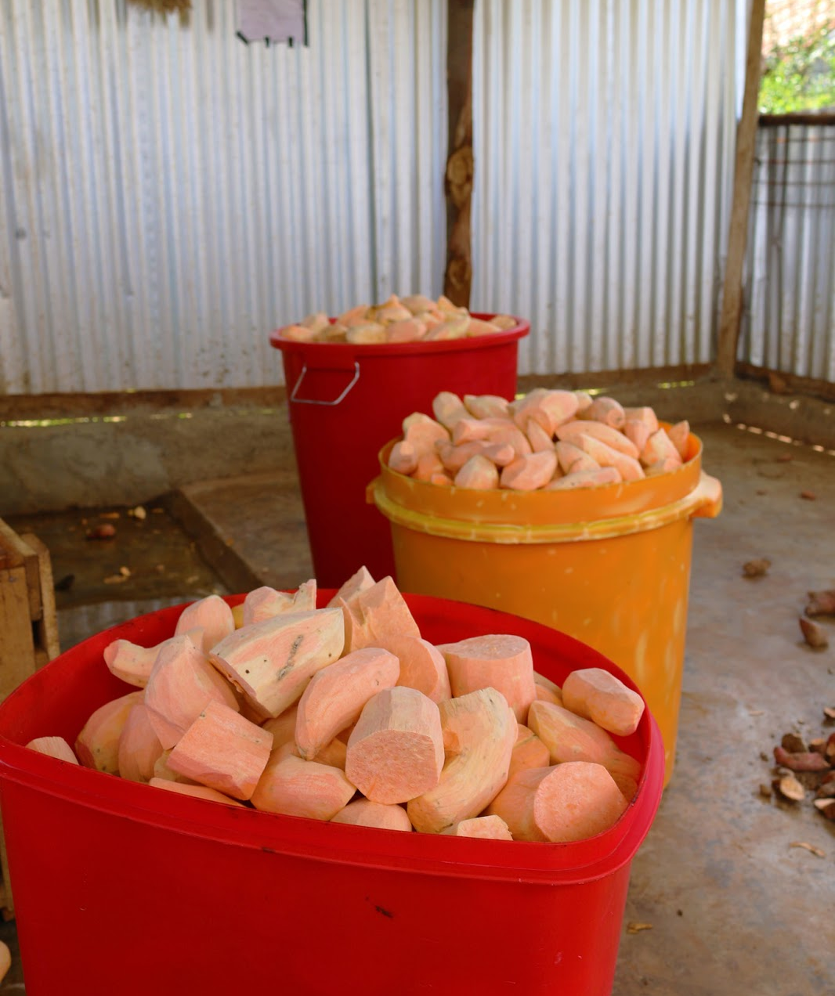
Macronutrients and Micronutrients
Carbohydrates, proteins and fats are called macronutrients because our bodies need them in large amounts.
Vitamins and minerals are called micronutrients because they are needed in small amounts.

Slide 11
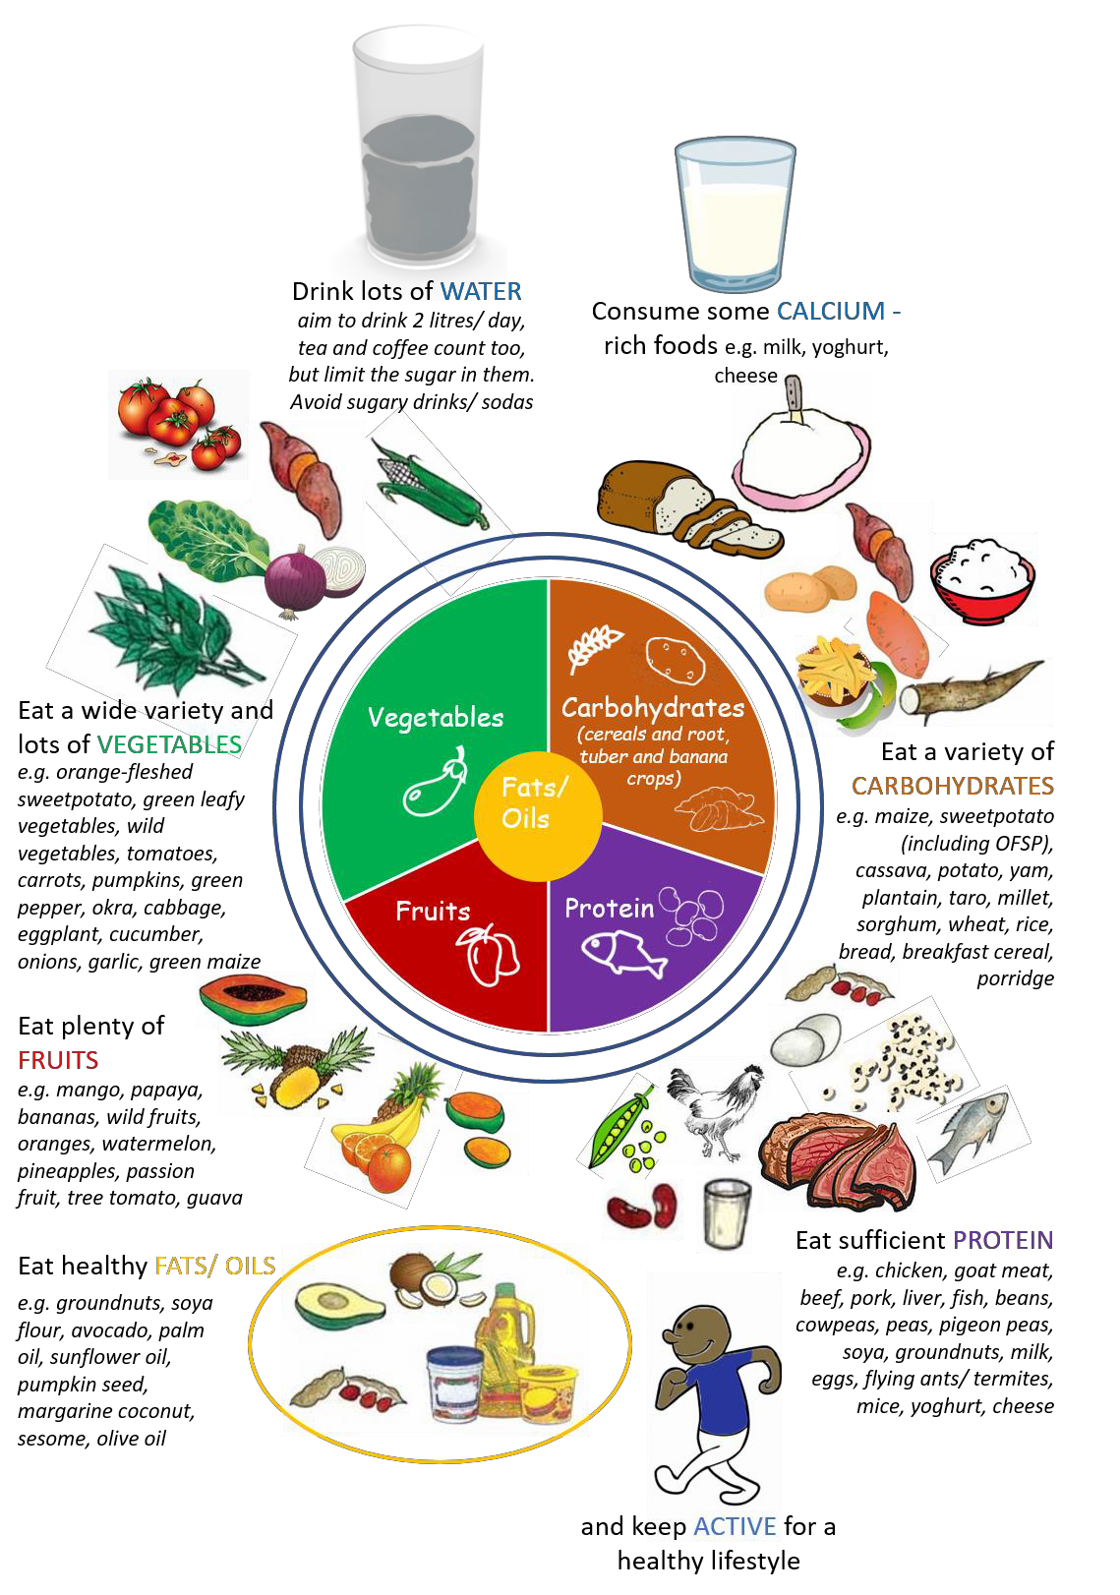
Healthy Balanced Diet
It is important to eat food from each group daily.
Nutrient requirements vary depending on:
  Age
  Gender
  Physical activity
  Pregnancy
  Breastfeeding
Healthy balanced diet provides adequate food for energy and nutrients.

Slide 12
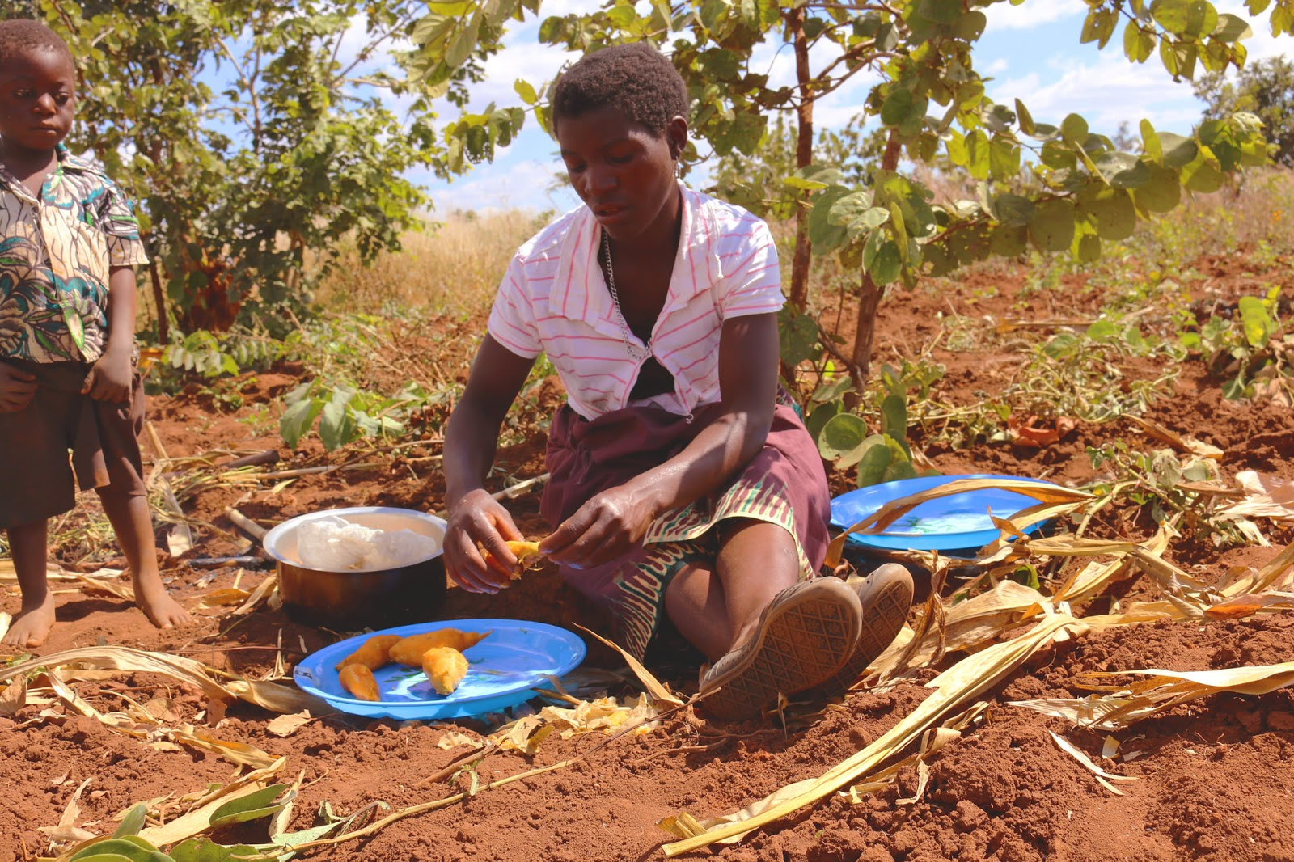
Importance of Healthy Nutrition
Nutrition impacts human growth and development
Adequate nutrition is critical during pregnancy, breastfeeding and childhood
Malnutrition can lead to:
  Poor growth
  Being less active
  Frequent illnesses
It is difficult to reverse malnutrition

Slide 13
What are the four main types of food, based on their main nutrient type?
What is the difference between macronutrients and micronutrients?
What could be some of the consequences of malnutrition?
Notes:
Answers
Carbohydrates (energy giving); Proteins (body building and energy giving); Fats (energy storage and giving, insulation); Vitamins and minerals (support and protect body development and functioning)
Carbohydrates, proteins and fats are called macronutrients because our bodies need them in large amounts.; Vitamins and minerals are called micronutrients because they are needed in small amounts.
Poor growth, being less active, frequent illnesses. Could be irreversible.

Slide 14
Key Points
Foods are categorised based on the main nutrients they contain: these are carbohydrates, proteins, fats, vitamins and minerals.
To stay healthy, we need to consume a balanced diet of a diverse range of foods containing these different nutrients; we also need to consume fibre and drink plenty of water.
We need to consume macronutrients in large amounts. These give us energy and include: carbohydrates, proteins which also help us build and repair our bodies, and fats which supply fatty acids and help us absorb some vitamins.
We also need small amounts of vitamins and minerals, which we call micronutrients, which help our bodily functions and protect us from disease.
Each micronutrient has a very specialized role in supporting growth and maintaining health.

Slide 15
Malnutrition
Unit 2

Slide 16
Objectives
By the end of this unit, you should be able to:
List the three main types of malnutrition.
Explain how poverty can cause malnutrition.
Discuss the consequences of malnutrition at individual, household and national level.
State how many African children under 5 years old are stunted, underweight or overweight.
Discuss the causes and prevalence of hidden hunger.

Slide 17
Types of Malnutrition
Malnutrition is simply ‘Poor Nutrition’
There are several types of malnutrition:
  Undernutrition
    Wasting: Low weight-for-height
    Stunting: Low height-for-age
    Underweight: Low weight-for-age
  Micronutrient-related malnutrition
    Micronutrient deficiencies
    Micronutrient excess
  Malnutrition can also be overnutrition, especially of the ‘wrong’ types of food, leading to overweight, obesity and diet-related non-communicable diseases, such as heart diseases, stroke, diabetes and even some cancers

Slide 18
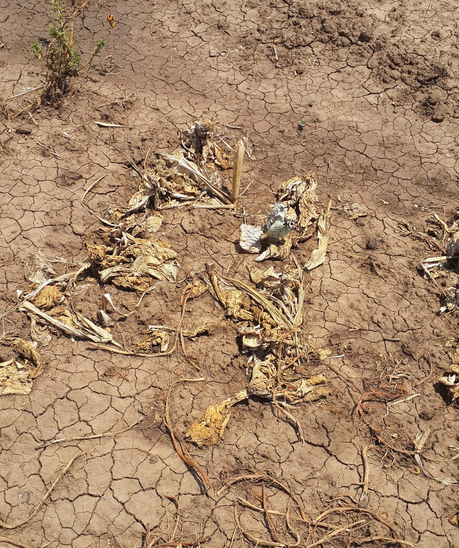
Causes of Malnutrition
Number 1: Poverty
  Limited food
  Bad quality
Droughts
Floods
Earthquakes
Failed crops
Interrupted food supplies
Wars
Civil disturbances

Slide 19
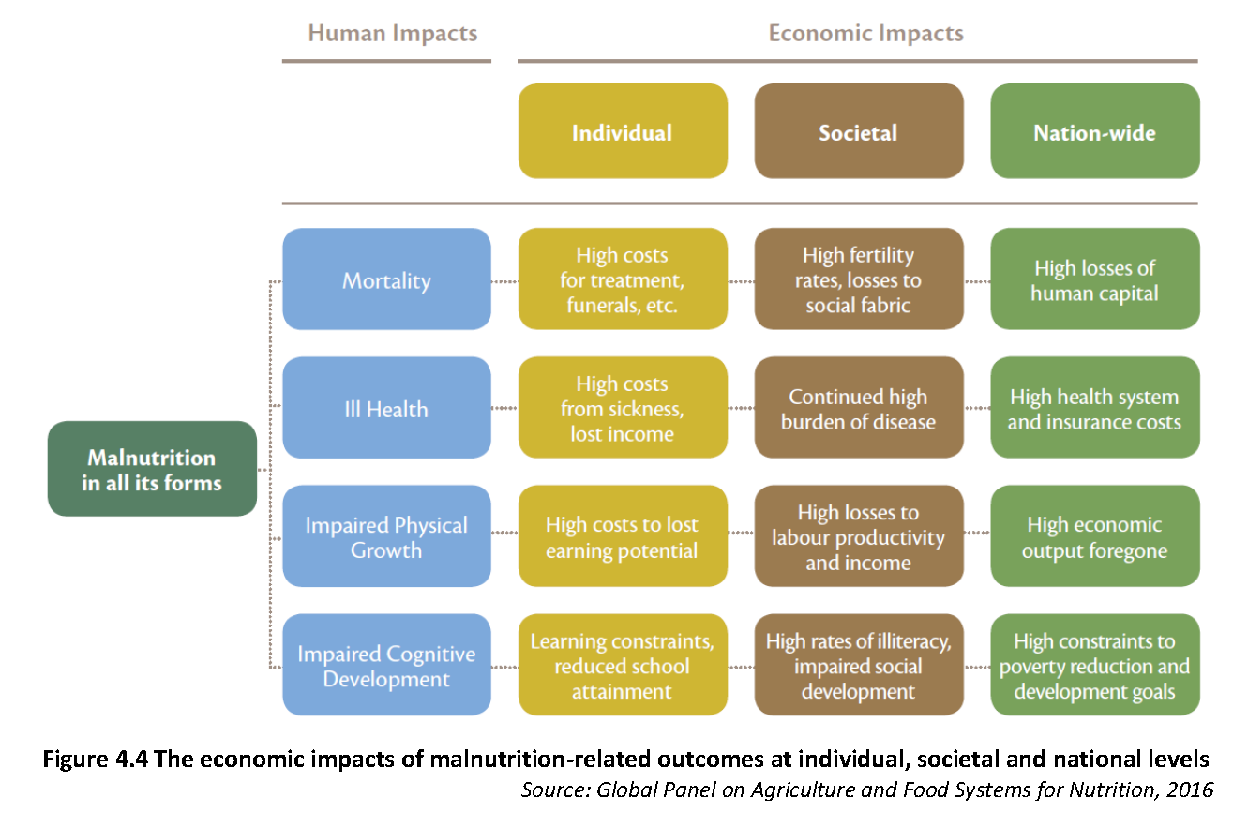
Impact of Malnutrition

Slide 20
Malnutrition in African Children under 5
Malnutrition is a severe problem in African children under 5:
  14 million are categorised as wasted
  59 million are stunted
  10 million are overweight
Recent study on the Cost of Hunger revealed that the annual cost of child undernutrition ranges from US $4.7 billion in Ethiopia to US $92 million in Swaziland.
A recent seven-year study also revealed that Africa is the only region where malnutrition increased.

Slide 21

Macronutrient Malnutrition
Lack of the macronutrients – carbohydrates, proteins or fats
Protein-Energy Malnutrition (PEM) is the most common
Severe cases of PEM can lead to kwashiorkor or marasmus.

Slide 22
Micronutrient Malnutrition
Micronutrient deficiency (“hidden hunger”) is lacking vitamins and/or minerals.
Detrimental to:
  Growth
  Immunity
  Health

Slide 23
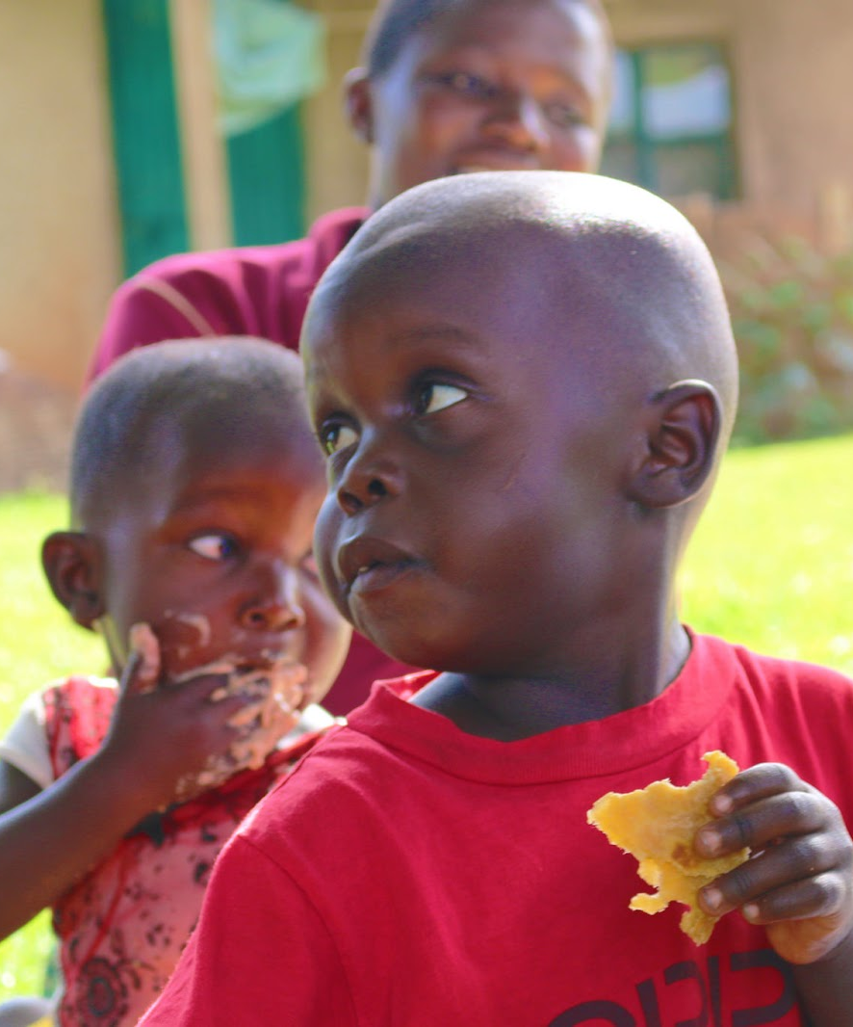
Foods to Address Malnutrition
Nutrient rich: Groundnut, sesame
Energy: Cereals, sweetpotato, cassava roots
Animal Foods: Meat, eggs, milk
Fruits
Vegetables

Slide 24
What are the types of malnutrition?
What is the number one cause of malnutrition?
What is ‘hidden hunger’?
Notes:
Answers
Undernutrition, micronutrient malnutrition (deficiency or excess), overnutrition
Poverty: lack of food and/or bad quality food
Micronutrient malnutrition

Slide 25
Key Points
There are three forms of malnutrition:
  Undernutrition (insufficient food intake, not enough calories, or protein or micronutrient deficiencies – wasting, stunting, underweight);
  Micronutrient deficient (not enough vitamins and minerals – hidden hunger),
  Overnutrition (too many calories – overweight and obesity)
Poor nutrition in the first 1,000 days of a child’s life can lead to irreversible stunting, poor micronutrient status and decreased cognitive ability

Slide 26
Nutrients
Unit 3

Slide 27
Objectives
By the end of this unit, you should be able to:
Describe which of the foods commonly consumed in your location are good sources of carbohydrates, proteins, fats, vitamins and minerals.
Name at least four important vitamins and minerals and explain what health problems deficiencies in each of them causes.
Explain the importance of vitamin A in the diet and discuss the prevalence and implications of vitamin A deficiency (VAD) particularly in young children and pregnant women.

Slide 28
Nutrient Classification
Essential nutrients
Non-essential nutrients
Not synthesised in body
Supplied through food:
  Proteins
  Fats
  Carbohydrates
  Minerals
  Fibre
  Water
Synthesised in body
Required non-essential nutrients are:
  Vitamin D
  Amino acids
  Cholesterol

Slide 29
Carbohydrates
The role of carbohydrates:
  The main source of energy
  Fibre helps digestion, bowel health and optimal cholesterol levels
Main source of carbohydrates is plants (e.g. potato, sweetpotato, cereal grains, legumes)
Carbohydrates can be in the form of fibre, starch or sugar
Excess carbohydrates are converted to fat

Slide 30
Forms of Carbohydrates
Starch
  Broken down in body
  Slow and steady energy release
  Contained in foods like maize, rise, wheat, oats, sweetpotato
Fibre
  Plant-based food
  Absorbs water
  Rids bodily waste
  Contained in foods like vegetables, fruits (especially peel on), whole grains
Sugar
  Quickly absorbed
  Concentrated energy
  Excess consumption can lead to overweight or even obesity
  Contained in fruit, processed sugar cane

Slide 31
Proteins
The role of proteins:
  Building blocks of life
  Build and repair body tissues, such as muscles, bones and organs, blood, skin and hair
  Necessary for blood clotting
  Keep the immune system strong by developing antibodies to fight disease
  A major component of the body’s transportation system that carries oxygen and nutrients to all cells
Sources of proteins:
  Animal foods, such as meat, poultry, fish, eggs, milk
  Vegetables, such as dried beans, lentils, legumes, pumpkin seeds, soy bean

Slide 32
Fats (Lipids)
Role of fats:
  Rich source of energy and Essential Fatty Acids (EFAs)
  Helps absorb fat-soluble vitamins (A, D, E, K)
  Important for brain and central nervous system development
  Important for manufacturing hormones
  Protects cells and internal organs
  Can cause weight gain and eventually obesity
Sources of fats:
  Animal, such as meat, dairy, fatty fish (contains omega-3 essential fatty acids), poultry, eggs
  Vegetables, such as seeds, nuts, olives

Slide 33
Vitamins and Minerals (Micronutrients)
Role of micronutrients:
  Each micronutrient has a specific function in enabling bodily processes
  Micronutrients fight infection and participate in chemical/enzymatic reactions
  Help build tissues (although not part of those tissues)
  Serve as antioxidants
  Micronutrient deficiency leads to various diseases, some severe
Types of micronutrients:
  Fat-soluble: Don’t dissolve in water or body fluids, can be stored
  Water-soluble: Lost in urine, can’t be stored
Plant and animal sources, e.g. leafy greens, fruits, vegetables, meat and fish, most whole and natural foods
  Sweetpotato is rich in beta-carotene

Slide 34
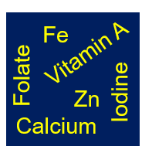
Common Micronutrient Deficiencies
Deficiencies in iron, iodine, zinc and calcium are common and a serious public health concern.

Slide 35
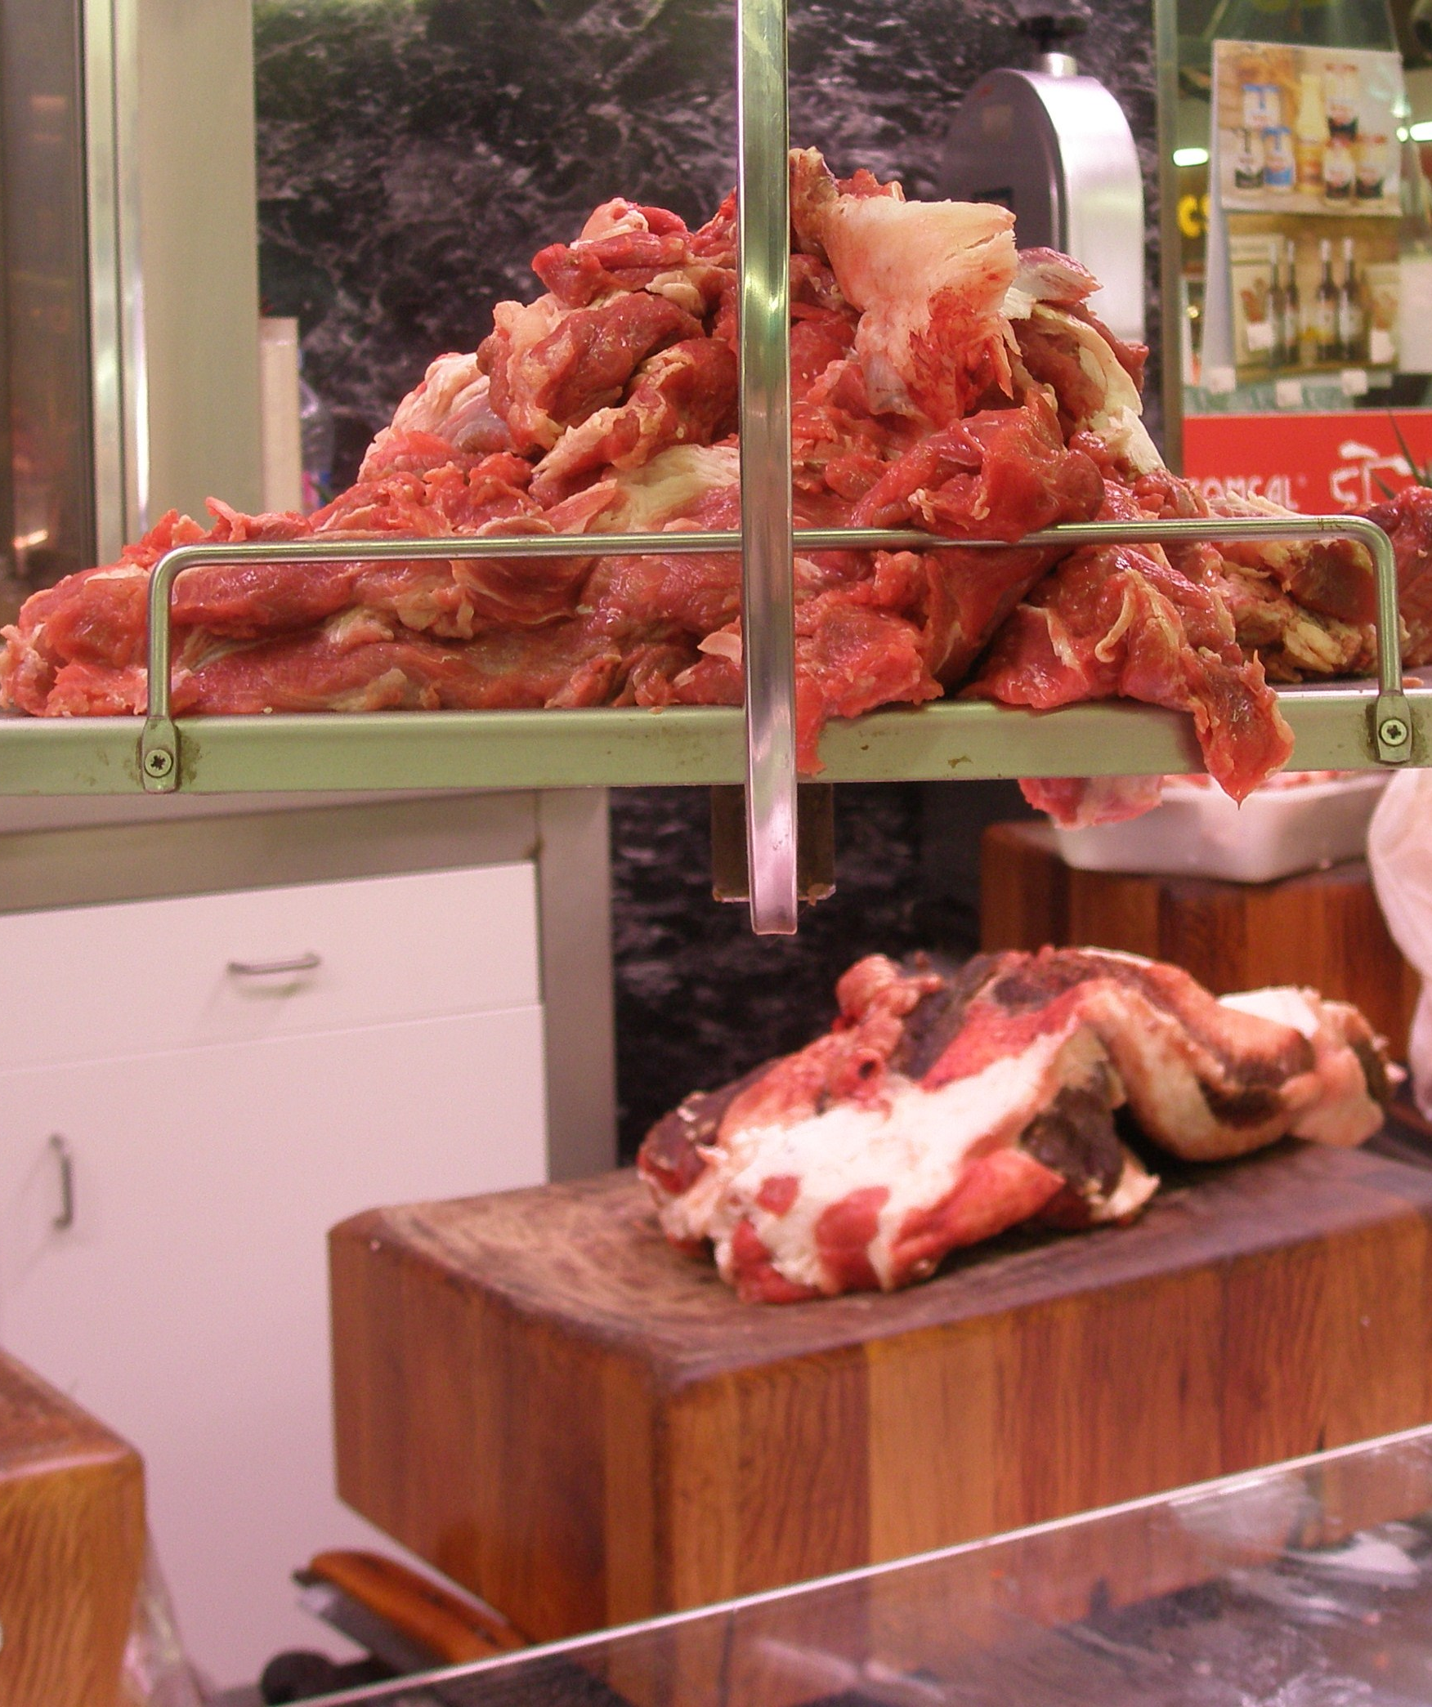
Iron Deficiency
Iron deficiency (anaemia) leads to reduced disease resistance and poor growth and development.
Iron-rich food sources are red meats, liver, fish, poultry and eggs, beans and leafy green vegetables.

Slide 36
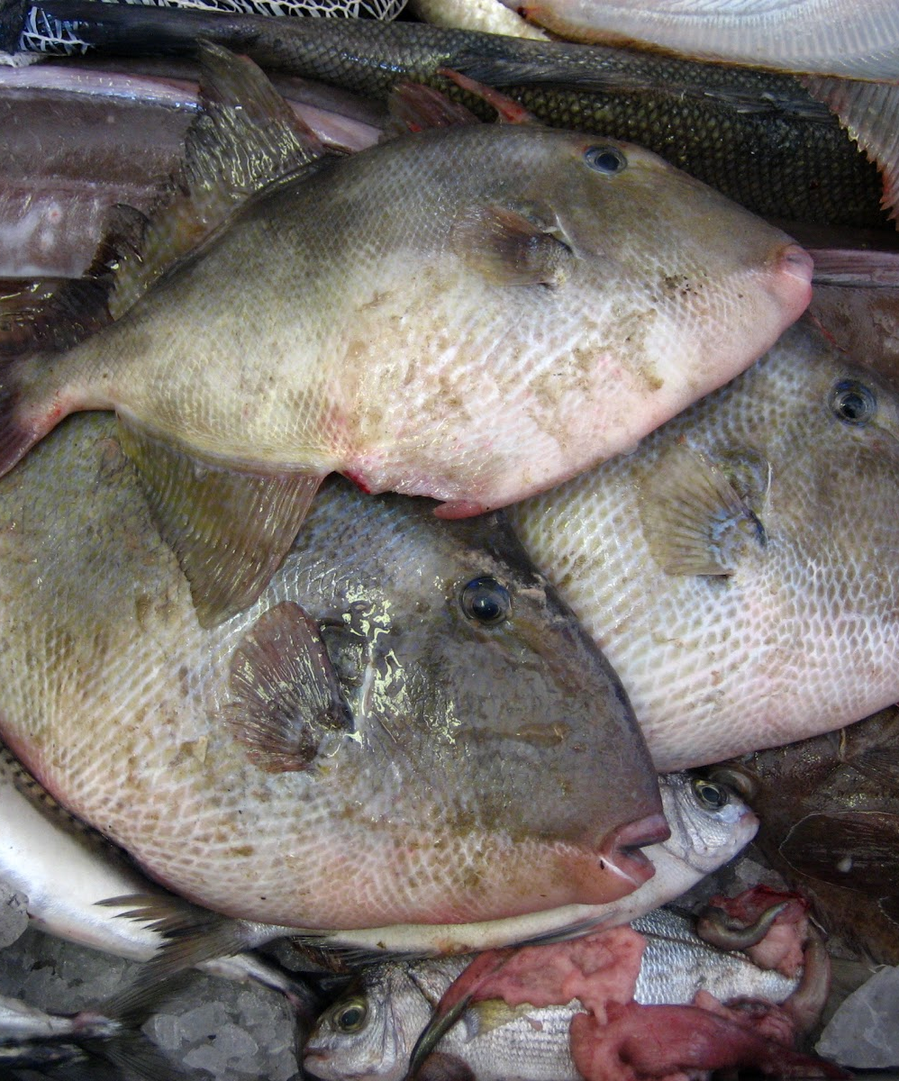
Iodine Deficiency
Iodine deficiency can result in goitre, and mental retardation in children.
Iodine-rich food sources need to be regularly consumed and include seafood, saltwater fish, seaweed and iodised salt.

Slide 37
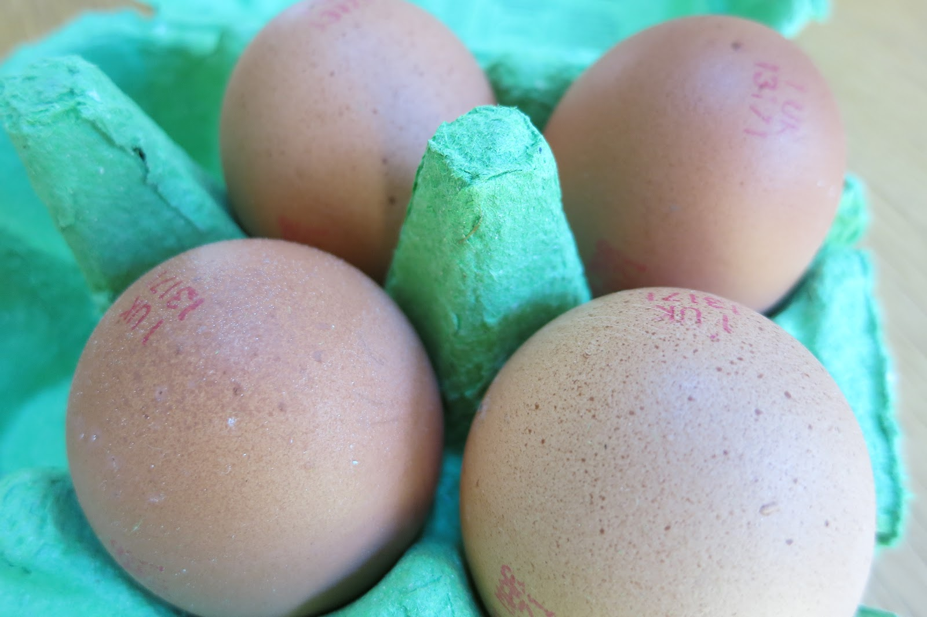
Zinc Deficiency
Zinc deficiency can affect the central nervous system and the brain.
Zinc-rich food sources are meat, milk, cheese, eggs, shellfish, wholegrain cereals, nuts and pulses.

Slide 38

Calcium Deficiency
Calcium deficiency leads to reduced bone density.
  Calcium consumption is particularly important during childhood and adolescence when bones are growing.
Calcium-rich food sources are milk, cheese, yoghurt, small fish and cabbage.

Slide 39
What is the difference between essential and non-essential nutrients?
What is the role of carbohydrates?
What type of food is called ‘building blocks of life’? Why?
What are the most common micronutrient deficiencies?
Notes:
Answers
Essentials are not synthesised in the body, supplied through food. Non-essentials are synthesised in the body
The main source of energy; Fibre helps digestion, bowel health and optimal cholesterol levels
Proteins; Build and repair body tissues, such as muscles, bones and organs, blood, skin and hair
Iron, iodine, zinc and calcium

Slide 40
Key Points
Although we only need vitamins in small/ micro amounts they are still vitally important, and a lack of any vitamin can cause serious health problems.
Vitamin A food sources include liver, eggs, dark orange or green coloured vegetables and fruits such as orange-fleshed sweetpotato, mangoes, spinach, milk.
Vitamin A helps maintain our eyesight, immune system, cell division, growth and reproductive systems. An estimated 250 million preschool children are vitamin A deficient, and a large proportion of pregnant women.
Vitamin D food sources include fish oils and liver and can also be synthesised by the body when our skin is exposed to sunlight. Vitamin D is important for bone formation and strength, and helps the immune system, brain, nervous system, skin, muscles and cartilage, kidneys, intestines and reproductive organs.

Slide 41
Key Points (cont.)
Our bodies need minerals to form structures such as bones, teeth, nails, muscles, and red blood cells and to regulate chemical reactions.
Eating a varied and balanced diet will help ensure an adequate supply of most minerals.
Deficiencies in iron, iodine, zinc and calcium are common and a serious public health concern.

Slide 42
Tackling
Micronutrient Malnutrition or Hidden Hunger
Unit 4

Slide 43
Objectives
By the end of this unit, you should be able to:
Describe and compare four different approaches used for tackling micronutrient malnutrition.

Slide 44




Four Approaches to Tackling Malnutrition
Supplementation
Food fortification
Dietary diversification
Biofortification

Slide 45
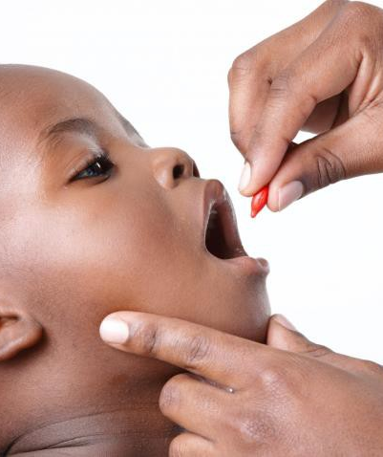
Supplementation
Supplementation means taking a capsule, tablet, or injection containing the needed micronutrient(s).
Mega doses of vitamin A are given every 6 months in some areas where vitamin A-rich animal foods are too expensive.

Slide 46
Supplementation Cont.
Advantages
Disadvantages
Tends to be low cost per capita
Unlike fresh food, supplements are easy to store/transit.
UN refers to the first 1000 days of a child’s life as a window of opportunity for supplementation, maintaining brain function.
Fat-soluble vitamins given in mega doses that release slowly into the body.
Many programs are expensive and must be donor-supported.
Short-term benefits
Targeted, yet difficult to reach the hard to reach population
Risk that it inhibits development of alternative and more sustainable programmes

Slide 47
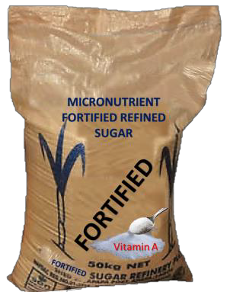
Food Fortification
Food fortification means adding extra nutrients to foods to increase micronutrient value.
Fortification has been used in industrialized and semi-industrialized countries since the late 1800s.

Slide 48
Food Fortification Cont.
Advantages
Disadvantages
Efficient, simple, inexpensive
Does not require people to change dietary habits
One input point (industry)
Many people purchase food from local and informal markets, making it hard to institute programs.
Requires public and private partnership, political commitment
Young children can only eat small amounts of food and will require additional supplements.
Requires enforcement

Slide 49
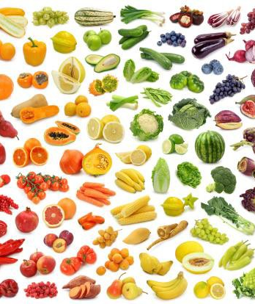
Dietary Diversification
Changing household diets to include micronutrient-rich foods.
Increasing access to nutrient-dense foods
Achieved through social and behaviour programs

Slide 50
Dietary Diversification Cont.
Advantages
Disadvantages
Bioavailability of nutrients is often better than supplements, as long as there is sufficient oil in the diet.
Long term impact
Complementarity with other objectives
No external inputs needed
Sometimes it is difficult to provide steady access to better foods
Food availability, supply chain disruptions could cause issues
High start-up costs
Long-term investment

Slide 51
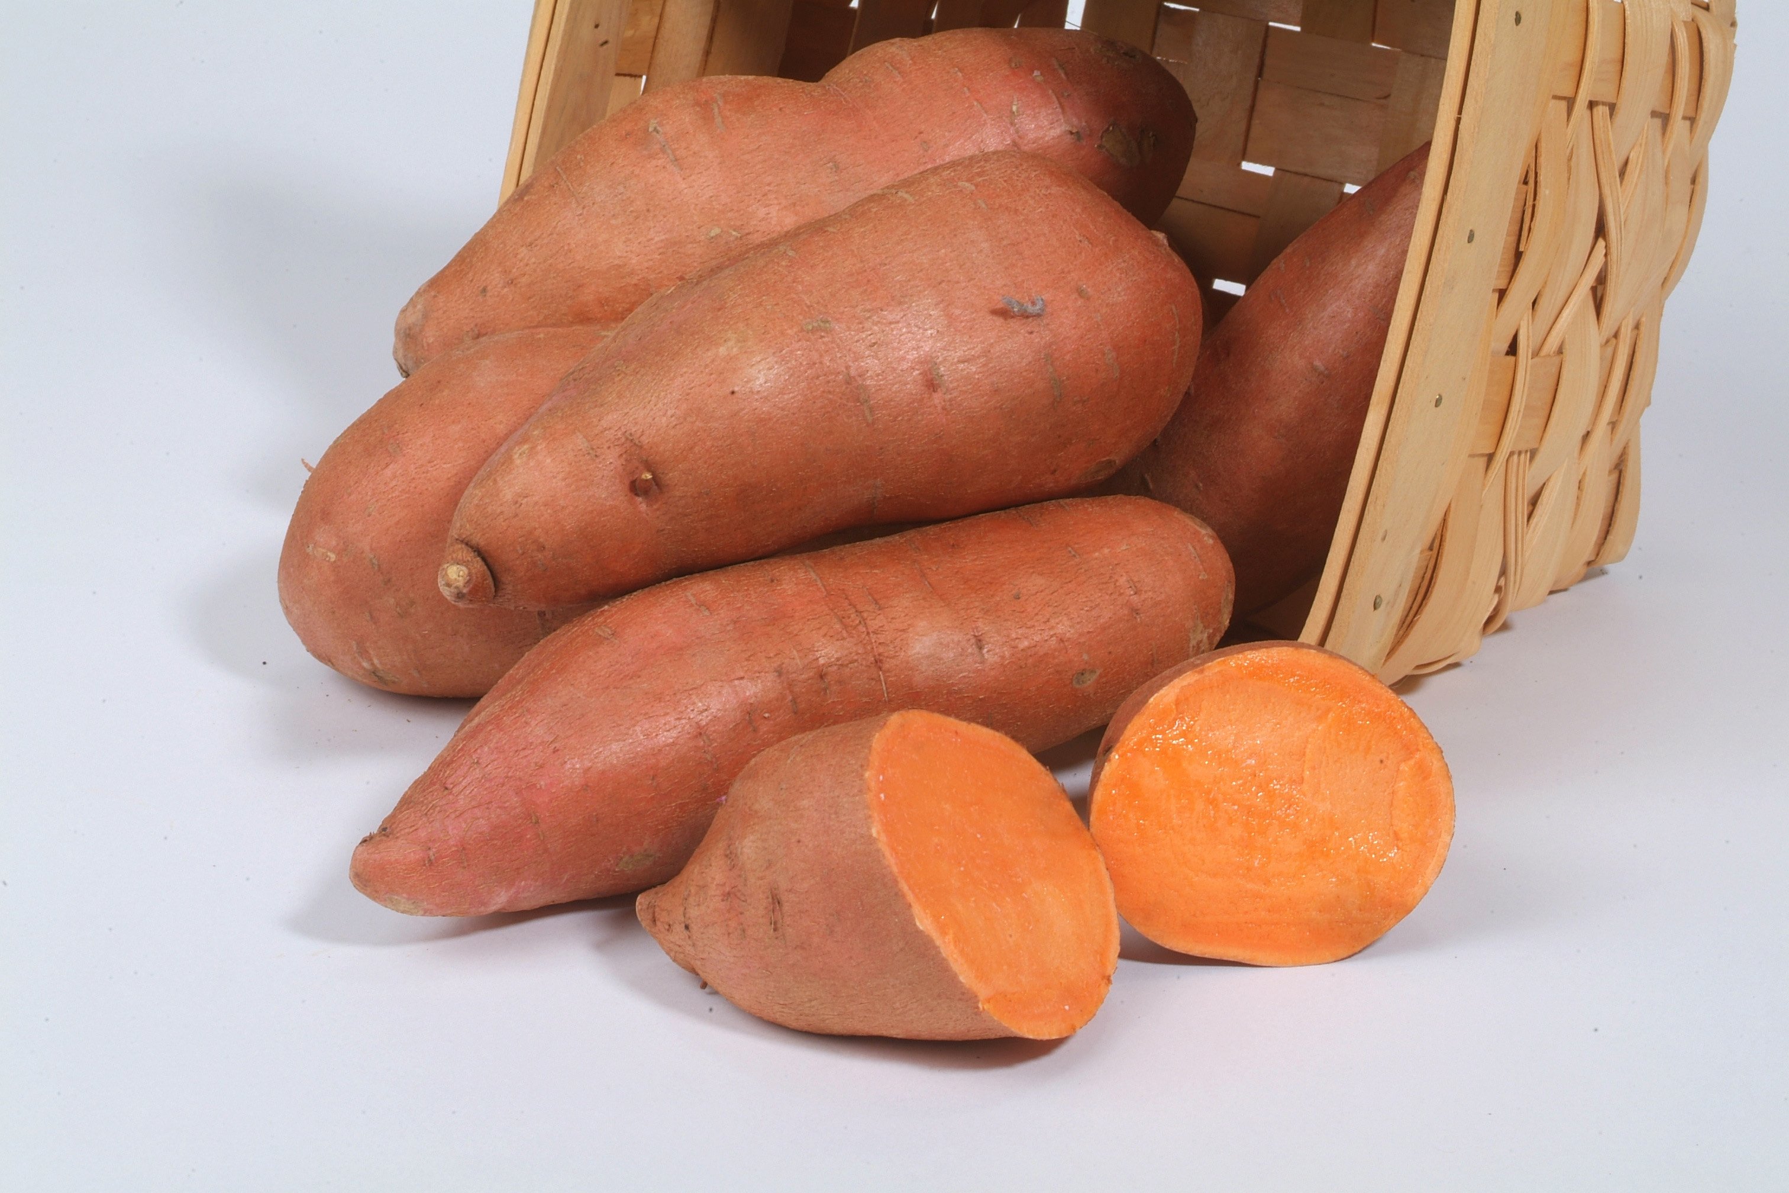
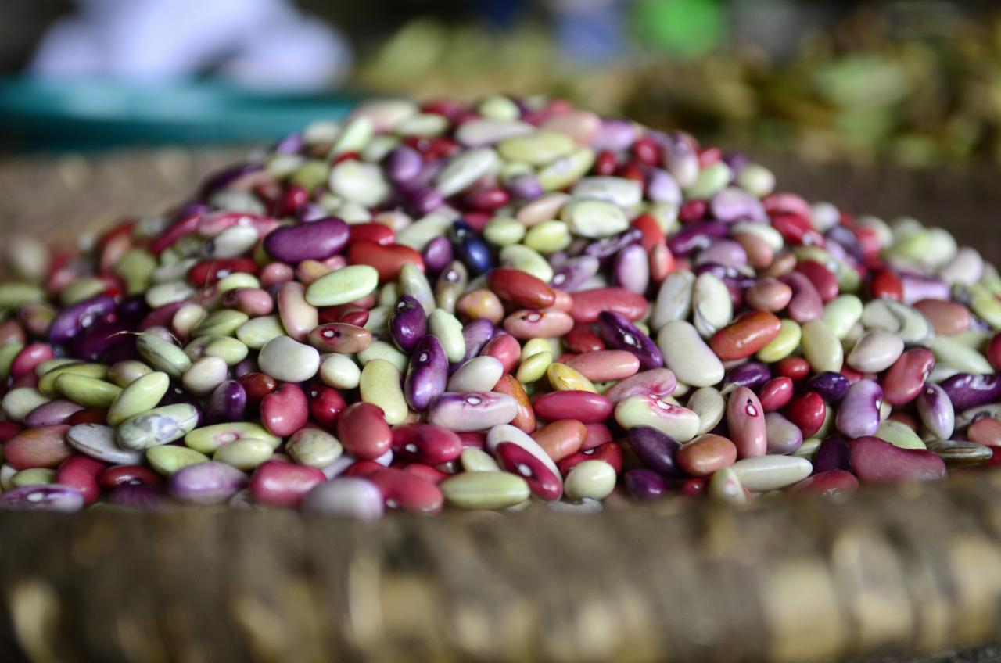
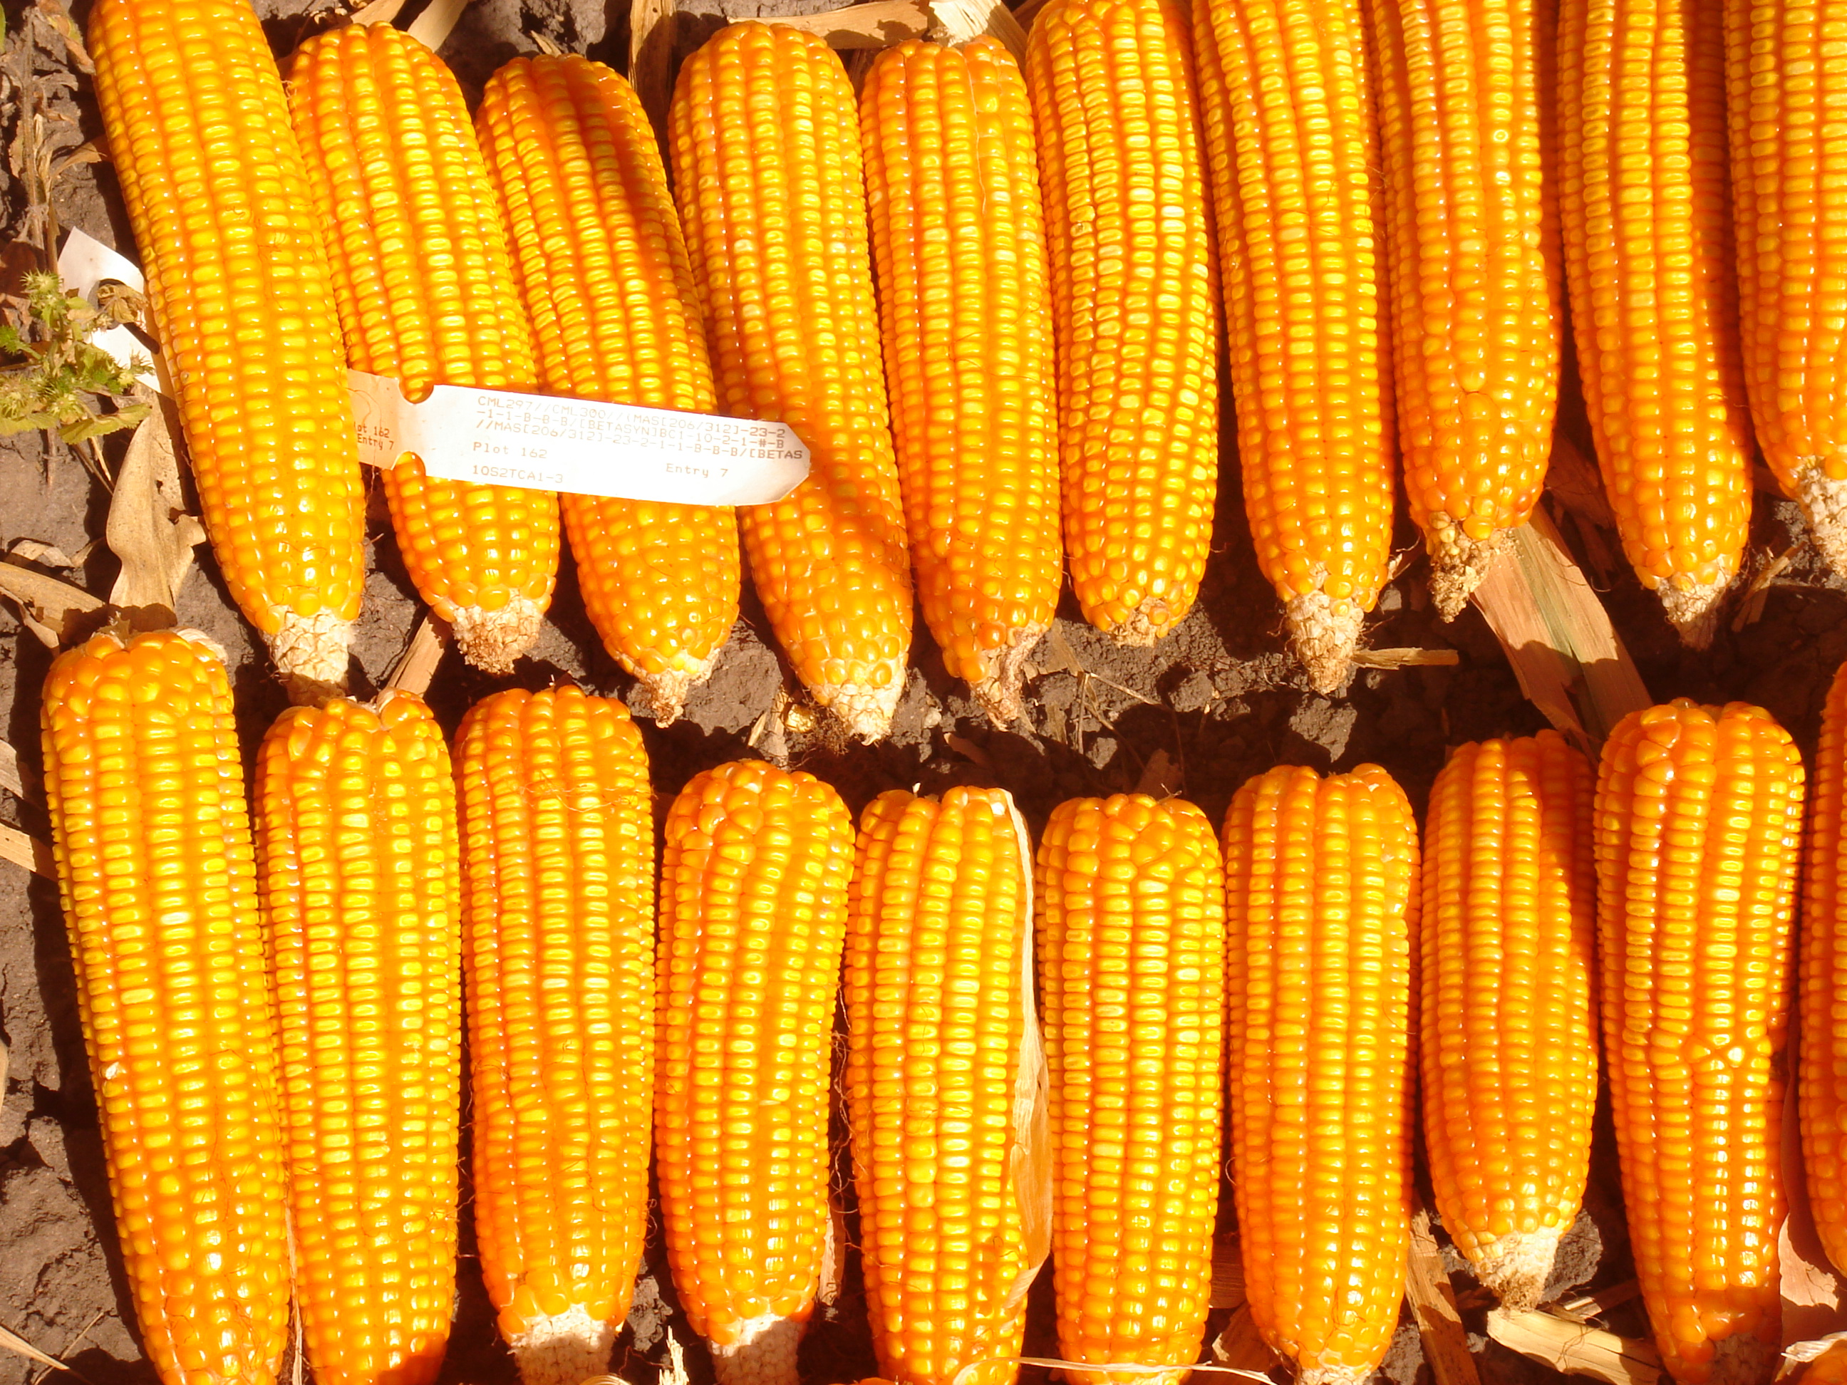
Biofortification
Biofortification means growing foods with more total micronutrient content.
Means of biofortification:
  Developing new strains through breeding
  Using best varieties available

Slide 52
Biofortification Cont.
Advantages
Disadvantages
Builds on staple foods that poor households already enjoy
Reaches rural and urban populations—any area where supplementation or fortification may be difficult
Sustainable approach
Takes time to implement
Public awareness needed

Slide 53
What are the four approaches to tackling micronutrient malnutrition?
What are the advantages of biofortification?
Notes:
Answers
Supplementation, Fortification, Dietary diversification, Biofortification
Builds on staple foods that poor households already enjoy; Reaches rural and urban populations—any area where supplementation or fortification may be difficult; Sustainable approach

Slide 54
Key Points
Micronutrient malnutrition or ‘hidden hunger’ can be managed using a range or combination of different approaches, including:
  Supplementation – taking a capsule or injection containing a sufficient amount of the deficient micronutrient.
  Food fortification – adding an essential micronutrient to commonly consumed processed foods such as cooking oil, sugar, salt, flour.
  Dietary diversification – increase the variety and quantity of micronutrient-rich foods, through social and behaviour change activities, often including the increased production of or access to nutrient-rich foods.
  Biofortification – breeding varieties of a popular staple food crop with high amounts of at least one important micronutrient.
Each of the approaches has advantages and disadvantages.

Slide 55
The Nutritional Value of OFSP
Unit 5

Slide 56
Objectives
By the end of this unit, you should be able to:
List at least five locally available foods that are rich in vitamin A.
Discuss how cooking, drying and storage processes effect beta-carotene levels in OFSP.
Describe the consequences of vitamin A deficiency.

Slide 57
Sources and Importance of Vitamin A
Sources of vitamin A include fruits, vegetables, including sweetpotato. Generally, the more brightly coloured a fruit or vegetable, the more Vitamin A it contains.
Animal sources include fish, meats, egg yolk
Deficiency in vitamin A is among the leading causes of blindness, especially in children.
Increasing vitamin A intake:
  Eat A-rich foods with fats, as fats help absorption
  Chopping and grating can increase bioavailability
  Excess Vitamin A can be stored in the body (liver) and can be released over months

Slide 58
Benefits of OFSP
Orange-fleshed varieties of sweetpotato have been developed to provide much greater amounts of vitamin A than other-coloured varieties of sweetpotato.
OFSP is the recommended source of vitamin A. In most places across SSA, OFSP is also the cheapest source.
OFSP has other nutritional benefits: fibre, moderate glycemic index, iron, zinc, and B vitamins. Sweetpotato leaves contain high levels of vitamins A, B and C, calcium, antioxidants and protein.
OFSP found to cost $US 15-20 per disability adjusted life year saved. Insufficient vitamin A can cause blindness, disability and even death, particularly in women and children.

Slide 59
Preserving Vitamin A in Sweetpotato
Cooking, drying, and storage processes can degrade OFSP vitamin A content to various degrees.
Cooking methods compared:
  Boiling, frying, steaming, roasting saved more than 75% of vitamin A, while baking and microwaving destroyed more beta-carotene
  Boiling whole root with peel on retains the most vitamins
  Boiling small pieces causes great nutrient loss
Drying: In dried chips thickness of slices can increase or decrease vitamin loss.
Storage can result in extremely high loss of vitamin A. This can be mitigated by lowering temperatures and shorter storage periods.

Slide 60
Besides vitamin A, what other nutrients does OFSP contain?
What cooking method retains the most vitamins?
Notes:
Answers
Fibre, iron, zinc, vitamin B. Sweetpotato leaves contain high levels of vitamins A, B and C, calcium, antioxidants and protein.
Boiling whole root with peel on

Slide 61
Key Points
Orange fleshed sweetpotato is a rich source of vitamin A
Other sources of vitamin A include dark orange or green vegetables or fruits, liver, milk, egg yolks, fish.
Vitamin A deficient children are at risk of night blindness, a weakened immune system and body development disorders.
Some nutrients such as beta-carotene can be reduced during cooking, drying or storage processes.
Sweetpotato leaves contain high levels of vitamins A, B and C, calcium, antioxidants and protein.

Slide 62
Nutrition Interventions
Unit 6

Slide 63
Objectives
By the end of this unit, you should be able to:
Explain the difference between nutrition-sensitive and nutrition-specific interventions.
Describe the different but often interrelating ways in which a nutrition-sensitive agricultural intervention may be impacting on nutrition at individual, household and community levels.
Analyse your existing agricultural projects to determine if they could be enhanced to make them more nutrition-sensitive or improved through the addition of nutrition-specific interventions.

Slide 64
Nutrition-Specific Interventions
Directly address causes of undernutrition:
  Dietary intake
  Disease or poor health state
Focus on:
  Increasing intake of specific nutrients
  Adding micronutrient supplements for people whose diets are heavy on starch-only foods
  Treating/preventing diseases that impact nutrient absorption
Examples of nutrition-specific interventions:
  Vitamin A supplementation, oral rehydration to help diarrhea, staple food fortification
  Pro-breastfeeding programs

Slide 65
Nutrition-Sensitive Interventions
Nutrition-sensitive interventions, by contrast, address underlying causes and fix long-term problems.
It is important to provide vitamin A supplements to under-nourished people, but equally important to find out why this became necessary and address root issues.
Examples of nutrition-sensitive interventions:
  Agricultural interventions: Ensuring production of a variety of nutritious, affordable, culturally appropriate and safe foods
  Crop biofortification: scientific and agricultural
  School feeding programmes
  Initiatives to increase gender equity

Slide 66
Agricultural Interventions
Goal: Increase the ability of the agricultural sector to support human health through nutrition.
Pathways to using agriculture system to improve nutrition:
  Increasing food access by increasing smallholder production
  Reducing food prices by increased supply
  Developing and planting higher-nutrient varietals of crops
  Effective natural resource management, especially water
  Empowerment and social status of women
Most OFSP programs are nutrition-sensitive, using the above pathways to increase food access, reduce prices, create and distribute more nutrient dense foods

Slide 67
Influences on Agricultural Pathways
The enabling environment impacts the agricultural pathways to better nutrition:
  Natural resources
  Market environments
  Nutrition education in the population
  Policy and governance
Possible agricultural interventions:
  Biofortification
  Home gardens and homestead food production
  Value chain interventions
  Women’s financial empowerment

Slide 68
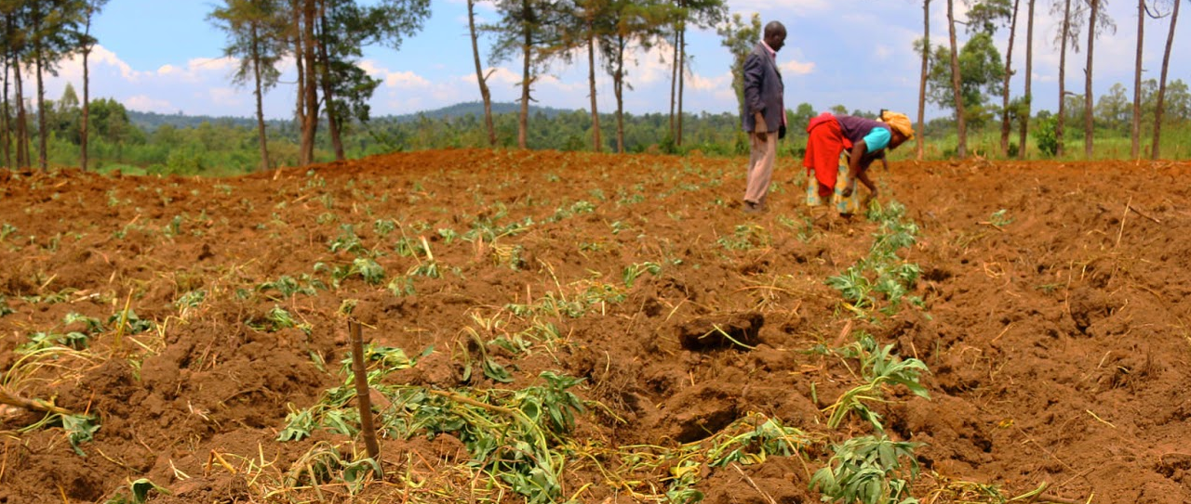
Three areas of impact
A nutrition-sensitive agricultural intervention can impact nutrition at individual, household and community levels.

Slide 69
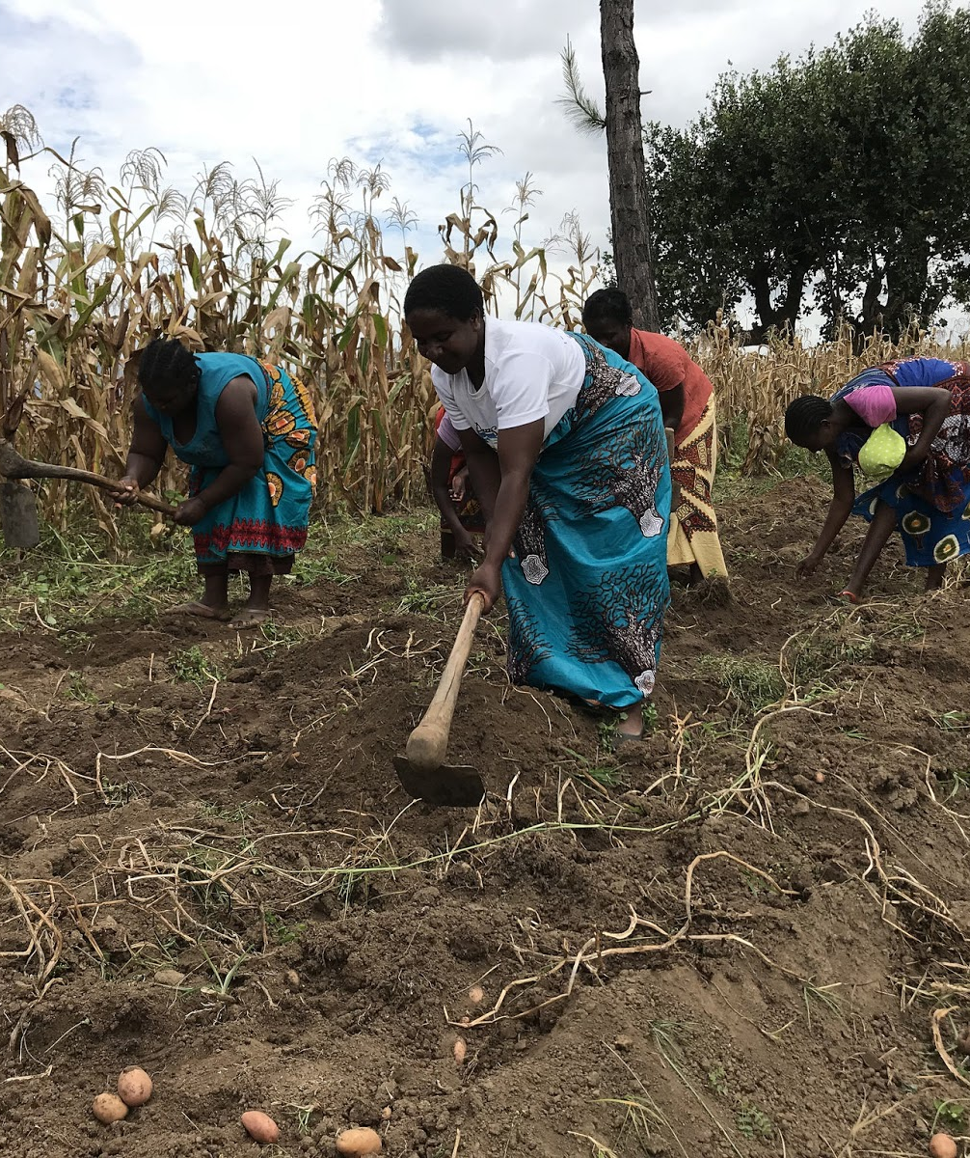
Agricultural Interventions at Individual Level
Improving individual growers’ practices and choice of high-nutrient varietals
Empowerment of individual women
Nutrition improvement for children

Slide 70

Agricultural Interventions at Household Level
Improving access to low-cost high-nutrient foods
Improving maternal nutrition
Better food security including micronutrients

Slide 71

Agricultural Interventions at Community Level
Reducing low birthweight births and other community medical problems resulting from poor nutrition.

Slide 72
What is the difference between nutrition-specific and nutrition-sensitive interventions?
What are some of the ways agricultural interventions can improve nutrition?
Notes:
Answers
Nutrition-specific interventions address direct issues. Nutrition-sensitive address root causes and long-term impact
Increasing food access by increasing smallholder production; Reducing food prices by increased supply; Developing and planting higher-nutrient varietals of crops; Effective natural resource management, especially water; Empowerment and social status of women

Slide 73
Key Points
Amplify agriculture’s contribution to nutrition.
Are deliberately planned to make an impact on nutrition.
Incorporate nutrition objectives and indicators into their design.
Can impact nutrition through many pathways, including: income from crop sales, food access and dietary diversity from self-production or increased income, women’s empowerment and health, natural resource management.
Might include: biofortification, home gardens, value chain interventions.

Slide 74
Behaviour Change for Improved Nutrition and Agriculture
Unit 7

Slide 75
Objectives
By the end of this unit, you should be able to:
Relate details of Alive and Thrive’s infant and young child feeding behaviour change programme.
Summarise key factors for a successful social behavioural change communication message.
Discuss how radio spots, market stall signs, and nutrition training can be used to drive demand creation for nutritional behaviour change in a nutrition-sensitive agricultural project.

Slide 76
Understanding Nutrition Behaviours
To improve nutrition, behaviour must change along with access to nutritious foods
To optimise behaviour, OFSP program facilitators must understand factors behind human behaviour:
  Social norms
  Self-belief
  Nutrition education and information
  Structural inequalities
Social change is key to individual behaviours
Two key approaches to changing behaviours:
  Alive and Thrive
  The positive deviance approach

Slide 77
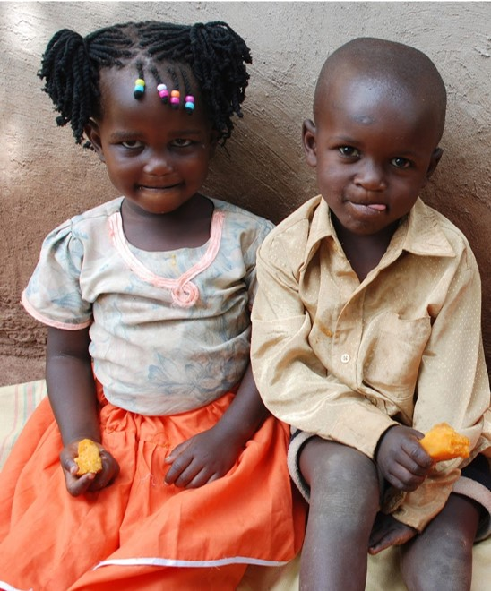
Positive Deviation
An approach that seeks out well-nourished children living in disadvantaged contexts to understand the local growth-promoting behaviours that enable these children to thrive while others are struggling.
Evidence-based approach.

Slide 78
Alive and Thrive Programme
Alive and Thrive began in 2009 to combat global child undernutrition
Evidence and action-based. Combines interventions to support infant and young child feeding and maternal nutrition
Large-scale interventions:
  Interpersonal counselling
  Mass media campaigns
  Community programs
  Policy advocacy

Slide 79
Factors Enabling Alive and Thrive Success
Advocacy: Improving political conditions, removing barriers
Interpersonal communication and community mobilisation
Improved knowledge, skills and environment lead to improved health outcomes
Bringing together communities, media and regulators:
  Engaging journalists
  Getting local, regional and national decision makers and stakeholders onboard
  Individualised meetings with decision makers and donors
  Involving mothers, community members, health providers, frontline workers, and rural community institutions

Slide 80
Key Factors for Successful Messaging
Participatory adult learning (for adults)
Seeing is believing (for children)
Social Behavioural Change Communication (SBCC)
The 7 C’s:
  Command attention
  Clarify the Message
  Communicate a benefit
  Consistency counts
  Create trust
  Cater to the head and heart
  Call to Action

Slide 81
Mass Media Messaging and SBCC
Radio spots, market stall signs, and nutrition training can be used to drive demand creation for nutritional behaviour change in a nutrition-sensitive agricultural project.
For maximum efficacy, use Social Behaviour Change Communication (SBCC) techniques.
Three core SBCC elements:
  Tailored Communication: Using channels and themes which respond to target audience’s needs and preferences
  Behaviour Change
  Social Change
Focus on evidence-based behaviours.

Slide 82
Ensuring Success of SBCC
SBCC uses evidence-based behaviours to inspire change in dietary practices across the community.
SBCC needs to be culturally appropriate and specific, and based on evidence data.
Key steps to ensure success of SBCC are:
  Identify key entry points to community participation
  Segment and Identify target audiences
  Design clear communication objectives
  Develop contextualised and clear messages
  Identify effective channels and pathways for message delivery
  Implement SBCC strategy
  Monitor and follow-up
  Use learning to redesign strategy and messages
  Develop long-term campaigns for sustained behaviour change

Slide 83
What is Positive Deviance?
What are some of the factors that contributed to the success of Alive and Thrive?
What are the 7 C’s of successful messaging?
Notes:
Answers
An approach that seeks out well-nourished children living in disadvantaged contexts to understand the local growth-promoting behaviours that enable these children to thrive while others are struggling.
Advocacy: Improving political conditions, removing barriers; Interpersonal communication and community mobilization; Improved knowledge, skills and environment lead to improved health outcomes; Bringing together communities, media and regulators
Command attention; Clarify the Message; Communicate a benefit; Consistency counts; Create trust; Cater to the head and heart; Call to Action

Slide 84
Key Points
To bring about improved nutrition behaviour it is necessary to understand the causes of ‘non-optimal’ behavior.
Behaviour change will involve the change in knowledge, attitudes and practices of individuals, and social change to create an enabling environment.
Nutrition behaviour change approaches need to strategically collect and use data to inform the design, implementation, monitoring and where necessary redesign of their activities.
Well-designed social behavioural change communication (SBCC) messages are simple, memorable, easily understood, culturally appropriate and meaningful to the key audience.
Demand creation campaigns can raise awareness about the nutritional focus and help enable the desired behavioural changes.

Slide 85
Gender and Diversity Aspects of Nutrition and OFSP
Unit 8

Slide 86
Objectives
By the end of this unit, you should be able to:
Describe at least three reasons why a gender responsive approach is required in any nutritional training or behavioural change work.

Slide 87
Why a gender sensitive approach?
Different people have different nutritional needs, including Vitamin A requirements, based on gender, size, age.
Even workloads change Vitamin A requirements.
Nursing and pregnant mothers have special dietary requirements outside of workload related needs.
It is important to understand local nutritional practices and beliefs and how these can be combined with improved nutritional behaviours and outcomes.
When conducting diagnostic studies, it is important to collect gender-related data that will help design appropriately targeted messages.

Slide 88
Messaging for Women
Use appropriate channels: messages need to reach women.
Examine your messages:
  Are they utilisable by the target audience?
  Are they appropriate to local gender beliefs? Roles?
Monitor and evaluate:
  It is important to continually monitor nutrition activities to make sure they are correctly understood and appropriate to all community members.

Slide 89
Key Points
Nutritional requirements including Vitamin A requirements vary by age, sex and workloads.
It is important to understand local nutritional practices and beliefs and how these can be combined with improved nutritional behaviours and outcomes.
It is important to monitor and evaluate nutrition activities in order to learn whether promotional messages and activities reaching both men and women audiences are being correctly understood, and whether they are utilised by the target audiences for whom they were designed; and if not, what changes are needed in order to improve their effectiveness.

Slide 90
How Well-Balanced Are Our Diets?
In groups of 5 or 6, identify at least two meals that are commonly eaten by the community in your area.
Analyse the adequacy of these meals in terms of the food categories that are needed by the body.
Discuss the challenges of preparing balanced diets in the community, and any solutions you know of.
You have 40 minutes.

Slide 91
Dining from A Vitamin A-Rich Menu
In your groups, come up with two meal plans that contain locally available vitamin A-rich foods (including orange-fleshed sweetpotato).
Write your meal plans on the A4 sheets of paper provided.
You have 20 minutes.

Slide 92
Virtual Porridge Making
In your groups, use the set of 25 ingredient cards provided by your facilitator to develop nutritious and acceptable porridge recipes that a typical household could use to feed children from 6 to 24 months old.
Note: The porridge can only have a maximum of 4 ingredients.

Slide 93
Develop a Gender Responsive Nutrition Behaviour Change Strategy
Read through the short story provided.
Discuss how poverty and gender issues affected the nutrition and health status of Chio, Tuy, the oldest girl, the other children and the baby in the womb. Record your responses on two separate flip charts (one for poverty and the other for gender).
Design a nutrition communication behaviour change program on how they could reach Chio, Tuy and Tuy’s parents with information and knowledge they need to change their nutritional behaviour.

Slide 94
Raising Awareness and Creating Demand for Orange-Fleshed Sweetpotato
In your groups, discuss and prepare a 5-minute presentation on your assigned OFSP community awareness raising techniques.
You have 15 minutes.

