Slide 1
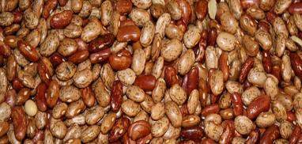
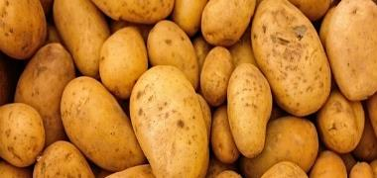
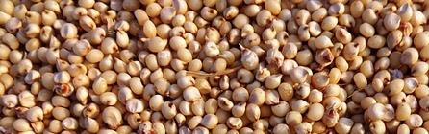




Innovation platforms for agricultural development case studies
- Bubaare Innovation Platform Multipurpose Cooperative Society Ltd -
Notes:
There MUST be a CGIAR logo or a CRP logo. You can copy and paste the logo you need from the final slide of this presentation. Then you can delete that final slide
To replace a photo above, copy and paste this link in your browser: http://www.flickr.com/photos/ilri/sets/72157632057087650/detail/
Find a photo you like and the right size, copy and paste it in the block above.

Slide 2
Can an Innovation Platform succeed as a Cooperative Society?

Slide 3

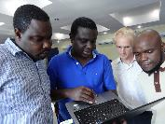

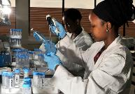

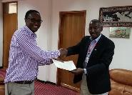


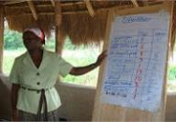
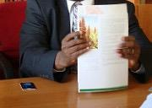

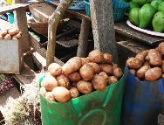
Stakeholders
Development donors
Researchers
Private sector
Innovation Platform
(IP)
NGOs
Policy makers
Farmers

Slide 4
Stakeholders’ Input
Biological, technological, institutional insight.
Support and promote innovations where they have been part of the decision-making or development process.
Understand what type of innovation is economically, socially, culturally and politically appropriate.
Aware of interdependencies and the need of action to address their constraints and reach their goals.

Slide 5
Innovation Platforms
Networks
Agricultural Innovation
Facilitating collaboration
Exchange of knowledge and learning

Slide 6
Networks

Slide 7
Agricultural Innovation

Slide 8
Facilitating collaboration

Slide 9
Exchange of knowledge and learning

Slide 10
IPs’ Main Functions
They contribute to technological and institutional agricultural innovations.
Examples: ICT, machinery, market approaches, mode of organization,
policies and rules.

Slide 11
IPs’ Main Functions
They facilitate collaboration in networks of farmers, extension officers, policy makers, researchers, NGOs, the private sector and other stakeholder groups.

Slide 12
IPs’ Main Functions
They provide opportunities for exchange of knowledge, learning, experience and negotiations.

Slide 13



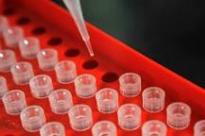




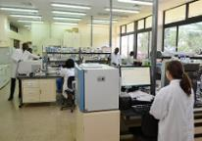
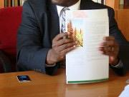
IPs’ Benefits
Stakeholders
Research
Strategies
Development
Policies & laws

Slide 14
IPs’ Benefits
IPs can strengthen the capacity
to innovate among interdependent
groups of stakeholders.

Slide 15
IPs’ Benefits
IPs have potential to perform robust agricultural research, development and policy strategies.

Slide 16
IPs’ Benefits
IPs can function on different levels
ranging from the community or village level to the administrative or spacial levels.

Slide 17
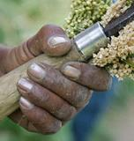

Between 2008-2020
Forum for Agricultural Research in Africa (FARA)
developed, funded and implemented a research program called
Sub Saharan Africa Challenge Programme
(SSA CP).

Slide 18
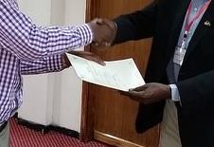
The program used
Integrated Agricultural
Research for Development
Approach (ARDA) -
an innovation-based research
approach involving many
stakeholders and innovative partnerships.

Slide 19



SSPCA formed 12 IPs in the region, 4 in each participating country:
Uganda
Rwanda
Republic of Kongo

Slide 20
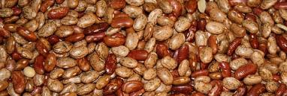
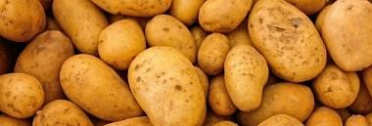
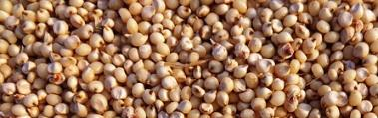
The IPs formed around
the following value chains selected by stakeholders:
sorghum
potatoes
beans

Slide 21

Bubaare IP was one of the IPs formed in southwest Uganda in the Lake Kivu Pilot Learning Site.

Slide 22
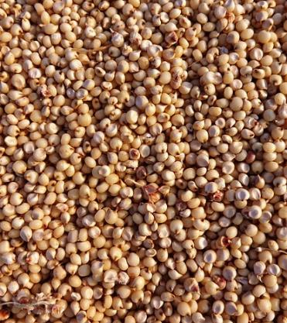
They decided to focus
on sorghum as the enterprise because every household in Bubaare grows a traditional sorghum variety.

Slide 23
Why Sorghum?
used for generations to produce porridge and weaning food for babies
traditionally and culturally important crop

Slide 24
Sorghum Challenges
Long and tedious production process making it unprofitable.
Bring low yields.
Locally processed products last only three days.

Slide 25
Strategy
Increase production
Increase value addition
Creation of
market linkages
Improved processing

Slide 26
Why did Bubaare succeed as an IP?

Slide 27
The key to their success
is the way they
approached their challenges.

Slide 28
Challenge 1
Low quality & quantity of sorghum

Slide 29

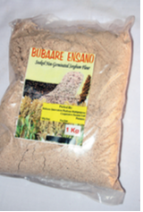
Challenge 1: Result
Improved agronomic practices
e.g. correct plant spacing, use of fertilizers
The Kabale Zonal Agricultural research developed varieties of sorghum that mature in shorter time and have higher yields.
With a help from the Department of Food Science and Technology at Makerere University, the IP members/farmers produce two types of sorghum flour - unmalted sorghum for food and malted sorghum for porridge.

Slide 30
Challenge 2
Existing byelaws poorly implemented & inadequately enforced
Lack of review procedures

Slide 31
Challenge 2: Result
IP members mobilized their respective parishes and villages to begin the process of reviewing and formulating the byelaws.
The byelaws were finally approved and implemented in several parishes and used to protect gardens and guide marketing procedures.

Slide 32
Challenge 3
Mamera: sorghum-based
non-alcoholic beverage:
Short shelf-life
Unattractive packaging of Mamera

Slide 33

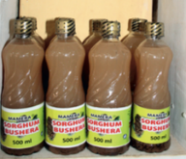

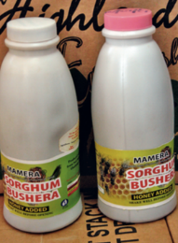
Challenge 3: Result
The IP negotiated with one of the IP stakeholders, Huntex Ltd - a food processing company, to process and pack sorghum produced by the member farmers into a non-alcoholic beverage - Mamera.
The Mamera drink has now two varieties: sweetened with honey and unsweetened, and its new packaging makes it both attractive and hygienic. It has a shelf life of six months.

Slide 34
Challenge 4
Launching other
value chains:
Honey & Irish potato

Slide 35


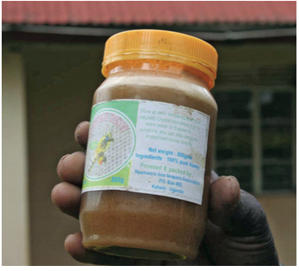
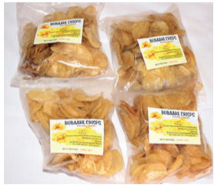
Challenge 4: Result
The IP members also purchased equipment to pack honey and produce and pack potato crisps.

Slide 36
Challenge 5
Lack of effective tools to perform wider market research

Slide 37


Challenge 5: Result
The IP purchased a computer which helps them research the market more effectively.

Slide 38
Challenge 6
Limited awareness of savings mobilization and a credit

Slide 39
Challenge 6: Result
The IP members have been introduced into savings mobilization and a credit by a partner institution - Agriculture Innovation Systems Brokerage Association.
The IP savings are kept with financial institutions such as Crane Bank, Muchahi Savings and Credit Cooperative.

Slide 40
Bubaare IP Success Factors
Improved farming practices
Byelaws formulation
Sorghum-based beverage Mamera - product improvements
Successful launch of other value chains - honey and Irish potato
New market research tool
Introduction to savings mobilization and a credit

Slide 41
What kind of local and state level favourable conditions would you expect for your IP to thrive
and be successful?

Slide 42
Bubaare IP Achievements - Summary
Political stability in the country
Adequate support from the local government
Venue for the IP meetings
Suitable stakeholders to address the community challenges
Various institutions contributing to the above developments

Slide 43
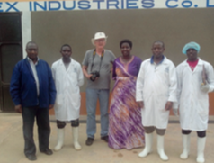
The Bubaare IP was initially registered as an association, which allowed the members to operate within the district, get into ventures and interactions.

Slide 44



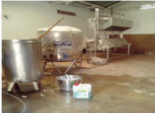


IP receives a grant from development partners to expand the production and processing of sorghum:
$30.000 USD
IP loans the funds to Huntex Ltd.
Huntex Ltd. expands premises and purchases equipment to process and package Mamera.

Slide 45
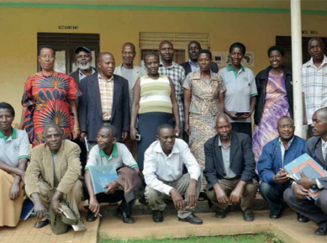
At this point the Bubaare IP needed to be formally registered.
This would allow them to sue and to be sued in courts of law in case of a breach of contract by the IP or Huntex Ltd.

Slide 46
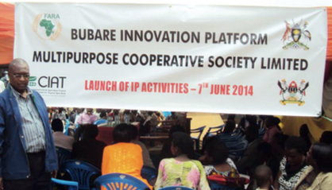
The IP was finally registered as Bubaare Innovation Platform Multipurpose Cooperative Society in 2013.
The process of registration was initiated by the District Commercial Office.
The Bubaare IP became the first among the 36 IAR4D-driven IPs in Sub Saharan Africa to register as a cooperative society.

Slide 47
Registration Outcomes
Infraestructural development

Slide 48

Infraestructural Development
The registration of the IP cooperative society has given Bubaare a new status.
The sub-country authority donated a piece of land for future developments and let the Bubaare IP use a store for bulking and storing sorghum
Construction of a new building to house an office, a community bank, a potato processing unit, sorghum milling, packaging facility and a computer room
The premises at Huntex Ltd. have been expanded, more equipment purchased to process larger quantities of sorghum having the capacity to produce 2,000 litres of Mamera from 250 kg of sorghum per day. The previous capacity was 50 litres from 13 kg per day.

Slide 49
Registration Outcomes
Self Help groups and membership

Slide 50

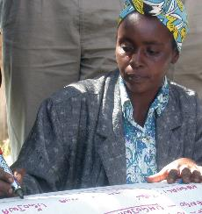
Formation of SHGs
More Self Help Groups formed and joining the IP to take advantage of the benefits.
Total membership has risen from 32 in 2009 to 1121 in 2014.
New plans provided incentives for more farmers to join. The plans included signing a contract with Huntex Ltd to purchase more of the farmers’ sorghum, hence ensuring the market for it. As a result more farmers have joined since then.
More women farmers joined the IP than men farmers. The number of women farmers doubled with more of them taking leadership positions.

Slide 51
Registration Outcomes
Affordable loans

Slide 52


Affordable loans
The society was able to internally generate funds from its members to create a start-up capital for loaning to the groups.
Individuals or an entire group may borrow funds to grow crops, or store sorghum which is later sold when the market price is favourable or for other enterprises.
Affordable loans have opened up more market activities among the IP member groups and individuals.

Slide 53
Affordable loans
Loans are available to a wide range of socio-economic groups of farmers, who can use the loans for a variety of enterprises and to market their products outside the cooperative.
As a result, women and poorer farmers can join a cooperative society and receive a loan.

Slide 54
Registration outcomes
Supply of Sorghum

Slide 55

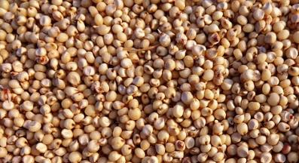
Supply of Sorghum
The supply of sorghum grain to Huntex Ltd has improved.
Since signing the contract both the society and the Huntex Ltd have been able to meet their obligations.

Slide 56
Registration outcomes
Training

Slide 57

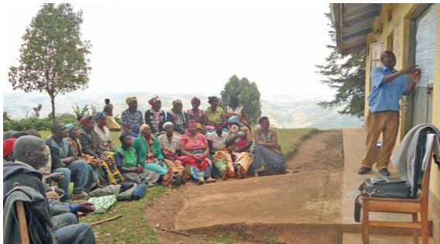
Supply of Sorghum
The registration has increased the demand for training in savings, lending, marketing and processing.

Slide 58

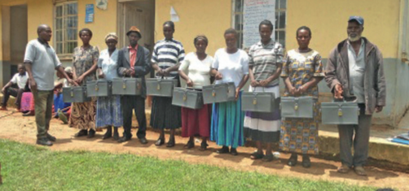
Supply of Sorghum
KDLG in partnership with Makarere University contracted Durosh Empowerment Consult Ltd to train the Self Help Groups. Altogether 32 Groups were trained by the end of 2014 and were given a free savings kit each.
Women members were entrusted with the responsibility of counting the group’s savings every time the group meets to collect their savings.

Slide 59
Registration outcomes
Product quality

Slide 60

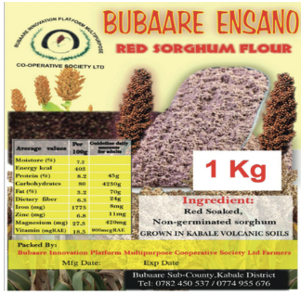
Improved product quality
The Bubaare IP cooperative society has linked with the Uganda National Bureau of Standards to obtain the S&Q marks for quality certification.
The Department of Food Science and Technology at Makerere University has analysed the nutrient content of sorghum and produced a label for the sorghum flour packets. Standard certification procedures enable access to affluent but previously inaccessible markets in Kampala, a city eight hours away from Kabale.

Slide 61
Improved product quality
The Department of Food Science and Technology at Makerere University has trained IP members to process high quality flour, and introduced the use of new equipment such as food weighing machines, sealers and food grade bags.
The society is pursuing the patenting of Mamera.
The new status of the IP enables it to pursue the development of other value chains, which has already gained interest of organizations such as National Organic Agriculture Movement in Uganda.

Slide 62
Registration outcomes
Which of the presented outcomes would you like most for your IP?

Slide 63
Challenges
Regulations
Sustainable Motivation
Expansion

Slide 64
1. How would you make sure the IP leaders and partners internalize regulations of the new society to assist members to operate within these regulations?
2. How would you make sure membership is sustainably motivated?
3. What measures would you take to make sure the society continues to expand?

Slide 65
How could you use the Bubaare IP experience to benefit your own IP?
Business entity
Development partner
Public institution

Slide 66
New model of
cooperative society

Slide 67
New model of cooperative society
An IP cooperative society creates wider impact in the community with less transaction and monitoring costs than a conventional primary society.

Slide 68
New model of cooperative society
The IP is comprised of Self Help Groups as members.
Each group has 20-30 individuals who due to a lack of relevant society in the area or a lack of resources to buy shares to join a conventional society would not have been able to join any.
Thanks to the new IP cooperative society model it is now possible.

Slide 69
New model of cooperative society
Group members monitor each other’s recovery of the acquired loan, which in turn reduces the cost of monitoring.

Slide 70
New model of cooperative society
Individual members of SHG each produce commodities of their choice at the scale they can manage.
This enables the IP society to produce variety of products from a very large number of small farmers.
These farmers would not have been targeted by a conventional society.

Slide 71
New model of cooperative society
The IP society is part of a wider IP of which partners and private sectors are stakeholders but not necessarily members of the cooperative society.
This enables long term support from partners such as research institutions, private sector or farmers.
The IP remains open to wide membership while it still owns its cooperative society.

Slide 72
Thank you,
and good luck with your IP work!
The Uganda flag image (Slide 20) courtesy of taesmileland at www.freedigitialphotos.net

