Slide 1









“Building a better seed future, together”
Tools4SeedSystems
GRADUATION CEREMONY
FIRST TRAINING ON THE TOOLBOX FOR WORKING WITH ROOT, TUBER AND BANANA SEED SYSTEMS
July to October 2021

Slide 2
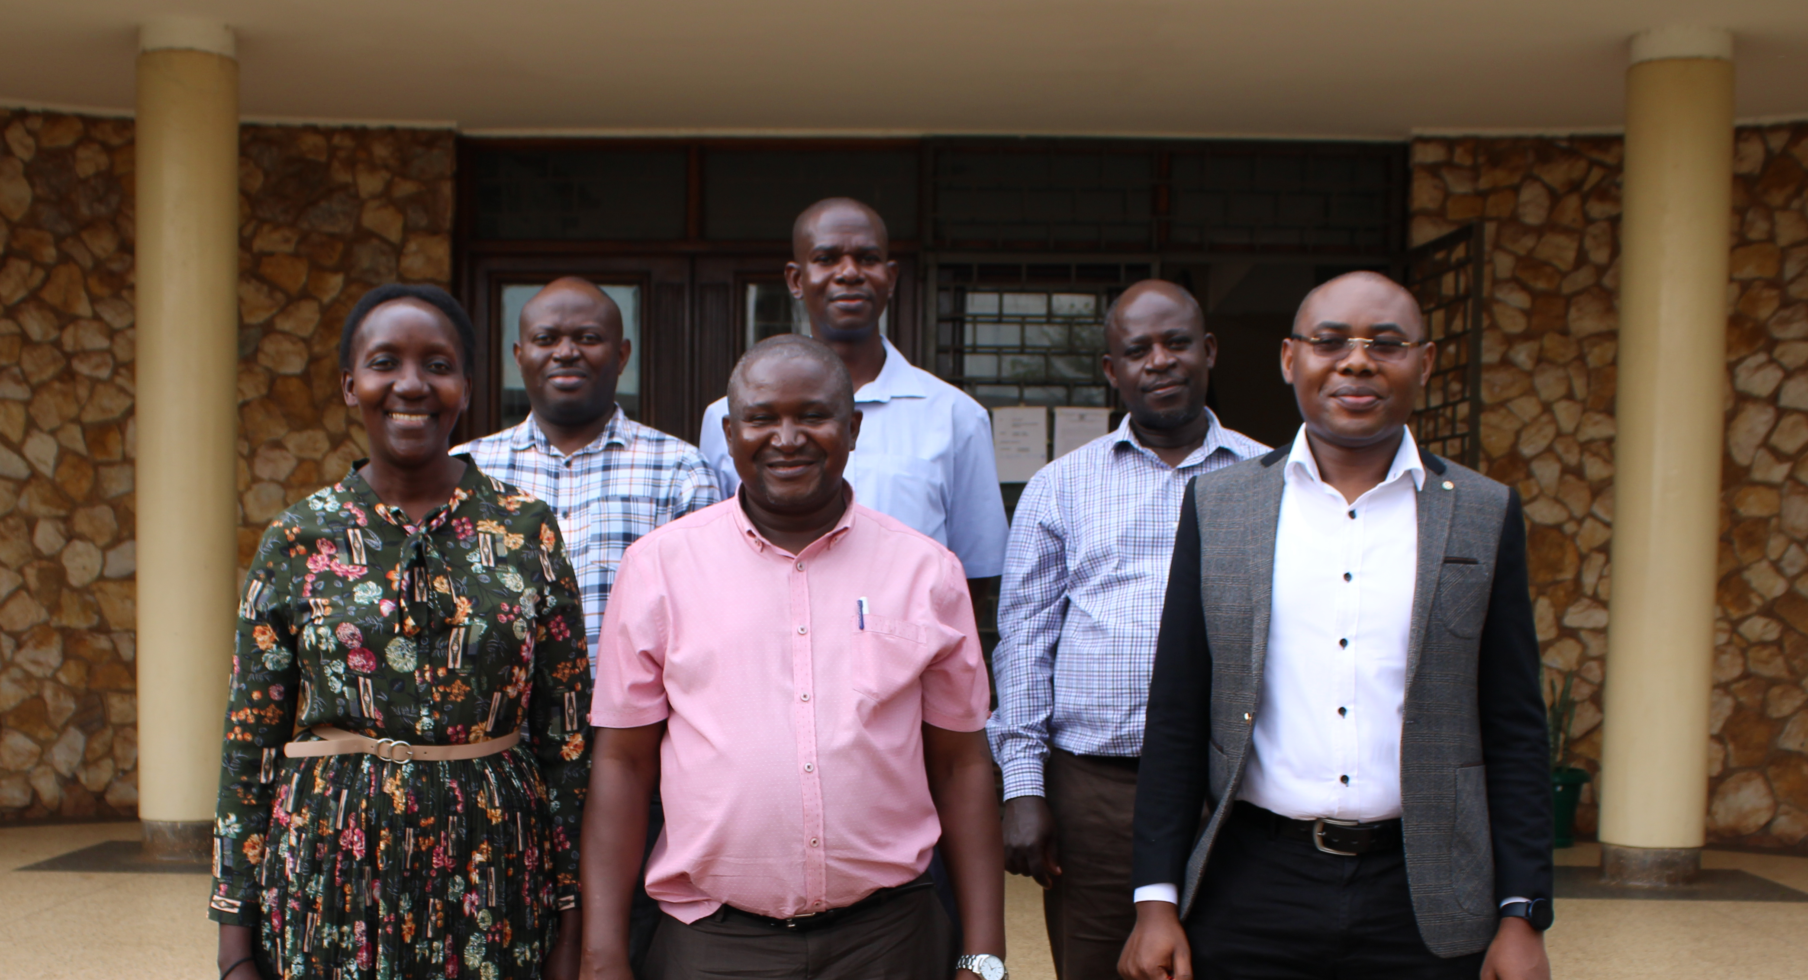
TEAM UGANDA
Lucy Mulugo, Basil Mugonola, Emmanuel Ngolobe, Evans Nakhokho, Samuel Kalimunjaye, Enoch Mutebi Kikulwe

Slide 3





CONGRATULATIONS TEAM UGANDA!

Slide 4
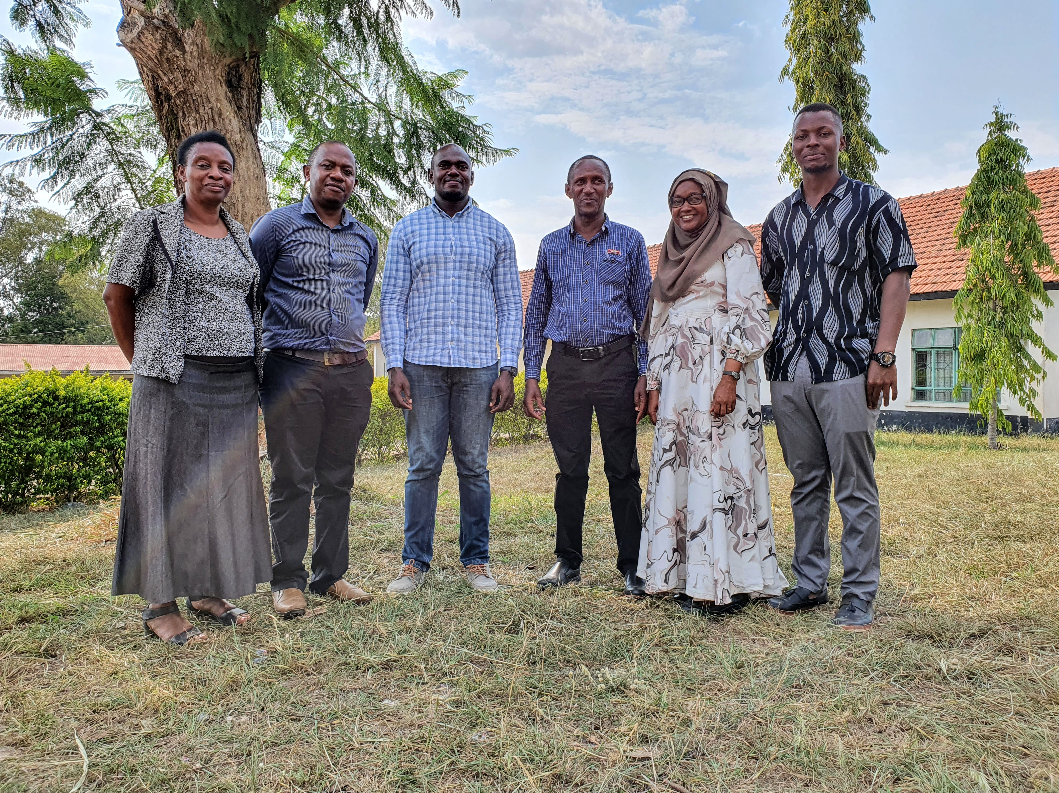
TEAM TANZANIA
Kwame Ogero, Deusdedit Mlay, James Nkwabi, Hadija Ally, Francisca Gwandu, Erick Chang’a, Robert Ngomuo, Adventina Babu and E. Delaquis

Slide 5








CONGRATULATIONS TEAM TANZANIA

Slide 6
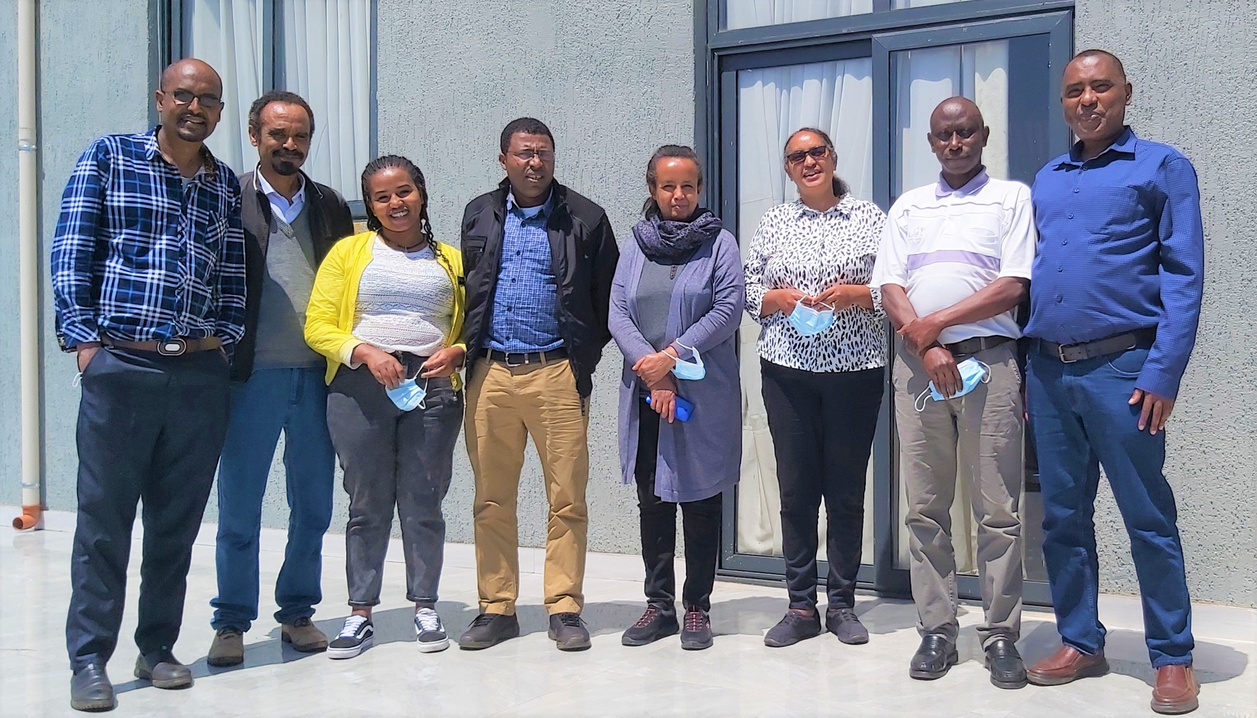
TEAM ETHIOPIA
Haileab Atsbeha Kassaye, Wudineh Getahun, Alem Jambo, Abebe Chindi Lemlem T/M Gebregiorgis Atsede Solomon Rogers Kakuhenzire Setegn Gebeyehu Mohammed Abinassa (not in photo)

Slide 7







CONGRATULATIONS TEAM ETHIOPIA

Slide 8
“Building a better seed future, together”
Tools4SeedSystems
TEAM AWARDS
For the MOST ORIGINAL presentation
For the MOST SCIENTIFICALLY RELEVANT presentation
For the most GENDER RELEVANT contribution to the use of the Tools4SeedSystems.org Toolbox

Slide 9

“Building a better seed future, together”
Tools4SeedSystems
FOR THE MOST ORIGINAL CONTRIBUTION
THE WINNERS: TEAM Ethiopia!

Slide 10

“Building a better seed future, together”
Tools4SeedSystems
FOR THE MOST SCIENTIFICALLY RELEVANT PRESENTATION
THE WINNERS: TEAM Tanzania!

Slide 11

“Building a better seed future, together”
Tools4SeedSystems
For the most GENDER relevant contribution to the use, usefulness and effectiveness of the Tools4SeedSystems.org Toolbox
THE WINNERS: TEAM Uganda!

Slide 12
“Building a better seed future, together”
Tools4SeedSystems
CONGRATULATIONS TO ALL THE TEAMS & PARTICIPANTS & WE LOOK FORWARD TO THE CONTINUED USE & USEFULNESS OF THE Tools4seedsystems toolbox for partners, seed producers, & seed users in the one cgiar and beyond

