Slide 1

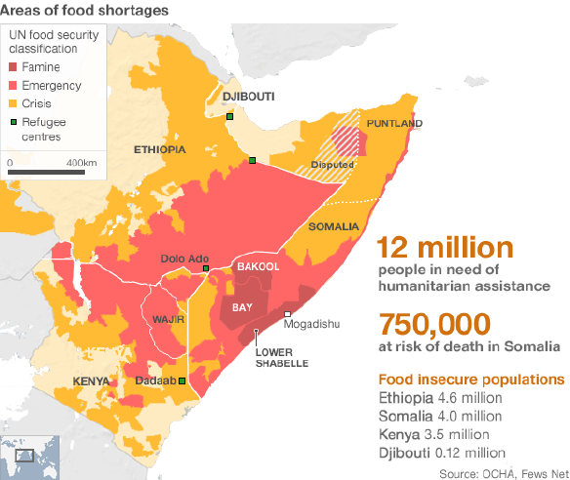
The context for Anticipatory Action in East Africa
Better lives through livestock
Polly Ericksen, Program Leader
Sustainable Livestock Systems
Resilience Hub, COP 26
3 November 2021

Slide 2
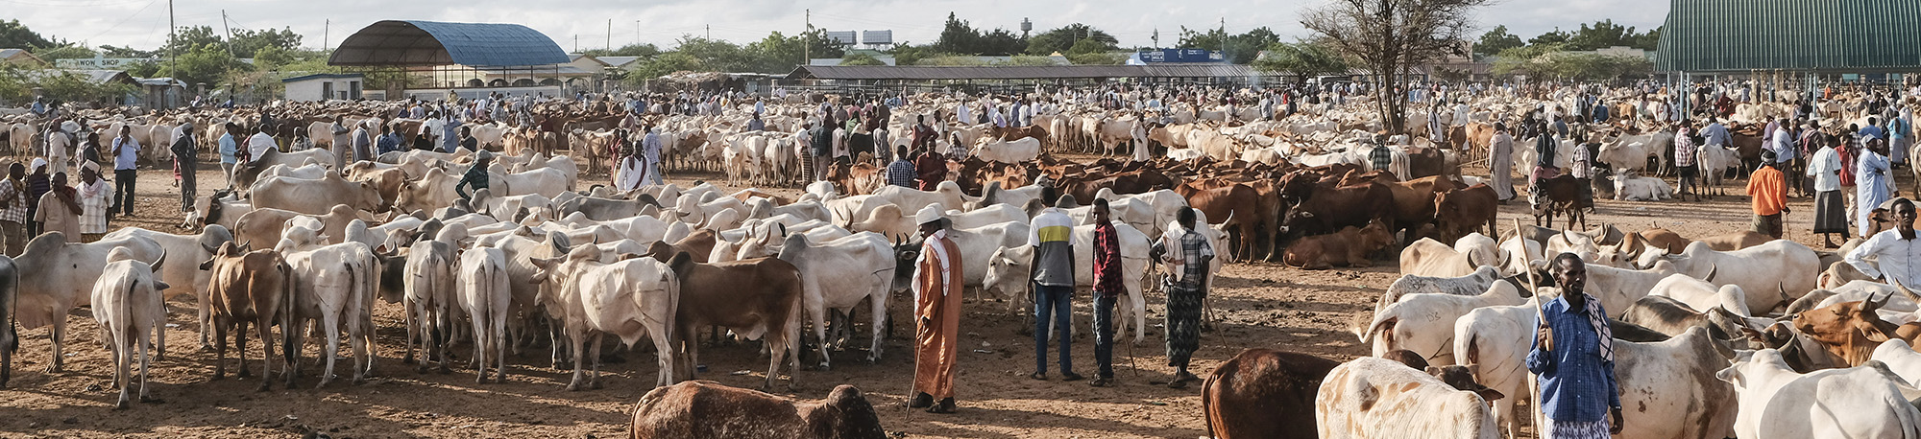
Pastoralists: economic benefits with high risk
Up to 1/5 of IGAD population are (agro) pastoralists
Produce from 30 to 80% of agricultural GDP
Pastoralists belong to poorest segment of IGAD populations
Low resilience and high exposure to droughts = poverty trap
Conflict and climate risk exacerbate each other

Slide 3

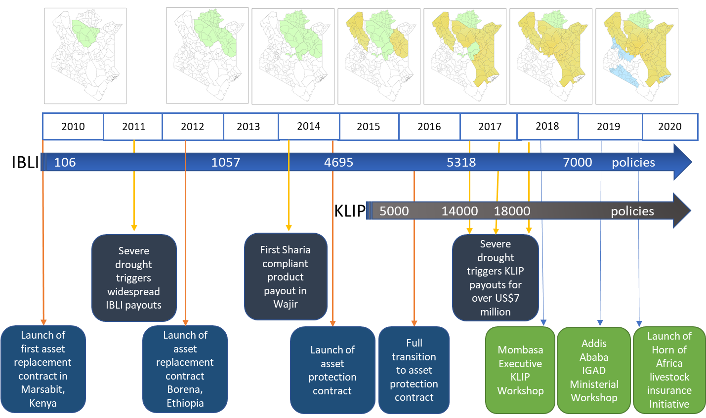
Index-based insurance protects livelihoods
Notes:
Developed after a decade of empirical research to understand how recurrent climate risk affected pastoralist livestock assets

Slide 4
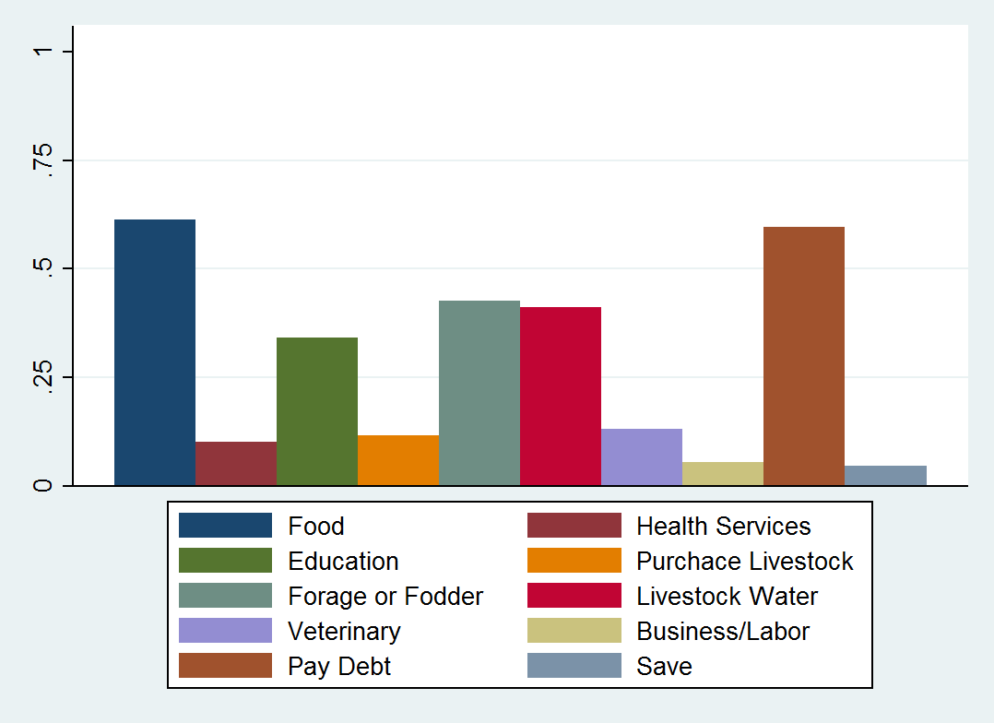
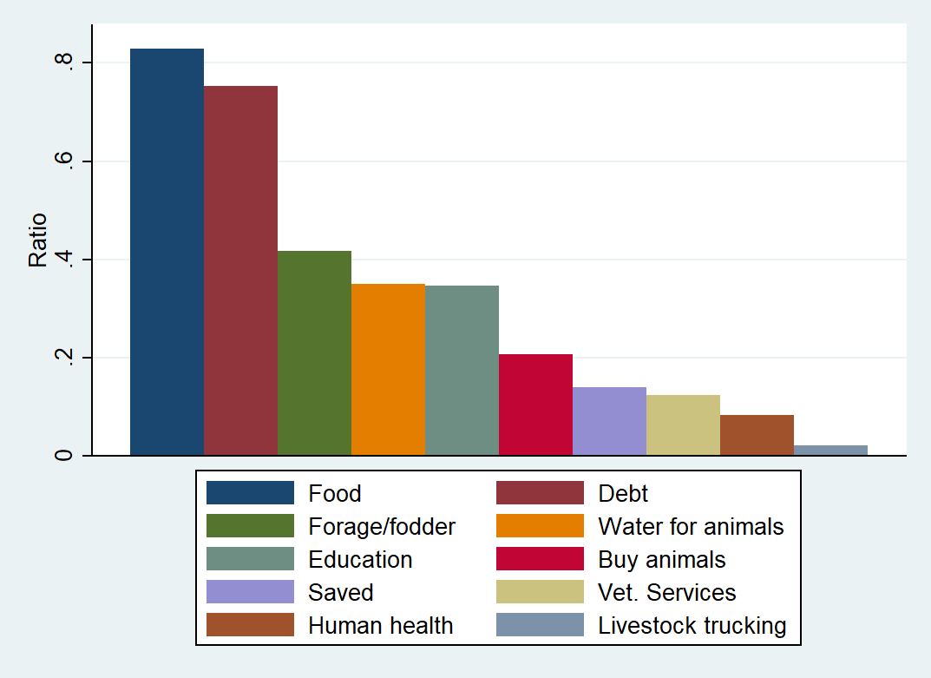
Does IBLI have benefits?
Is there anything that you spent money on because of the KLIP payment that you could not have done so without the payment?
SRSD Drought 2016
LRLD Drought 2017
Taye et al., 2019
Notes:
In order to go to scale need to link well-designed micro products with macro level support.
Also need many more opportunities to crowd in investments with markets, more information about risk, inputs; improved financial information and targeting, etc…
Need more evidence to convince governments and investors.

Slide 5
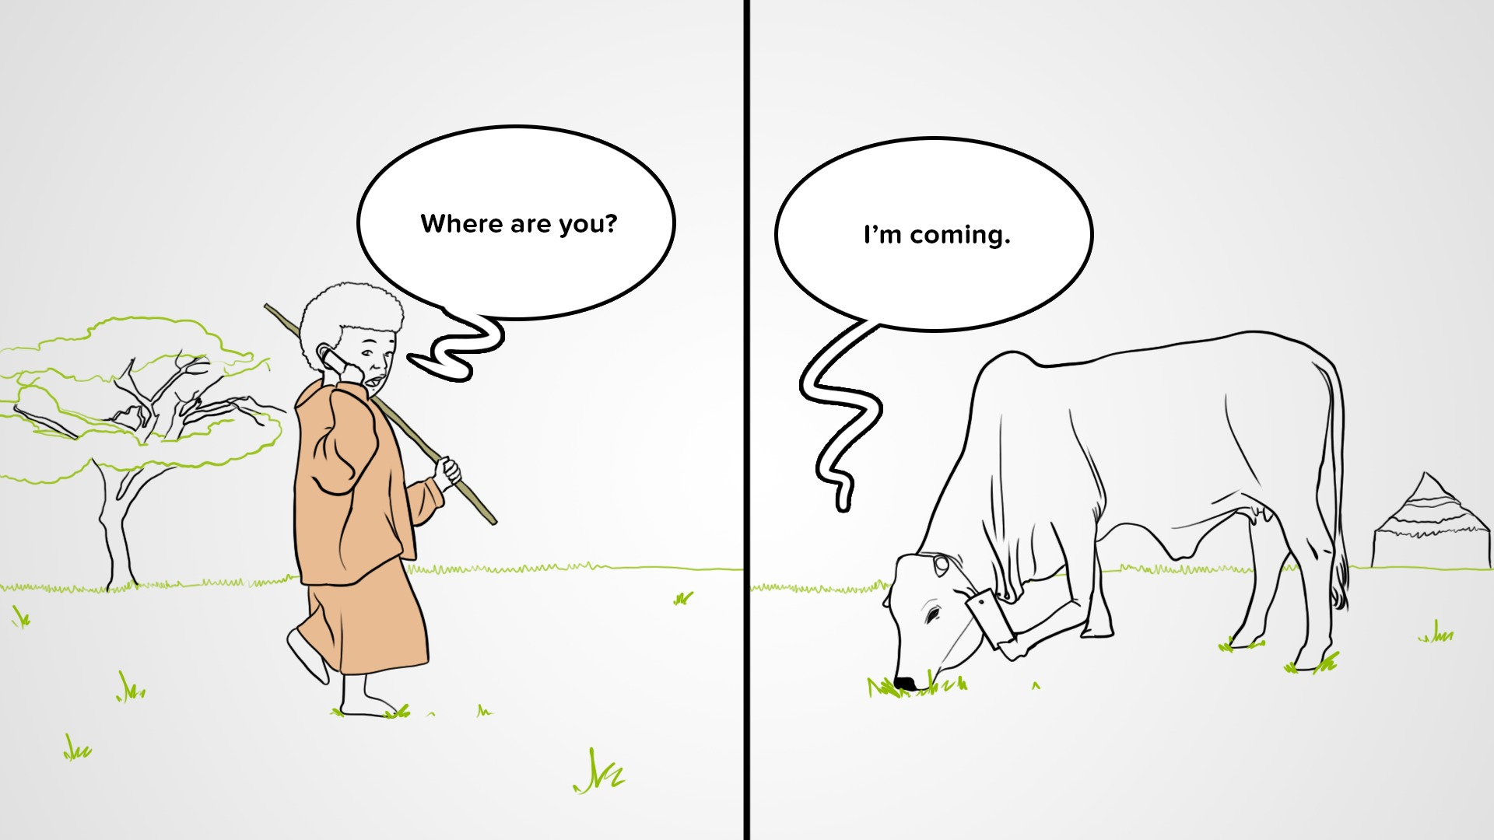
THANK YOU

