Slide 1
WE4.2: Pastoralists and Power: The Impact of a Food Security Program on Women’s Agency in Northern Tanzania
Brooke Krause, College of Wooster
Aine McCarthy, Lewis & Clark College
Cultivating Equality Conference, October 12-15, 2021

Slide 2
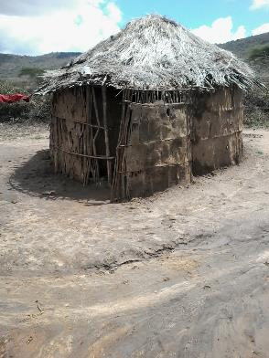
What is the impact of a women’s empowerment and food security program on agency (as measured using the Pro-WEAI) in an extremely patriarchal society?
Pastoralists
Polygamous
Low levels of education
High fertility
Poor
Few Swahili speakers
Notes:
These communities are poor even by Tanzanian standards. 99% of the households in the sample have earth floors.
Only half the sample speaks Swahili – the national language and the language of public schools
Standard 7 is primary school

Slide 3
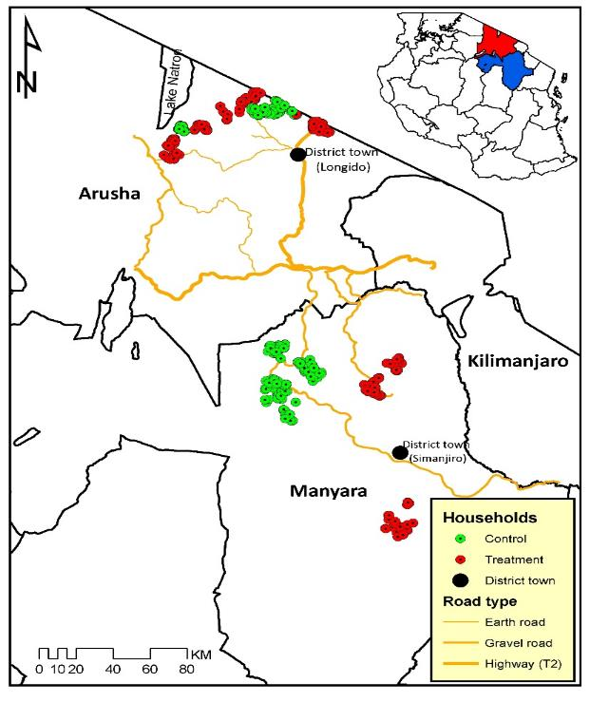
Longido & Simanjiro Districts Northern Tanzania
Notes:
We need an introduction and lit review slide before the map.

Slide 4
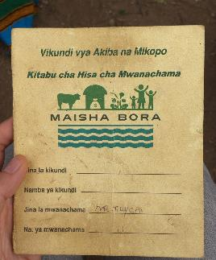
Maisha Bora Program
Access to Credit and Training (Trias)
Women's microfinance groups (Village Community Banks)
Entrepreneurship and business trainings
Supply chain support, such as tannery and livestock fattening
Nutrition (World Food Programme)
Nutrition and sanitation education
School-level vegetable gardens
Livestock (Vétérinaires Sans Frontières)
Vaccination and livestock health education
Notes:
There definitely was some selection into the VICOBA

Slide 5
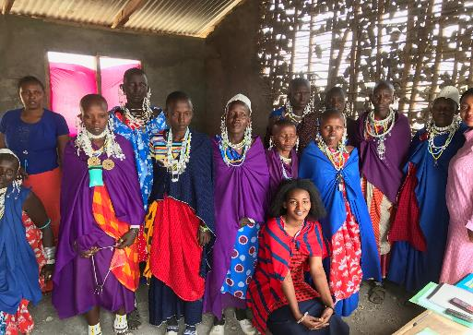
Maisha Bora Program
Women’s Rights (Ujamaa Community Resource Trust)
Intimate partner violence
Legal rights (land and livestock ownership)
Water (Iles de Paix)
Water management
committees
(50% women, who can
read/write)
Constructing/rehab
water access, water
management
Notes:
implementation was not universal. Some planned programming did not happen in treatment villages. So it will be important to examine the local average treatment effect.
EG Water access: This happened in 6/7 Simanjiro villages and 7/8 Longido villages

Slide 6
Theory of Change
Focus on creating the settings that can create access to the sources of empowerment (Kishor and Lekha, 2008)
Access to credit and markets
Information
Increasing knowledge about livestock, agriculture, sanitation, and nutrition, human rights
Business and entrepreneurial training
Social capital
Through participation in groups and building social networks
Understanding rights and learning to communicate
Alleviating time constraints
Spend less time fetching water
Notes:
So the program focused on creating the settings to create access to empowerment

Slide 7
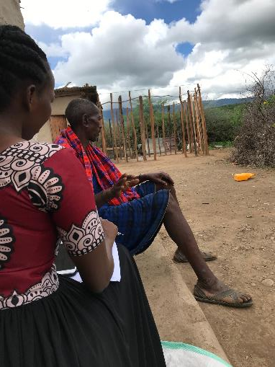
Data Collection
Baseline data collected in 2016
Endline data collected in 2019/20
14 villages (7 treated)
1,072 Endline individuals
367 Men / 705 Women

Slide 8
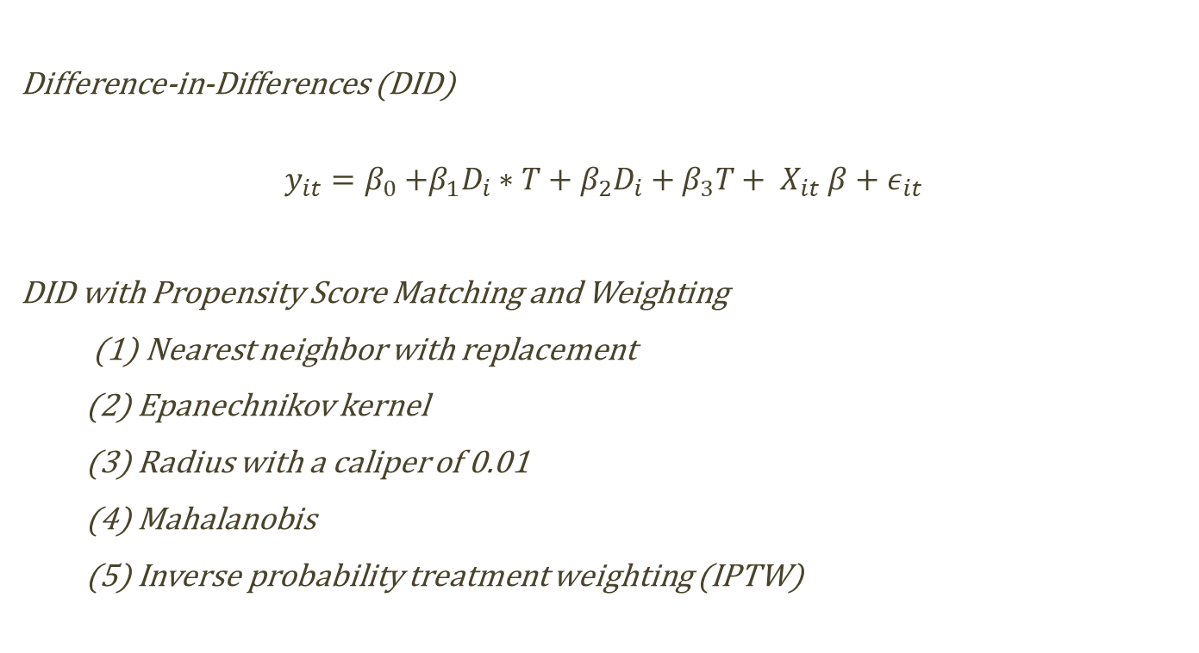
Empirical Strategy
Difference-in-Differences (DID)
$$y_{it}=β_{0}{+β_{1}D_{i}∗T+β_{2}D_{i}+β_{3}T+ X}_{it}β+ε_{it}$$
DID with Propensity Score Matching and Weighting
(1) Nearest neighbor with replacement
(2) Epanechnikov kernel
(3) Radius with a caliper of 0.01
(4) Mahalanobis
(5) Inverse probability treatment weighting (IPTW)

Slide 9
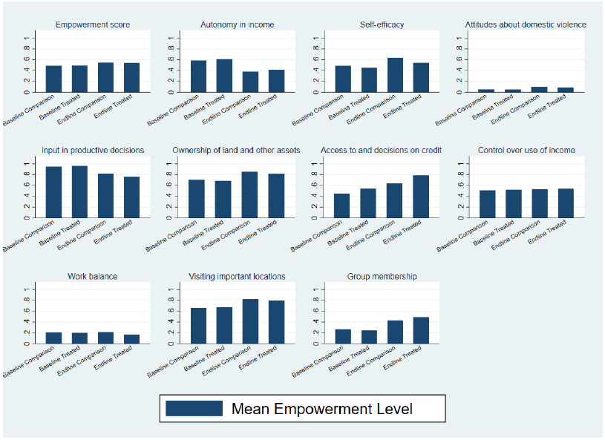

Slide 10
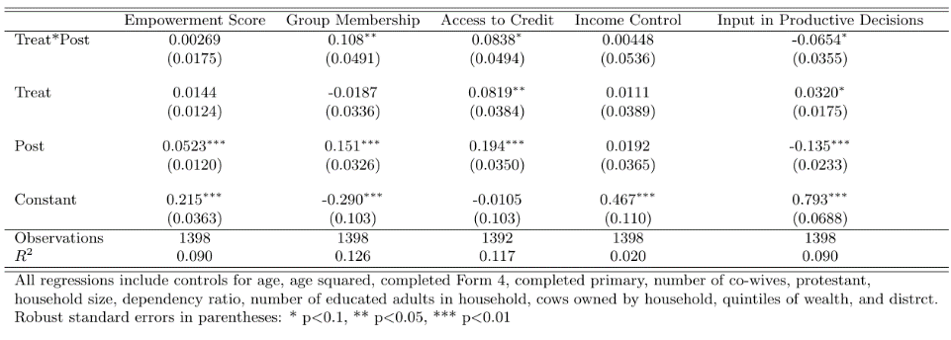
Impact Evaluation: Unweighted DID
Increases in group membership and access to credit
Decline in input into productive decisions

Slide 11
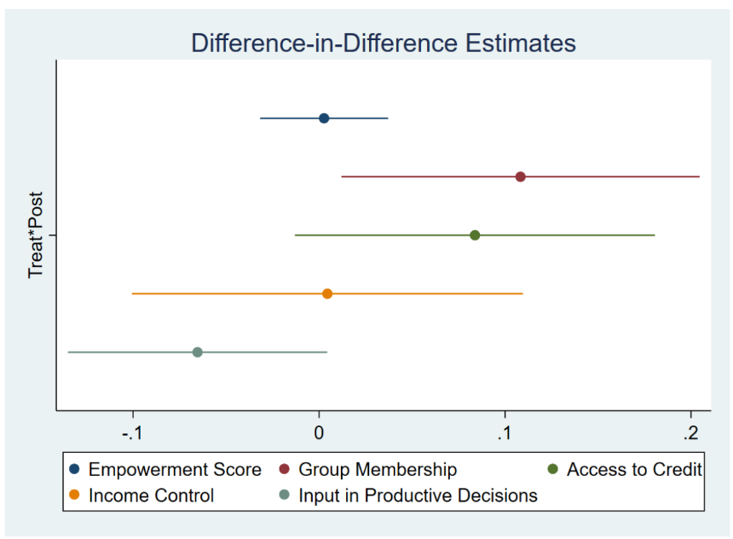

Slide 12
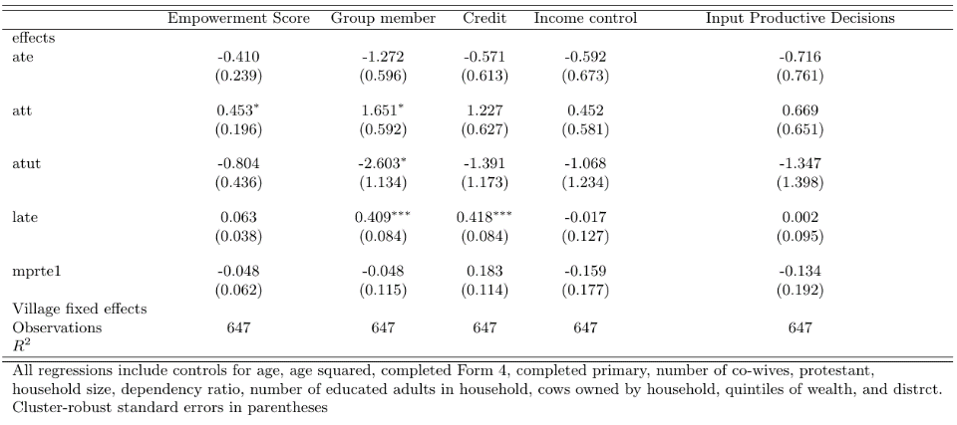
Marginal Treatment Effects with FE

Slide 13
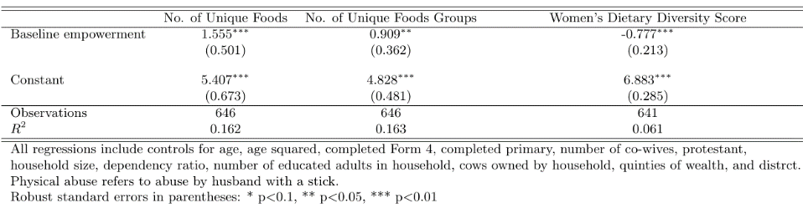
Food Security Cross-Sectional Correlations
Empowered women have households with greater dietary diversity, but they have less diverse diets themselves

Slide 14
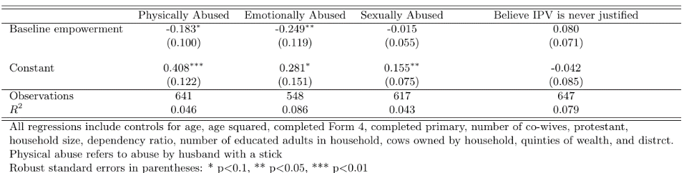
Intimate Partner Violence Cross-Sectional Correlations
Empowered women experience less abuse

Slide 15
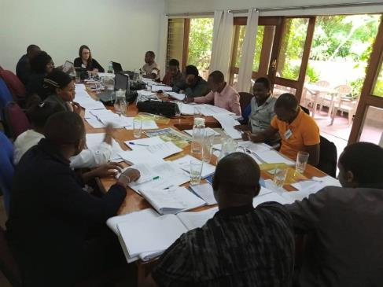
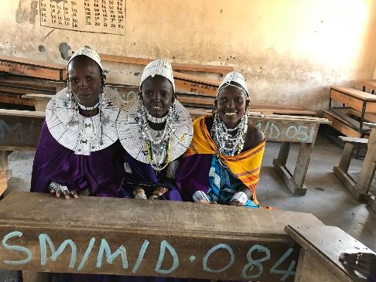
Conclusion
Small positive effect on group membership and access to credit, using unweighted DID and LATE
Effect disappears using matching methods (so may be due to selection)
No effect on overall measurement of empowerment
Program implementation is extremely important
Brooke Krause: bkrause@wooster.edu
Aine McCarthy: mccarthy@lclark.edu

Slide 16
Background
Women’s empowerment is good for food insecurity, health and education (Malapit et al., 2015; Quisumbing and Maluccio, 2003); Smith Ruel and Ndiaye, 2005)
Also an end in and of itself (Sustainable Development Goals)
Creative new ways to measure women’s empowerment (Jayachandran et al., 2021; Alkire et al., 2013)
Livestock-Enhanced Project Women’s Empowerment in Agriculture Index (Pro-WEAI) is very useful for rural areas (Malapit et al., 2015)
In addition to the challenge of measurement, women’s empowerment is a tricky outcome to change
Mixed evidence so far (Brody et al., 2017; Bandiera et al., 2020; Gram et al., 2019)
Maasai are both difficult to reach (measure) and have cultural norms that institutionalize gender inequality (Goldman and Little, 2015)

Slide 17
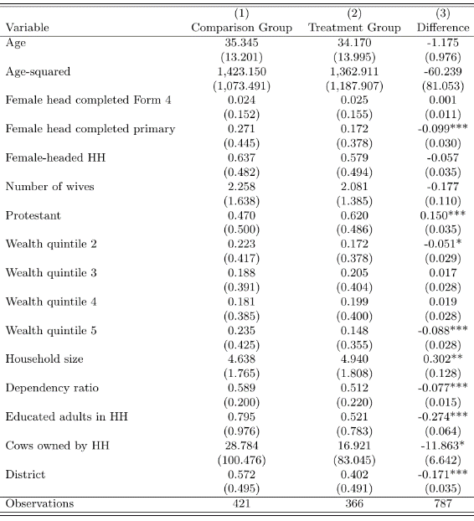
Unmatched Descriptive Statistics
Notes:
You can see that the treatment and comparison groups are pretty different in terms of education, religion, wealth and demographics. So, matching is really a good idea here. All of these statistical differences go away when we match

Slide 18
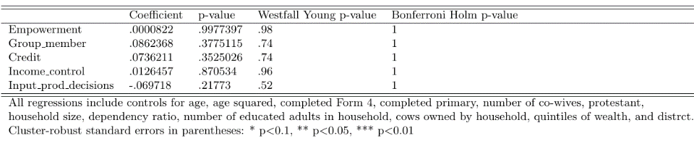
Impact Evaluation: Unweighted DID with Adjustments for Related Hypotheses
No effect of the program after adjusting for related outcomes

Slide 19
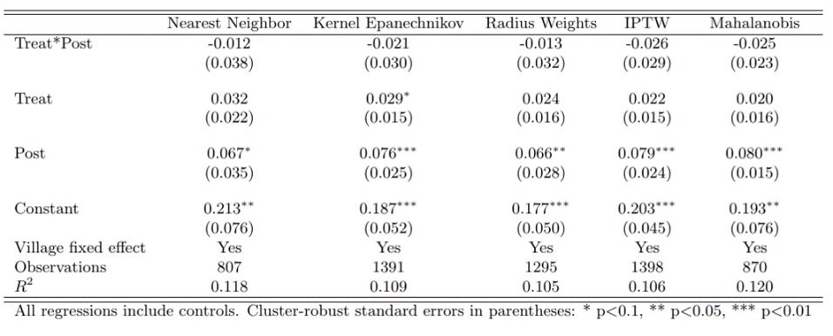
Impact Evaluation: Weighted DID
Outcome: Empowerment Score
No effect of the program, using weights and restricting sample to common support

Slide 20
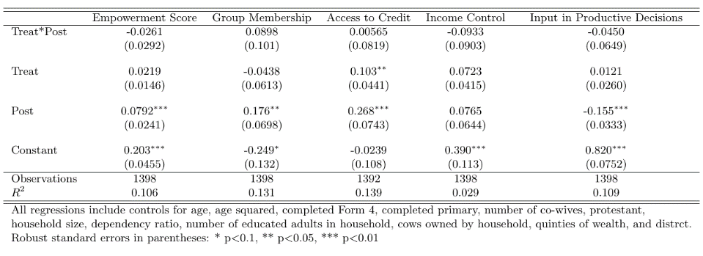
Impact Evaluation: IPTW Weighted DID
No effect of the program, using weights and limited sample

Slide 21
Conclusion
Brooke Krause: bkrause@wooster.edu
Aine McCarthy: mccarthy@lclark.edu

Slide 22
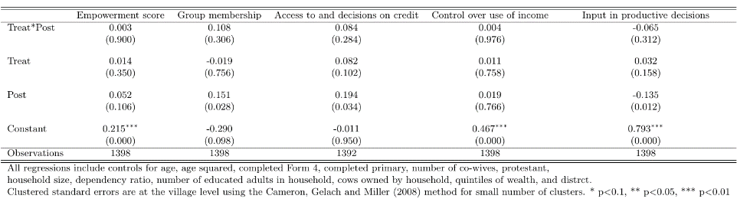
CGM Adjustment for Few Clusters

Slide 23
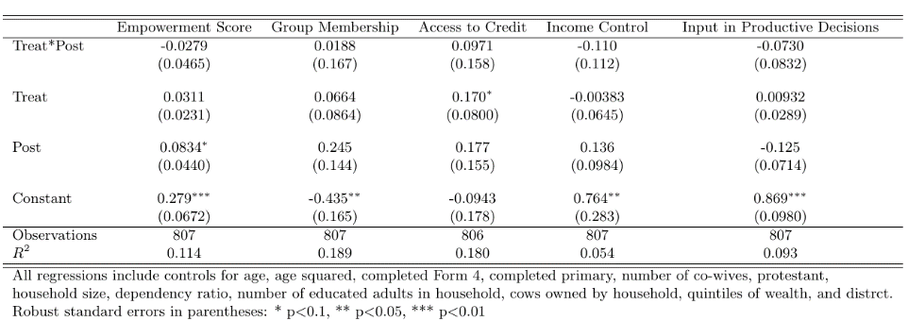
Impact Evaluation: Nearest-Neighbor Weighted DID
Impact on all outcomes, using nearest neighbor matching method
No effect of the program, using weights and limited sample

Slide 24
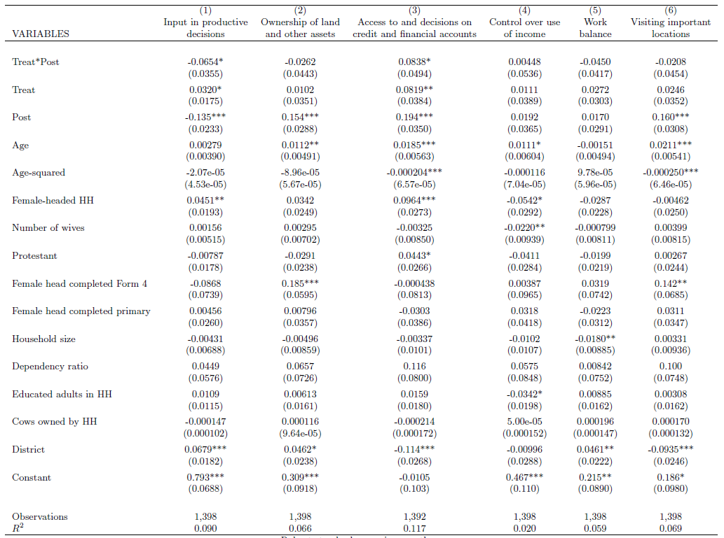
Instrumental Agency

Slide 25
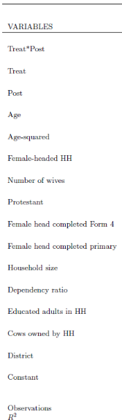
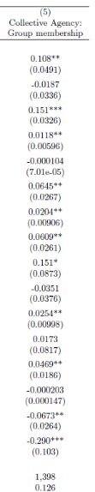
Collective Agency

Slide 26
Increase in Empowerment
The Maisha Program and other cultural factors helped empower Maasai women on multiple dimensions
“These women [VICOBA participants] have become different than others because they are in the next good level of their lives, It makes other people see them as good examples in the community, and they say: ‘This woman is almost becoming the same as a man who is doing well in his life within the village.’”
“This is a woman who is courageous and speaks with confidence and leaves the old traditions when most women were desperate and were afraid of expressing themselves in the society. That’s why she put those decisions into action because in the past, women were not knowledgeable about many things but for these days, women are able to claim their rights for equality and justice.”
“Women who participated in Maisha Bora microfinance groups are women who were in poverty, but after joining the VICOBA, their life has improved through livestock that they were given by the project, like a goat and others benefited through the experience of doing business through trainings.”

Slide 27
Qualitative: Intrinsic Agency
Decision making
“Women who joined the VICOBA groups are taking care of their responsibilities and implementing their life plans such as building the houses and buying livestock.”
“They are hard working women with financial capabilities within their villages and they make decisions within their families.”
Relationship improvement
“Through trainings that we have gotten from the VICOBA, we teach one another to have unity and love among us so that we can continue to perform group activities peacefully
“These women have become good leaders in their families because they are the ones who cooperate with their husbands to discuss different issues in the boma, for example about food, clothes and livestock.”
Self efficacy:
“Because nowadays women attend different meetings, and they stand confidently to share their ideas and they are heard.”
“Women being in groups has increased love in the family because men have recognized us to some extent, and we have been able to speak with our husbands [more] compared to the past when we were afraid to sit at one table with our husbands talking about a certain issue.”

Slide 28
Instrumental Agency:
Access to credit and control of income:
Membership in the Maisha Bora VICOBA groups allowed women to start new businesses and earn money independent of husbands.
Women gained control of funds earned from petty trading and accessed loans to cover shocks.
Relationships with family members improved when women contributed funds and helped men from forced livestock sales
Women’s self efficacy increased because members paid for food for family, soap clothing, and housing improvements.
Mobility:
“Before joining to the VICOBA, we were very poor people and we did not go anywhere outside of our village; but now we are going to different places out of this village to do business and, through this, we have seen many changes in ourselves. So the old people said “Engang’u naipung’o eng’en” This is a Maasai saying which means “An eye that visited different places is the one which is clever.”

Slide 29
Instrumental Agency:
Work Balance
Women in VICOBA remain responsible for household chores but sometimes receive more help from husbands
“A woman is the “minister of home affairs, I mean she is the one who decides about everything in the house such as, what to cook, how much to cook, what time to cook, who to eat, washing, cleaning, fetching water, collecting firewood, look after children and also looking after sick people.”(man with wife in VICOBA)
“There are changes because now days we are doing our domestic work faster in order to attend VICOBA on time as agreed by members so that we can avoid the fines levied for the late comers.” (woman in VICOBA)

Slide 30
Collective Agency
Solidarity of group members
“Before the VICOBA, women were not able to send their children to school but after joining to the group women became unified in the community and helped each other more closely.”
“Through the VICOBA, we have seen men and women be influenced about different issues. If there is a certain governmental event or from another organization, people respond, and they come to the area of an event on time.”
“There are changes because when a woman fails to send her child to school, she can be helped by the group by contributing her small amount of money so that she/he will continue with studies therefore I feel empowered through my group.”

Slide 31
Qualitative: Food Insecurity
Women in VICOBA reported buying food for family from their savings or through group support.
“Before VICOBA, we depended on our husbands for everything so when they failed to get what we needed [food], then children slept on empty stomachs but now we are working very hard and our children are not sleeping hungry because we [women] will provide for our families in circumstances when men could not.”
Respondents in almost all FGD reported training in nutrition, dietary
“Yes, Maisha Bora has brought about changes in how to make a balanced diet in the family for example, people have been educated to eat variety of foods; mothers to only breast feed their babies in their first six months and pregnant women were taught to attend pre-natal clinics and to eat fruits. The one who trained us was a community nutritionist.”
“They provided kitchen garden training. They provided seeds and people planted them. They benefitted through getting vegetables and food security to households. And women who attended the training got the knowledge of how to cook different kinds of food.”
More remote villages had a difficult time accessing vegetables

Slide 32
Qualitative: Intimate Partner Violence
Some respondents reported incidences of violence decreased due to a combination of factors:
Cultural change because of exposure to other people and media
Trainings from churches
Reduction in arranged marriages in younger age sets
Some women and men said that women now knew their rights and could take abusive husbands to village leaders.
Deeply embedded norms allow men to beat women.
Disobedience, arrogance
Losing cattle
Not cooking meals on time
“No, slapping a woman is not allowed but hitting with a "njipishipi" meaning hitting her with a small stick when she is wrong is okay.”

