Slide 1
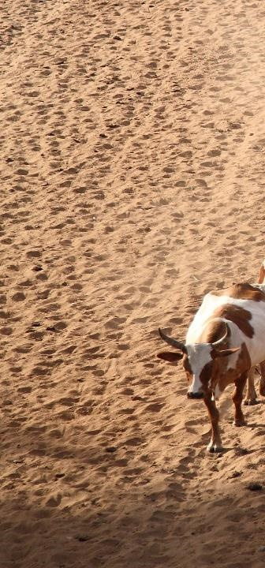
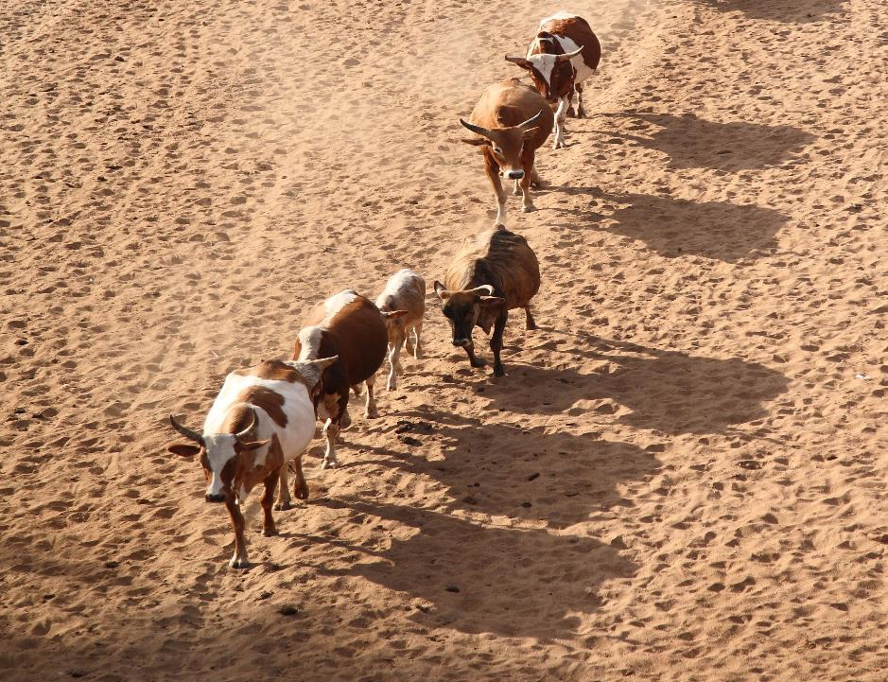

‘til the cows come home: a well-worn path or a new trajectory?
Exploring why livestock matter in sustainable development
Shirley Tarawali
Assistant Director General
International Livestock Research Institute
Global Academy of Agriculture and Food Security
Edinburgh
19 February 2020

Slide 2
Global commodity values: on average animal source foods, five of the top ten
Livestock is 40% of agGDP globally
Notes:
Meat: Production from slaughtered animals: all animals of indigenous and foreign origin, slaughtered within the national boundaries.
Indigenous meat: Production from indigenous animals: indigenous animals slaughtered plus the exported live animals of indigenous origin.

Slide 3
% growth in demand for livestock products comparing 2005 to 2030
Beef
Pork
Poultry
Milk
Increases not because of overconsumption!
OECD average 2018 = 69 kg/capita meat
SSA average 2018 = 10 kg/capita meat
Estimates of the % growth in demand for animal source foods in different World regions, comparing 2005 and 2030. Estimates were developed using the IMPACT model, courtesy Dolapo Enahoro, ILRI.
Notes:
FAO. 2011. Mapping supply and demand for animal-source foods to 2030, by T.P. Robinson & F. Pozzi.
Animal Production and Health Working Paper. No. 2. Rome.
IMPACT results generally suggested smaller changes in demand compared to FAO. Among other drivers of the results, the observed differences may be related to the underlying assumptions on how future demand will respond to prices and incomes. FAO projections could for example be assuming big shifts to Chicken Meat consumption (e.g., from pork) as incomes grow in Asia. IMPACT makes the same assumption in terms of direction, but with the expected shifts a bit more dampened.
High income countries include much of Europe. In fact, if one looks at individual European nations in many cases there is a DECLINE in demand (Switzerland for beef (-22%) and pork (-14%) for example)
Figures for meat consumption: https://data.oecd.org/agroutput/meat-consumption.htm

Slide 4
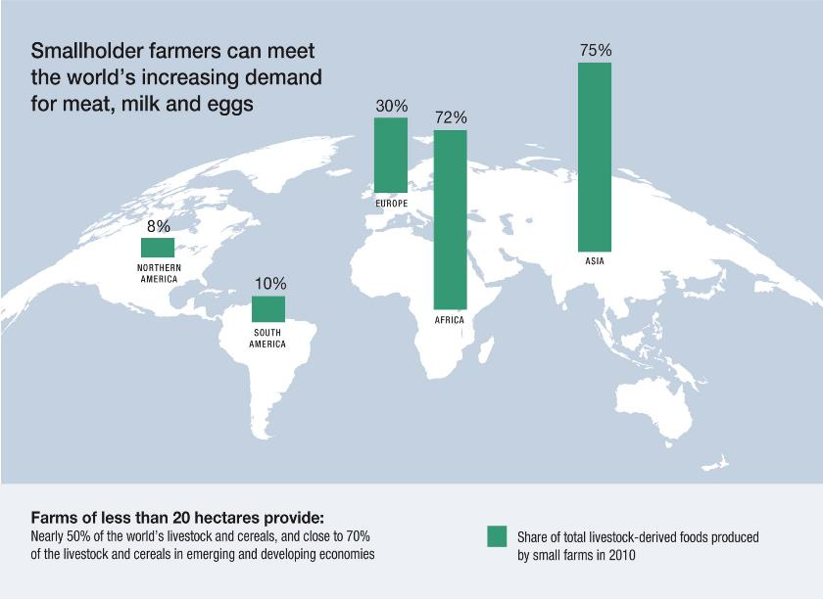
In reality: the starting point Proportion of livestock-derived foods produced by small farms in 2010
Source: Options for the Livestock Sector in Developing and Emerging Economies to 2030 and Beyond. World Economic Forum White Paper January 2019

Slide 5
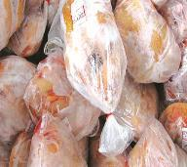
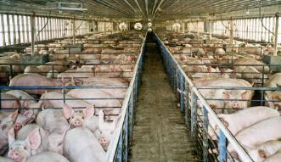
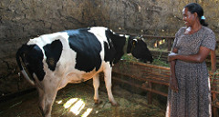


Meeting the demand for animal-source foods in LMICs
Importing livestock products
Importing livestock industrial production know-how
Transforming smallholder livestock systems
Alt- products?

Slide 6








Livestock and sustainable development

Slide 7
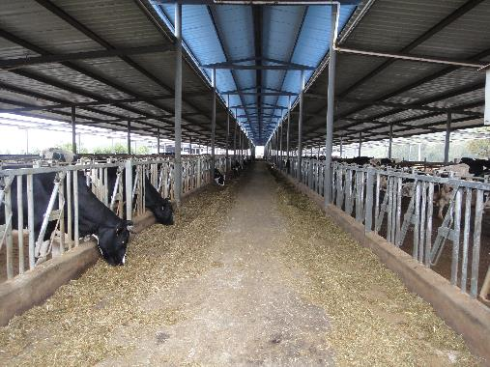
Environment
A sustainable livestock sector presents many very big opportunities to adapt to climate change and lower GHG emissions

Slide 8
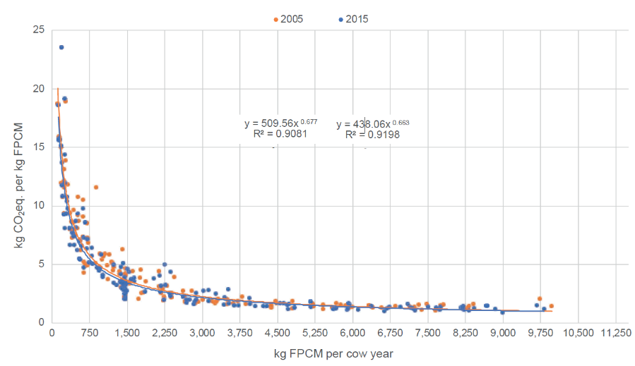
Mitigate environmental harms
Notes:
FAO and GDP. 2018. Climate change and the global dairy cattle sector – The role of the dairy sector in a low-carbon future. Rome. 36 pp. Licence: CC BY-NC-SA- 3.0 IGO

Slide 9
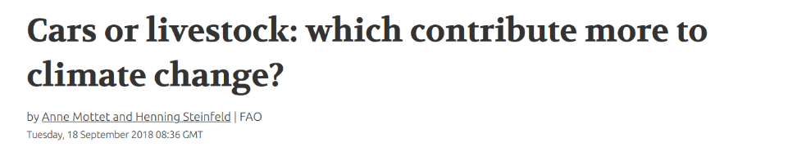
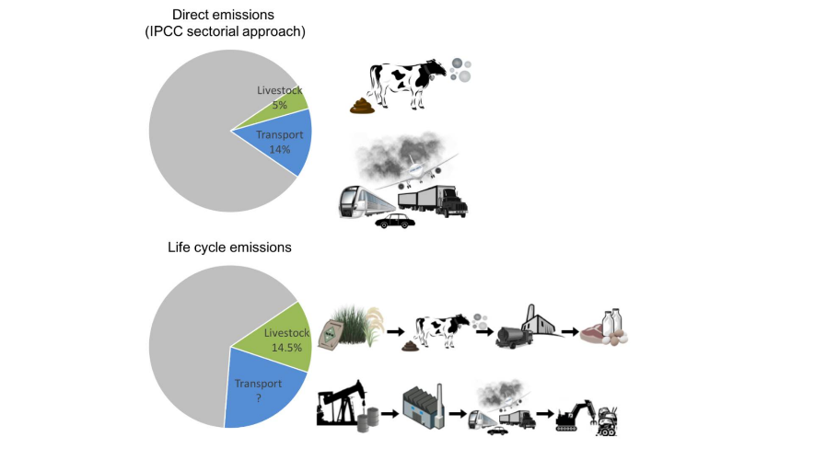
Comparisons?
Notes:
https://news.trust.org/item/20180918083629-d2wf0

Slide 10
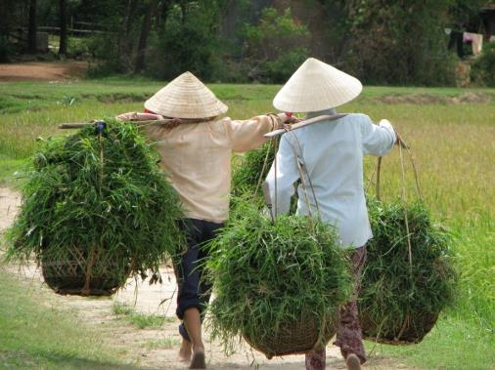
Gender
The transformation of women’s livelihoods is impacted by livestock; the transformation of livestock food systems is impacted by women

Slide 11
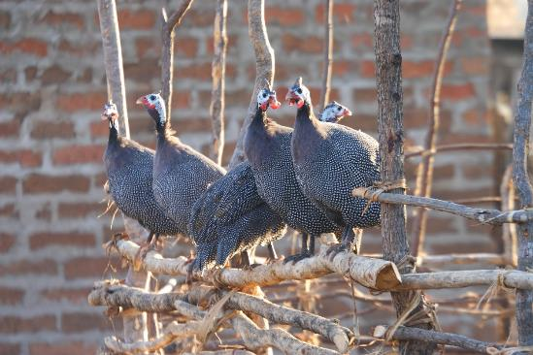
Food
Animal source foods remain essential for proper nutrition and long-term health for most people in lower- and middle-income countries

Slide 12
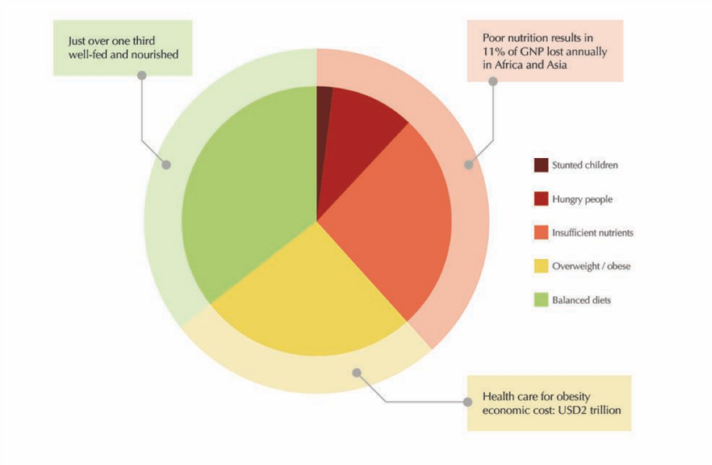
Nutritional divides among the world’s 7.5 billion people
Notes:
Data from FAO, IFAD, UNICEF, WFP and WHO, “The State of Food Security and Nutrition in the World 2018: Building Climate Resilience for Food
Security and Nutrition”, 2018, http://www.fao.org/3/I9553EN/i9553en.pdf; Development Initiatives Poverty Research Ltd, Global Nutrition Report 2017:
Nourishing the SDGs, 2017, https://reliefweb.int/sites/reliefweb.int/files/resources/Report_2017.pdf.

Slide 13
Diverse nutritional status demands diverse solutions
Lower-income countries
Reduce
micro-nutrient deficiency
Reduce energy deficiency
Reduce excessive net energy and unhealthy diets
Higher-income countries
% population
Notes:
Data extracted from: Robert F. Townsend, Steven Jaffee, Yurie Tanimichi Hoberg, and Aira Htenas, with inputs from Meera Shekar, Zia Hyder,
Madhur Gautam, Holger Kray, Loraine Ronchi, Sarwat Hussain, Leslie Elder, and Gene Moses. Overall guidance was
provided by Juergen Voegele and Ethel Sennhauser (2106) Future of Food: Shaping the Global Food System to Deliver Improved Nutrition and Health. The World Bank Group, USA.

Slide 14
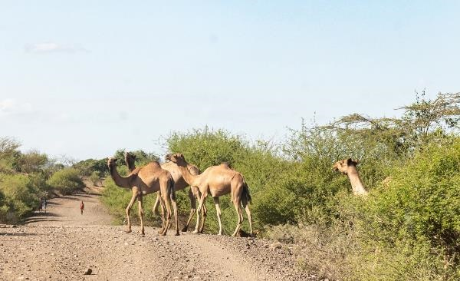
Health
The animal dimensions of disease transmission need greater attention for global public health and safety

Slide 15
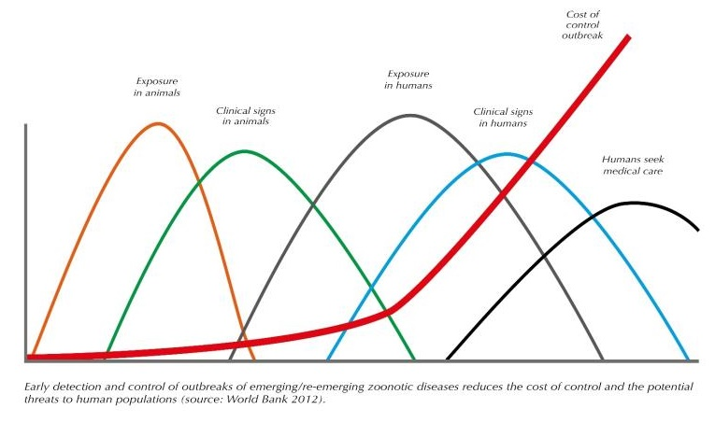
Big opportunities exist to reduce the threat of pandemic disease events via livestock interventions
Better animal disease surveillance, ‘One-Health’ and ‘herd health’ could save billions of dollars by stopping disease outbreaks in animals rather than people
It’s estimated that a global investment of USD25 billion over 10 years in One Health work would generate benefits worth at least USD125 billion
Notes:
Source: Delia Grace, 2014, ‘The business case for One Health’, Onderstepoort Journal of Veterinary Research, http://dx.doi. org/10.4102/ojvr.v81i2.725

Slide 16
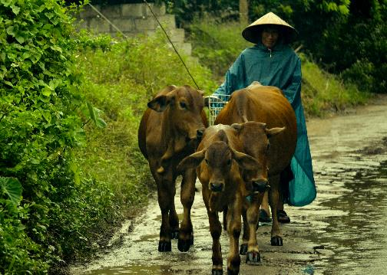
Prosperity
Livestock are fundamental for the livelihoods of almost one in five people on the planet and in virtually every country on earth, for national economic growth

Slide 17
Common destinations, multiple, different pathways
…..efficient, low-carbon, sustainable livestock production that supports rather than harms the environment…..
…..inclusive, fair, equitable livestock systems……
…..affordable, accessible, balanced, nutritious diets that include the choice of healthy livestock-derived foods
…..healthy animals, safe food, healthy people….
…..every opportunity for every citizen and every nation to benefit fully from multiple livelihood and economic dimensions from sustainable livestock…..

Slide 18
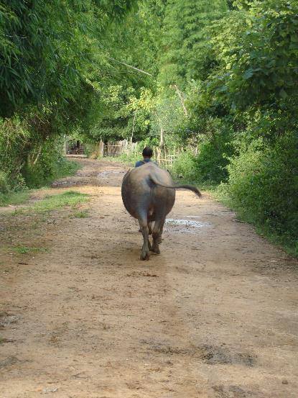
THANK YOU

