Slide 1
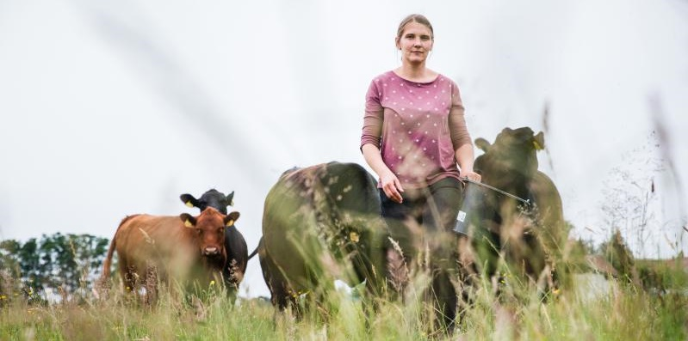

WE1.3: Start-up women farmers in Germany: An organic avant-garde challenging gender stereotypes?
Cultivating Equality Conference, October 12-15, 2021
Janna Luisa Pieper, M. Sc. Research fellow and PhD candidate,
Chair of Rural Sociology, Georg-August-University Göttingen

Slide 2
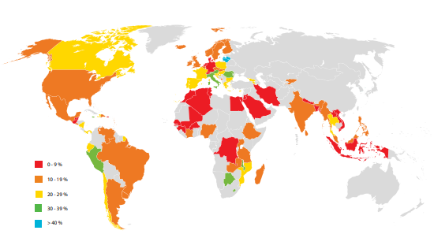
Land rights and gender equality
Distribution of agricultural landholders by sex, global and regional averages
Source: FAO Gender and Land Rights Database
0 – 9 %
10 – 19 %
20 – 29 %
30 – 39 %
> 40 %

Slide 3
How to become a women farmer (in Germany)?
Farm succession
Start-up farming
Marriage

Slide 4

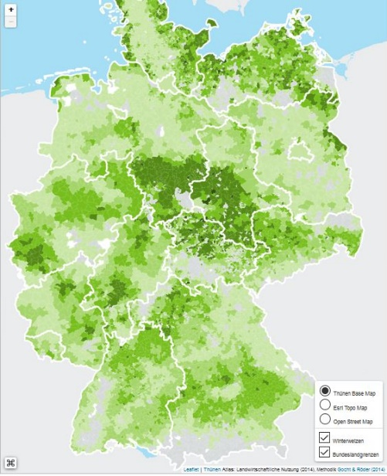
Methods and Sample
Narrative-biographical interviews (Rosenthal & Loch 2002)
Nationwide study “The life situation of women on farms in German rural areas – a socio-economic analysis “
(58 Interviews)
Sample: Female start-up farmers (n=11)
Age between 28 and 56 years
Mostly organic
0 – 10 employees
0,5 – 250 ha
Various production orientations: arable farming, dairy, laying hens, vegetables, pension horses
interview region

Slide 5
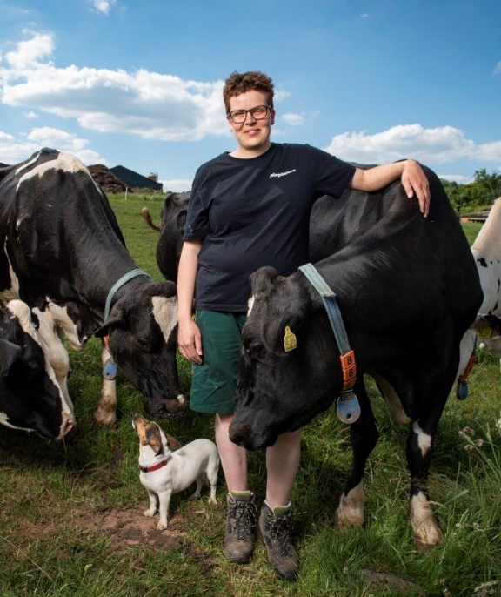
Start-up types
Solo start-up
As a couple
As business partners
Starting from scratch (7)
Buying/renting land and/or stables
Buying a farm site
Taking over an existing farm (4)
Renting a farm
Adoption
Funding types
Crowd funding
(Personal) loan
Subsidies from social services

Slide 6
Biographical background and motivation
Agricultural experiences in childhood and youth
Agricultural studies or training (as a second career path) or lateral entry
Positive role models and experiences
Political and ecological motivation, self-realization
Longing for a rural idyll, “the good life”
Precarious conditions
Unconventional lifestyles
Flexibility, autonomy and self-determination
“If we decide in 20 years, we don't want a farm anymore, then we sell it, then we don't do it, then we do something else. So, no one tells us what to do”
(Elsa, 43, farm manager)

Slide 7
Farming style and philosophy
"I want to farm with respect for everything, both for the people who eat my food and for the animals that make it all possible for me here in the first place. As well as for the environment and the soil, which make it possible for me to keep animals and that I can produce anything at all."
(Eva, 29, farm manager)
Organic farming with direct marketing
Labor intensive
Pluriactivity
Innovative business concepts
Most important agricultural values:
Autonomy
Animal welfare
Quality > quantity
Care for ecosystem/animals/people
Biggest concern: Climate change

Slide 8
Farming style and philosophy
Many aspects fit into the
“peasant condition”
(van der Ploeg 2008)
→(female) Start-up Peasants?
Organic farming with direct marketing
Labor intensive
Pluriactivity
Innovative business concepts
Most important agricultural values:
Autonomy
Animal welfare
Quality > quantity
Care for ecosystem/animals/people
Biggest concern: Climate change
→Care practices?
“making kin”
(Haraway 2018, p. 140)
(Puig de la Bellacasa 2015)
(Kosnik & Heistinger 2020)

Slide 9
Sustainable and resource-conserving farming practices
Handling animals/plants/ microorganisms
Processing and marketing of products
As employer
Self-care
Creation of “social places” (Neu et al. 2020)
Family/ domestic area
Caring Peasants

Slide 10
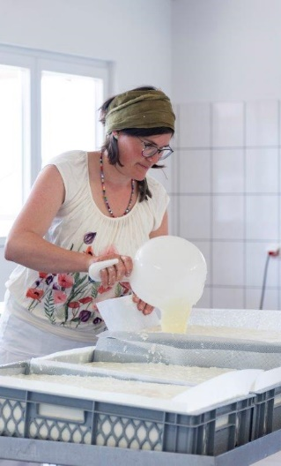
Peasants, Care & Gender
Care work in families or domestic contexts:
division of labor is still gender specific!
Female Peasants perform both: agricultural and domestic care work
Enabled by unconventional arrangements or women's networks of solidarity
Perpetuation of heteronormative care work?

Slide 11
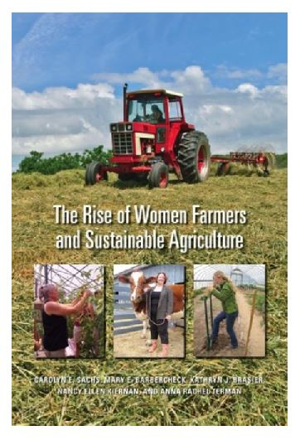
Gendering of care practices
“feminist agrifood systems theory” (FAST) (Sachs et al. 2016)
Personal satisfaction
Financial support of the family
Providing customers with healthy food
Farming in harmony with their land and their communities
Feminist ecological transformation of agriculture?

Slide 12
Gendering of care practices
“feminist agrifood systems theory” (FAST) (Sachs et al. 2016)
Personal satisfaction
Financial support of the family
Providing customers with healthy food
Farming in harmony with their land and their communities
→Attribution of gender characters (Hausen 1976)?
→Sustainable management philosophy is not gender specific

Slide 13
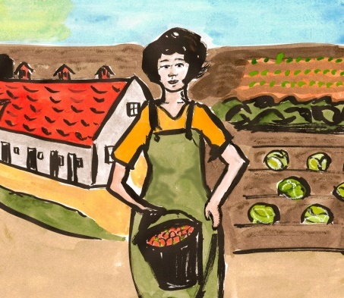
Conclusion
Are start-up women farmers an organic avant-garde challenging gender stereotypes?
Provide ecosystem services and care work that promotes the common good → Caring Peasants
Many of these services are not (yet) monetizable
Lack of appropriate support programs
Division of labor is still gender specific
Supporting women to start their own farming businesses could be a measure to achieve a more gender-equitable agriculture

Slide 14
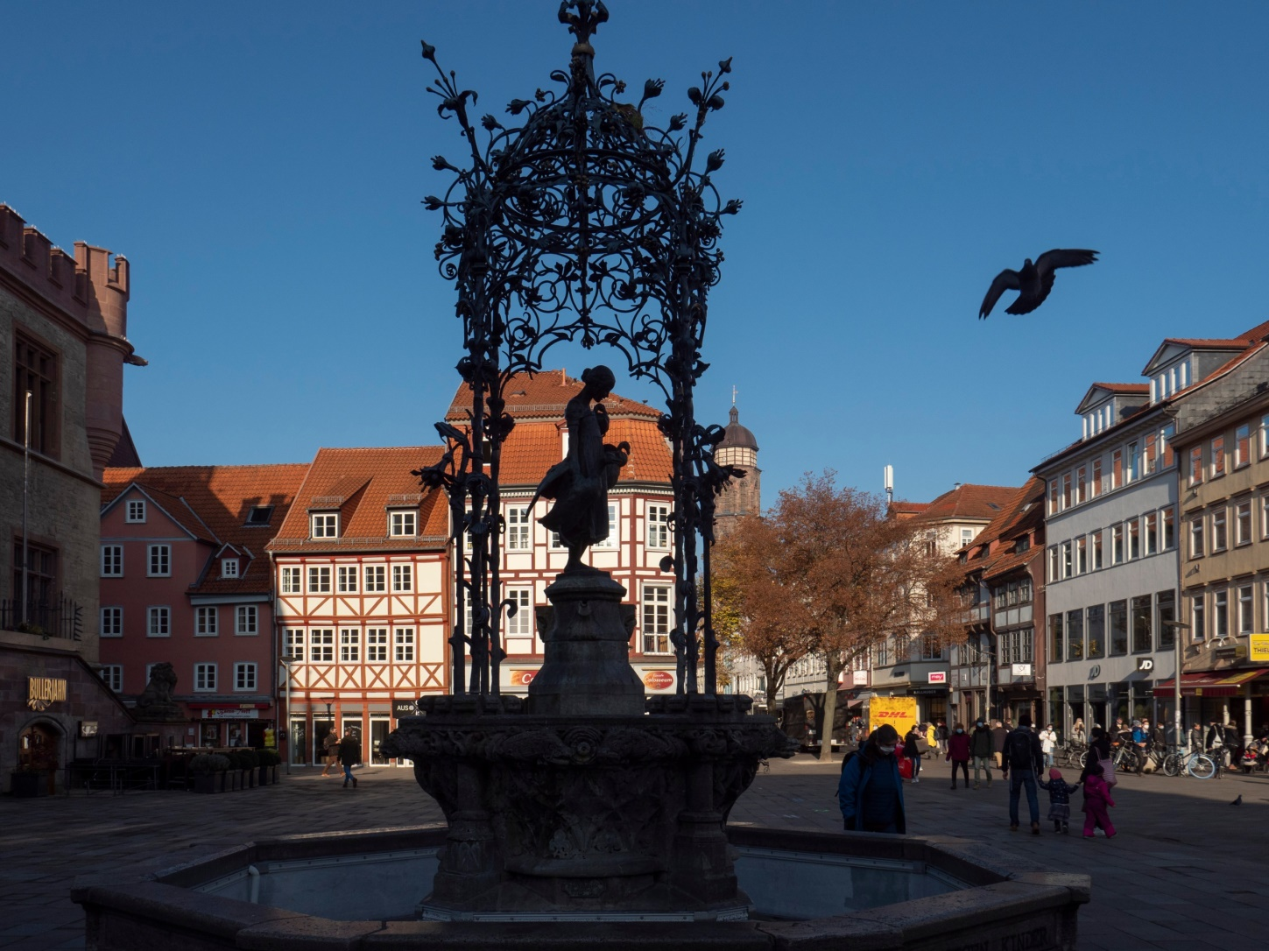
Thank you!

Slide 15
Literature
Haraway, Donna J. (2018): Unruhig bleiben: Die Verwandtschaft der Arten im Chthuluzän, Campus Verlag, Frankfurt
am Main-New York.
Hausen, Karin (1976): Die Polarisierung der Geschlechtscharaktere. Eine Spiegelung der Dissoziation von Erwerbs-
und Familienleben, In: Conze, Werner (Hg.): Sozialgeschichte der Familie in der Neuzeit Europas, Klett-Cotta,
Stuttgart, S. 363-393.
Heistinger, Andrea, Kosnik, Elisabeth (2020): Sorgsame Landwirtschaft – Resiliente Praktiken im ökologischen
Landbau, Arbeitsgemeinschaft ländliche Sozialforschung, Protokoll der Sitzung vom 18. November 2020.
Neu, Claudia; Arndt, Moritz; Buschbom, Kai; Nikolic, Ljubica; Reingen-Eifler, Helena; Simmank, Maike; Vogel,
Berthold; Wicklow, Dagmar (2020): Soziale Orte. Ein Konzept zur Stärkung lokalen Zusammenhalts, Friedrich-
Ebert-Stiftung, Abteilung Wirtschafts- und Sozialpolitik, Berlin-Bonn.
Rosenthal, Gabriele; Loch, Ulrike (2002): Das narrative Interview. In: Schaeffer, Doris; Müller-Mundt, Gabriele
(Hrsg.): Qualitative Gesundheits- und Pflegeforschung. Handbuch Gesundheitswissenschaften, Huber, Bern-
Göttingen-Seattle-Toronto, S. 221-232.
Sachs, C.E., M. Barbercheck, K. Brasier, N.E. Kiernan, and A.R. Terman. (2016). The rise of women
farmers and sustainable agriculture. Iowa City: University of Iowa Press.
Van der Ploeg, J. D. (2008). The New Peasantries: Struggles for Autonomy and Sustainability in an Era
of Empire and Globalization. 1. Auflage. London. Earthscan.

