Slide 1
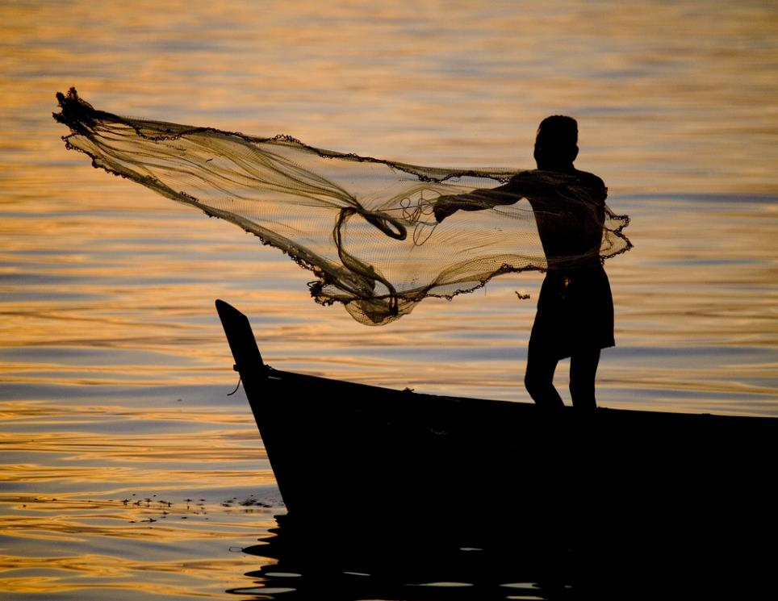
TH1.2: Diluting gender equality:
The case of small-scale fisheries
Sarah Lawless
ARC Centre of Excellence for Coral Reef Studies
James Cook University
Collaborators:
Dr Philippa Cohen
Prof. Tiffany Morrison
Dr Andrew Song
Dr Sangeeta Mangubhai
Dr Cynthia McDougall Dr Danika Kleiber
Photo: WorldFish
Cultivating Gender Equality Conference, 12-15 October 2021

Slide 2


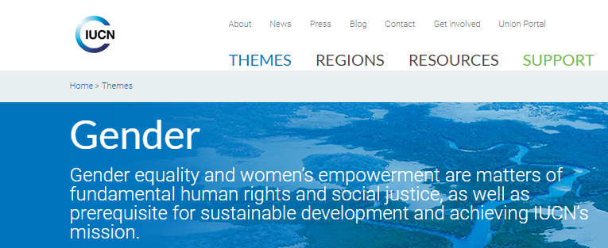
Gender equality: an environmental governance principle

Slide 3

Gender equality: an environmental governance principle

Slide 4
Assumption
Gender equality in environmental policy
More equitable practice
Progress toward gender equality
Yet, research suggests that progress toward gender equality is not necessarily guaranteed
(Grabowski & Essick, 2020)

Slide 5
Research gap
Gender equality in environmental policy
More equitable practice
Progress toward gender equality
Gap
Are environmental policies and practices progressing gender equality?

Slide 6
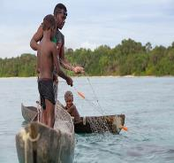
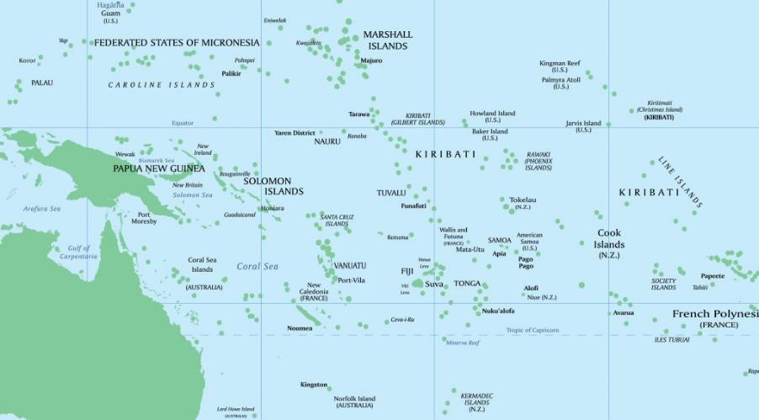
Case study
Pacific Islands region
Small-scale fisheries
Pacific Community, 2018

Slide 7
Sample
Organization type
Level of governance
Small-scale fisheries policies
n=76
Foreign donors
UN agencies
Regional agencies
Non-governmental organizations
National governments
Private agencies
Civil society organizations
Policy
Regional
Pacific Islands region
Small-scale fisheries organizations
n=34
National
Fiji, Solomon Islands,
Vanuatu
Practice

Slide 8
Data collection and analysis
Small-scale fisheries policies
Influential small-scale fisheries policy instruments (n=76)
Small-scale fisheries organizations
Key-informant interviews (n=80)
f=49, m=31
Self-identified as a small-scale fisheries and/or gender expert
Range of positions: organizational executives, fisheries officers and field staff

Slide 9
Policy: Conceptualization of gender equality
Overall focus on ‘fixing’ women rather than the structures (cultural, political organizational) and norms (attitudes, behaviours)
13%
8%
79%
“Avoid the overuse of the word ‘gender’ throughout project documents as this may disengage people. A clever tactic is to use gender responsive terms without directly using the word ‘gender’ or ‘gender equality’...”
- Donor guide for gender proposals
Lawless et al. 2021, World Development

Slide 10
Policy: Rationalization of gender equality
75%
Instrumental frame
Promote gender equality to achieve or enhance environmental management
25%
Intrinsic frame
Promote gender equality to ensure fair and just outcomes

Slide 11
Policy: Rationalization of gender equality
16 distinct rationale for pursuing gender equality
Instrumental
75%
Intrinsic
25%
Lawless et al. 2021, World Development

Slide 12
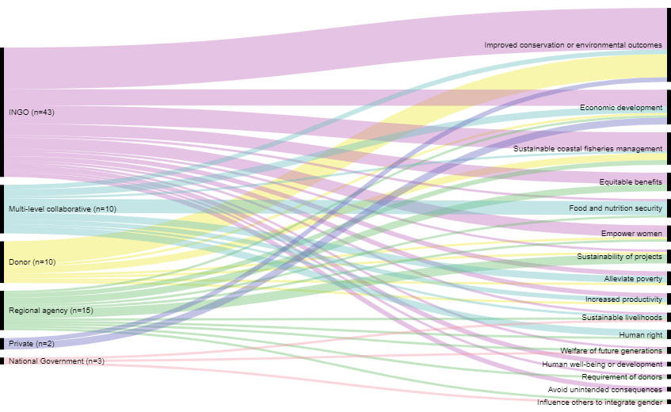
Policy: Rationalization of gender equality
Instrumental
Lawless et al. 2021, World Development

Slide 13
Gender equality in small-scale fisheries
practice
Provided detailed descriptions of fisheries initiatives (intentions vs. impact)
1. Key-informant interviews (n=71)
Examples of proposed gender approaches (intentions)
2. Policy document review (n=29)

Slide 14
Analytical framework
Gender assessment typology
Tinker
Women included in spaced occupied by men
Tailor
Gendered difference in needs, constraints and interests accounted for
Transform
Unequal gender norms, relations and structures are displaced
Progress toward gender equality
Adapted from:
Rees 1998; Squires 2003, 2005; IGWG 2017; Johnson et al. 2018; Kleiber et al. 2019

Slide 15
Practice: Intentions
Intention of gender approaches (n=218) in fisheries policy and practice
Tinker
51%
Tailor
44%
Transform
5%
“... ensure that equal numbers of men and women are invited to meetings and workshops”
“We tailor livelihood options [because] women's interests might be different [to men’s] … [women target] different habitat areas like mangroves”
“We undertake a series of gender transformative activities to help the staff apply a gender lens to their own lives”
- Program guide, International NGO, Fiji
- Senior Official, National government, Solomon Islands
- Regional Program Manager, International NGO

Slide 16
Practice: Depth of impacts
Impact of gender approaches (n=71) in fisheries practice
Tinker
42%
Tailor
31%
Transform
0%
“[name of organization] has taken more women onboard [in terms of employment]. There is more of a gender balance [in staff], but they [women] are mainly doing data entry”
No change 17%
“We don't know how to do it [gender]. We've never been trained … we don’t know how to integrate it into our work”
Fisheries Policy Specialist,
Regional agency
Fisheries Officer,
National Government, Vanuatu

Slide 17
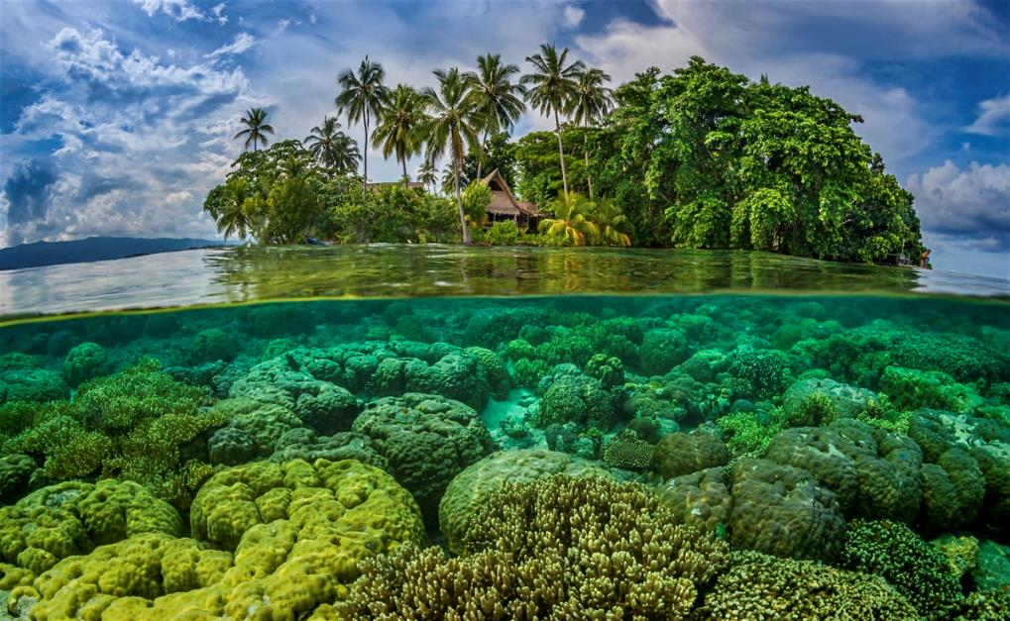
Contribution
The vast majority of gender approaches are neither meeting or advancing gender best practice frontiers
Gender equality tends to be diluted in small-scale fisheries policy and practice
Framing matters:
Conceptualization
Rationalization
Impact
Lawless et al. 2020, Earth System Governance
Lawless et al. 2021, World Development
Lawless et al. in review

Slide 18
Opportunities
Framing:
Organizations need to question their dominant narratives for pursuing gender
Assessment of the depth of approaches:
Tinker-Tailor-Transform typology
Lawless et al. 2020, Earth System Governance
Lawless et al. 2021, World Development
Lawless et al. in review

Slide 19

Thank you
Sarah Lawless
sarah.lawless@my.jcu.edu.au
Lawless_Sarah_
Advisory panel:
Prof. Tiffany Morrison
Dr Andrew Song
Dr Philippa Cohen

