Slide 1
Sustainable Animal Productivity for Livelihoods, Nutrition and Gender inclusion in the Northwest Highlands of Vietnam
Thinh Nguyen, ILRI
Community engagement workshop held at Mai Son, District Son La province, Vietnam,
11 October 2022

Slide 2
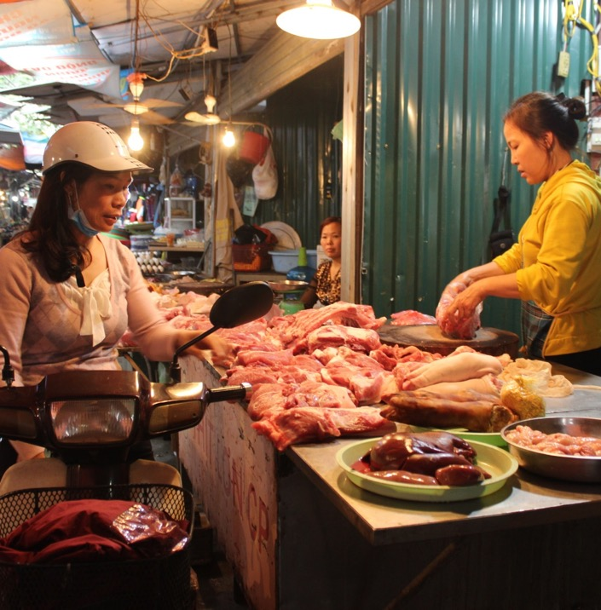
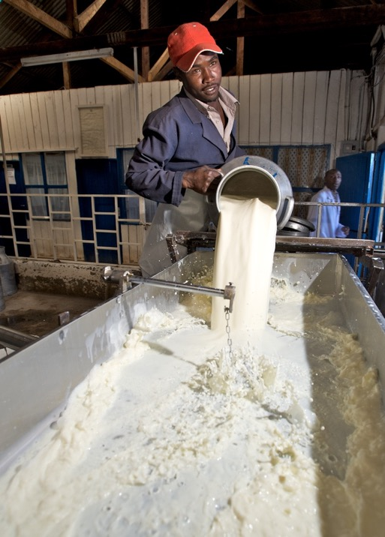
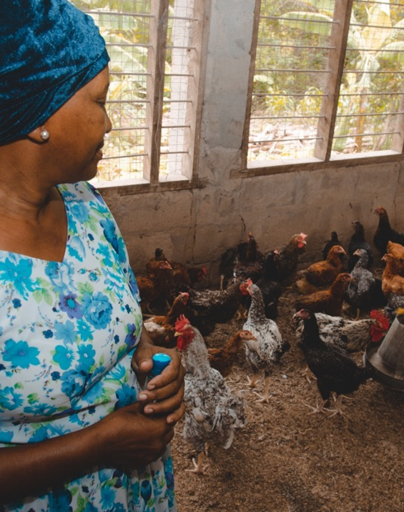
SAPLING - Why livestock?
Livelihoods
Demand
Women empowerment

Slide 3

Livestock challenges
Gender and other bias
Inefficient value chain
SAPLING
Low productivity
Failure of scaling up good intervention packages
Suboptimal use of animal sourced foods
Lack of evidence for decision making

Slide 4
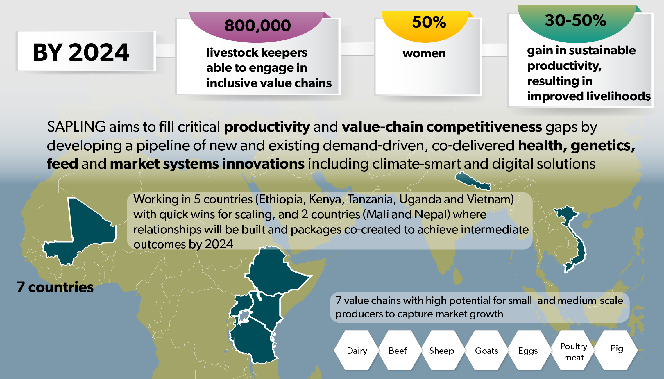
SAPLING focus

Slide 5
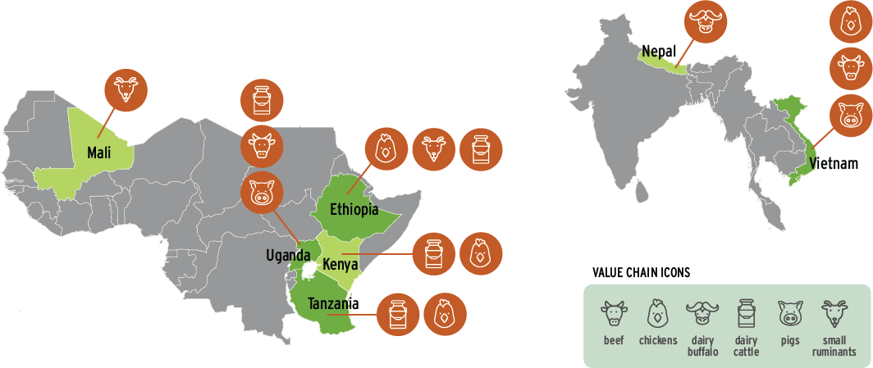
SAPLING countries & value chains

Slide 6
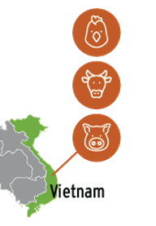
Selected value chains in Vietnam
Building from Livestock CRP (Li-chăn) efforts to scale tested and validated innovations
Stakeholder prioritization – July 2021 virtual meeting with stakeholders during SAPLING consultation meeting
Government and Donor interest

Slide 7
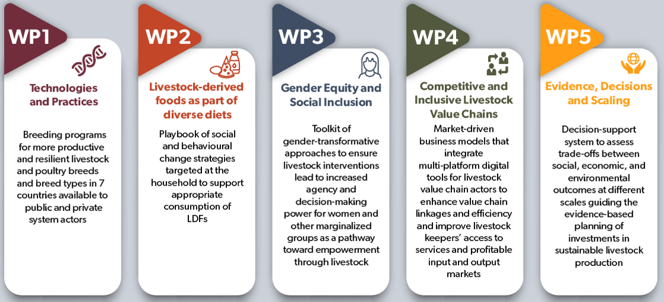
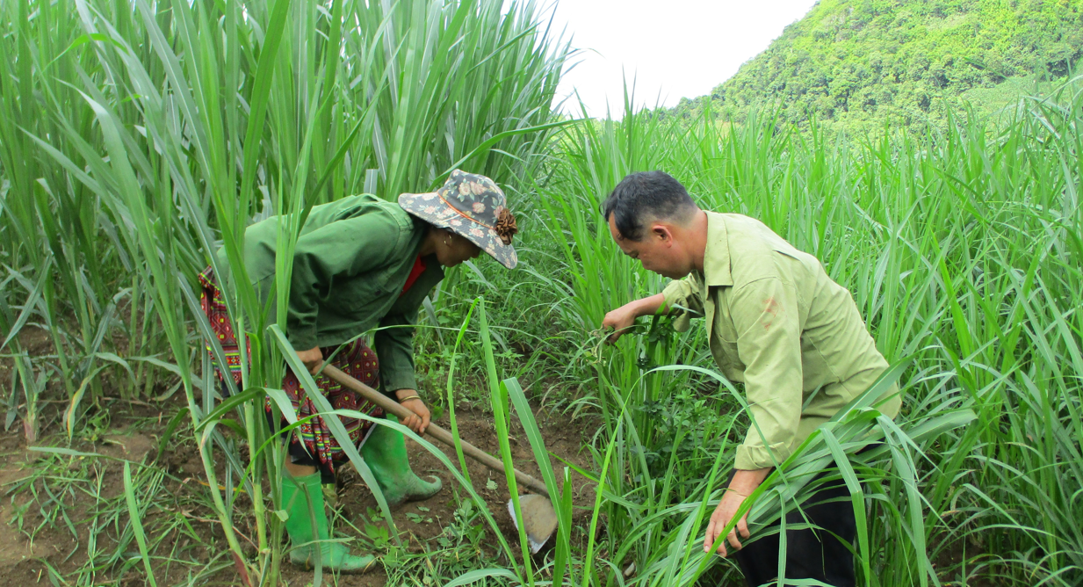
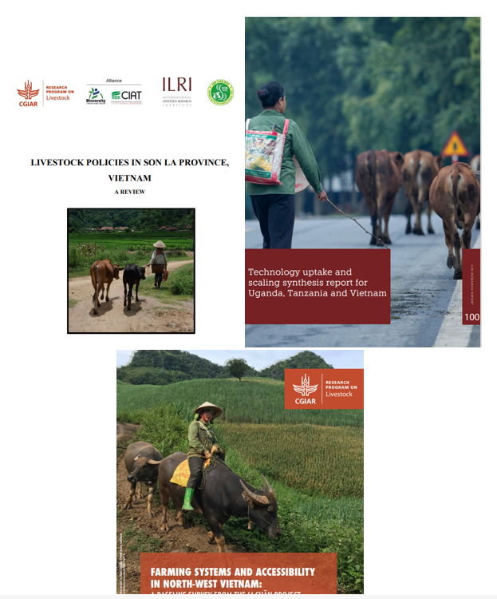
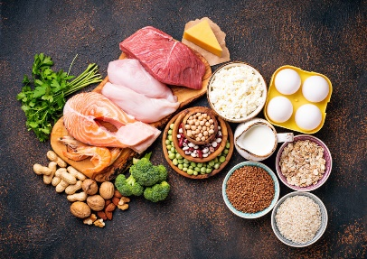
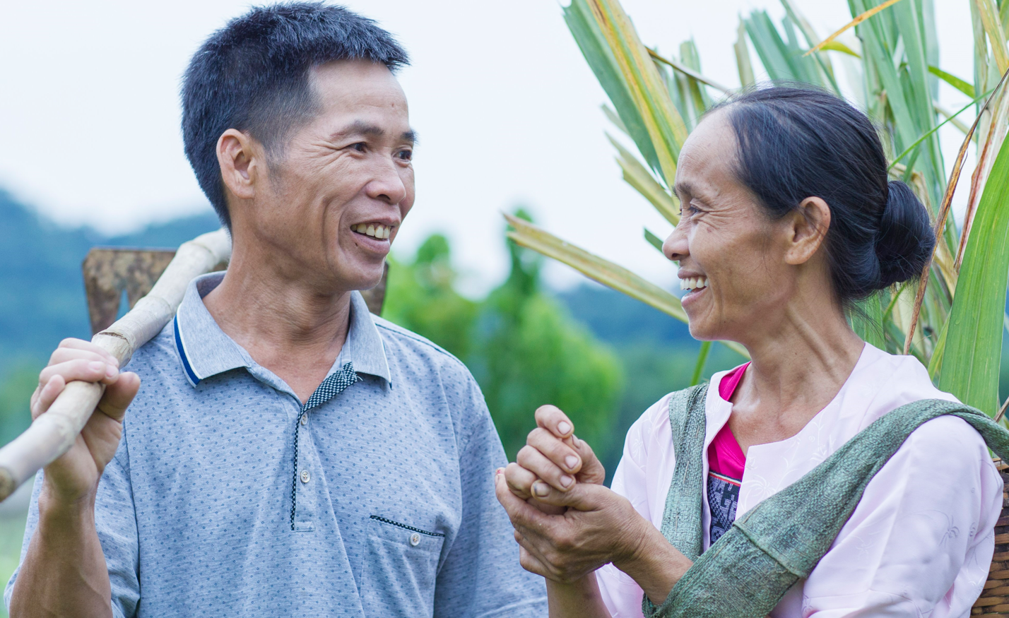
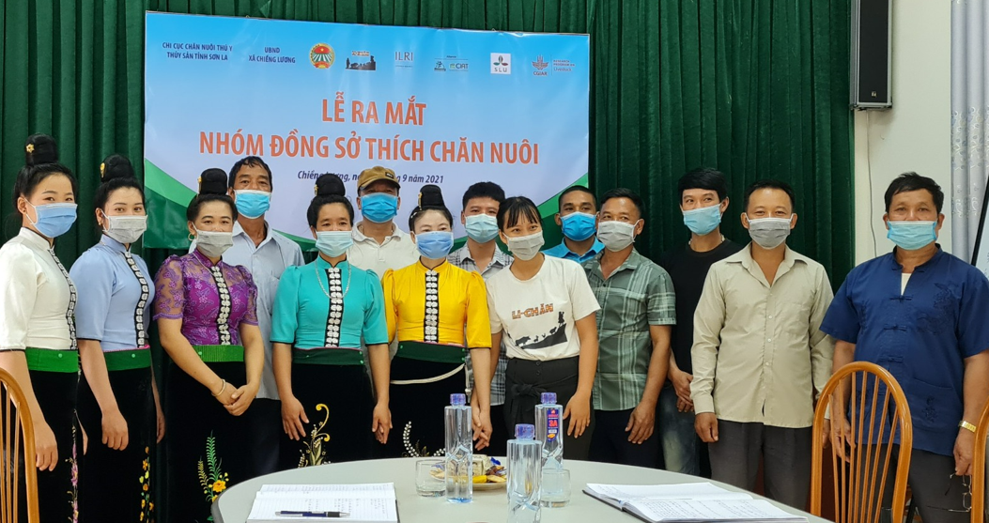
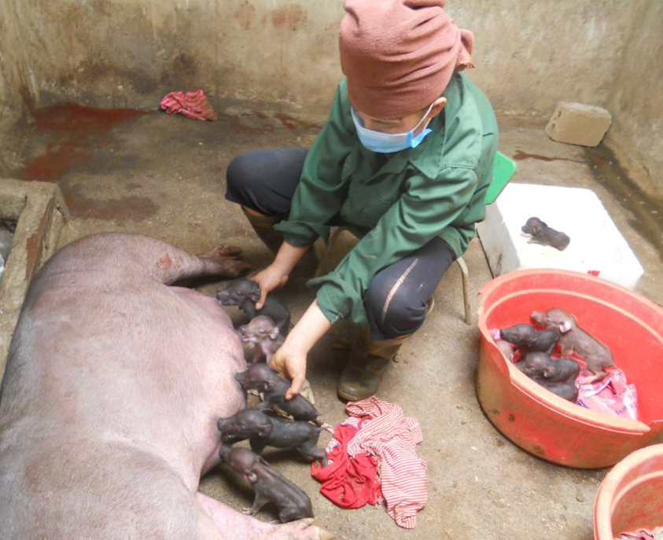
SAPLING work packages

Slide 8
What SAPLING built on?
SAPLING
2017
2022
2023
2019
2018
2021
2020
2024
Livestock CRP (Li-chăn)
CGIAR Research Program on Agriculture for Nutrition and Health (A4NH)
Safer indigenous pork and healthier ethnic minorities in Vietnam through better management of parasitic pig-borne disease
Market-based approaches to improving the safety of pork in Vietnam (SafePORK)
Asian Chicken Genetic Gains (AsCGG)

Slide 9
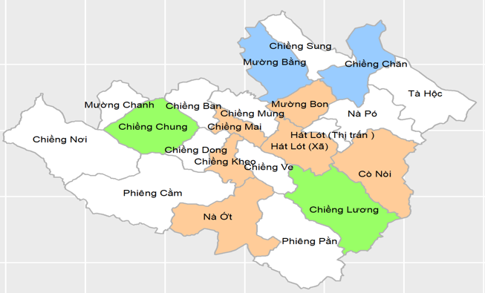
SAPLING sites
1. Son La province - Mai Son district
Chieng Chung commune
Chieng Luong commune
Hat Lot commune
Co Noi commune
2. Hoa Binh province – Da Bac district
4 communes (tbd)
Xã Hát Lót
Cò nòi

Slide 10




SAPLING partners
Sub-DAH
DARD
People’s Commitee

Slide 11
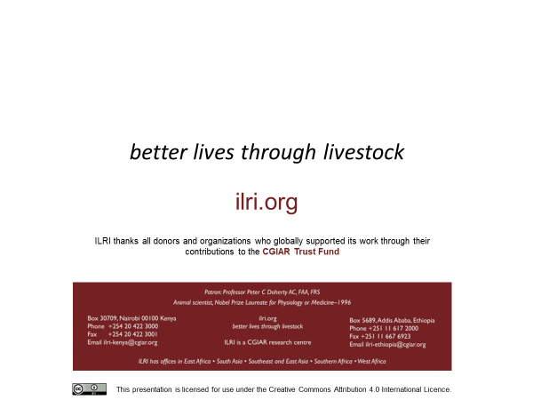

Slide 12
Thank you!

