Slide 1

Public Private Partnerships for Delivering Contagious Caprine Pleuropneumonia Vaccine in Borena Zone Oromia, Ethiopia
A Participatory Impact Evaluation and Policy Analysis
Tesfaye Haile Dargie, Research Consultant
SLS
Public-Private-Partnership for delivery of veterinary services
Review and validation of PPP models for scaling out
ILRIETH campus, Azage Auditorium, Addis Ababa 27 March 2025

Slide 2

Introduction
Deliva was develop to test an alternative vaccine delivery approach in Borena zone Oromia Region
Due to time and operational constraints a final evaluation of DeLiVa was not conducted after the project ended in December 2023.
This assessment was conducted by Smart Livestock Solutions One Member Plc (SLS) in partnership with Global Alliance for Livestock Veterinary Medicines in August and September 2024.

Slide 3
The objectives of the evaluation:
• Assess the impact of a novel PPP livestock vaccine delivery model on livestock health and livelihoods of pastoralist women and men in Borena Zone, in southern Ethiopia.
• Review institutional and policy factors that are needed to support the PPP model in Ethiopia and enable sustainability and scaling-up.
• Provide evidence on the impact of a PPP model for vaccine delivery to guide policy in Ethiopia and other countries

Slide 4
Approach
The evaluation was conducted in the four DeLiVa Project woredas (districts): Yabello, Dubuluk, Moyale, and Elwaye in August and September 2024.
In each woreda, 4 kebeles (villages) were selected purposively making a total of 16 kebele sites
Data Collection tools:
Desk review works,
KII (Key informant interview)
Proportional Pilling with focus groups: Comparing CCPP mortality and changes in livelihoods of pastoral community after the PPP vaccination
Triangulation of data and information

Slide 5
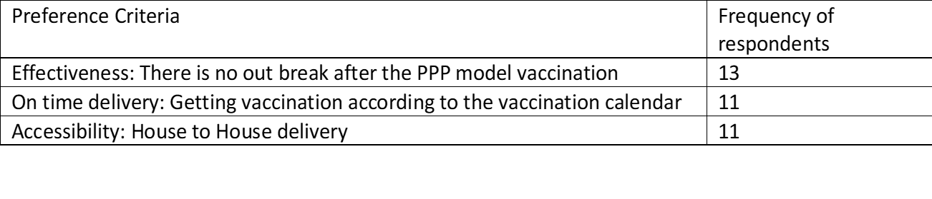
Evaluation Findings
Preference: Pastoralists preferred the PPP model that required payment for vaccine services over government services based on:
CCPP Vaccination coverage: Deliva PPP model Districts and Other Districts Covered by Government services: (Deliva 4 woreda 89.3% and government vaccination in 6 woredas 53.2%)

Slide 6
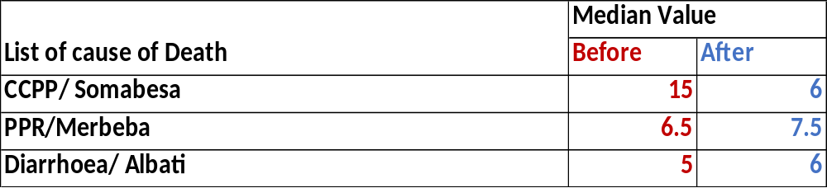
Evaluation Findings
CCPP Vaccination coverage in Deliva PPP Districts and Government services: (Deliva 4 woreda 89.3% and government vaccination 53.2%)
General Goats Mortality reduced after PPP CCPP vaccination: Due to the vaccine and improved weather conditions the view of 12/16 groups.
CCPP as cause of death reduced when compared with other causes of death

Slide 7
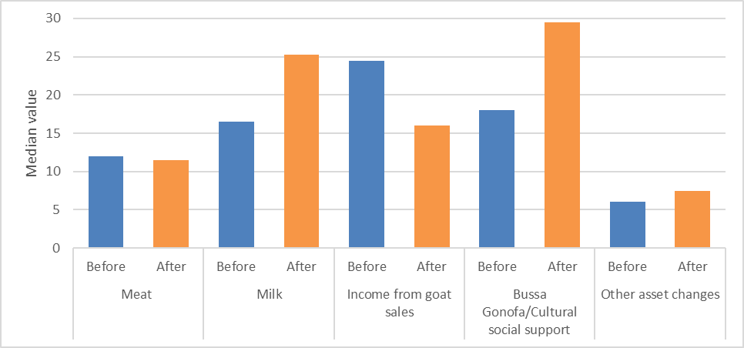
Impact on Livelihoods:
Livelihood benefits from goats before and after the PPP model

Slide 8
Conclusions and Recommendations
The evaluation of the PPP model showed strong performance in terms of vaccination coverage, reduced mortality due to CCPP and related livelihood benefits, despite only one round of vaccination in 2023.
Challenges to look at:
Concerns over continuity of the vaccination program
Limited awareness and knowledge
Submission of vaccination fees to Agrovet
Opportunities for upscaling:
Willingness to pay: One goat for 400 goats in Borena and one egg for one goat in Konso
Interest from neighbouring woredas, zones and regions: (expansion to Other woredas in Borena and Southern Ethiopia Region Konso zone)
Advocacy at federal and regional levels:

