Slide 1



Assessing community vulnerability to COVID-19 in Kenya: A spatial outlook
Paul Guthiga, Leonard Kirui, Joseph Karugia & Mohammed Ahid
April 22nd 2021

Slide 2


OUTLINE
Introduction
Methodology
Findings
Conclusions
Implications

Slide 3
INTRODUCTION

Slide 4
Introduction (1)
Disease and disaster governance have gained urgency as a public policy concern
Especially since the emergence of the novel coronavirus disease (COVID-19)
COVID-19 pandemic has spread worldwide and affected individuals, communities & national and global economy
Effective and efficient response to this pandemic requires resources be directed to the most vulnerable sections and areas
To be effective and efficient such response must be informed by data and evidence

Slide 5
Introduction (2)
Due to limited resources - prioritize the most vulnerable communities where the effects of the pandemic are likely to be proportionately more devastating
Vulnerability is defined as the propensity of an area to be exposed to the spread of Covid-19 combined with limited capacity to control the it and care for infected people, as well as high exposure to negative food security impacts
Vulnerability is not geographically uniform
This study focused on the differentiated spatial vulnerability using an overlay of indicators: -
Food and nutrition security,
Disease burden,
Health infrastructure and outcomes,
Population density

Slide 6
METHODOLOGY

Slide 7
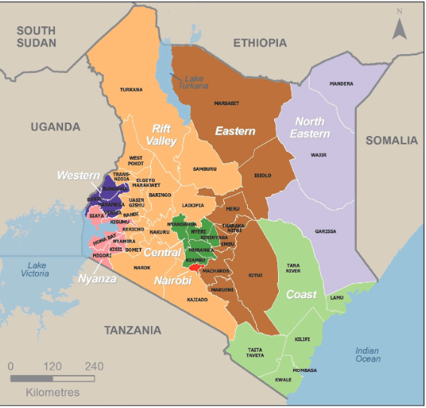
Spatial classification of regions
The study used 8 regions of the country based on data available in the DHS survey data (2014)
Western
Nyanza
Rift Valley
Nairobi
Eastern
North-Eastern
Coast
Largely coincide with the 6 reginal economic blocks
Notes:
1. Frontier Counties Development Council (FCDC), 2. North Rift Economic Bloc (NOREB), 3. Lake Region Economic Bloc (LREB), 4. Jumuia ya Kaunti za Pwani, 5. South-Eastern Kenya Economic Bloc & 6. Mt. Kenya and Aberdares Region Economic Bloc

Slide 8
Data sources
Various data sources were considered, and choice made as follows:-
Variable | Description | DATA SOURCE
hfa2 | Height-for-age (Prevalence of stunting) | Demographic and Health Survey (DHS) 2014
diab | Prevalence of diabetes | (DHS) 2014
bloodp | Prevalence of high blood pressure | (DHS) 2014
Assis_pp | Proportion of females (15-49) getting assistance from doctor, nurse/midwife, | (DHS) 2014
medhelp_disthf | Proportion of females (15-49) for whom distance to health facility is a big problem | (DHS) 2014
pcfood | Food expenditure per capita | KNBS Statistical abstract 2020
pop_above_50 | Proportion of persons above 50 years | Population and Housing Census (2019)
density_pop_sup | Density of inhabited areas (estimated through remote sensing) | Population and Housing Census (2019)

Slide 9
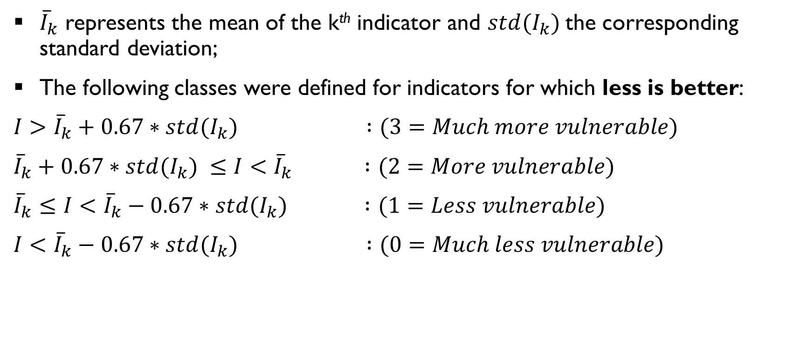
Computation of vulnerability index
${\overline{I}}_{k}$ represents the mean of the k^{th} indicator and ${std(I_{k})}_{ }$the corresponding standard deviation;
The following classes were defined for indicators for which less is better:
$I>{\overline{I}}_{k}+0.67∗{std(I_{k})}_{ }$ $:(3=Much more vulnerable)$
${\overline{I}}_{k}+0.67∗{std(I_{k})}_{ }≤I<{\overline{I}}_{k}$ $:(2=More vulnerable)$
${\overline{I}}_{k}≤I<{\overline{I}}_{k}−0.67∗{std(I_{k})}_{ }$ $:(1=Less vulnerable)$
$I<{\overline{I}}_{k}−0.67∗{std(I_{k})}_{ }$ $:(0=Much less vulnerable)$
Notes:
For each sub-indicator as well as for the composite vulnerability index, we classify areas as “much less”, “less”, more”, or “much more” vulnerable compared to the eight-region average index
For that purpose, we create a composite indicator that includes indicators on nutrition and food security, health infrastructure and access, and population density to measure and map vulnerability across local communities
The overlaying of multiple indicators provides a more nuanced picture of vulnerability at community level and allows identification of areas that would be missed if only a few factors were considered

Slide 10
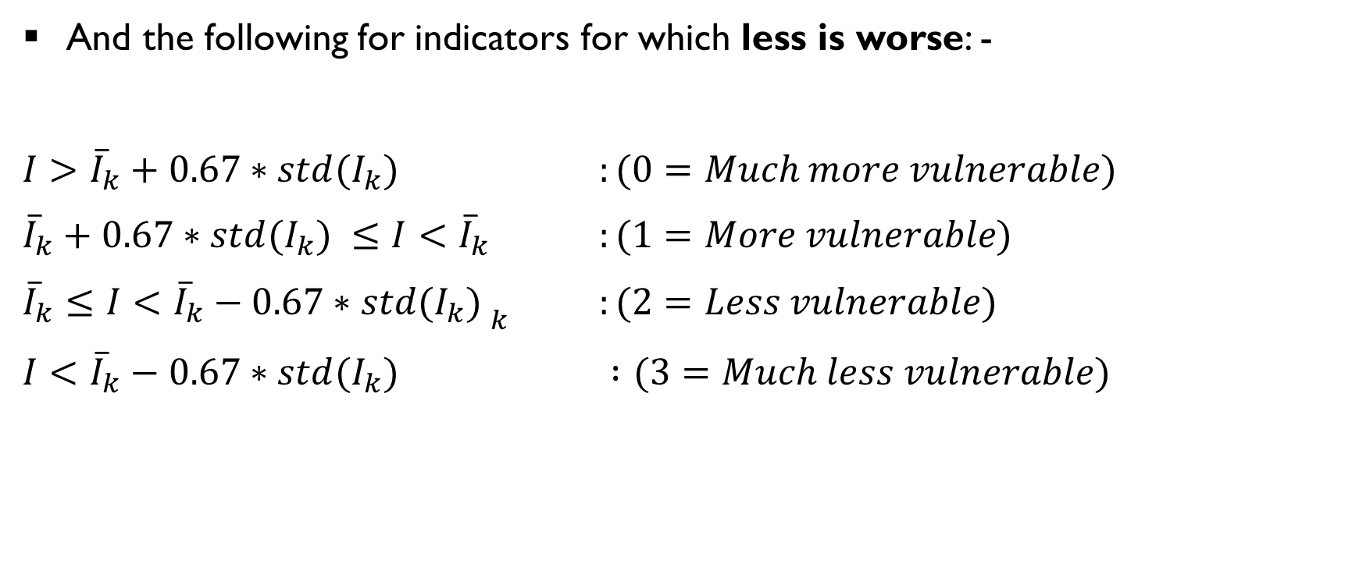
Computation of vulnerability index (3)
And the following for indicators for which less is worse: -
$I>{\overline{I}}_{k}+0.67∗{std(I_{k})}_{ }$ $:(0=Much more vulnerable)$
${\overline{I}}_{k}+0.67∗{std(I_{k})}_{ }≤I<{\overline{I}}_{k}$ $:(1=More vulnerable)$
${\overline{I}}_{k}≤I<{\overline{I}}_{k}−0.67∗{{std(I_{k})}_{ }}_{k }$ $:(2=Less vulnerable)$
$I<{\overline{I}}_{k}−0.67∗{std(I_{k})}_{ }$ $:(3=Much less vulnerable)$

Slide 11
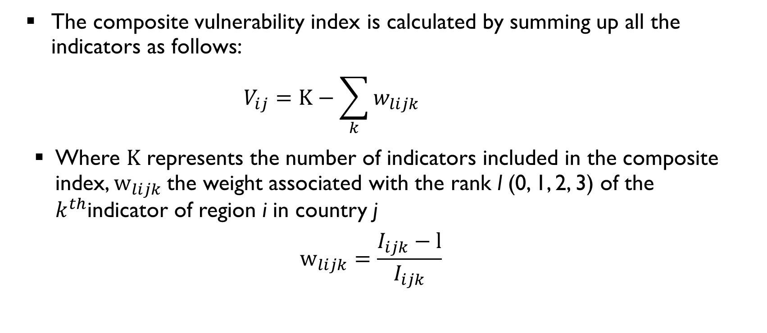
Computation of vulnerability index (4)
The composite vulnerability index is calculated by summing up all the indicators as follows:
$$V_{ij}=K−\sum_{k}{w_{lijk}}$$
Where $K$ represents the number of indicators included in the composite index, $w_{lijk}$the weight associated with the rank l (0, 1, 2, 3) of the $k^{th}$indicator of region i in country j
$$w_{lijk}=\frac{I_{ijk}−l}{I_{ijk}}$$

Slide 12
FINDINGS

Slide 13
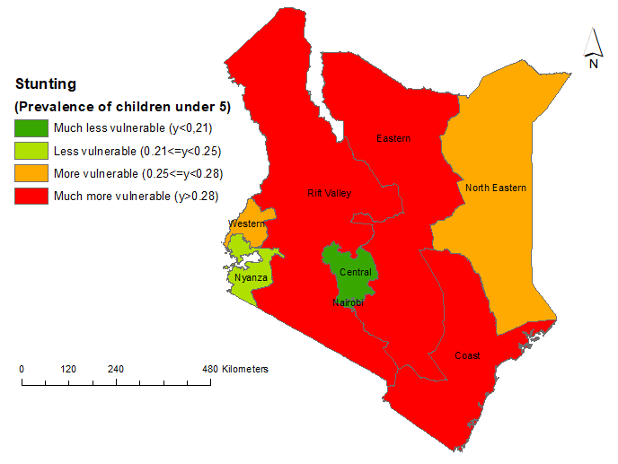
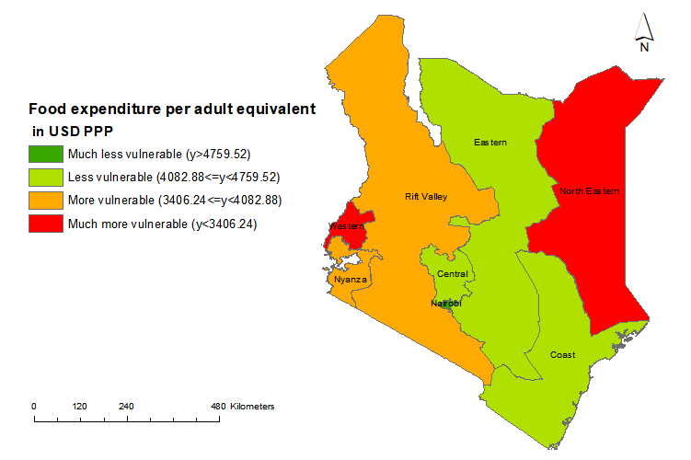
Food and nutrition security indicators & vulnerability to COVID-19
There is marked difference between the two nutrition and food security indicators
Stunting in Kenya is not perfectly associated with poverty levels.
It is influenced by a complex set of factors e.g such as dietary diversity, feeding and caregiving practices, access to adequate sanitation and disease

Slide 14
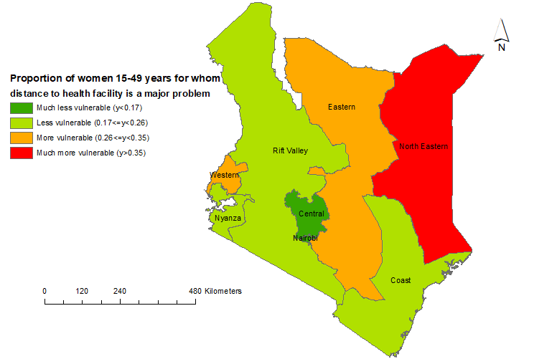
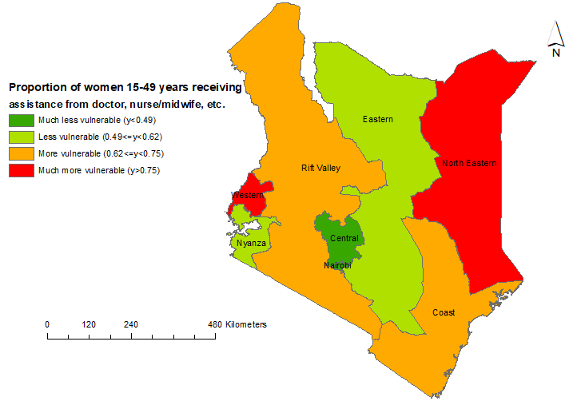
Health infrastructure and access indicators & vulnerability to COVID-19
Similar trends in the regions for the two indicators, high rates in North Eastern

Slide 15
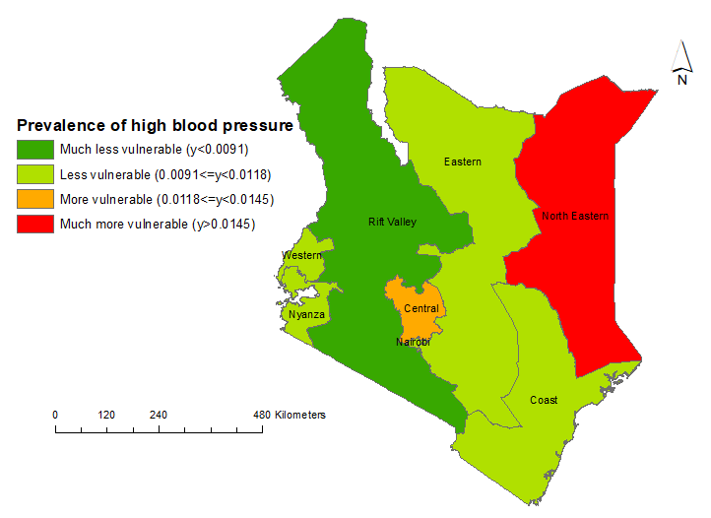
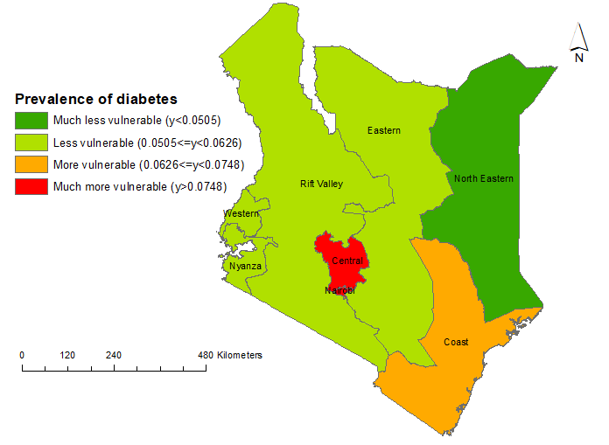
Disease burden indicators & vulnerability to COVID-19
North Eastern region shows remarkable difference for the two indicators
The region has a much higher level of vulnerability to severity of contagion and consequences of COVID-19, but it is much less vulnerable with respect to the prevalence of diabetes

Slide 16
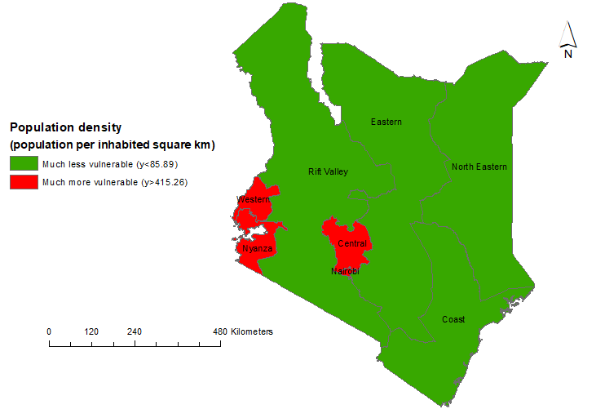
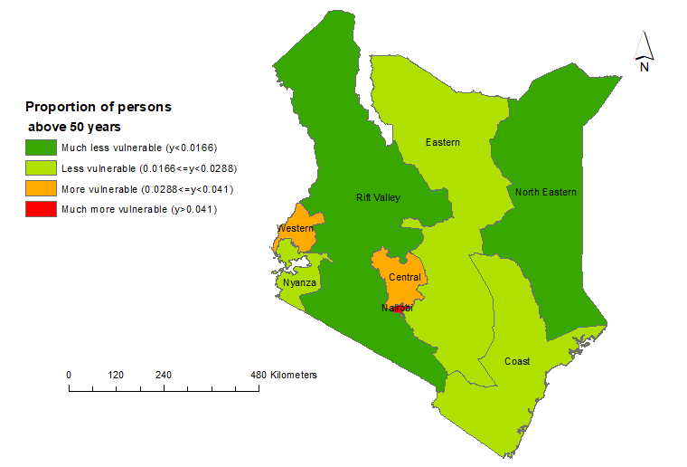
Demographic structures & vulnerability to COVID-19
Central, Nyanza, Western and Nairobi regions are much more vulnerable to severity of contagion and consequences of COVID-19
The rest of the regions are less vulnerable due to low population density

Slide 17
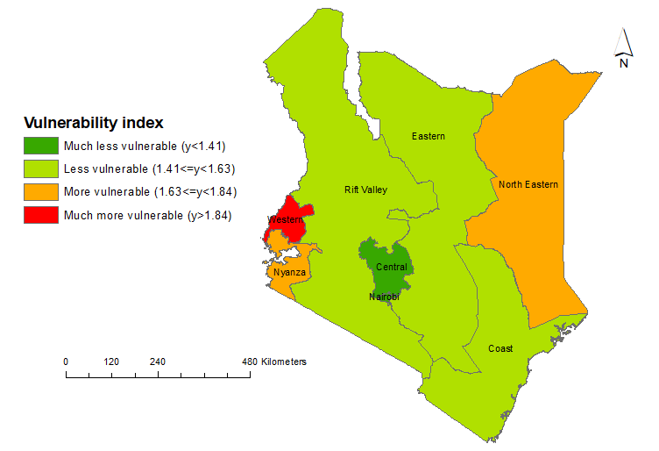
Overall patterns of vulnerability to COVID-19
Vulnerability is highest in Western region, followed by Nyanza and North-Eastern regions.
Rift Valley, Eastern and Coast are less vulnerable
Lowest-vulnerability areas - central part of the country and Nairobi

Slide 18
conclusions (1)
Examined the vulnerability of eight regions: -
With respect to existing food and nutrition security, health infrastructure and access, health outcomes, and population density and demographic structure
The vulnerability indices revealed widespread inequalities across the regions of Kenya
These factors are likely to raise the probability for a location to suffer more severe effects from shocks of Covid-19 pandemic

Slide 19
conclusions (2)
More susceptible regions to infections and spread - northern, western and eastern parts
They have poor access to food, constrained access to health infrastructure, and have poor health outcomes
The least vulnerable regions are mainly located in the central parts of Kenya and Nairobi

Slide 20
IMPLICATIONS
For government of Kenya and other stakeholders:
Information useful to guide and inform their interventions spatially in the short term
There is a need to reduce inequalities in the longer term, beyond the current COVID-19 pandemic
Preparation for future pandemics and other health shocks that are inevitable
Implement policies that reduce vulnerability to such shocks in the future

Slide 21

Thank You

