Slide 1
Chăn-hênh: Sustainable Animal Productivity for Livelihoods, Nutrition and Gender inclusion (SAPLING)
Thinh Nguyen and Karen Marshall (ILRI)
Aura Bravo, Natalia Triana and Stefan Burkart (Alliance Bioversity - CIAT)
Stakeholder Engagement Meeting, Vietnam, 11 October 2022

Slide 2







Work package 4: Competitive and inclusive livestock value chains
Integrated technologies and innovative delivery systems
Market-driven business models that integrate multiplatform digital tools for livestock value chain actors to enhance value chain linkages and efficiency and improve livestock keepers’ access to services and profitable input and output markets.
Proactive stakeholder engagement
Institutional arrangements
Livestock value chains
Profitable
Inclusive
Sustainable
Sustainable business models
Capacity development
Inclusive innovation packages

Slide 3
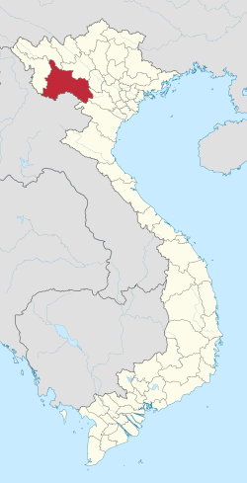


Work package 4: Business models
Objectives:
Co-design, co-testing and co-development of context specific innovation packages.
Identifying business models and delivery systems work best
Generating evidence on the effectiveness of innovative delivery systems to scaling out the adoption of technical livestock innovations packages
Co-creating gender and youth inclusive innovation packages
Carrying out a comprehensive assessment of the business models for cattle AI service to propose transformations for moving towards sustainable business models to make the activity profitable and inclusive.
Son La Province

Slide 4
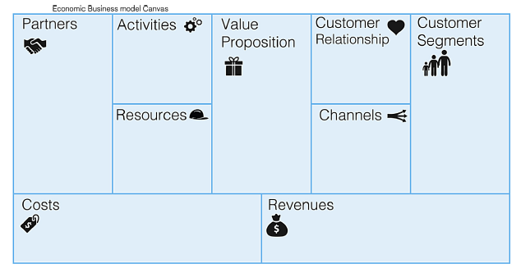
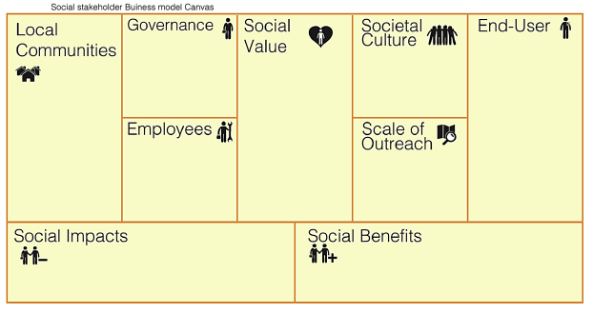

Work package 4: Comprehensive assessment of BM and SBM design
Innovative and inclusive delivery systems for improve the adoption through the providers
Co-design inclusive innovation strategies and make it available to service suppliers and boost the offer and profitability of the different animal welfare technologies packages
Alternatives to make the supply of animal welfare’s technological packages affordable, sustainable and available for livestock keepers and promote the adoption
Sustainable value proposal and channels tailored for delivering it, which fits with the demand of improved practices of animal welfare
Capacity building of service providers in the development of SBM
SBM AI providers
Genetics
WP1
SBM
Feed & Forages
WP1
Social layer of BM
SBM Animal Health
WP1
Economic layer of BM
Describe and analyze the different BM for the animal welfare technologies and practices provision
Identify gaps and opportunities to improve (linkages and sustainability)
Gender and social inclusion approach

Slide 5
Work package 4: Comprehensive assessment of BM and SBM design
Activities and timeline:
• To analyze two layers of a business model (BM) for cattle AI: Economic and Social
• Qualitative approach mainly, including key informant interviews (KIIs), focus group discussions (FGD) and costing workshops.
KIIs: • Target population: providers of AI service for cattle (women and men) • Objective: To collect information of the business model (economic and socio-environmental layers) • Estimated duration: 2 hours • Made up by: Two modules and 64 questions • Sample size: potentially 15-20 respondents | FGD and KIIs: • Target population: Other stakeholders related to the AI service for cattle • Objective: To collect information for describing the social layer of BM. • Estimated duration: 4 hours • Made up by: Four main topics of value mapping and 21 questions • Sample size: * Cattle farmers: Hat Lo and Co Noi communes: 4 FGD (each one with 8-10 women and men) and 12-15 KIIs of women and men farmers who have used cattle AI. Chieng Luong and Chieng Chung communes: Approximately 12-15 KIIs * Other stakeholders (4 communes): Approximately15-20 KIIs | Costing workshops: • Target population: providers of the AI service for cattle • Objective: Gathering data to financial analysis and economic indicators • Estimated duration: 1 day • Made up by: Five activities • Sample size: potentially 15-20 respondents

Slide 6
Interactions with other work packages
Animal health
Feed and forages
Genetics and breeding
WP1. Technologies and practices for sustainable livestock productivity
WP5. Evidence, decisions and scaling
WP4. Competitive and inclusive livestock value chains
WP2. Safe livestock derived foods as part of diverse diets
WP3. Equity and inclusion

Slide 7
!
Contact information:
Karen Marshall
Email: k.marshall@cgiar.org
Stefan Burkart
Email: s.burkart@cgiar.org

