Slide 1
Photo report on Africa RISING Project Key Partners Meeting and Field Visit to Intervention Areas
13 and 14 May 2018
Maychew, Tigray

Slide 2
Introduction
Africa RISING in the Ethiopian highlands has started the second phase implementation since October 2017. During the first year, the project managed to conduct action research through Research for Development (R4D) approach and scaling activities with strong development partnership. The R4D activities are mainly on livestock feed resources, improved crop varieties, watershed management and fertilizer studies. The scaling work focused mainly on demonstration of crop, livestock and Natural resources Management (NRM) validated innovations/technologies, seed multiplication and facilitating dissemination to reach more areas and farmers.
As part of the scaling activities, the project organized a one-day meeting with Key partners in Maychew, Tigray. This meeting which was held on 13 May 2018 had the objectives of introducing Africa RISING to new partners and individuals, updating on the scaling and R4D activities, identifying opportunities and challenges from previous year, developing action plan for the coming cropping season and strengthening partnership. The meeting brought around 25 individuals representing zonal and woreda agriculture and livestock heads and experts, non-government partner institution representatives and farmers.
On 14 May , the Africa RISING team visited some intervention areas in Emba Hasti kebele to observes the work on the ground.

Slide 3
Activities | Time | Responsible
Participants Registration | 8:30 AM- 9:00 | Organizers
Welcoming /Briefing the objective of the meeting | 9:00 – 9:10 | Simret
Opening speech | 9:10 – 9:15 | Mr G/Zgabher Aregawi, head, Southern Tigray zone Agriculture office
Introduction of participants & setting expectation and ground rule | 9:15 - 9:30 | Simret
Africa RISING over view | 9:30 – 9:40 | Simret
Africa RISING Pathway to Partnership building- Innovation Platforms (IP) | 9:40 – 10:00 | Million
Discussions on the above presentations | 10:00 – 10:15 | Participants
Tea break | 10:15 – 10:30
Updating / Highlighting on 2017 scaling and Demos (Tree lcuerne, Oat/vetch, Lupine, Feed trough, fodder beat | 10:30 – 10:50 | Mohammed
Updating on available (validated) crop technologies, 2017 R4D / for 2017 scaling and demonstration including previous one | 10:50 – 11:10 | Mohammed
Discussion on the above presentation | 11:10–11:30 | Participant
Model farmers and DAs experience sharing | 11:30-12:00 | Model farmers
Partners scaling progress | 12:00-12:30 | Key partners
Lunch | 12:30– 1:30
Group Discussion - Possible discussion points Explaining the role of AR in the scaling up process: Questions for group discussion (Crop, Livestock and mixed groups) What were the major constraints that you faced during scaling up activities last year What resources/capacity/mandate do you have about the scaling up technologies the following What sort of partnership do you need to scale up the technologies | 1: 30 – 2:00 | Participant
Presentation and Plenary Discussion | 2:00–3:00 | Group presenters/Participants
Tea Break 3:00–3:15
Developing Action plan (woreda, Zone, NGos) | 3:15–3:45 | Participates
Presentation and Plenary Discussion | 3:45 – 4:15 | Participants
Way forward and closing | 4:15–5:00 | Mohammed and G/Ezgabher

Slide 4
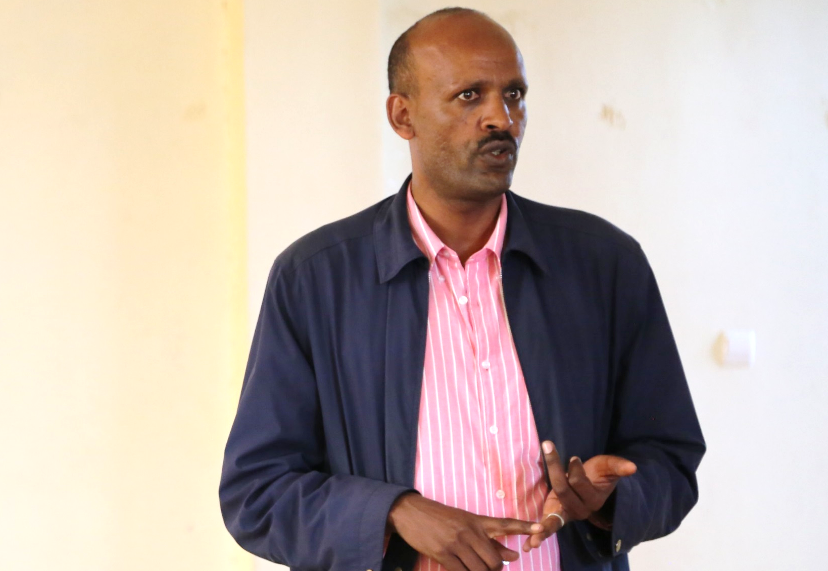
Mr G/Zgabher Aregawi, head, Southern Tigray Zone Agriculture office delivering an opening speech

Slide 5
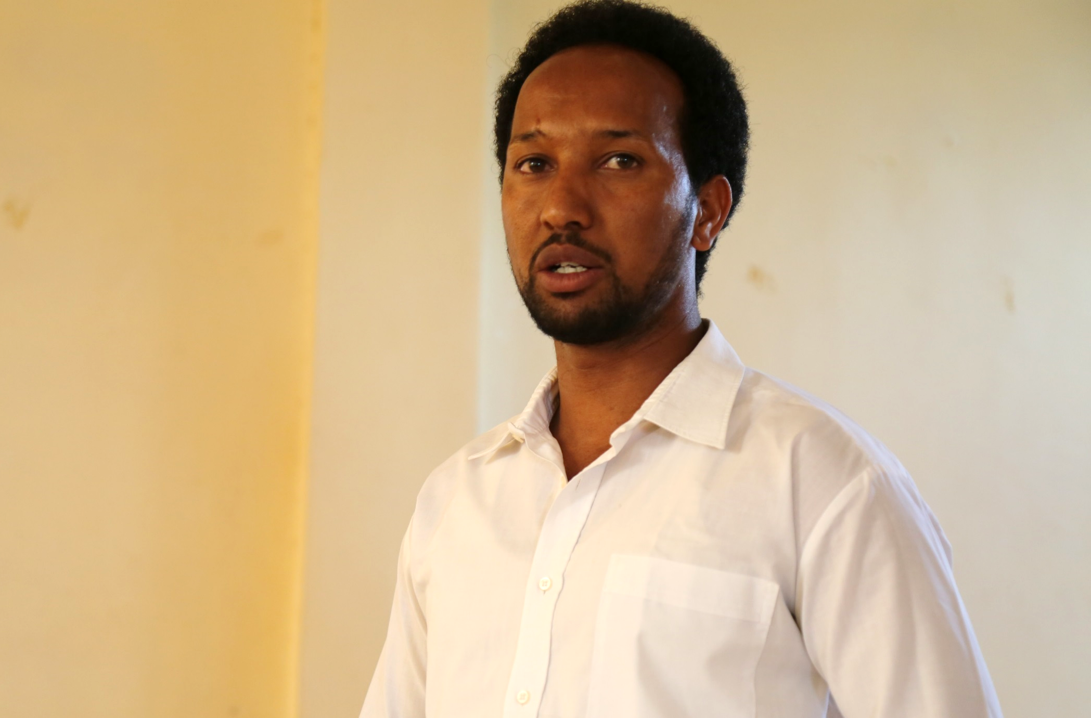
Mohammed Ebrahim , Africa RISING site coordinator in Tigray presenting the 2017 overall activities

Slide 6
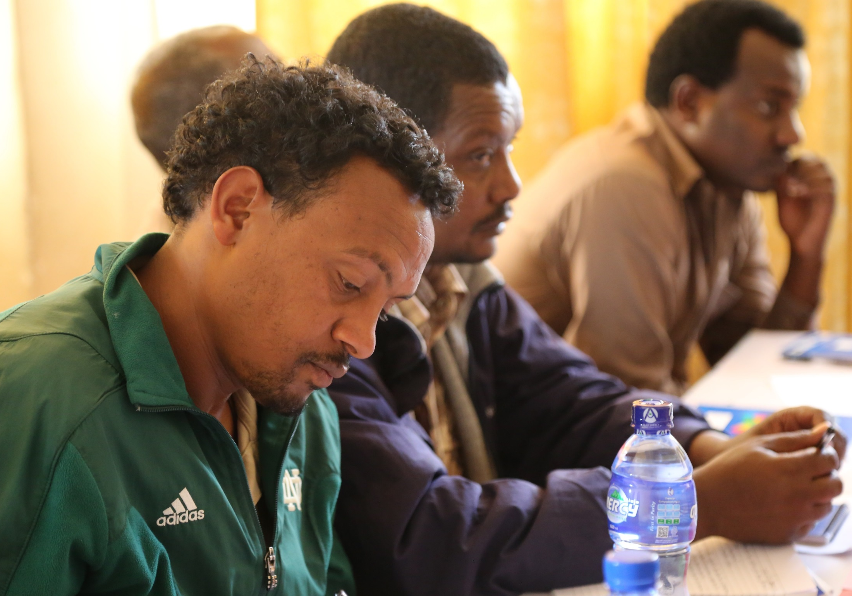
On the left , Gebru Teklay, Ofla woreda crop contact person

Slide 7
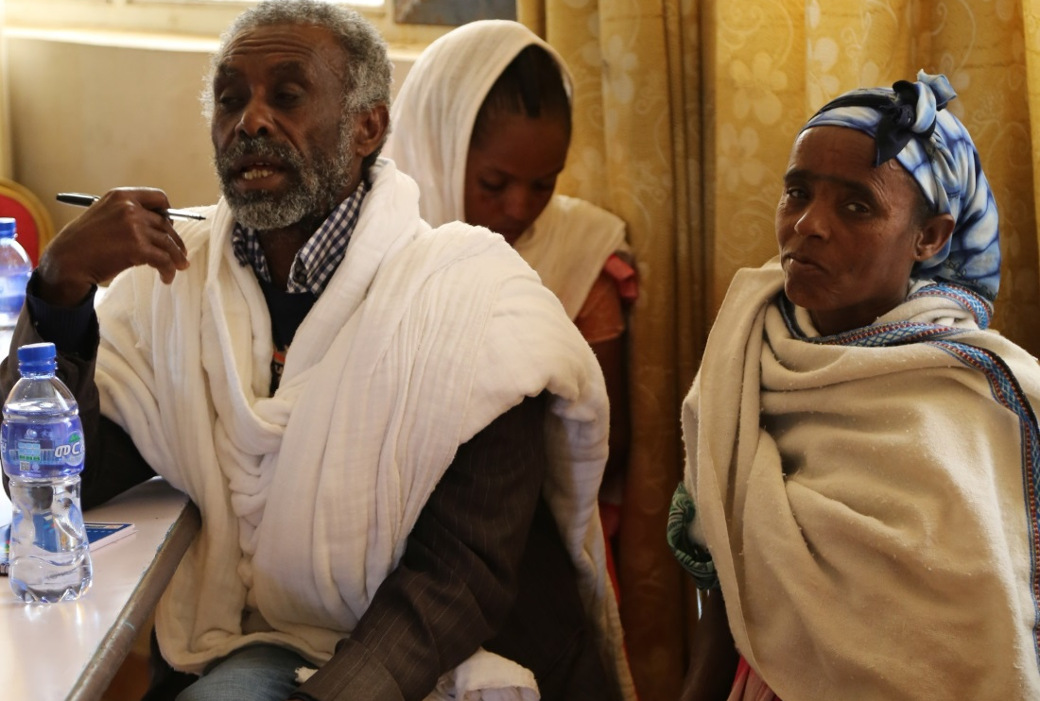
Left , Kes Birhanu Aregawi, Africa RISING Model Farmer from Emba Hasti Kebele

Slide 8
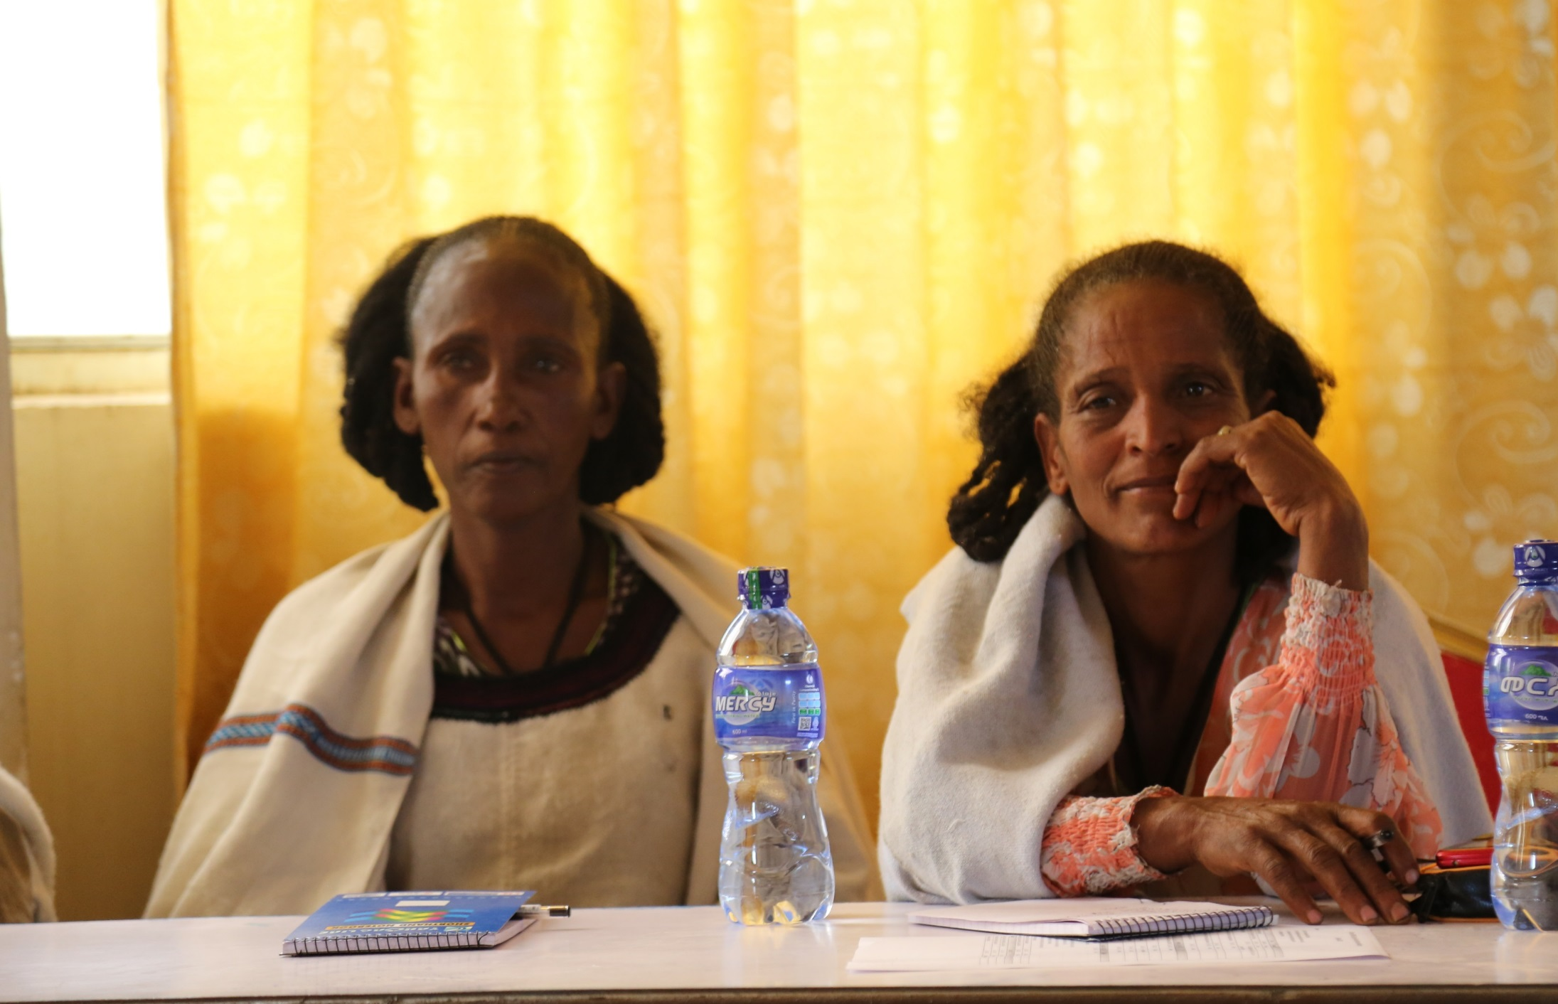
Behafata Meresa (Left) and Fitale Eyasu (right) from Emba Hasti kebele

Slide 9
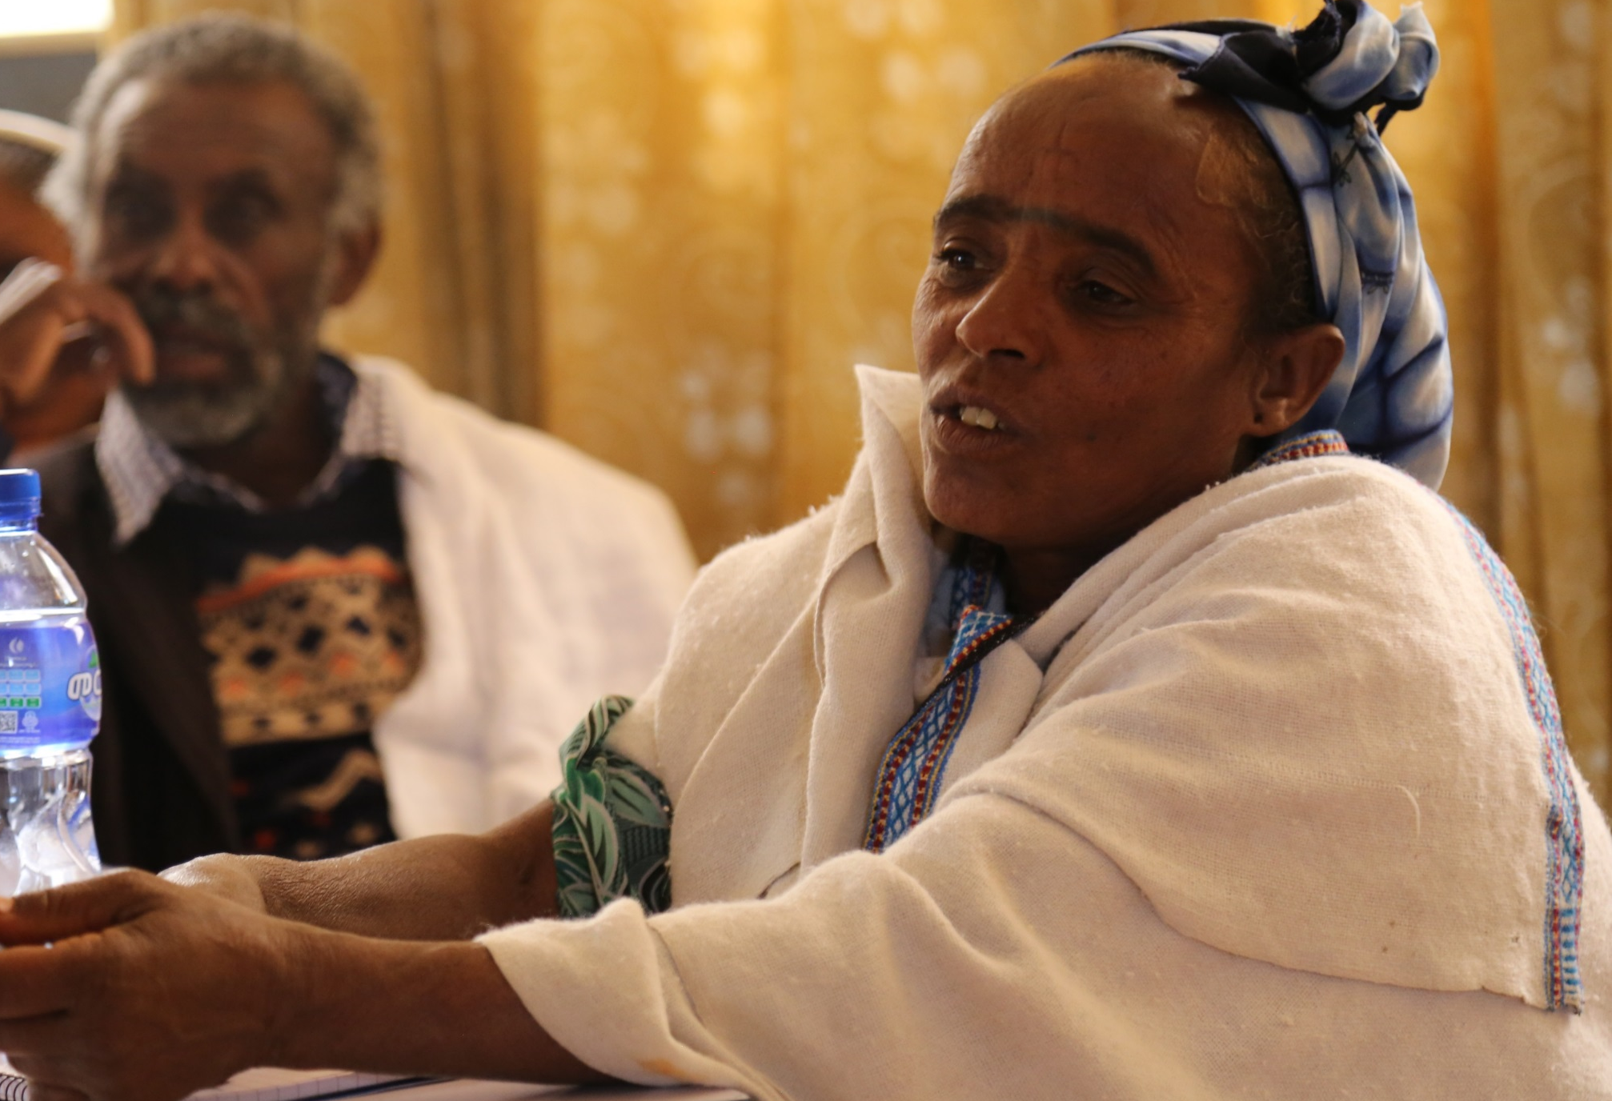
Amakelech Meresa, Africa RISING model farmer from Emba Hasti Kebele sharing here experiences

Slide 10
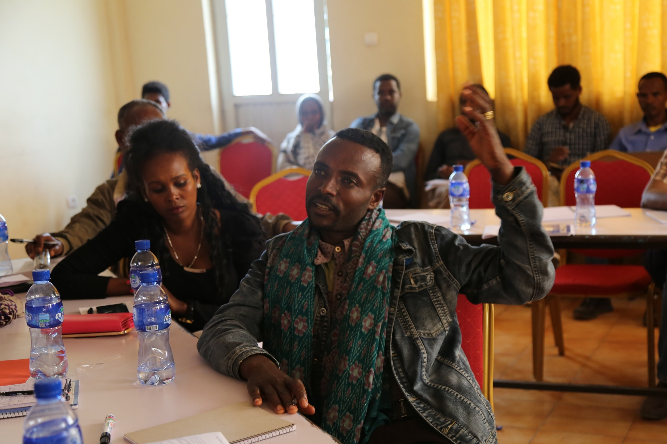
Hayelom Gidey, Africa RISING model Farmer from Tsibet kebele sharing his experience

Slide 11
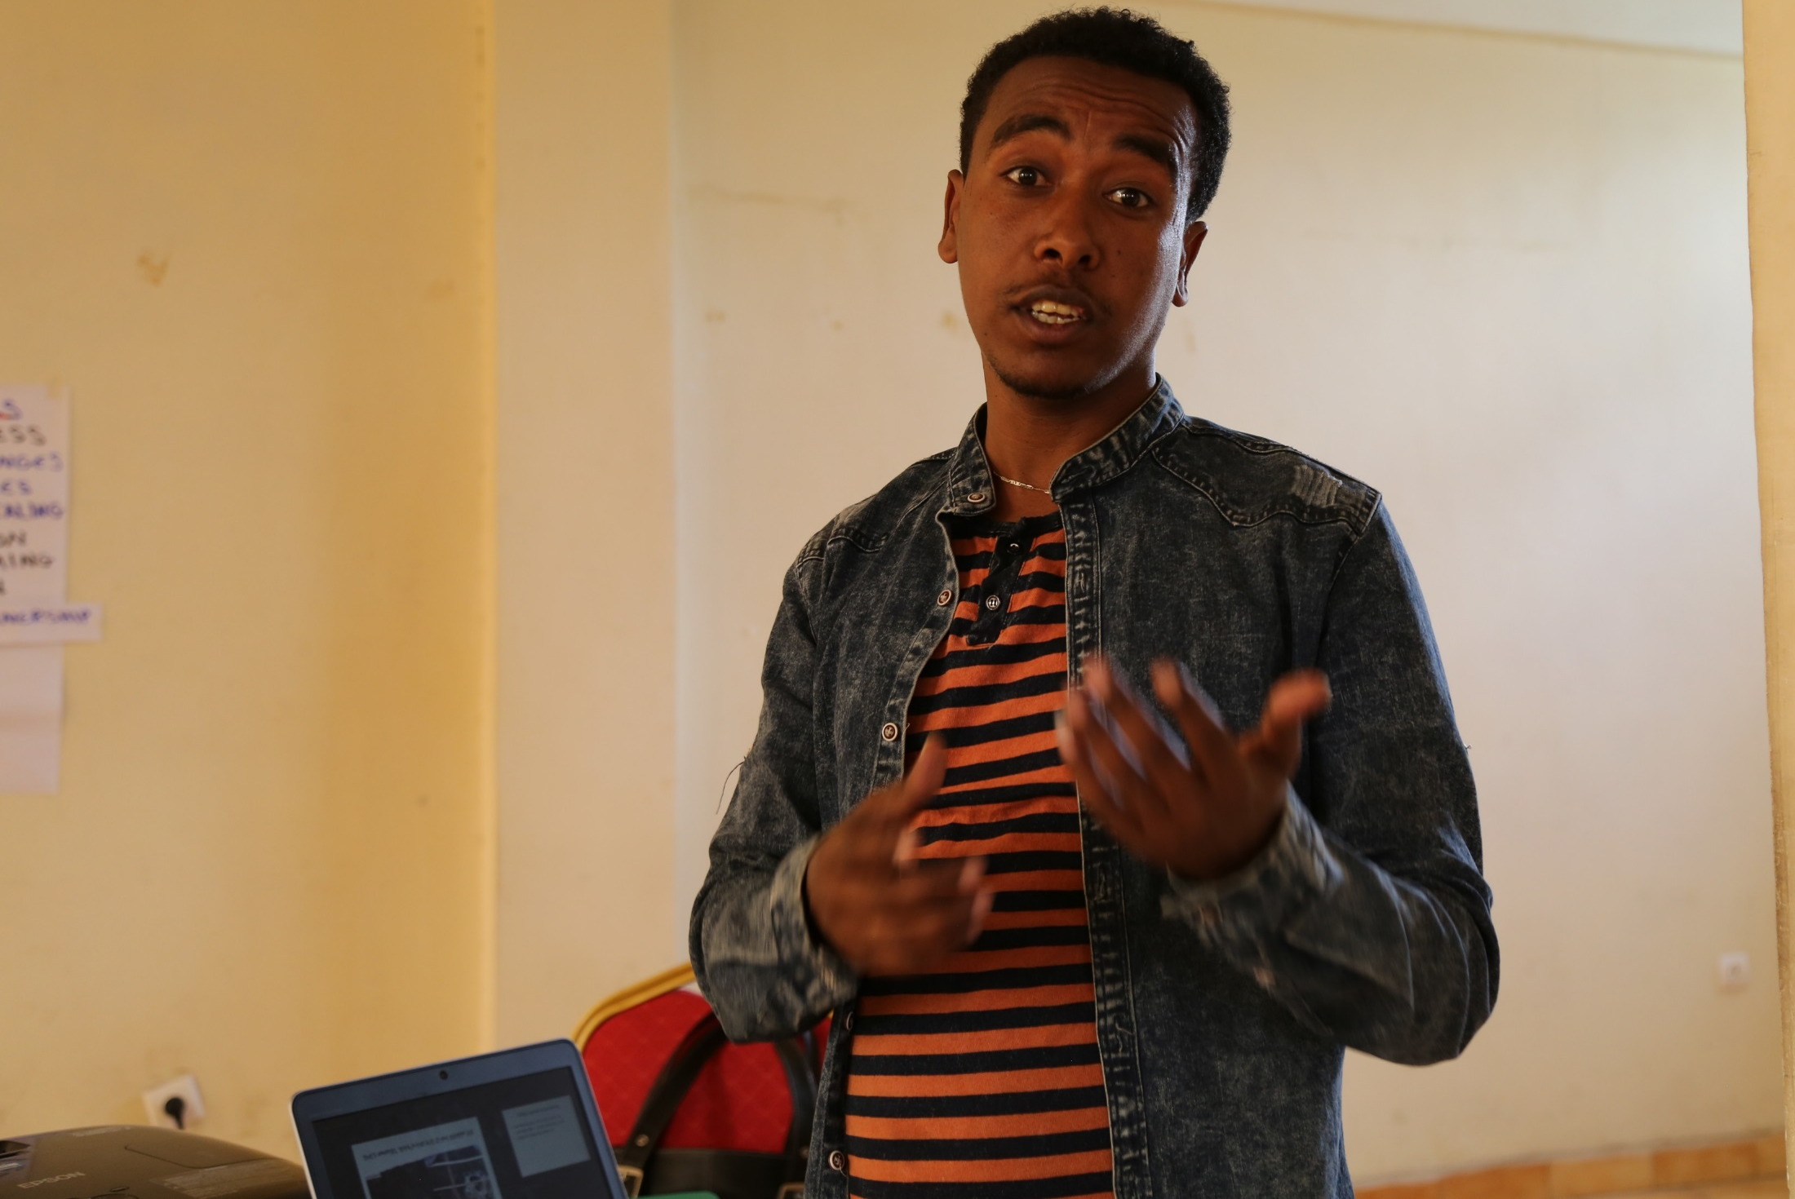
Menber Birhane, Ofla woreda Livestock contact person, presenting the woreda livestock related scaling

Slide 12
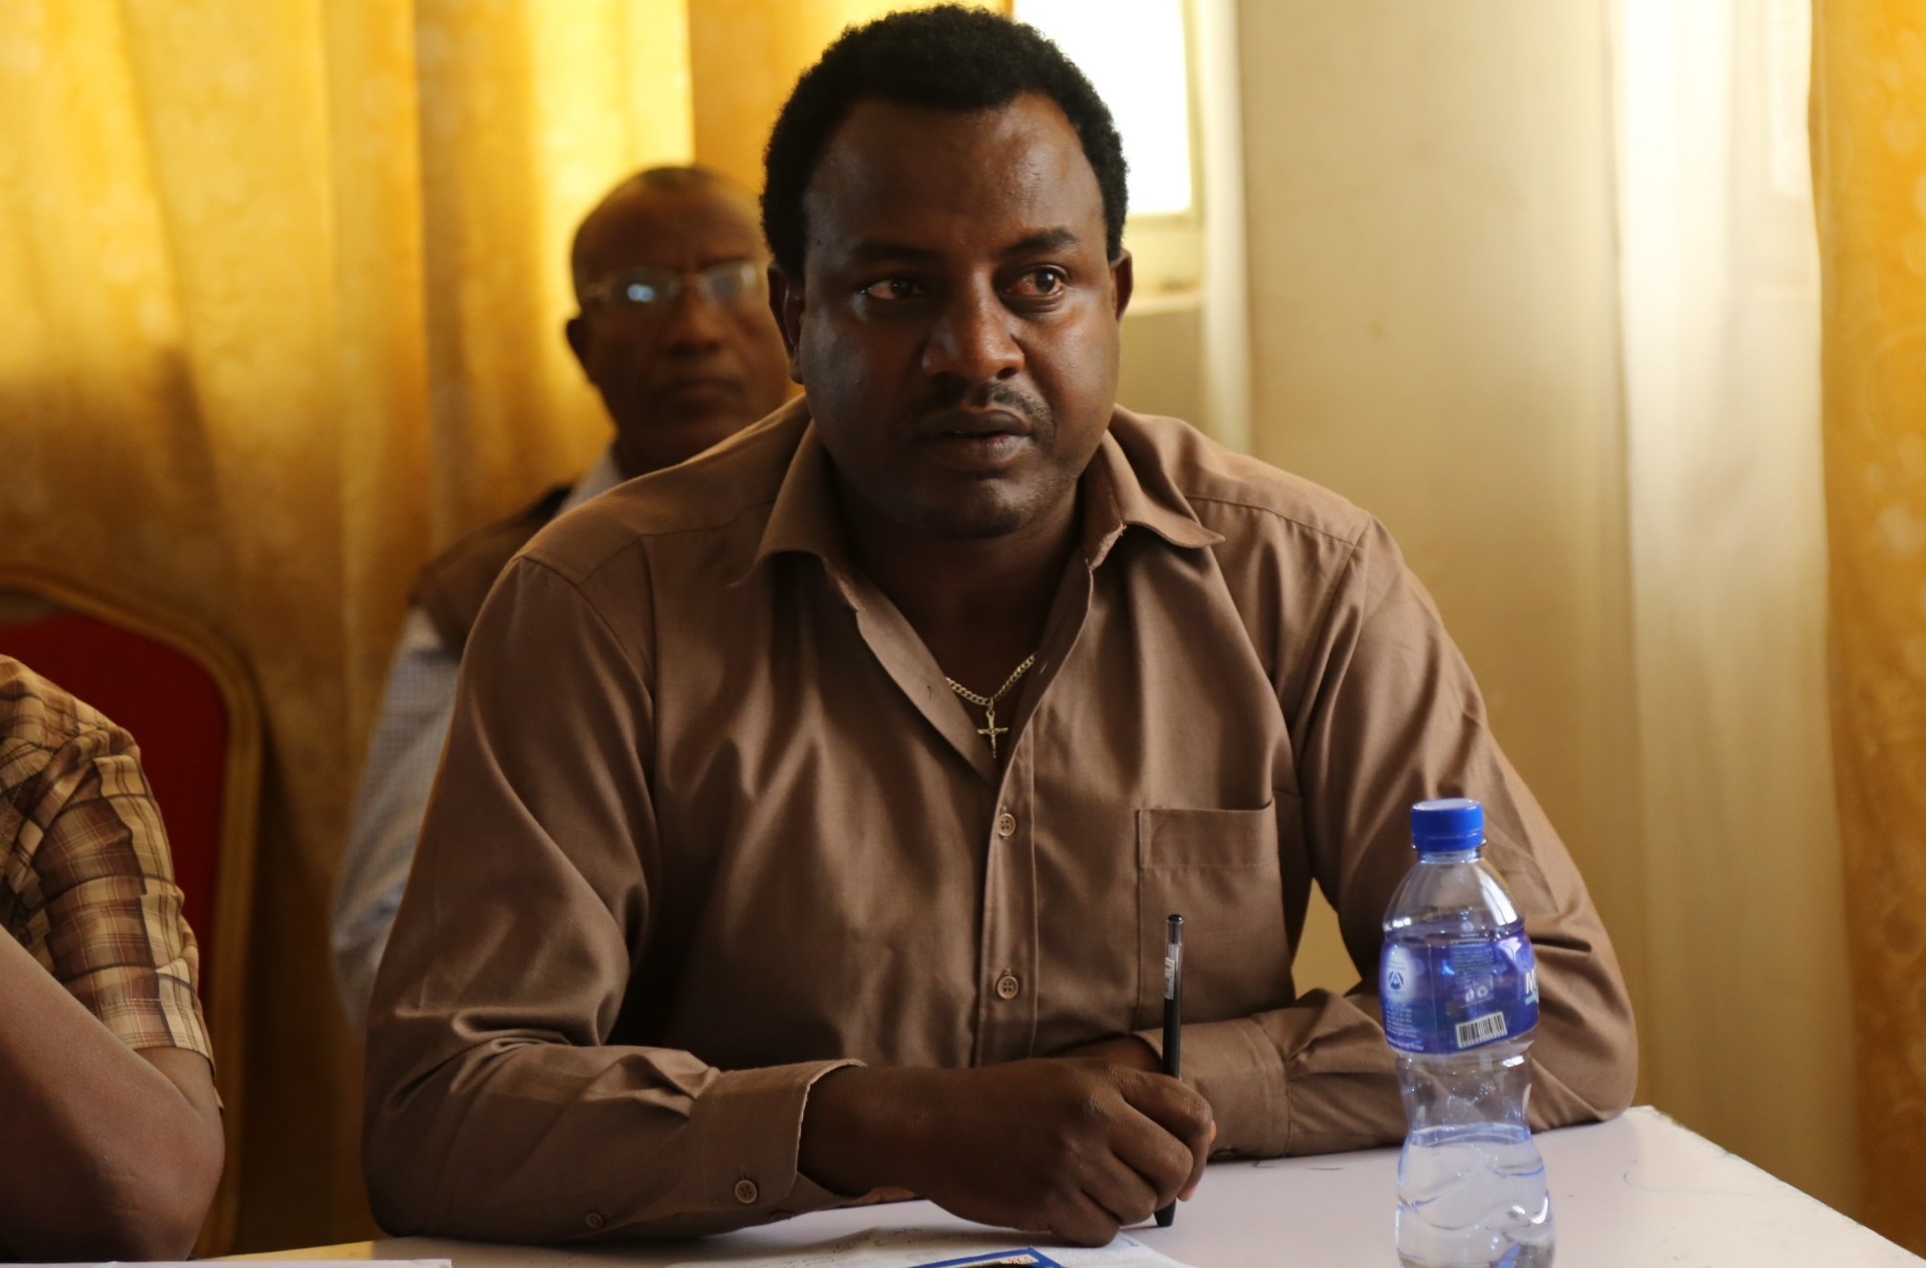
Solomon Wayu, Alamata Agriculture Research Center livestock researcher sharing the success and challenges they had in 2017

Slide 13
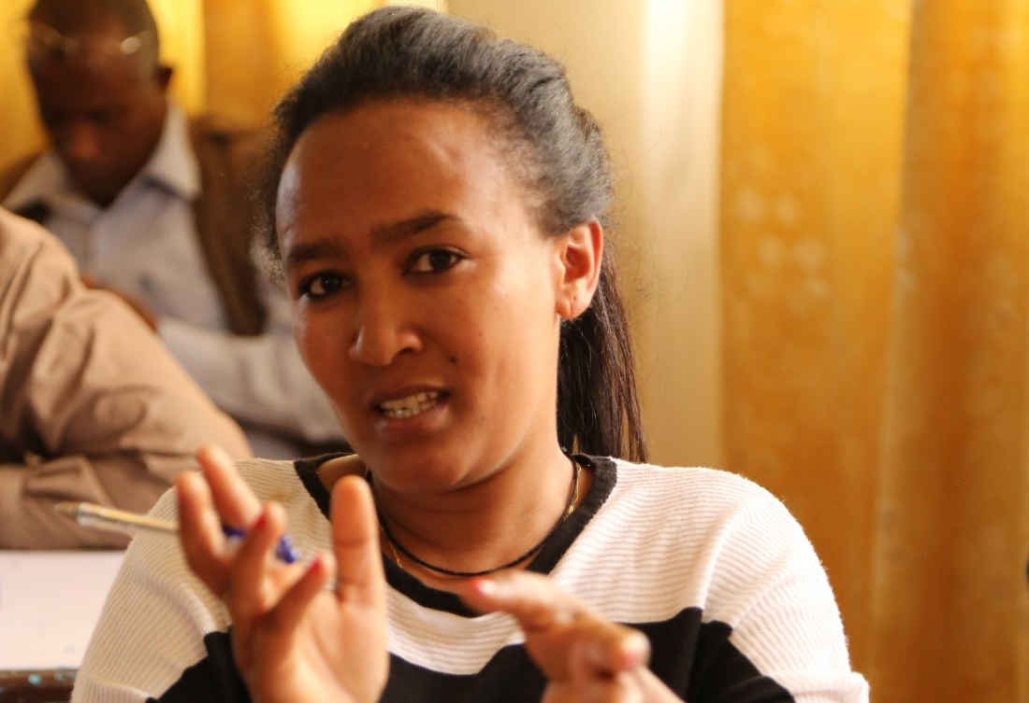
Abeba Tesfaye, Mehoni Agriculture Research Center Watershed researcher and Africa RISING gender representative

Slide 14
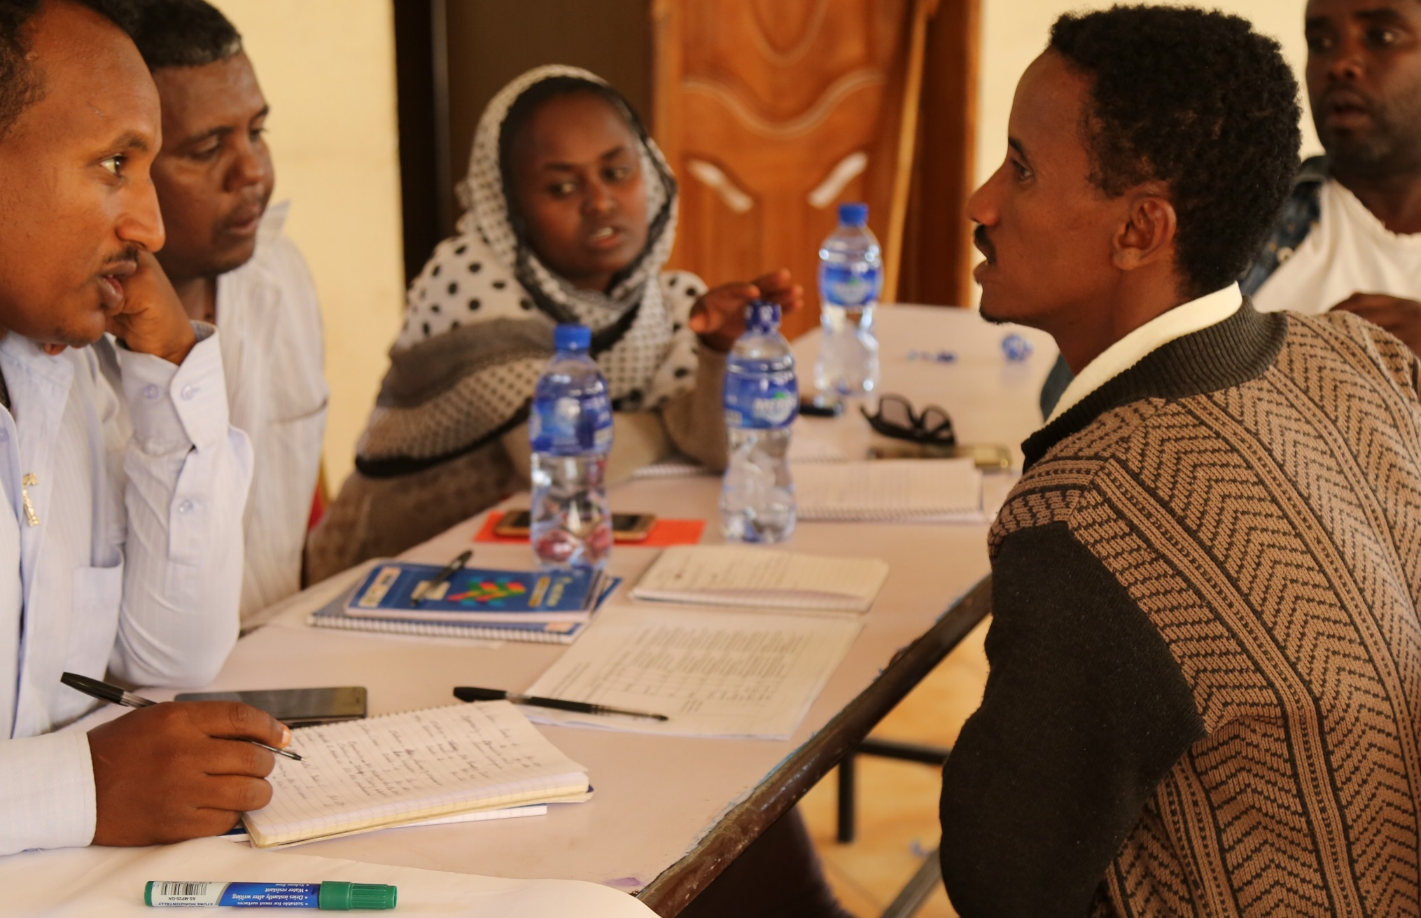
Alamata agriculture office team discussing on the major constraints during the last year scaling and the available resources/capacity for the coming cropping season

Slide 15
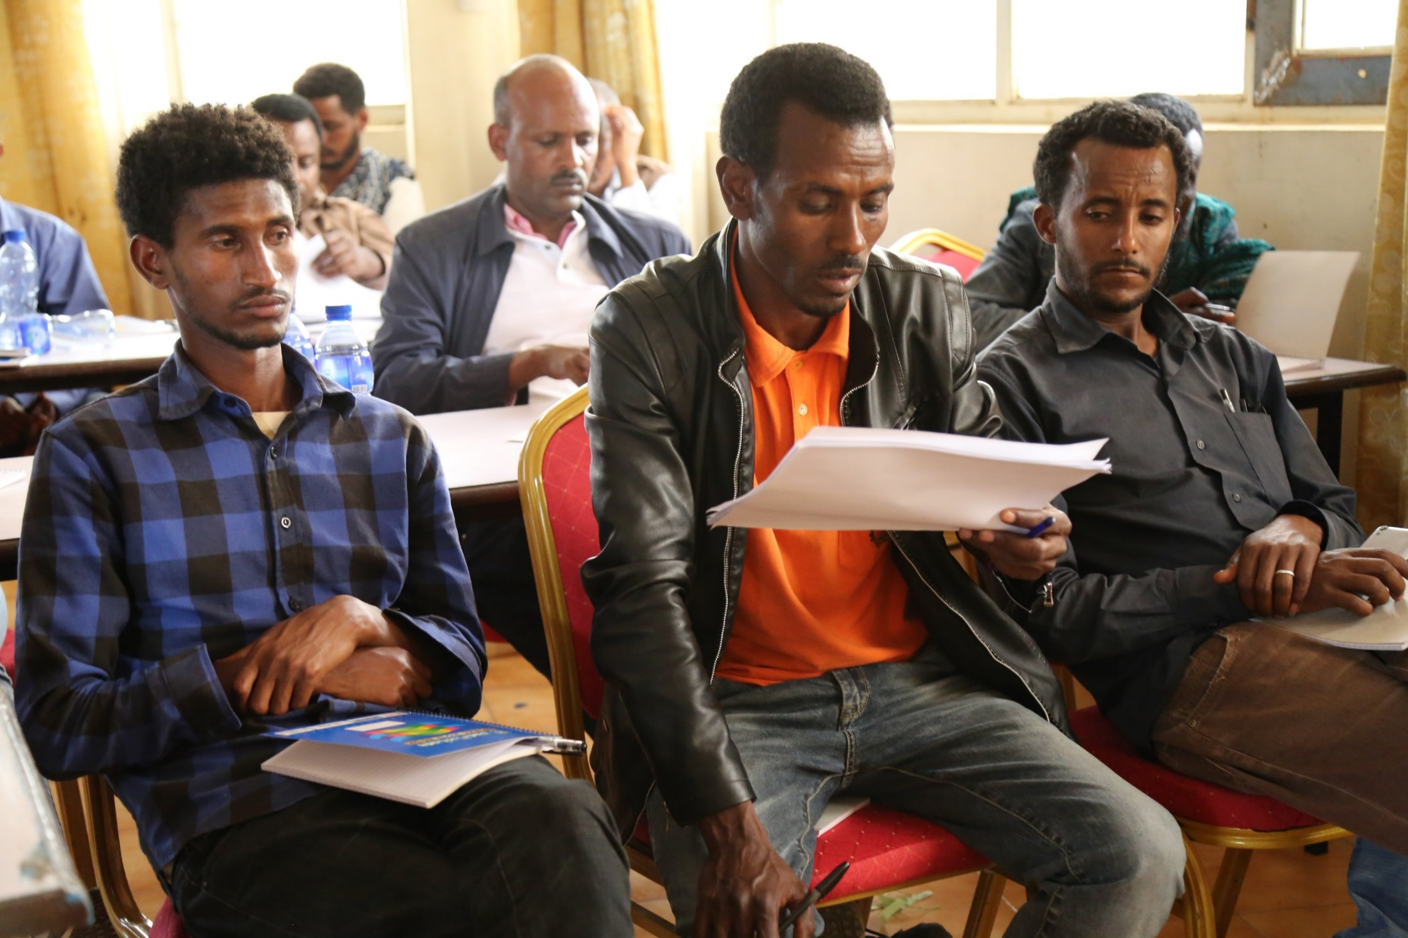
Kahsay Berhe(middle) form Endamehoni woreda presenting the outcome of the group discussion on action plan for the upcoming cropping season

Slide 16
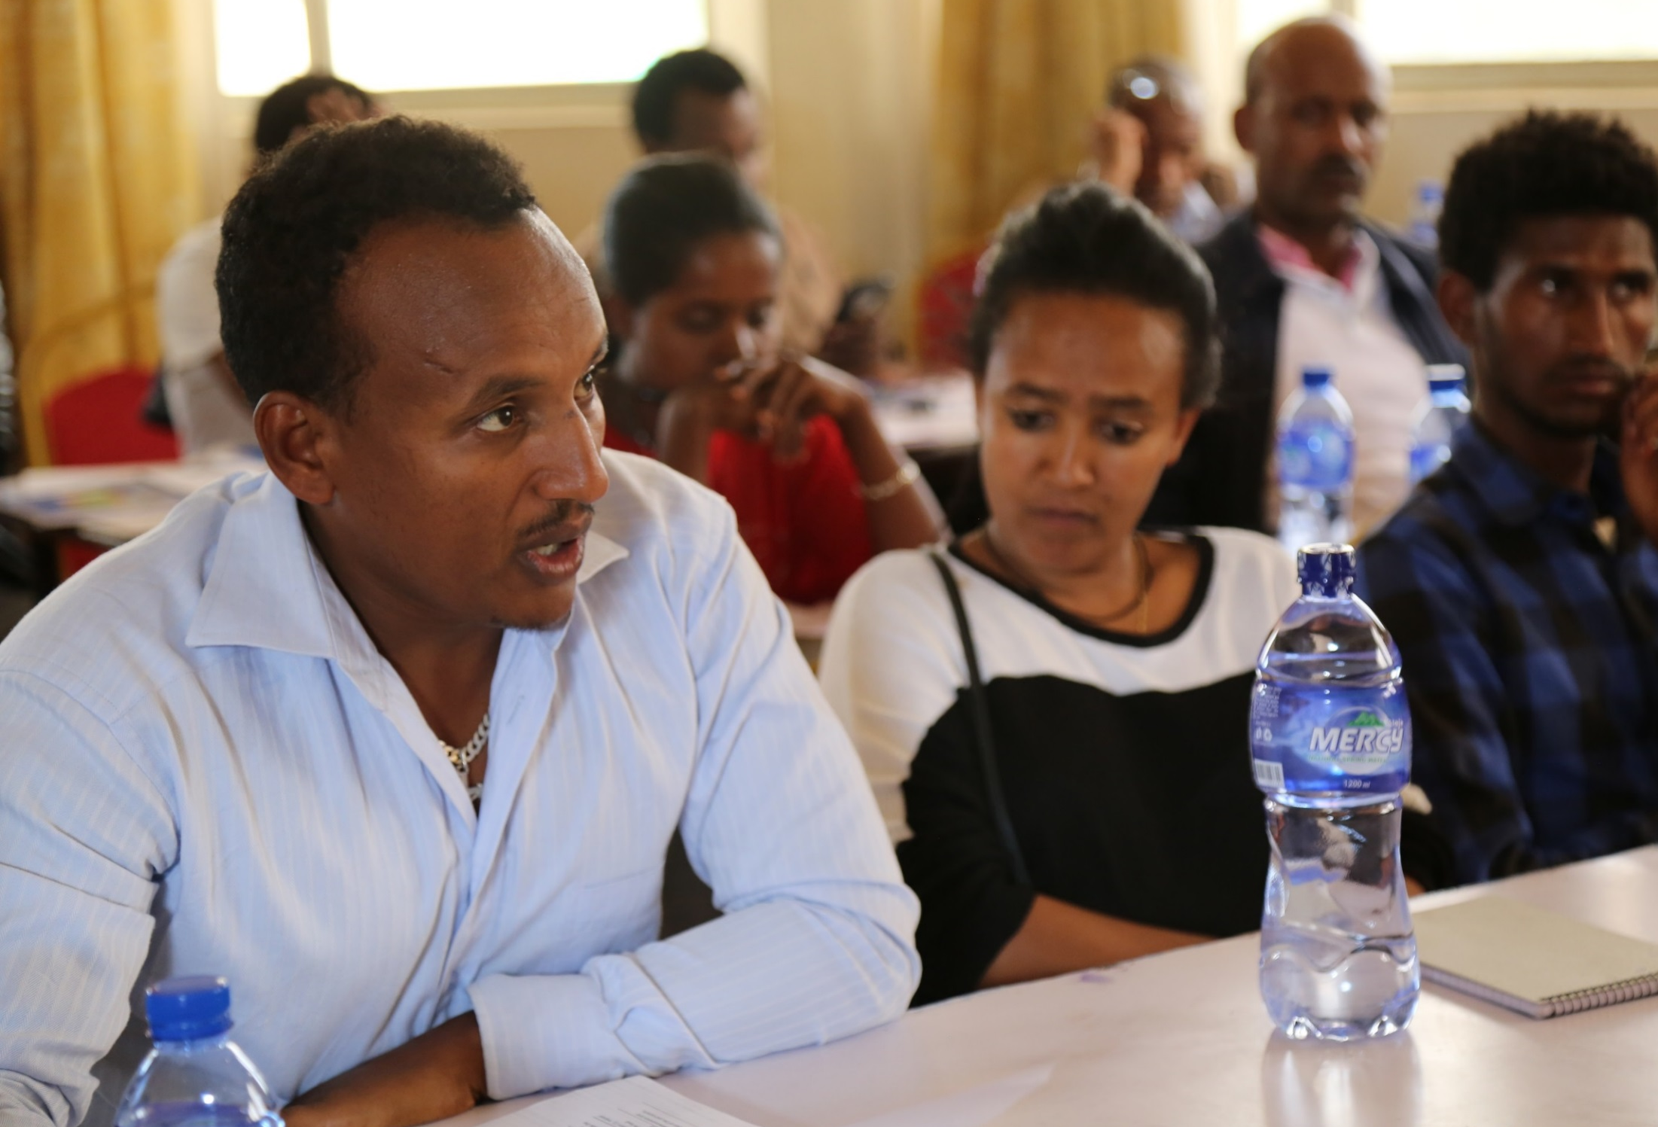
Getachew Abraha(left), Alamata Agriculture office

Slide 17
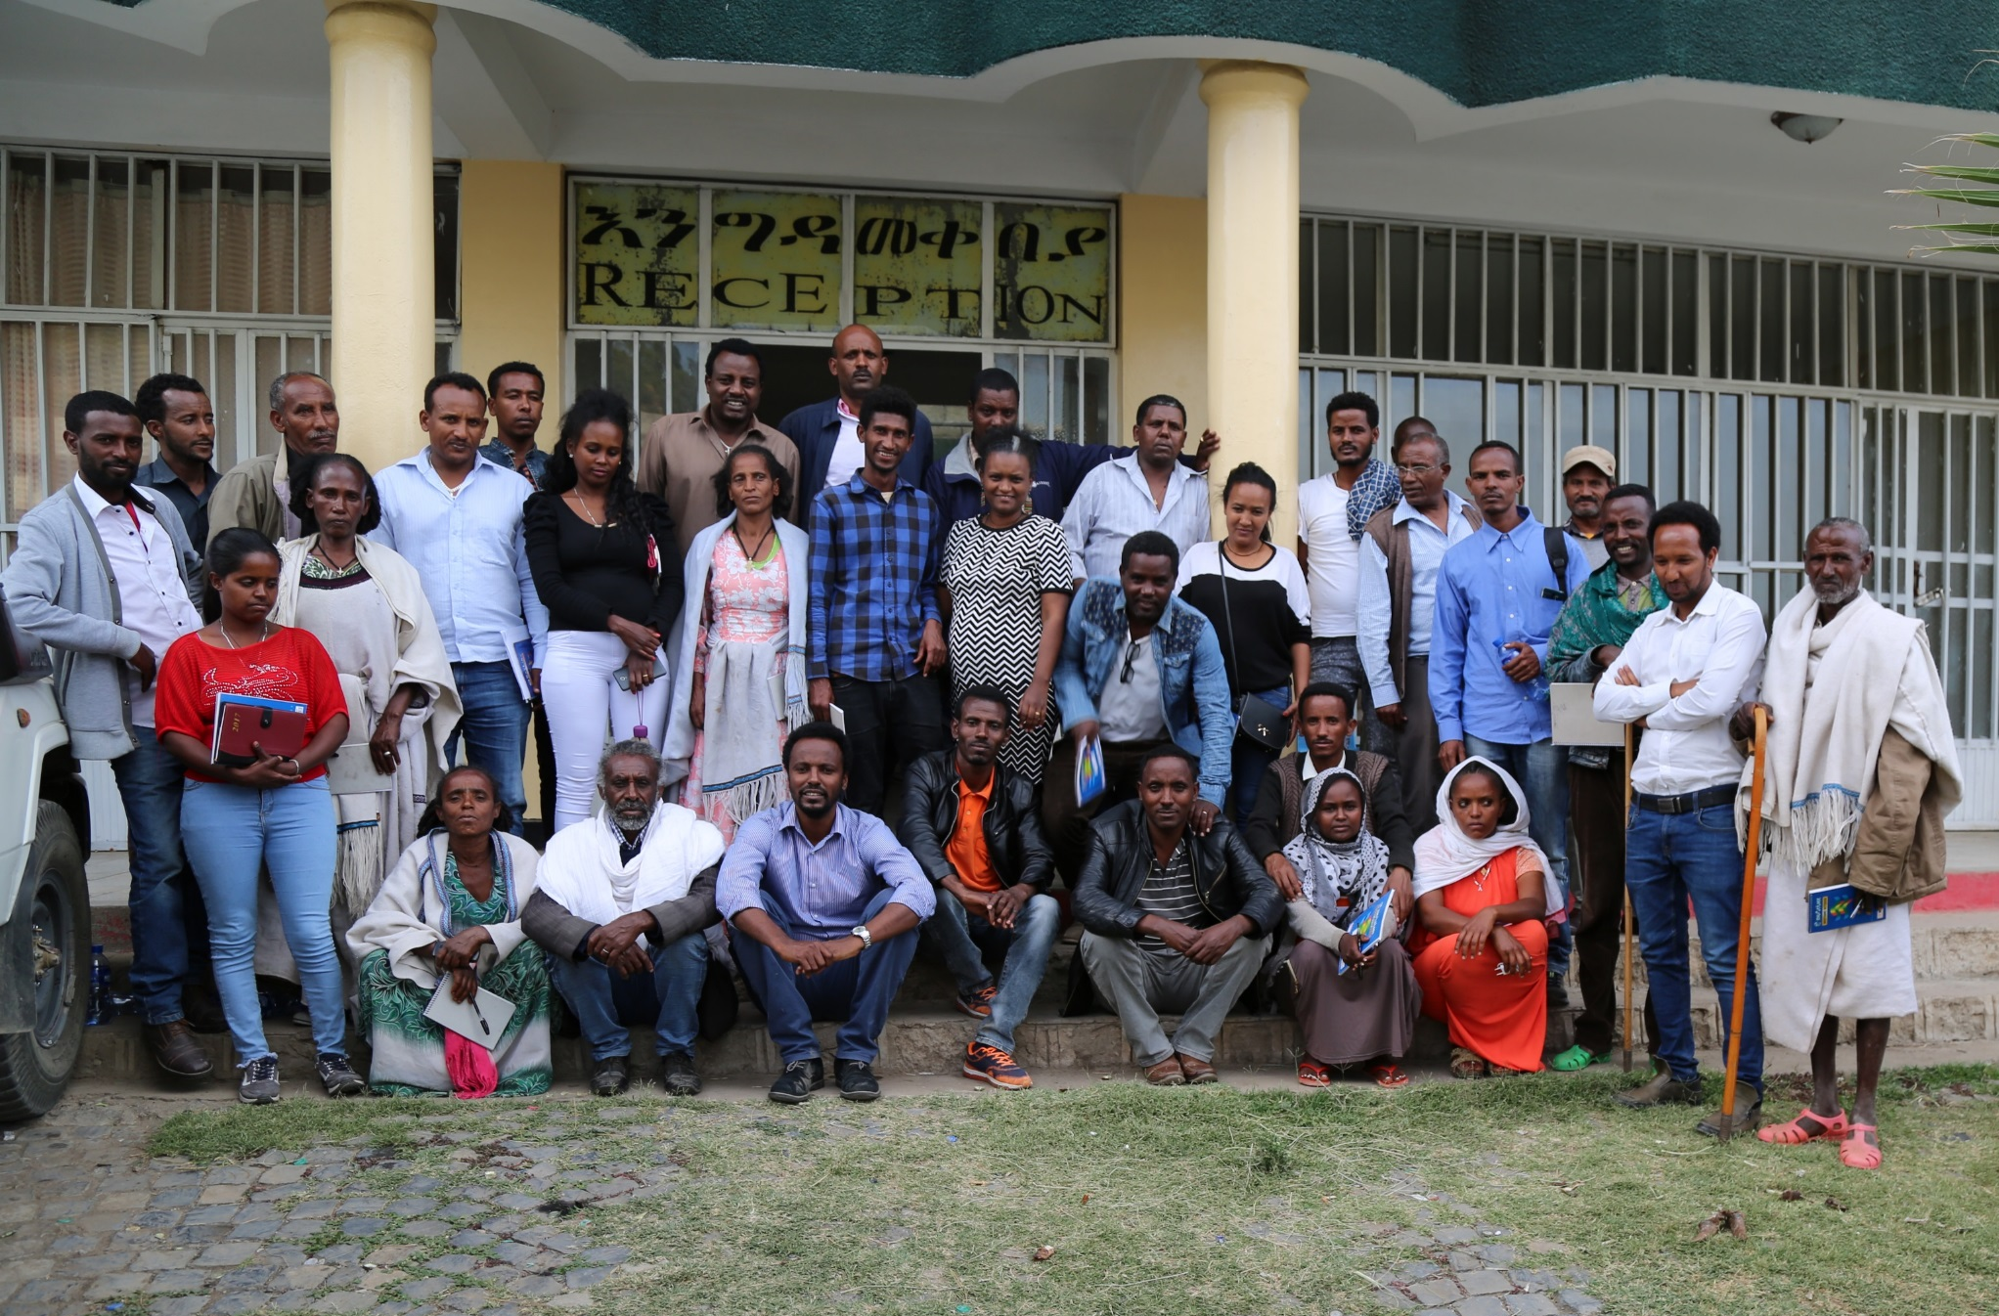
Participants group photo

Slide 18
Field visit
14 May 2018

Slide 19
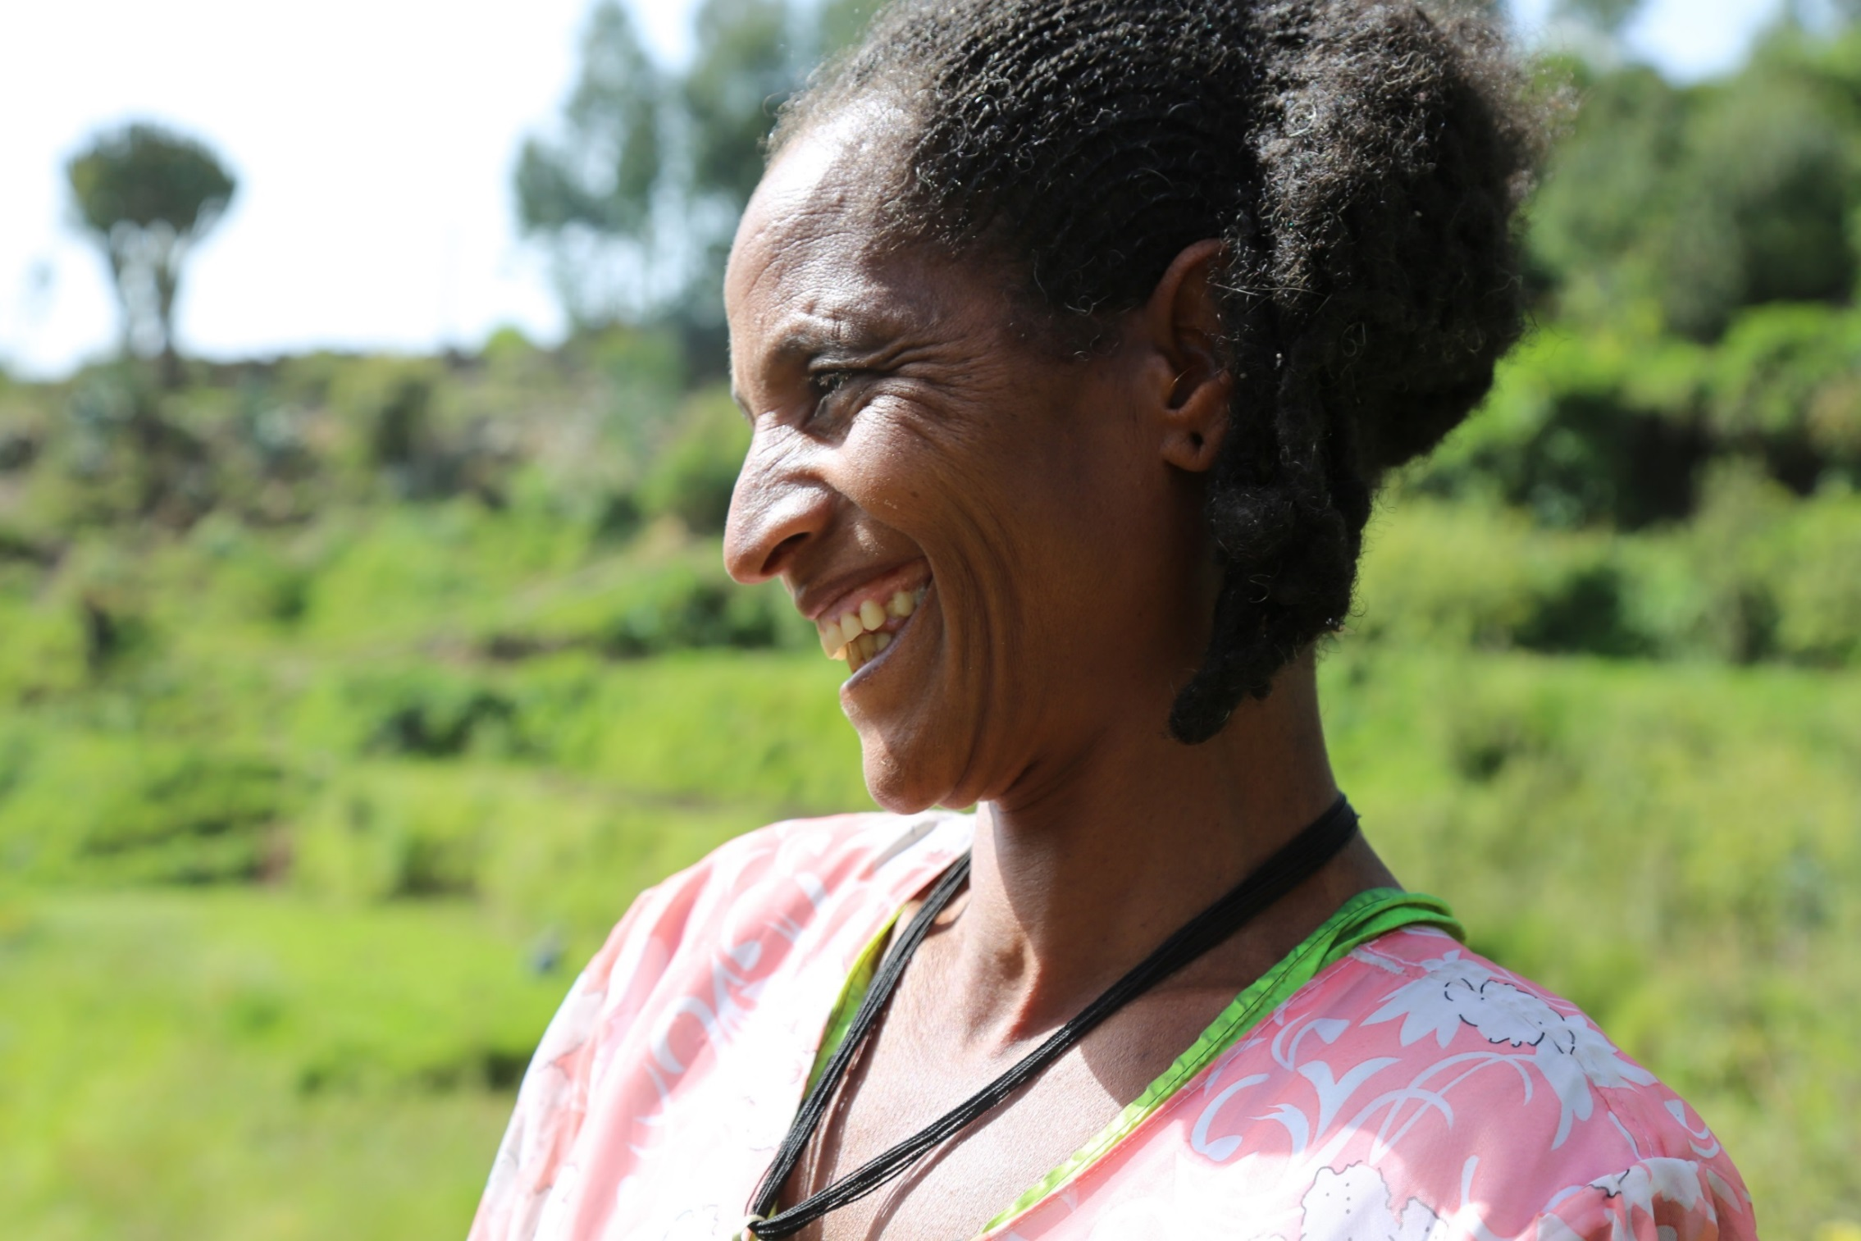
Fitale Euasu, Africa RISING Model Farmer from Emba Hasti kebele

Slide 20
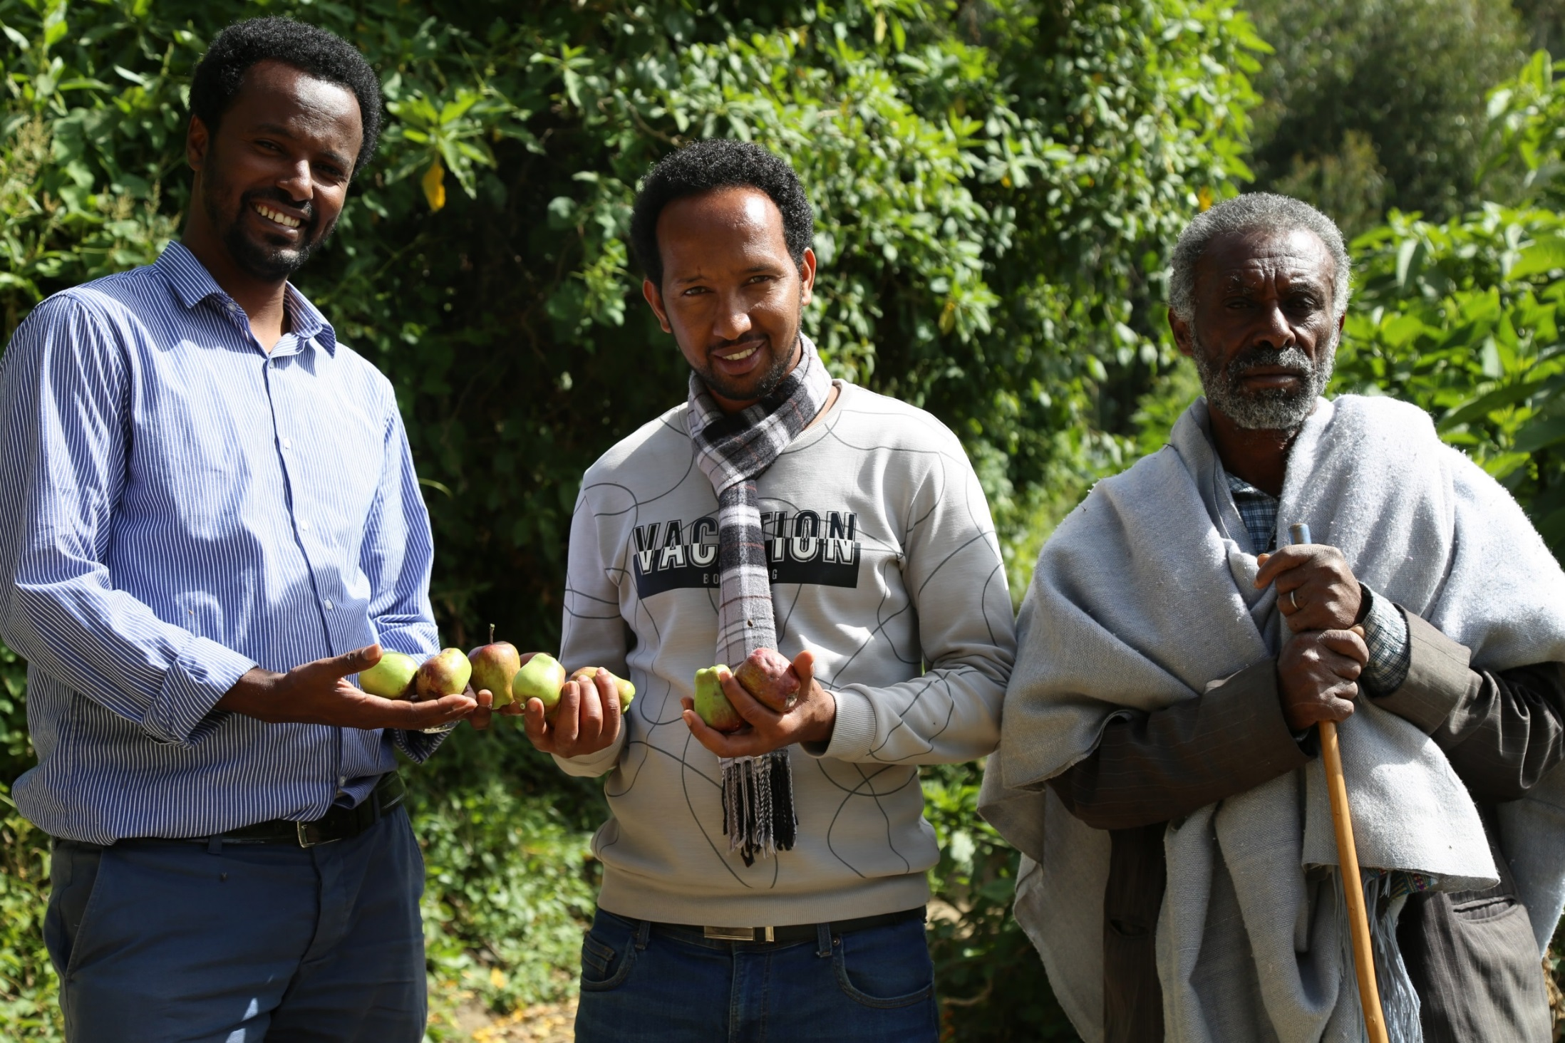
From left to right , Million Gebreyes, Mohamed Ebrahim and Kes Birhanu Aregawi vising Fitale Euasu’s Apple trees

Slide 21
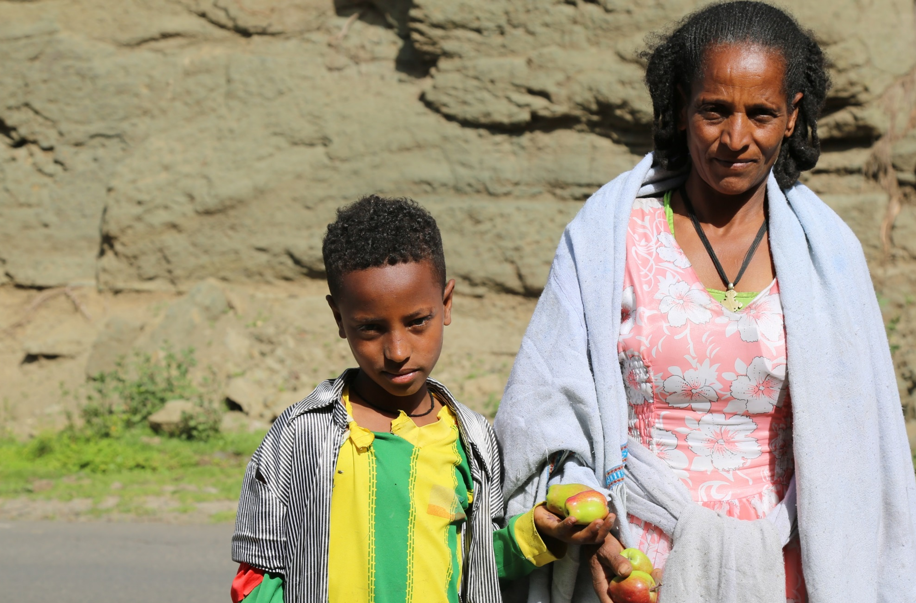
Fitale Euasu and her son bring apples to the market and sell one piece for about six to eight birr depending on the season

Slide 22
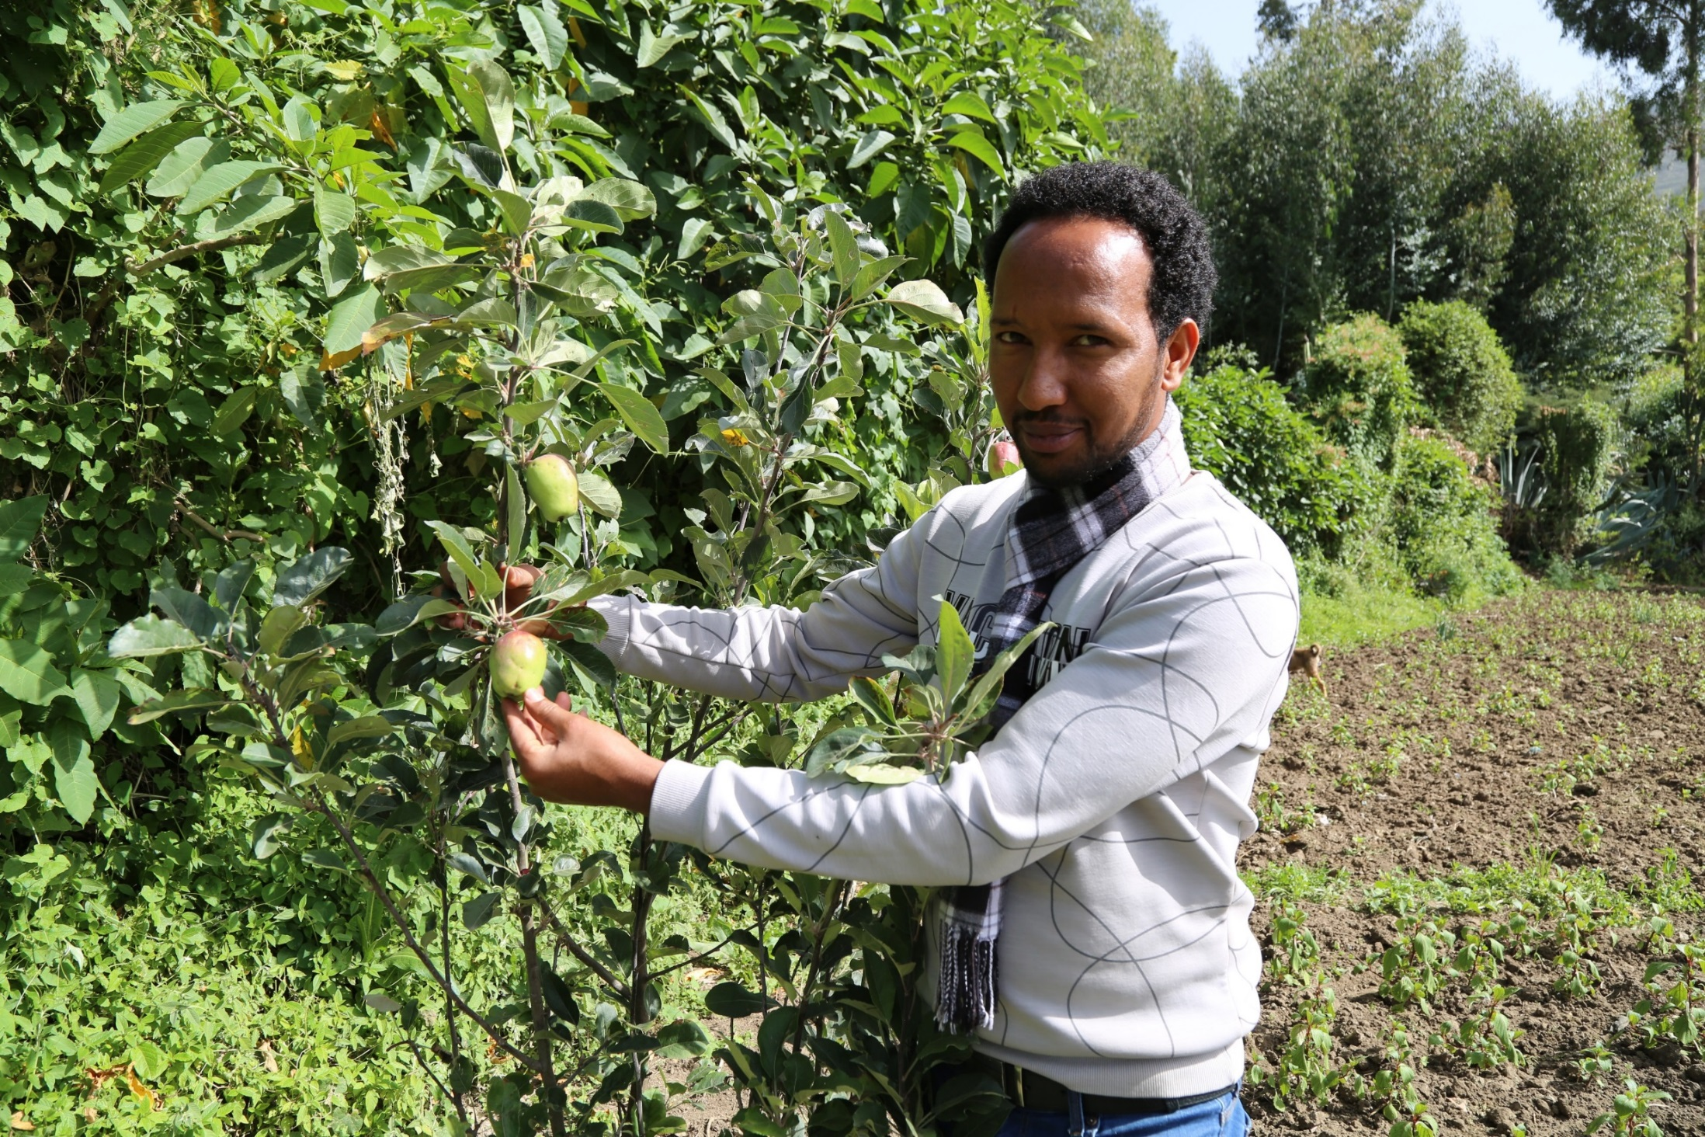
Mohammed Ebrahim, explaining to the team the performance of the apple fruit and the advantage farmers are getting either by consuming or selling it to the market

Slide 23










Africa RISING CGIAR partners in Ethiopia
Notes:
Ethiopia

Slide 24

Credits
Produced by Africa RISING Project in Ethiopia
Compiled by Simret Yasabu (ILRI)
Photos: Simret Yasabu
Our appreciation goes to local partner organizations and farmers in Africa RISING project operational areas of Tigray region.

