Slide 1
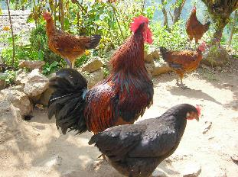
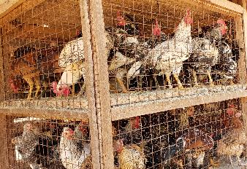
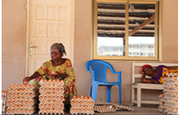


Tanzania and Ghana poultry value chains: a status report
Emily Ouma, Alessandra Galie, Christoph Weber, Dolapo Enahoro, Karl Rich, Nelly Njiiru, Amos Omore, and Isabelle Baltenweck
Presented at the 2019 IL_GIP AGM held at SUA on 8th Oct 2019

Slide 2
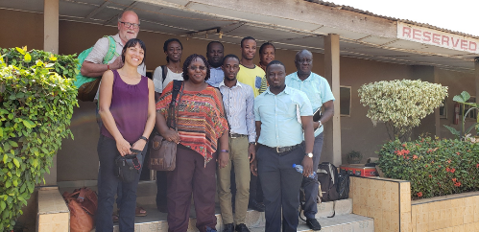
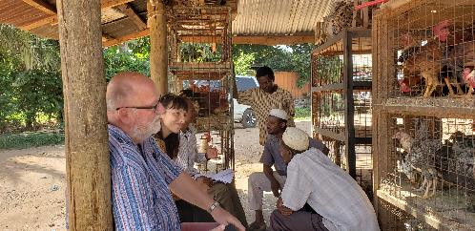
Progress
Objective 4: Conduct poultry value chain assessment and develop a business model for breeding and distribution of chicken line with enhanced ND resistance
Progress from Oct 2018
Scoping visits - to better understand the poultry value chains in Tanzania and Ghana, and to identify the potential target group/poultry systems for the chicken lines with enhanced ND virus resistance
Desk review to understand the context of the poultry sector – production systems, value chain, consumer demand, and enabling environment
Development of survey tools for value chain assessments and identification of preferred chicken traits
IRB clearances – ILRI and Ghana

Slide 3

The livestock sector in Ghana
Agriculture sector
Contribution to GDP – 19.7% in 2018 with a 4.8% growth (GSS, 2019)
Livestock sector
Contribution to GDP – 3% in 2018 (GSS, 2019)
At least 70% of the population rears one kind of livestock
Poultry
sector
Poultry population growth of 40% between 2011 – 2017, mainly from layer population increase (SRID, 2017)
Cocoa - an important source of export earnings
Dominated by crops sector, which contributes 14.6% of the GDP
Meat (both livestock and poultry) contributes 40% of the national animal protein supply, with the rest coming from fish.

Slide 4


Livestock population
Trends in livestock population (in ‘000’) in Ghana
Species | Period (in years)
 | 2011 | 2012 | 2013 | 2014 | 2015 | 2016 | 2017
Cattle | 1,498 | 1,543 | 1,590 | 1,657 | 1,734 | 1,815 | 1,901
Sheep | 3,887 | 4,019 | 4,156 | 4,335 | 4,522 | 4,744 | 4,978
Goats | 5,137 | 5,435 | 5,751 | 6,044 | 6,352 | 6,740 | 7,151
Pigs | 568 | 602 | 638 | 682 | 716 | 777 | 816
Poultry | 52,575 | 57,885 | 63,732 | 68,511 | 71,594 | 73,885 | 75,363
Source: Statistics, Research and Information Directorate, MOFA, 2017
Notes:
1. Poultry contributes about 80% of total livestock population
2. Growth rate of more than 40% b/w 2011 – 2017; Poultry, pigs and goats
3. High population rise fuelled by removal of customs duties on poultry inputs (such as feed, feed additives, drugs and vaccines) and improved access to veterinary services

Slide 5
Ghana poultry species %, based on population
Source: Veterinary Services Directorate, 2010

Slide 6
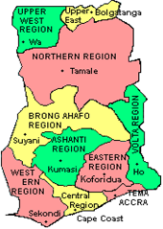
Poultry production types and systems in Ghana
Distribution of indigenous chickens, by region
25 Mn local chicken breeds (2014 estimates)
Mainly backyard free range systems by smallholders, having about 20-50 birds/household
Important source of livelihood for many rural based households, especially women
Farmers mix the chicken with guinea fowls, turkey and ducks
Low input system – minimal feed supplementation
High bird mortality rates
Low chick hatchability and chick survival
Egg production: 3 clutches/year
Approx. 15 eggs/clutch
Notes:
The local chicken breeds are dominant in the Northern part of the country (more than 50% of the indigenous breed population) due to availability of land for practising free-ranging. The local chicken and guinea fowls produced in the North are bulked and marketed to urban areas all over the country.
Producers use local herbs and antibiotics such as Amoxillin to prevent diseases , a few vaccinate against ND

Slide 7
Poultry production types and systems in Ghana
Distribution of layers, by region
Dominant poultry type
Population of 23 Mn layers raised under commercial systems (2012 estimates)
Layers mainly raised indoors on either deep litter or battery cage systems – high productivity about 250 eggs annually
High investments costs including, purchase of imported DOCs, well formulated diets, vaccines, drugs, and strict biosecurity practices
Dominated by large commercial farms that are vertically integrated, owning breeder farms, hatcheries and layer farms
Notes:
1. Maize is the main feed ingredient for energy, soybean for protein and premixes for vitamins and other trace minerals.
2. Ashanti and Brong Ahafo regions account for about 39.7% and 36.5% respectively of total eggs produced in Ghana. These comprise the forest-Savannah transition zones which are maize growing reas

Slide 8

Poultry production types and systems in Ghana
Distribution of broilers, by region
Decline in broiler production in Ghana from late 1990s
Population of only 5Mn broilers (2010 estimates)
High cost of local production – high feed costs (insufficient supply of maize locally leading to importation)
High chicken meat imports (223,000 MT in 2018)
Uncompetitive consumer prices for locally produced broilers vs imports

Slide 9
Ghana chicken meat consumption, production and imports
Domestic chicken meat consumption and production in “000” MT (FAOSTAT, 2018)
Imports of chicken meat, beef and veal in Ghana in “000” MT (Index Mundi, 2019)
Rise in chicken imports from 2002
1990s – 2000, poultry sector was supplying about 95% of domestic consumption
The bulk of chicken meat consumption is from imports (increased from 16MT in 2000 to 223MT in 2018)
Chicken imports comprise the bulk of meat imports. B/w 2000 - 2009, it was estimated at 58% of total meat imports (MOFA, 2010)
Notes:
1. 90s to 2000 – poultry sector was supplying about 95% of domestic consumption of chicken meat and eggs

Slide 10
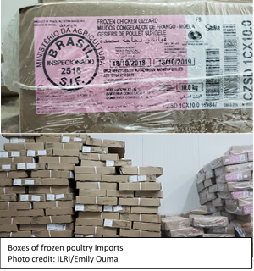
Ghanaian poultry market shares
Chicken imports are mainly from Brazil, EU, U.S.A and China
Market shares (%) of total chicken meat consumption
10% domestic broiler production
20% spent layers
10% guinea fowls and local breeds raised in backyard systems
60% - 70% imported broiler parts
High chicken meat imports
Increasing preference for dressed and processed chicken (a common attribute of imported chicken meat)
Per capita consumption of chicken meat has increased from 4 kg in 2010 to 6.6 kg in 2012 (FAO, 2014)
Ghana imports large quantities of day-old layer chicks and hatching eggs from the EU, USA and Brazil
Notes:
1. Poultry imports from USA constitute over 40% market share in Ghana while 25% of poultry imports come from Brazil and European countries (Andam et al., 2017: GAIN, 2017).

Slide 11
Retail poultry prices per Kg (Kumasi and Accra)
Poultry retail prices, and consumer preferences, Ghana
 | 2015 |  | 2016
 | Ghana Cedis | USD | Ghana Cedis | USD
Imported broilers | 12 | 3 | 14 | 3.5
Domestic broilers | 50 | 12.8 | 60 | 15
Imported frozen chicken is distributed through private cold stores located in major cities
Preference of imported chicken cuts, due to availability, affordability and convenience
High price of local chicken breeds, guinea fowls and eggs from local chicken
High preference of local chicken breeds, especially during festivities. Preference largely driven by taste
Source: GAIN/USDA, 2017
 | Ghana Cedis | USD
Indigenous breeds - hen | 24 | 4.9
Indigenous breeds- cockerel | 30 | 6.1
Guinea fowl | 30-35 (North) 50-70 (Accra) | 6.1 (North) 10 – 14 (Accra)
Spent layer | 23-24 | 4.9
Eggs from indigenous/tray | 30 | 6.1
Eggs from layers | 21 | 4.3
Notes:
1. Retail prices of local broiler higher than imported poultry meat by 30-40 % margin

Slide 12

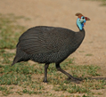

Ghanaian smallholder backyard poultry value chain
Inputs and services
Production
Consumption
Marketing
Processing
Wholesale/
retail
Feeds
The birds (chicken and guinea fowls) scavenge for feed
Chicks
Chicks mainly hatched through natural incubation. Guinea fowl eggs hatched by hens
There are a few locally fabricated incubators for hatching eggs.
Animal health products
Veterinary products not used in most cases. Farmers use herbs as well as Amoxillin antibiotic for disease prevention. No NCD vaccines used
Special order for functions (Idd-ul-Fitr, Idd – al – Adha, etc)
Production mainly in the hands of women. The local chicken breeds and guinea fowls are raised under free-range systems.
Typically smallholder farmers.
Intermediaries (middlemen) located in rural villages
Guinea fowls are mainly from the North
Live bird traders in big towns/cities in open air markets, e.g. Accra and Kumasi
Key
Individual consumers/
local restaurants
Live bird
Egg
Slaughter done by processors like JFamco meat processing plant in Madina
guinea
fowl
Hotels/restaurants/bars in cities
Fertilised eggs used for building flocks
Eggs sold in Retail shops and restaurants
Individual consumers

Slide 13
Ghana poultry sector constraints
Low access to financial services by value chain actors due to high interest rates and lack of collateral - most providers do not readily finance poultry production due to high risk
Diseases – outbreak of H5N1 avian influenza in 2007
High cost of production for producers and hatcheries – feeds and energy costs
Lack of a legislative framework/policy to regulate operations of local hatcheries – USDA funded - GPP has made headway to address this
Poor processing facilities – perishability of dressed birds
Notes:
1. Lack of the legislative framework to regulate operations of local hatcheries has contributed to production of poor-quality DOCs

Slide 14
The livestock sector in Tanzania
Agriculture sector
Contribution to GDP – 29 % in 2018 (TNBS, 2018)
Livestock sector
3rd largest livestock population on the African continent comprising 25 million cattle, 16.7 million goats, 8 million sheep, 2.4 million pigs, and 36 million chickens (MOLFD, 2015)
Poultry
sector
66% of the population that keep livestock rear poultry (MOLFD, 2015)
Comprises commercial (broilers and layers) - and traditional systems (indigenous and improved dual purpose breeds)
Economy dependent on agriculture – export earnings, and employs about 65% of the work force
Contribution to GDP – 7.4% of which 1.8% is attributed to poultry
50% of households keep livestock (27Mn people)
Commercial systems – 7% of bird population; traditional indigenous systems – 93% of bird population

Slide 15
Livestock population in Tanzania
Type | Number (‘000’ ) units | % of total
Chicken | 35,820 | 40
Cattle | 25,654 | 29
Goats | 16,735 | 19
Sheep | 5,574 | 6
Pigs | 2,446 | 3
Other | 1,509 | 2
Total | 87,738 | 100
Source: MOLFD, 2015

Slide 16
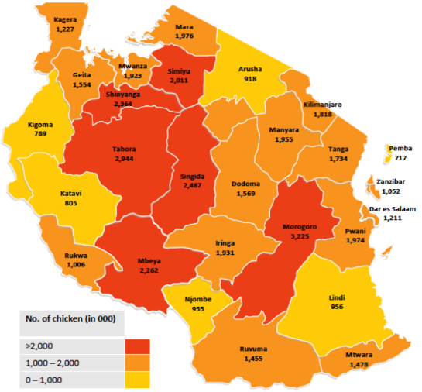
Indigenous chicken location and production systems
The traditional indigenous system (low-input low output system)
Free range scavenging of chickens with minimal supplementation with whole grains or kitchen leftovers
Limited application of biosecurity practices and vaccines
low levels of production for both eggs and meat
Market share of 50-60% of poultry consumption
Number of indigenous chickens, by region
Parameter | Average performance | Good practices
Mortality % (0-8wks) | 55% | 10%
Hatchability % | 75% | 95%
Eggs per clutch | 10 | 15
Clutch per year | 3 | 4
Average adult body wt (kg) | 0.5-1 | Above 2
Ringo and Mwenda (2018)
Notes:
Traditional indigenous system – most commonly practised in TZ
Mainly managed by womena nd children

Slide 17
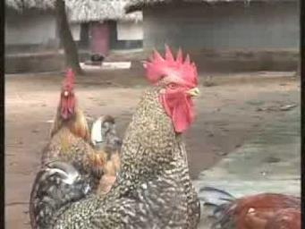
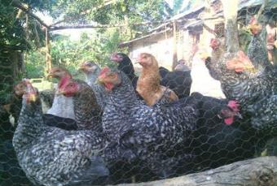
Improved cross-bred chicken systems
Comprise improved local/ imported breeds-mainly crossbreeds
Raised in a semi-intensive system (with feed supplementation in addition to scavenging)
Specialized dual-purpose breeds are reared in this system e.g. Kuroiler and Sasso
Compared to indigenous chicken, dual-purpose breeds are superior in performance both production and body weight
E.g. egg production ranges between 140 – 150 per year for Kuroiler
Medium input-medium output system with some attention to biosecurity and vaccination – approximately 100-800birds/hh
Notes:
1. Farmers vaccinate for Newcastle and Gumboro diseases

Slide 18
Tanzania poultry market growth rates (ITC Trademap, 2018)
 | 2014 – 2016 ( ‘tons’– absolute level) | 2006 - 2016 Absolute growth (‘tons’) | 2006-2016 (% growth per annum)
Production | 99,070 | 32,470 | 3.5%
Domestic consumption | 101,880 | 35,370 | 3.8%
Exports | 0.00 | 0.00 | 0
Imports | 2,810 | 2,900 | 57.0%
Chicken production in Tanzania has increased rapidly since 2006, by an annual average of 3.5%, but this remains below the 3.8% per annum growth in consumption
Deficit met through imports, small volumes though significant despite formal ban of imports into mainland Tanzania. Imports comprise frozen cuts and frozen whole dressed birds.
Chicken imports are from US, UAE, and Brazil (2011 – 2014) and in addition, Ukraine and Russia from 2016
Notes:
1. Import volumes underestimated. Mirror data shows

Slide 19
Consumer preferences and prices
Growth in chicken consumption due to changes in eating habits due to higher disposable incomes – per capita consumption of poultry meat – 15kg p.a. (2017)
Preference for indigenous “Kienyeji” chicken, which is significantly more expensive than broiler meat
Preference is associated with the perception that chicken produced in modern, commercialised systems is not healthy, as well as the difference in the taste of the meat
Younger, urban consumers are more receptive of broiler consumption due to associated lower prices
More hatcheries have been built, which are producing more DOCs and culminated in the development of TPBA
 | Retail prices in TZS/USD
Indigenous chicken | 15000 – 20000 (USD 6.6 – 8.7)
Spent layer | 10000 – 11000 (USD 4.4 – 4.8)
Broiler | 6,000 – 8,000 (USD 2.6 – 3.5)
Indigenous chicken eggs/tray | 12000 – 15000 (USD 5.2 – 6.6)
Exotic eggs/tray | 6000 – 8000 (USD 2.6 – 3.5)

Slide 20
Tanzanian smallholder backyard and semi-intensive poultry value chain
Inputs and services
Production
Consumption
Marketing
Processing
Wholesale/
retail
Feeds
Sourced from feeds shops
Chicks
3 month old chicks purchased from neighbours
Fertilised eggs purchased and hatched in an incubator
Incubators/hatcheries
Many small hatcheries, for hatching eggs from dual purpose and local breeds
Veterinary products
From agro-vet shops: vaccines (I2, Gumboro) and antibiotics
Farmers, both men and women keep local as well as dual purpose breeds under different systems:
Extensive systems
Local chicken breeds are mainly raised under free-range systems especially in the rural areas.
Semi-intensive systems
Peri-urban and urban farmers raise local and dual-purpose breeds under semi - intensive system.
Birds are vaccinated and fed on commercial feeds
Middlemen in villages especially in Dodoma city and Singida region
Special order for functions (weddings, graduation, etc)
Roasters – sell roasted chicken by the roadside, in small cubicles
Individual consumers
Key
Live bird traders (aggregators) in the towns/cities in open air markets
Live
bird
Backyard slaughters at the market spaces – slaughtering done by the live bird sellers
Egg
Hotels/restaurants/bars in Dar es Salaam and Morogoro
Collectors
Chips making eateries (for making chips-eggs)
Individual consumers
Boiled eggs sold on the roadside to bus passengers
Spoilt eggs sold to herbalists

Slide 21
Tanzania poultry sector constraints
Gumboro vaccine is imported from Pakistan, Italy, South Africa and Israel. There are periods when the vaccine is not available in the market
High cost of quality poultry feeds. Some of the ingredients such as soybean meal is imported from different countries
Government is promoting local production of soybean but there is lack of capacity on extruder machine fabrication
Ineffective vaccines. There are reported cases of ineffective ND vaccines.
Diseases such as infectious coryza
Poorer women who raise local chickens have no incentives to invest in their poultry - current system requires no investments of money or labour, and brings some earnings, however small

Slide 22
Implications for the project
Identify sites to focus on – production and demand areas for the chicken lines with enhanced ND virus resistance
Target group for the chicken lines with enhanced ND virus resistance may be small in Ghana, given the current low market share of indigenous chicken
Business models that have worked for smallholder farmers in Tanzania for accessing the specialised dual-purpose breeds esp Kuroiler and Sasso – potential for replication
I2 vaccine is available in urban areas in both countries at affordable prices. However, limitations include;
Poor infrastructure and low business potential in rural areas (low input systems) results in minimal investment by private sector, yet majority of farmers are in such areas
Large pack sizes – for 100 birds. Smaller pack sizes should be made available and targeted to smallholders to increase uptake
Gender based constraints especially in relation to access to financial services
Notes:
Hatcheries sell vaccinated DOCs to mother units, with a package of necessary inputs; feeds, feeders, vaccines, coupled with extension trainings. Raise the chicks to 4-6 weeks then sell off to farmers

Slide 23
Next steps - workplan
Activities | Timeframe
A. Value chain assessment surveys Indigenous poultry value chain constraints Participatory epidemiology Trait preferences Gender based constraints (access to inputs and markets) in the indigenous poultry value chains | Nov 2019 – Feb 2020
B. Analysis of value chain assessment data and develop choice experiment tools | Mar - April 2020
C. Choice experiment surveys with men and women poultry producers and different market actors to assess potential demand (willingness to pay) for chicken lines with enhanced ND virus resistance | May – Aug 2020
D. Evaluate the most likely business models for distribution and marketing to producers and other value chain actors Develop a modelling framework Modelling different scenarios of the enabling environment (policy, financial, and technical) and its influence on the demand and supply of the ND indigenous poultry ecotypes Analysing the financial viability of such models | 1st sub-activity Sept 2020

Slide 24
Thank you

