Slide 1
Photo Report on small scale maize-shelling machines in northern Ghana
11 - 18 December 2018

Slide 2
Introduction
Africa RISING in West Africa is currently implementing the second phase program since October 2016. During the second year (2018), the project is conducting action research with development partners.
Africa RISING seeks to offer a range of options that open up opportunities for smallholder farm households to move out of hunger and poverty through sustainably intensified farming systems that improve food, nutrition, and income security, particularly for women and children, and conserve or enhance the natural resource base.
Demonstration events were conducted in Northern Ghana in the Northern Region, the Upper East Region and the Upper West Region in December 2018 to demonstrate the capacity of maize shelling machines both the diesel and electronic types. These technologies substantially reduce the labor burden of smallholder farmers.

Slide 3
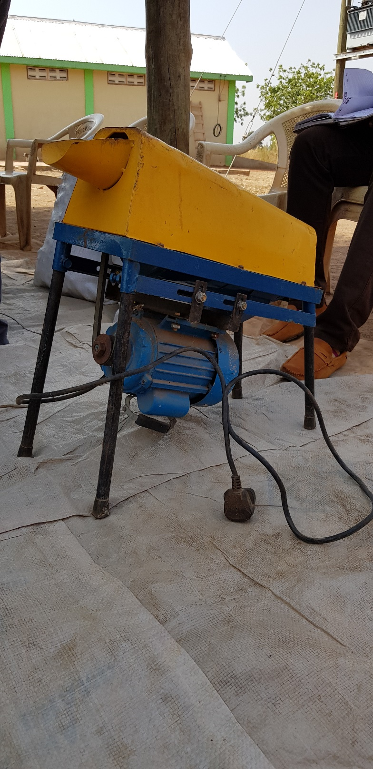
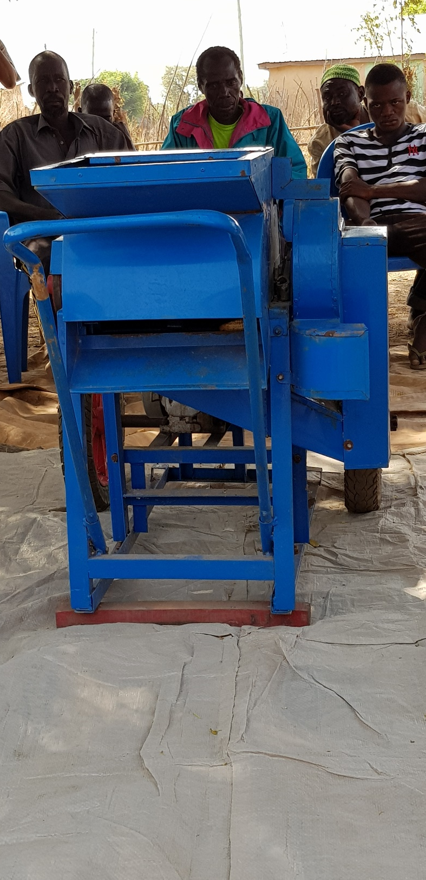
Maize shelling machines
A: Electronic maize shelling machine
This shells 5 one hundred-kg. bags of maize in 1 hour
B: Diesel powered maize shelling
This shells 15 one hundred-kg. bags of maize in 1 hour
Smallholder farmers who were invited
to the demonstration
events were very keen to be involved in the initiative.
A
B

Slide 4
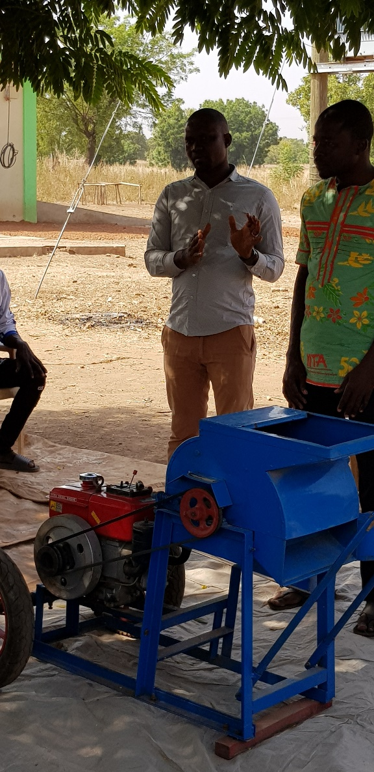
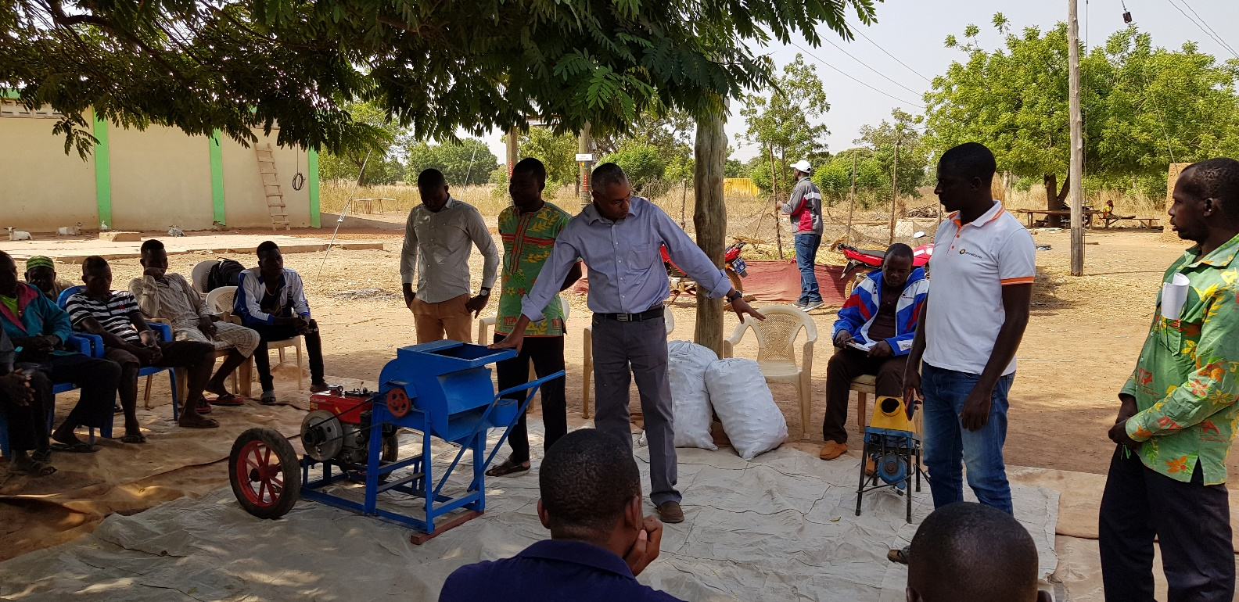
Linking farmers to small scale manufacturers:
Bottom left: Africa RISING team members explaining about the capacity of the two machines to the farmers (Northern Region, Duko community) i.e. the electric one which shells 5 bags per hour and the diesel one which shells 15 bags per hour. Also present were small scale artisans from GRATIS manufacturing limited based in Tamale. The GRATIS agent had an interactive session with the farmers. The farmers inquired if it was possible to have a machine that can also do de-husking of the maize before the shelling. GRATIS noted this would be possible at additional costs.
Top Right:
Small scale artisan (GRATIS agent) was on ground to listen to farmers needs.

Slide 5
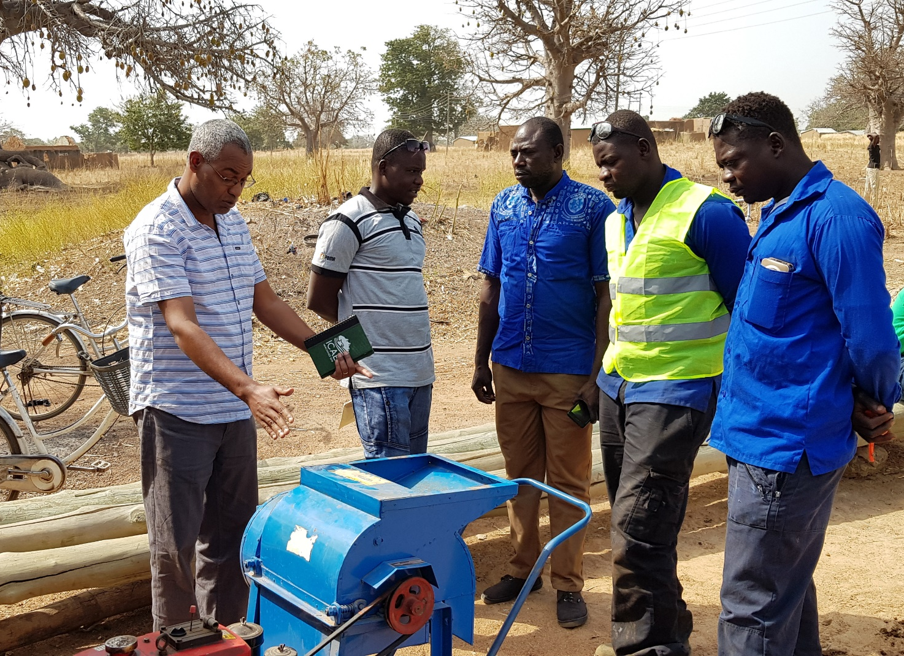
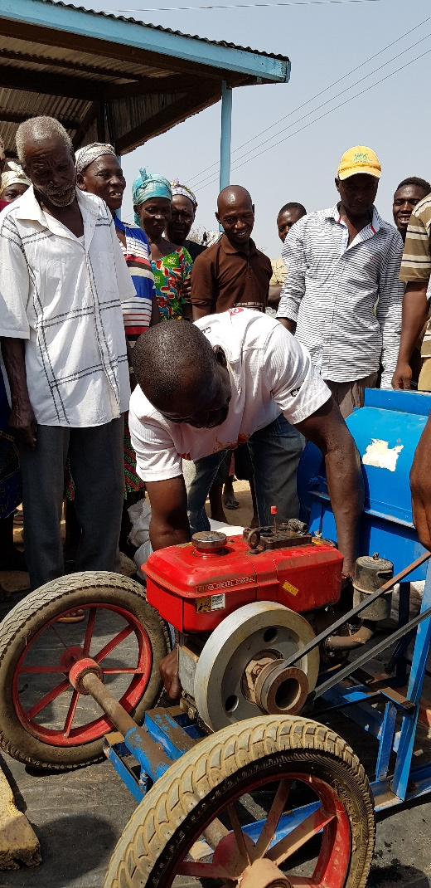
Linking farmers to small scale manufacturers:
Left: Small-scale artisans in the Upper East (Emmanuel Innovations and Rural Technologies from the Rural Enterprise Program) who are locally accessible discuss with an AR team member the alternative range of options that farmers can use in relation to using multiple crops, increasing volume of harvest shelled as well as modification of the current designs. The linkage to farmers will help maintain open communication channels and allow for modification of machines based on farmers preferences.
Right: Farmers in the Upper East Region learning how to start up the maize shelling machine. Farmers who previously benefited from the training helped their peers.

Slide 6
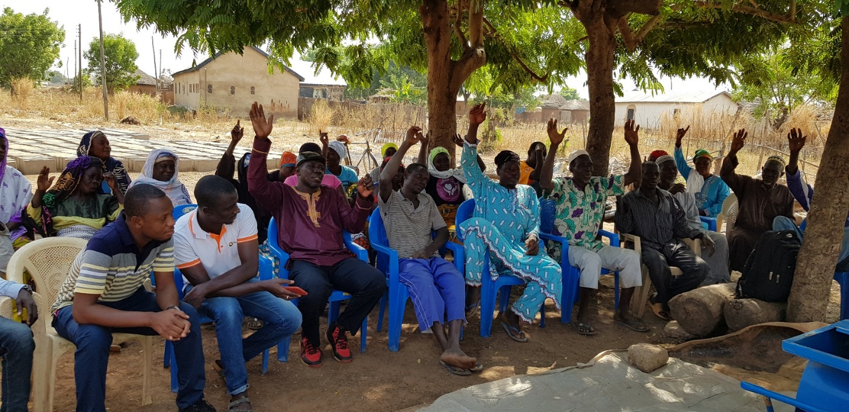
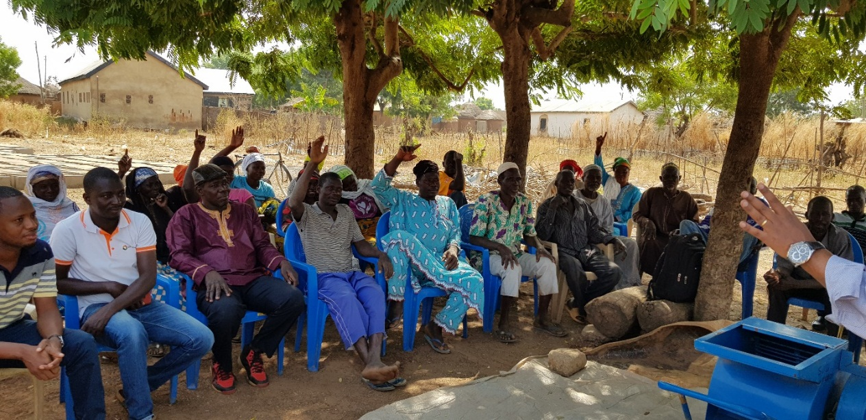
Africa RISING farmers and non Africa RISING farmers in the Northern Region (Doku community) participate in the maize shelling Demo event.
Farmers inquired about the cost of the maize shellers and responses were given by local artisans and the AR team members.
Top left:
Farmers when asked how many are currently engaged in shelling their maize by a show of hands.
Farmers who use tractor shelling, it costs them one 100-bag of maize for every 10 bags of maize shelled (this is about 120 GHc =25 USD)
Bottom right:
Farmers when asked how many are conducting manual shelling by a show of hands.
Men noted it takes them 10 hours to shell one bag and women reported that it would take them about 1 week if they are doing it as a sole activity.

Slide 7
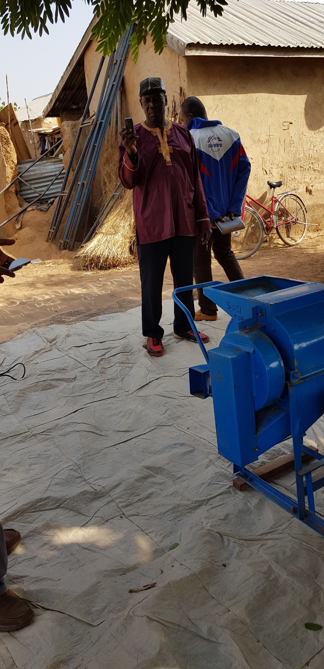
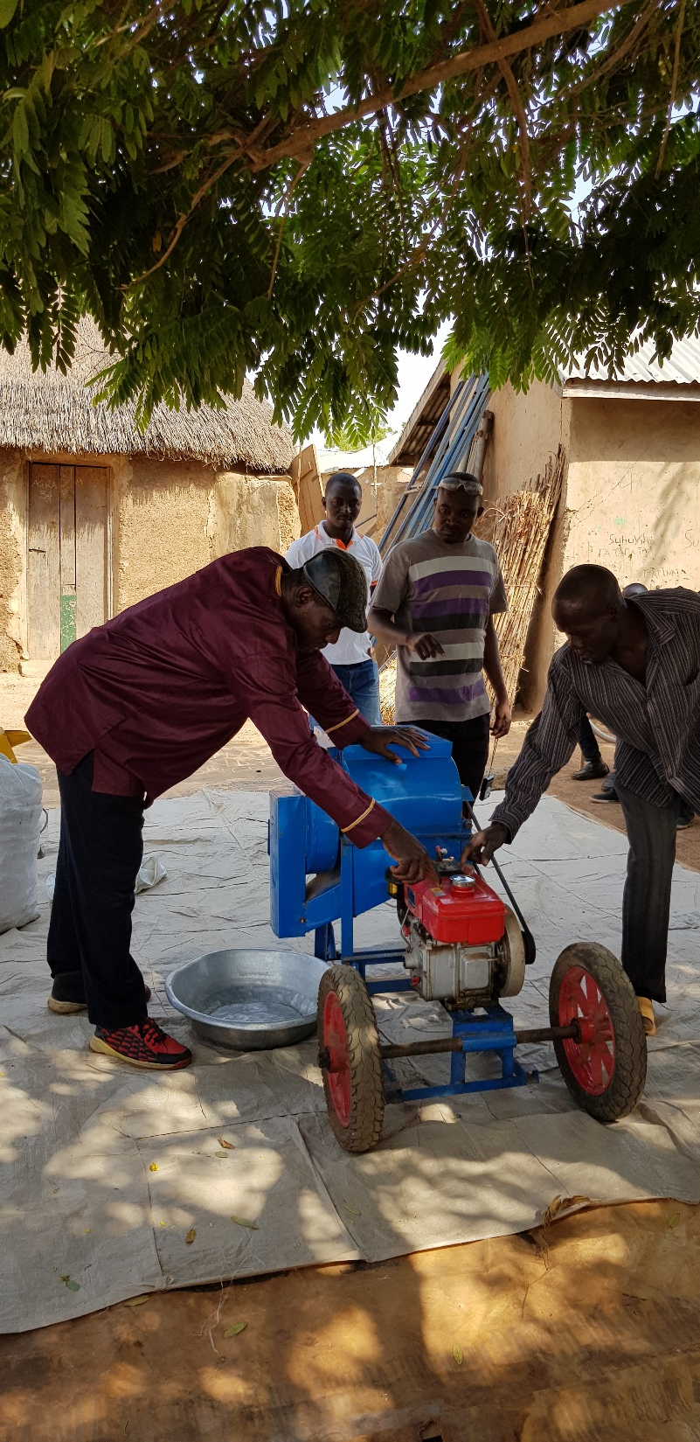
The power of peer to peer learning:
Left: One of the Africa RISING farmers in the Northern Region taking a mini-video of the maize shelling machines. When asked what he intends to do, he quickly replied “I am taking this video to show the people in my village the advantages of saving time and labor while using these machines”
Right: One of the farmers who went through training last year demonstrating to another farmer how to operate the maize shelling machine.

Slide 8
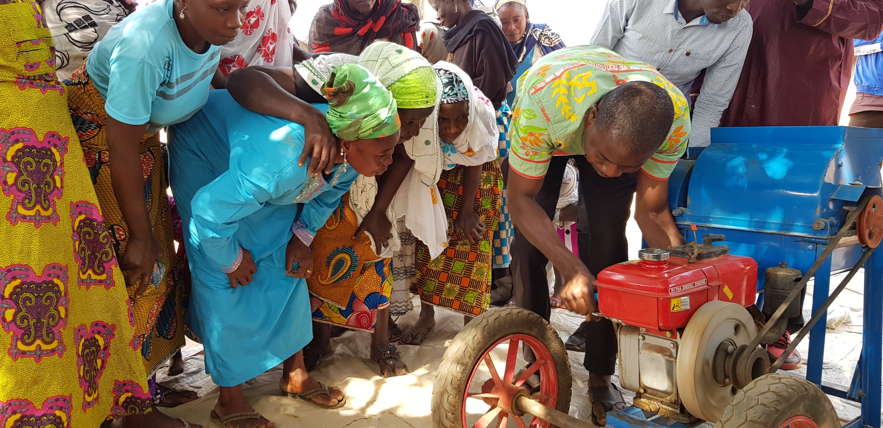
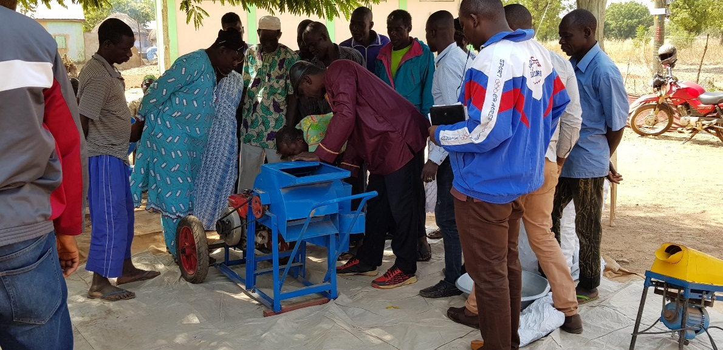
Top:
Women in the Northern Region learning how to operate the maize shelling machine.
Bottom right:
Men in the Northern Region learning how to operate the maize shelling machine.

Slide 9
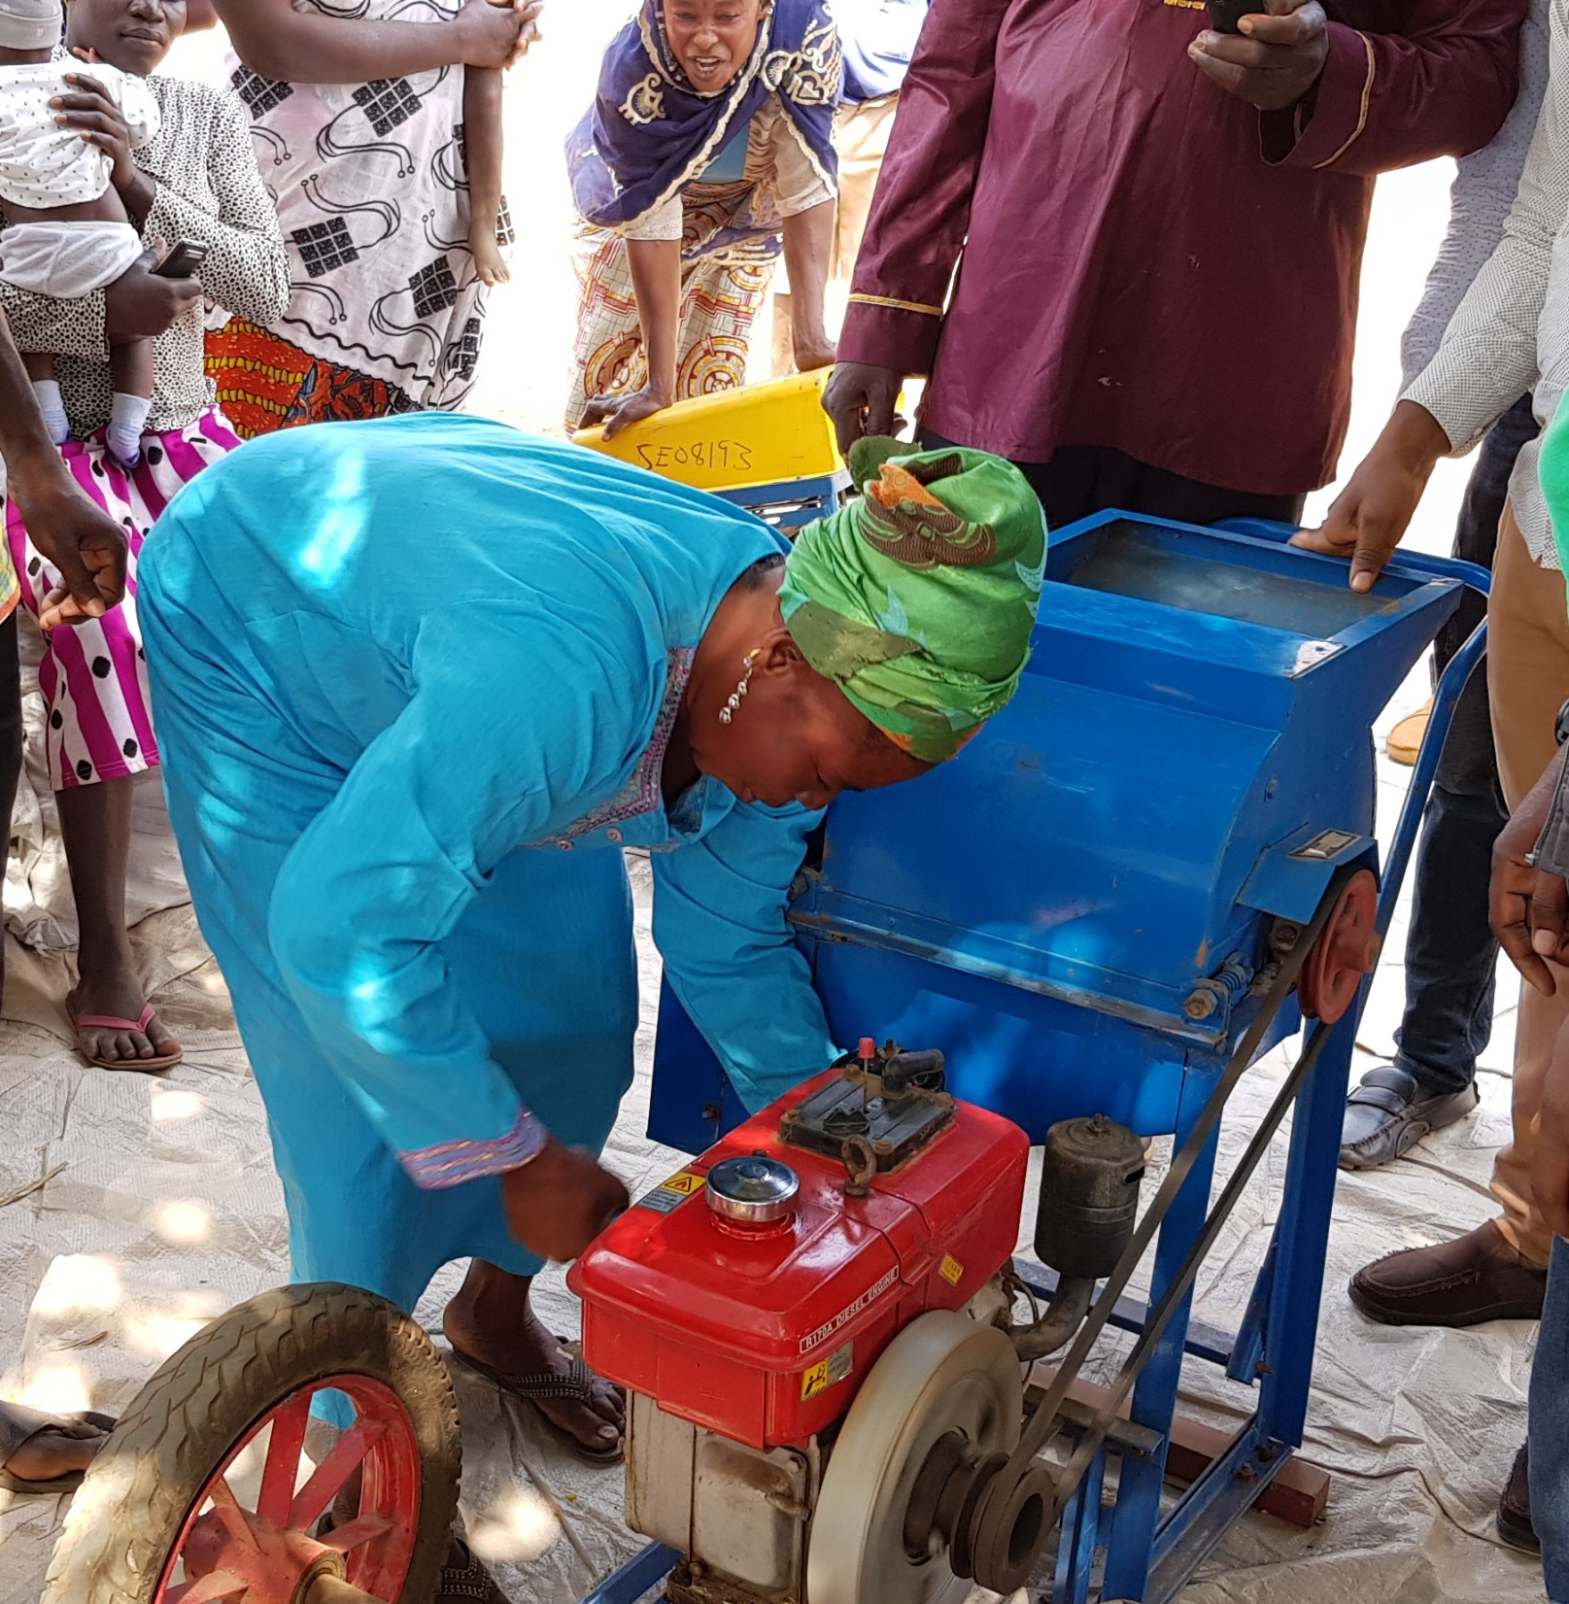
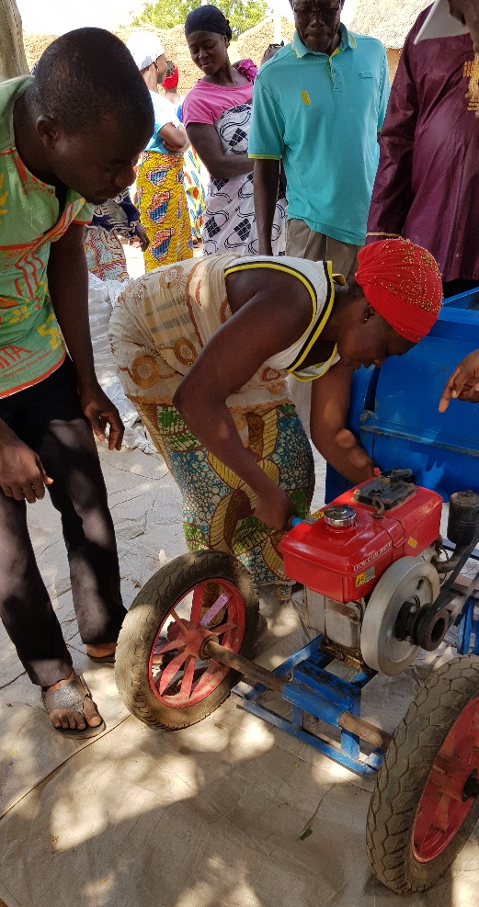
Let us give this a try:
Women farmers successfully operate the maize shelling machine by timing the throttle and choke release.
The machine can be operated by 1 person.

Slide 10
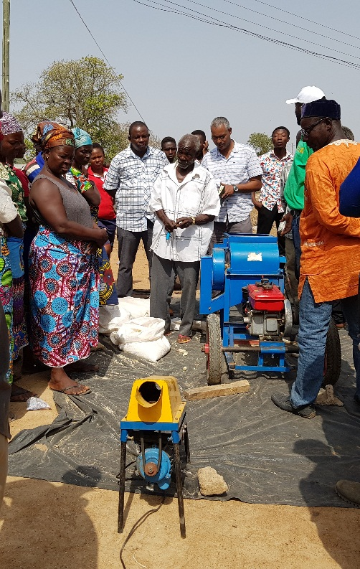
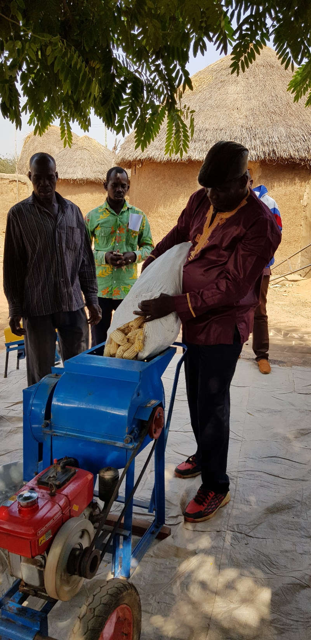
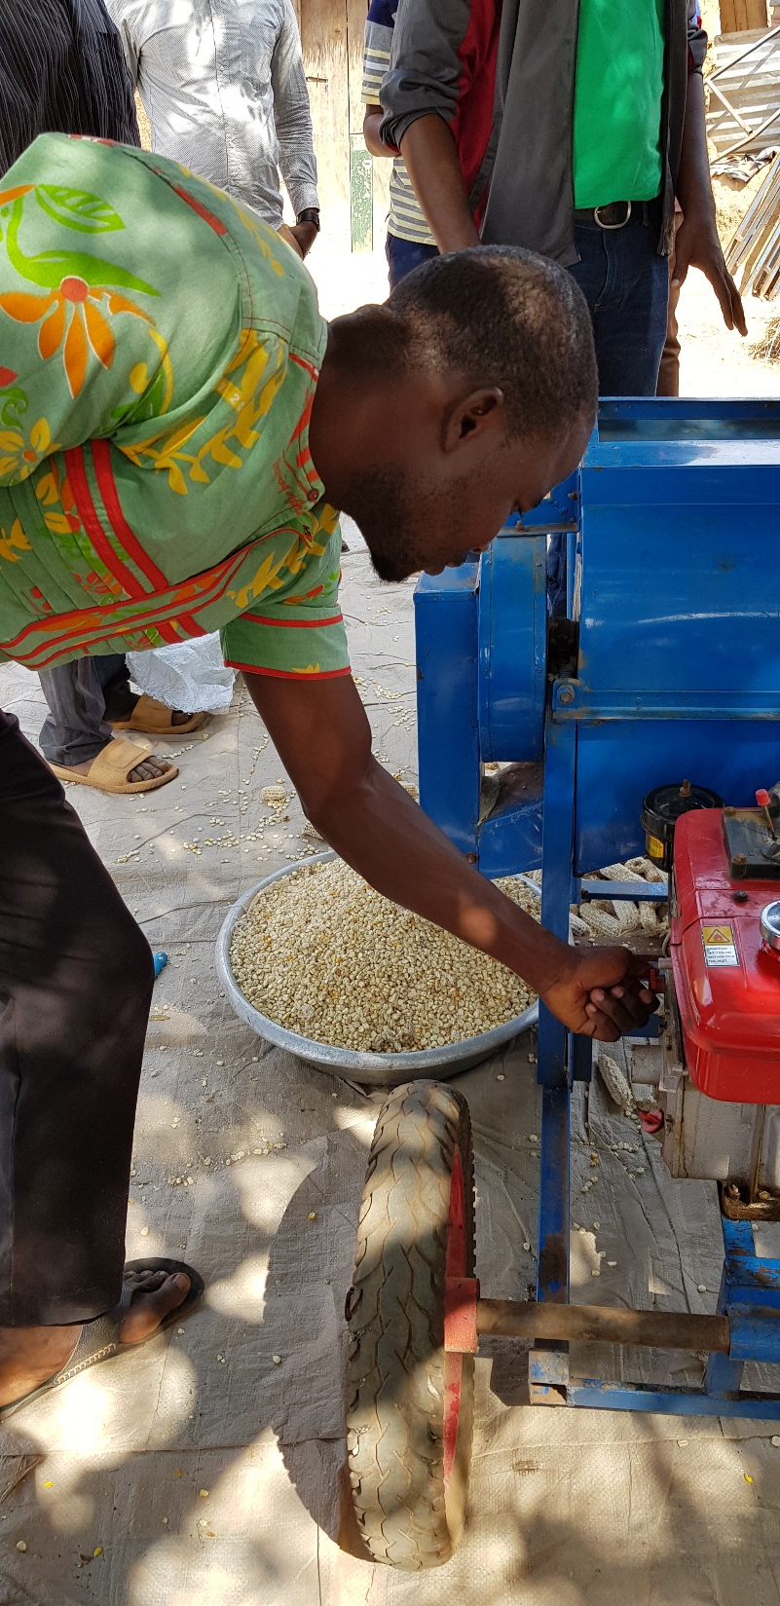
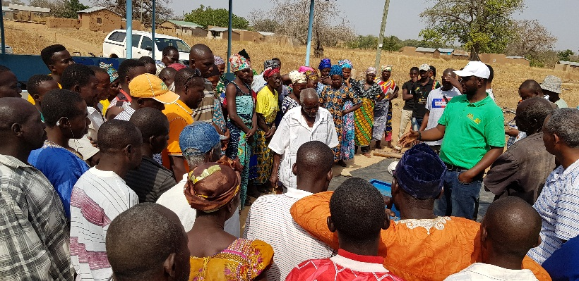
Let the shelling begin: Africa RISING trainees demonstrate the shelling of maize to the participants.

Slide 11
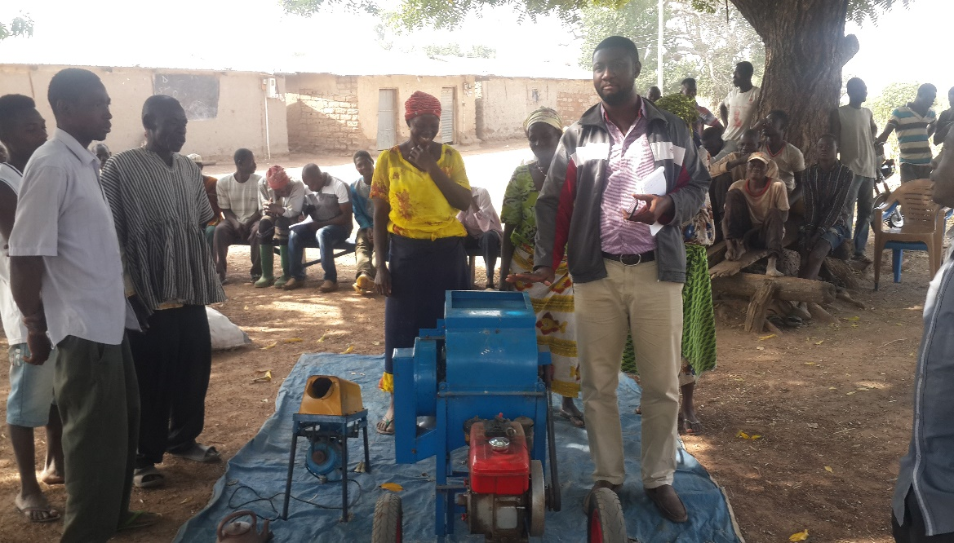
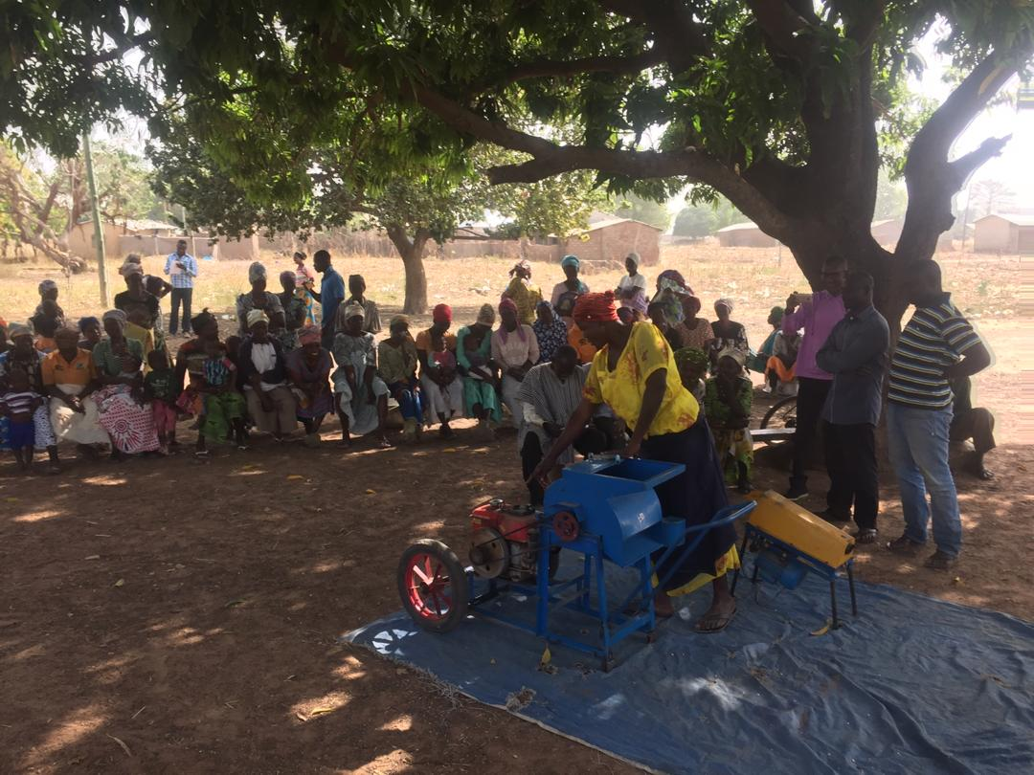
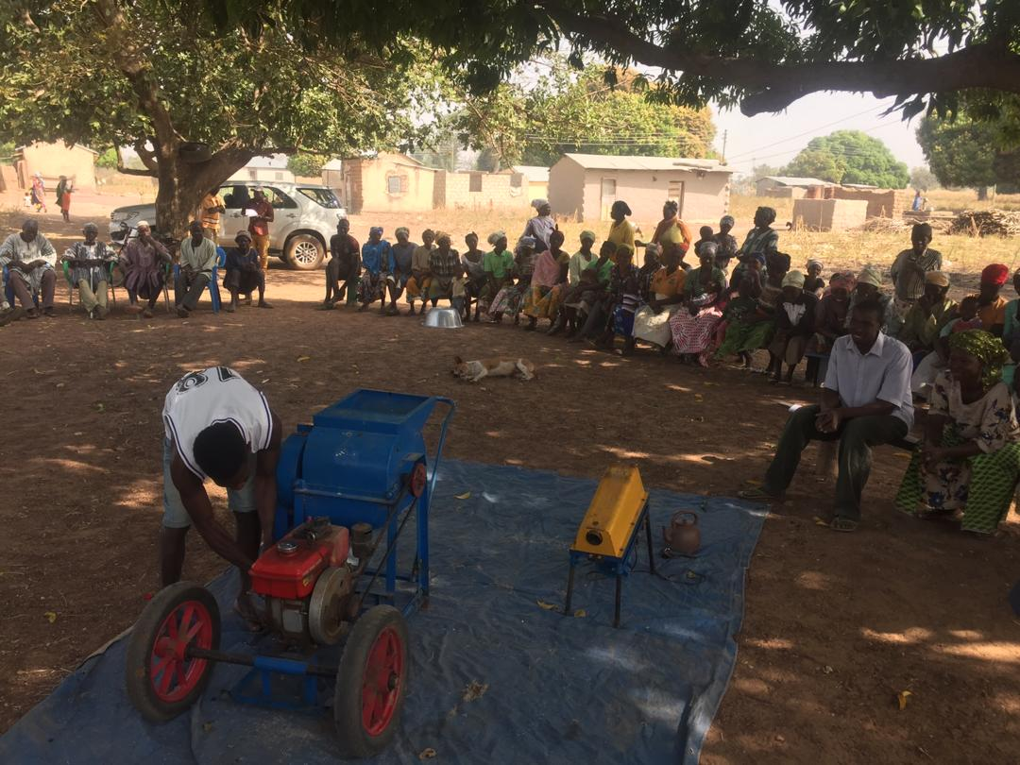
Right: Explanation was given to farmers by AR team members on the capacity of the machines and the procedures to be followed to start using them, Upper West Region, Zanko community.
Bottom Left and Right: Farmers who had prior training explaining to other farmers how to operate the machine, Upper West Region. Three farmers from each sex were invited to try and all of them could start the machine properly.

Slide 12
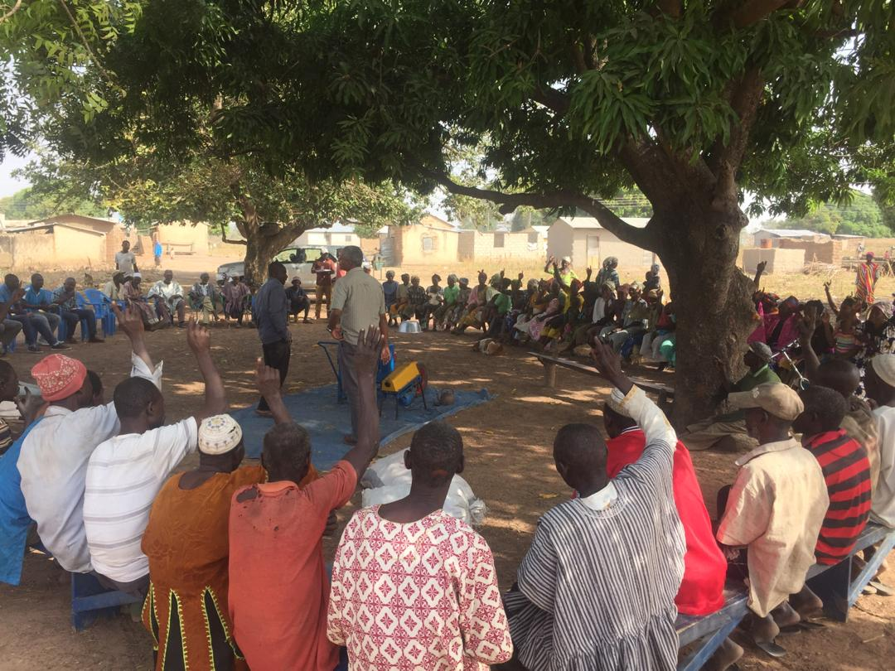
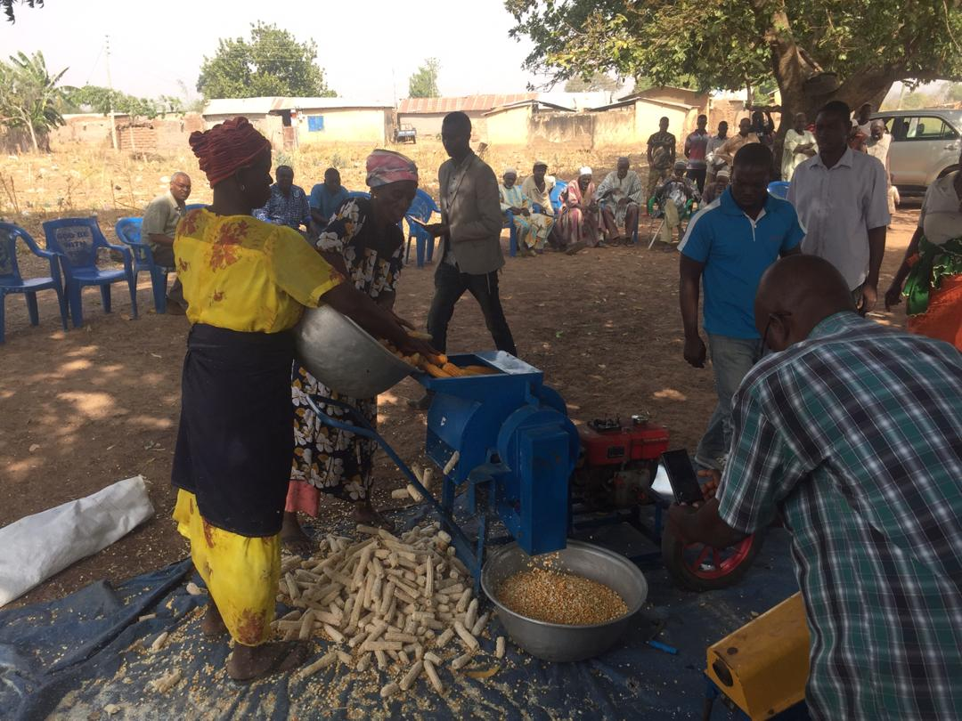
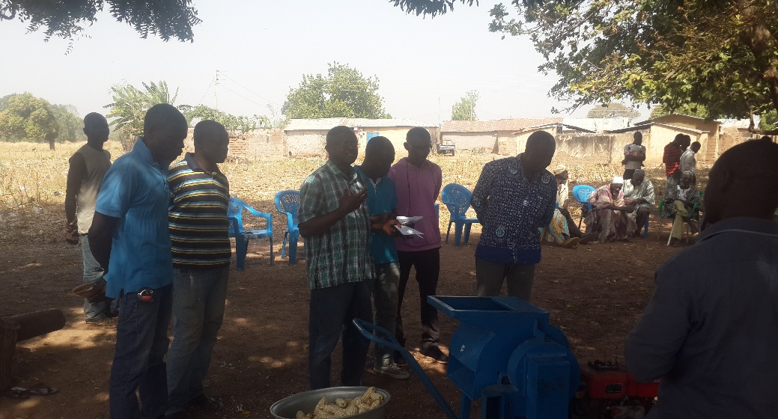
Right: Many farmers use manual method to shell maize and they show interest to have the machine, Upper West Region. Some of the farmers have access to commercial shelling services (CSS) but they indicated that CSS is expensive while it is available on regular basis.
Left: Farmers observing while the machine is operating. The farmers shelled about a bag of maize to test the machine.
Right: Local artisans and other stakeholders taking notes on farmers feedbacks after demonstration. Farmers stressed that they would be happy if the machine could be modified so that it can also de-husk maize cobs.

Slide 13
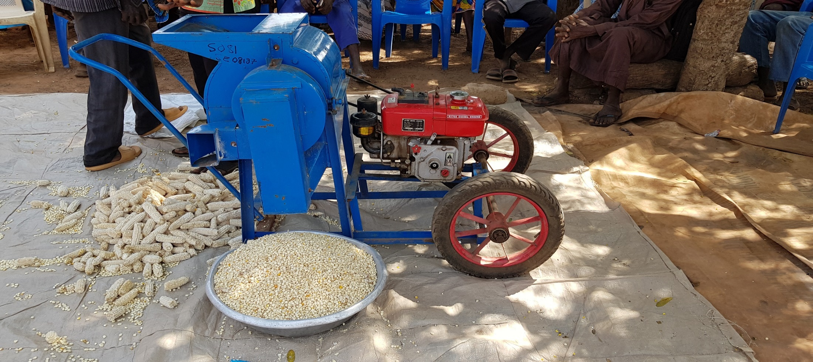
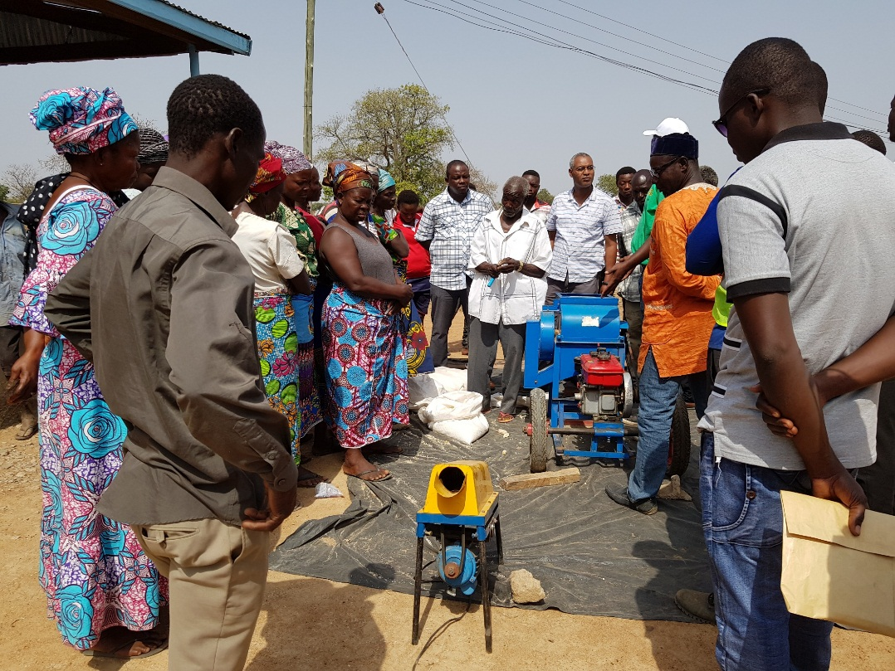
Farmers noted that they use the maize cobs as a source of fuel. They were informed that if the maize cobs are well ground, they can serve as an excellent supplemental animal feed. Farmers asked whether they can take possession of the maize shelling machine after the Demo. The AR team responded that they would discuss and get back to them on the conditions of using the machines.

Slide 14
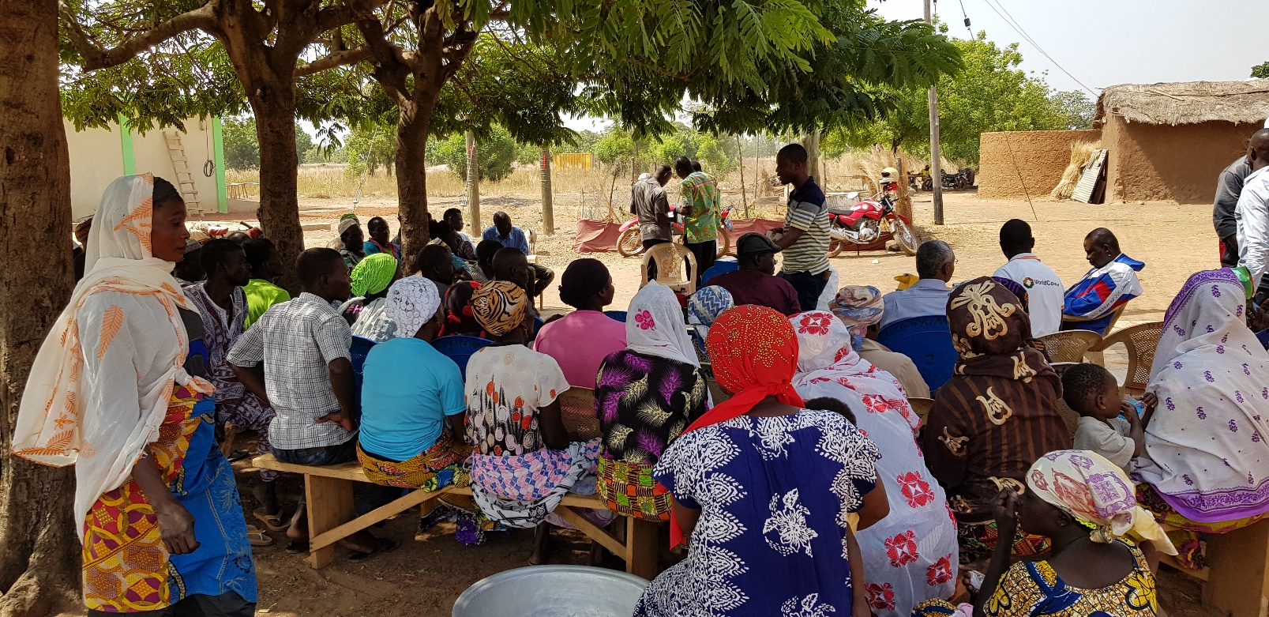
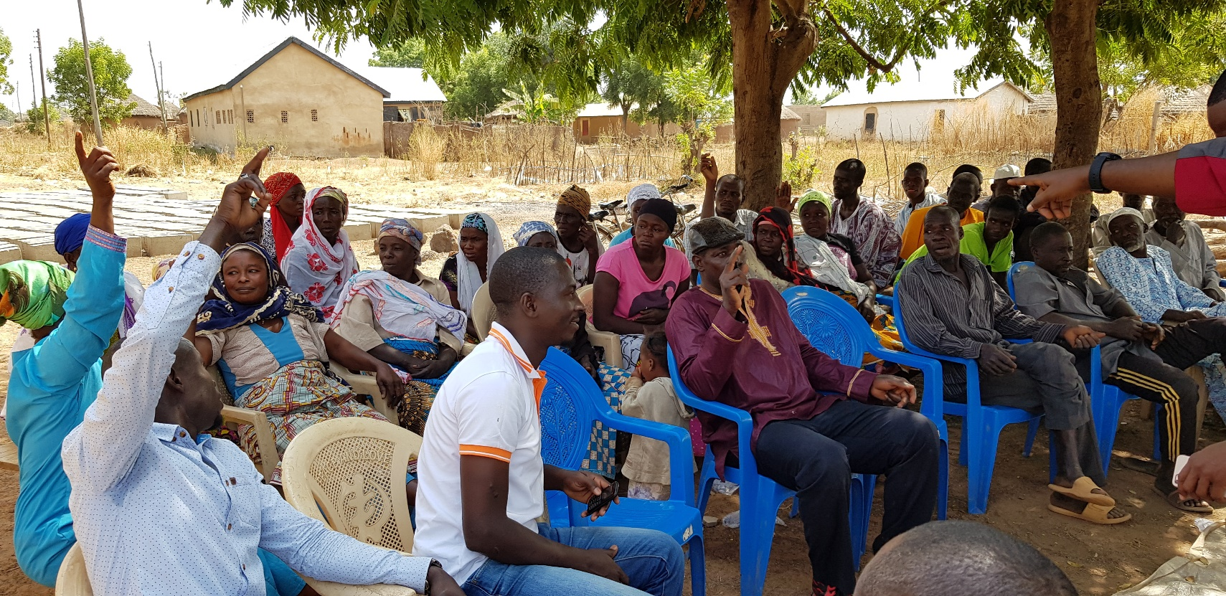
Linking farmers to crop insurance products.
WorldCover provides crop insurance to farmers to protect them against loss of yield.
WorldCover agent explains to farmers how the insurance product works
Farmers that belonged to both Africa RISING and WorldCover raise their hands.
A register was taken for farmers who are interested in being part of the crop insurance.

Slide 15
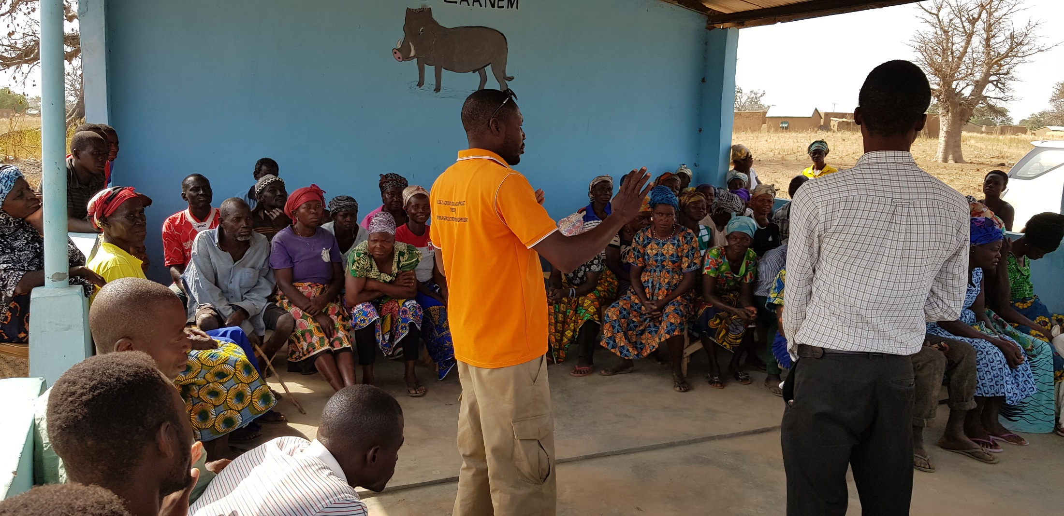
Training on post-harvest handling, Upper East Region (Nyangua community)
Farmers were trained on key post-harvest aspects required to ensure that the use of the maize shelling equipment starts and ends as a rewarding experience. The training focused on timing of harvest, ensuring that the moisture content of the grain is appropriate for storage (about 13%). If the maize is not dry enough, it will not shell off the cob easily, if it too dry, it will likely crack and break during the shelling process.

Slide 16
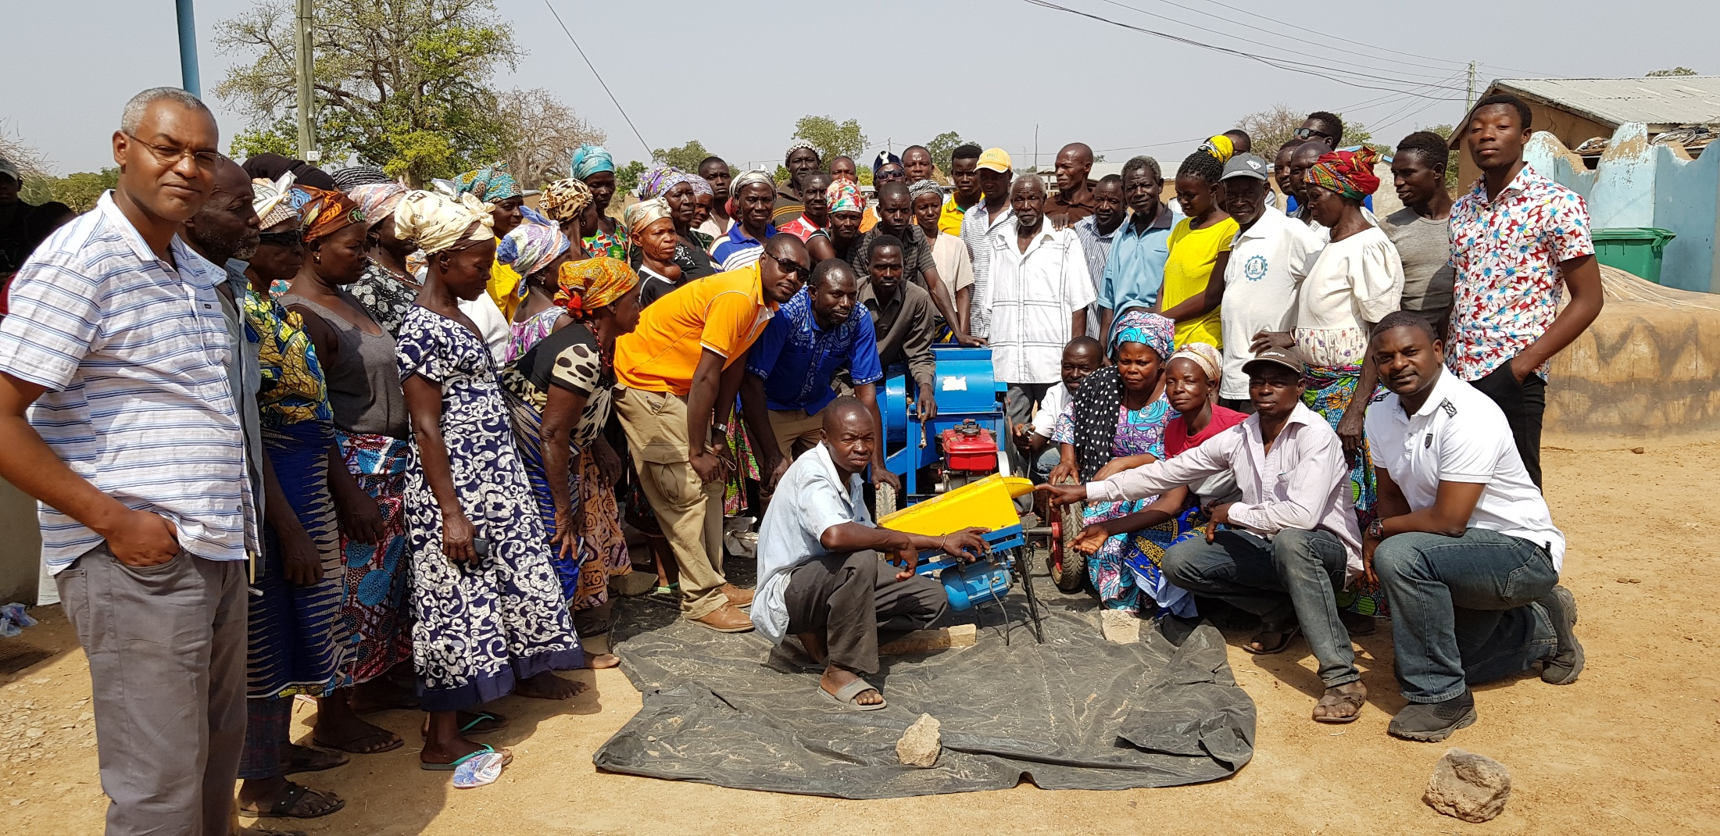
A day well spent, an event well attended
Farmers, small scale artisans and the Africa RISING team pose for one last picture in Nyangua community in the Upper East Region of Northern Ghana.
Discussions: After the demonstration, farmers centered their questions around how they can obtain possession of the maize shelling machines, whether modifications would be possible for the electric machine to be diesel driven. The responses were focused on ensuring that this initiative becomes self-sustaining and community owned as a common pool resource for sustainability reasons.

Slide 17

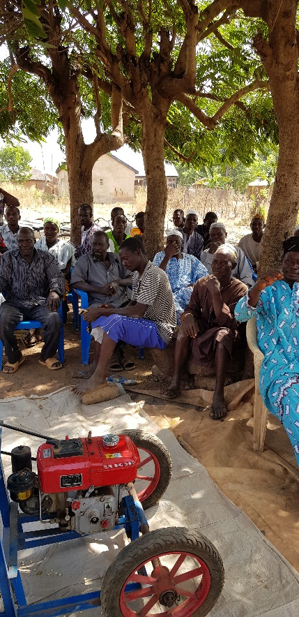
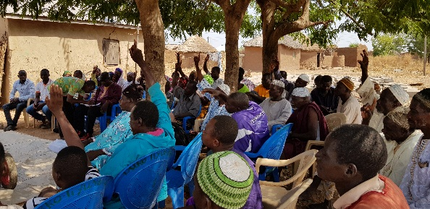
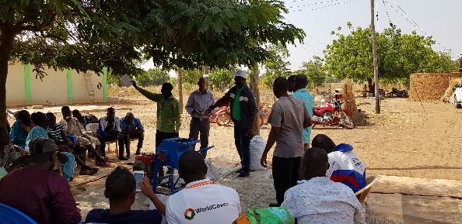
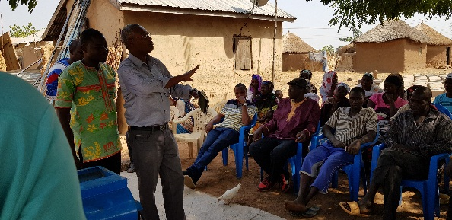
Next Steps
The Africa RISING team has suggested that the transfer of the maize shelling machines to the farmers should take place after the farmers fulfill the following conditions.
1) Groups: Farmers’ groups will be from the existing AR farmers with a minimum number of 12 and a maximum number of 18
2) Group Leaders: The group will have chairman, secretary, treasurer, and a custodian of the shelling machine. None of the aforementioned group members will hold 2 positions at the same time.
3) Community opinion leaders: The group will have to involve opinion leaders such as the Village Chiefs to ensure that they are having some oversight in relation to the community dynamics.
4) Willingness to purchase shelling machines: Group members will open a group account and contribute 775Ghc at the end on June 2019. The group will use the contributed money for the purpose related to the operations and maintenance of the shelling machine.
5) Submission of group bye-laws: The group will need to submit its operational rules (by-laws) to the AR team who will then verify if the pre-requisites are met.

Slide 18
Africa RISING CGIAR partners in West Africa
International Research Institutions |  | Ghana | Mali | Role
International Crops Research Institute for the Semi-arid Tropics | ICRISAT | + | + | Sorghum/millet−groundnut R4D with IITA and SARI
International Food Policy Research Institute | IFPRI | + | + | Surveys, and Monitoring and Evaluation
The World Vegetable Center | AVRDC | + | + | Leads R4D on vegetable production systems
International Institute of Tropical Agriculture | IITA | + | + | Project coordination and R4D research on cereal−legumes.
International Livestock Research Institute | ILRI | + | + | Leads R4D on livestock, especially ruminants
International Water Management Institute | IWMI | + |  | Leads R4D on water management
Wageningen University, The Netherlands | WUR | + | + | R4D on farming systems and graduate training
International Center for Tropical Agriculture | CIAT | + |  | Research on land and soil management

Slide 19
Africa RISING national partners in West Africa
Name | Abbreviation | Ghana | Mali | Role/responsibility
Government Ministries and Entities
Ministry of Food and Agriculture | MoFA | + |  | Scaling-out SI technologies and establishment of R4D platforms
Ministry of Health | MoH | + |  | Household nutrition R4D with UDS and IITA
Ghana Health Services | GHS | + |  | Household nutrition R4D with UDS and IITA
Veterinary Services Division | VSD | + |  | Animal health and capacity building of community health workers
Institut d’Economie Rurale | IER |  | + | Socio-economic and on-farm studies with ICRISAT
Regional Direction of Agriculture in Sikasso | DRA-Sikasso |  | + | Scale-out provision of secondary data on socio-economics

Slide 20
Africa RISING national partners in West Africa
Academic/National Research Institutions | Abbr. | Ghana | Mali | Role/responsibility
University for Development Studies | UDS | + |  | Research on livestock nutrition and human nutrition, Graduate training and R4D
Science and Technology Policy Research Institute | STEPRI | + |  | Policy review and analysis
Institut Polytechnique Rural de Formation et de Recherche Appliquée Katibougou | IPR-IFRA |  | + | Polytechnic for rural education and applied research
Kwame Nkrumah University of Science and Technology | KNUST | + |  | Graduate student training, research on soil water dynamics
Animal Research Institute | ARI | + |  | R4D on livestock production (sheep and goats) with ILRI
Non-governmental organizations
Fédération Nationale pour l'Agriculture Biologique et Équitable | FENABE |  | + | Scaling-out, capacity building, community mobilization, on-farm research

Slide 21
Africa RISING national partners in West Africa
Academic/National Research Institutions | Abbr. | Ghana | Mali | Role/responsibility
Association Malienne d’Eveil et de Développement Durable | AMEDD |  | + | On-farm field trials and household nutrition studies with ICRISAT
Private Organizations and Development Projects
Community-based Organizations | CBOs | + | + | On-farm implementation of R4D activities

Slide 22
Credits
This photo report was compiled by: Fred Kizito (IITA/CIAT), Nurudeen Abdul Rahman (IITA), Benedict Boyubie (IITA), and Bekele Kotu (IITA).
Photo Credits: Fred Kizito, Abdul Rahman Nurudeen, Bekele Kotu
Our appreciation goes to the site coordinators and their teams, CGIAR partners, and national partner organizations including farmers, in Africa RISING project sites in the Northern Region, Upper East Region and Upper West Region.

Slide 23
Thank You

